Slide 1











CSE 424: Pattern Recognition
Detecting Vegetation Degradation with Satellite Imagery using Deep Learning Techniques

Slide 2




Group 7
1
Mohammad Omar Raihan- 21141058
2
Omor Bin Amjad Chowdhury- 23241085
3
Abrar Sami Khan- 24141153
4
Showrin Rahman- 24141255
5
Sowad Rahman- 24341284

Slide 3
Introduction
This study uses sentinel-2 satellite imagery to anticipate deforestation and vegetation loss, with potential benefits including improved conservation efforts, faster detection of illegal logging, and empowering local populations to conserve natural resources. It also helps to mitigate climate change through carbon sequestration, promotes sustainable economic development by preserving vital ecosystems, reduces disaster risk through better forest management, and provides valuable educational resources for raising environmental awareness and academic research.

Slide 4

Datasets
EuroSAT: A dataset of Sentinel-2 satellite images covering 10 classes for land use and land cover classification in Europe. Link
BigEarthNet: A large-scale Sentinel-1 and Sentinel-2 dataset for multi-label remote sensing image classification across various biomes. Link
Lombardia Sentinel-2 Time Series: A time series dataset of Sentinel-2 imagery for crop classification and vegetation monitoring in the Lombardy region of Italy. Link
WorldStrat: A global, high-resolution satellite imagery dataset providing stratified samples to support land cover mapping and analysis across different terrains. Link

Slide 5


Literature Review
Deforestation Detection with Fully Convolutional Networks in the Amazon Forest from Landsat-8 and Sentinel-2 Images investigates various fully convolutional neural networks (FCNs) for semantic segmentation tasks like deforestation detection, comparing U-Net, ResU-Net, and SegNet architectures. These FCNs have been applied in early fusion change detection to identify deforestation pixels using satellite imagery. ResU-Net showed superior performance, overcoming the challenges of spatial resolution loss during upsampling​
Forest Disturbance Monitoring with Satellite Imagery explores methods for monitoring forest disturbances using satellite data. The study emphasizes the importance of cloud-free image availability in detecting vegetation loss accurately. Techniques like Normalized Difference Vegetation Index (NDVI) were used to assess vegetation health and highlight the potential of change-detection methods​
State-of-the-Art Architectures for Deforestation Mapping using Satellite Imagery assesses six state-of-the-art FCN architectures for deforestation mapping using Landsat-8 and Sentinel-2 images. It found that ResU-Net consistently outperformed other models, providing accurate deforestation detection in diverse Amazon landscapes. The study also highlights the potential of DL techniques to automate deforestation monitoring effectively​

Slide 6
Literature Survey
Remote Sensing & Deforestation: High-resolution satellite imagery, like BigEarthNet, enhances the accuracy of deforestation monitoring (Hansen et al., 2013; Sumbul et al., 2019).
Machine Learning Applications: Convolutional Neural Networks (CNNs) effectively classify land cover and detect deforestation with high precision, making them ideal for large datasets (Zhu et al., 2017).
Conservation & Legal Enforcement: Satellite data supports real-time monitoring, aiding in the prompt detection of illegal logging and the protection of biodiversity (Asner et al., 2005).
Community Engagement & Climate Mitigation: Providing communities with predictive tools helps in managing resources and contributes to climate change mitigation through carbon sequestration (Chavez et al., 2014; Pan et al., 2011).
Economic & Educational Impact: Preserving ecosystems supports sustainable economic development and offers valuable educational resources for environmental awareness (Costanza et al., 1997; Melesse et al., 2007).

Slide 7
Real Life Applications
Disaster Risk Reduction: Enhances forest management practices, reducing the likelihood of landslides and floods, and safeguarding communities.
Sustainable Economic Development: Protects ecosystems critical to agriculture, tourism, and other industries, promoting long-term economic growth.
Improved Legal Enforcement: Facilitates rapid detection of illegal logging, allowing authorities to respond quickly and reduce environmental crimes.
Climate Change Mitigation: Supports carbon sequestration by preserving forests, contributing to the reduction of greenhouse gas emissions.
.

Slide 8
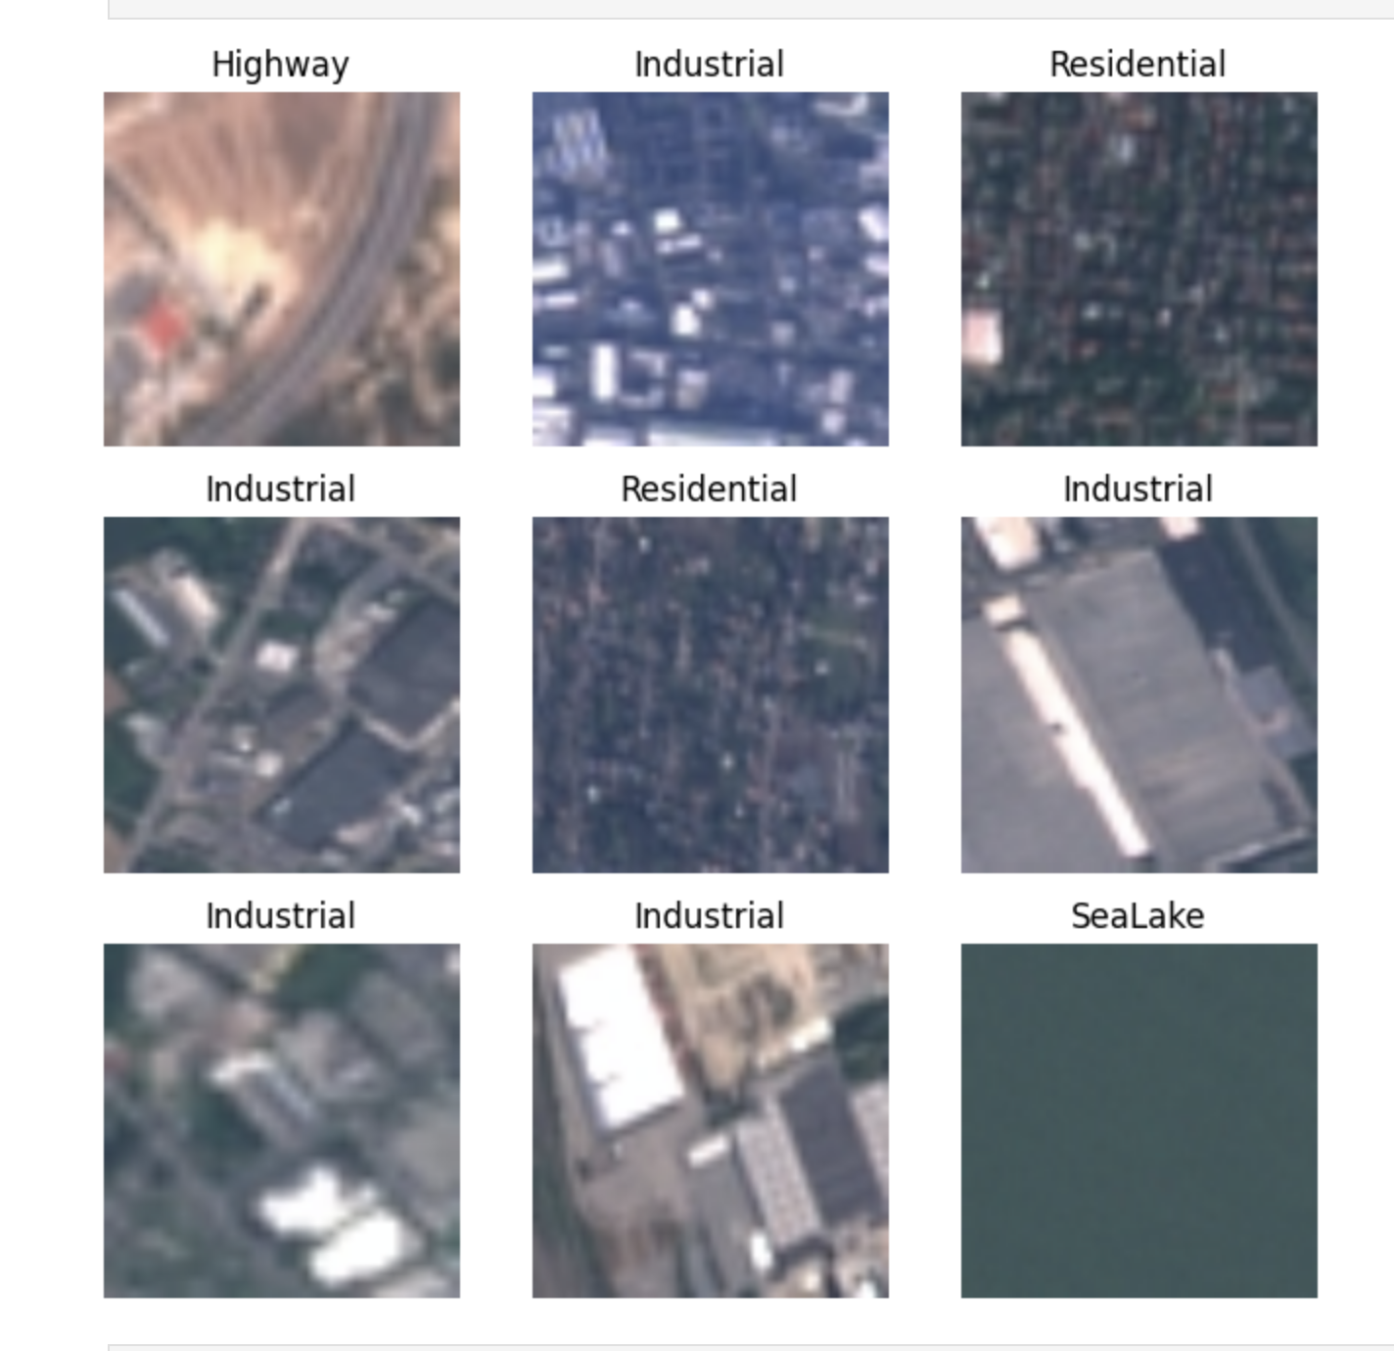
Data Cleanup
Implements EuroSAT dataset for training and testing using PyTorch.
Two sets of transformations are defined using torchvision.transforms.
Training transformations include random resizing, flipping, converting to tensors, and normalizing.
Testing transformations include resizing, center cropping, and normalizing.
Dataset loaded using Image Folder to categorize images by class.
Dataset is split into training (80%) and testing (20%) sets, with randomized indexes.
Subsets created using Subset, and DataLoader instances set up for batching data.
Batch size is set to 16 with 2 workers for concurrent data loading.
show_sample_images function reverses normalization to display images from train_loader.
It plots images without axes and titles subplots with class names.

Slide 9
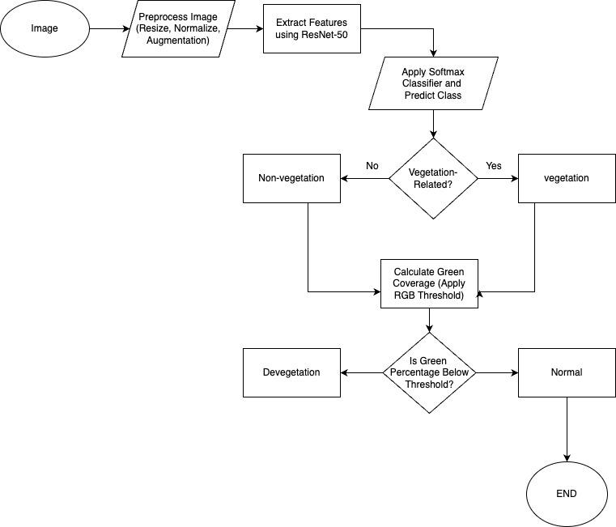
Planned Architecture

Slide 10
Methodology
Pre-trained ResNet-50 model used for feature extraction from satellite images.
Model is fine-tuned on the given dataset for enhanced performance.
Final fully connected layer replaced to match the required number of classes
Feature map generated to capture high-level attributes of the image.
Softmax classifier assigns probabilities to each class.
Class with the highest probability selected as the predicted label
Predicted label checked for vegetation-related categories like Forest, Pasture, or River.
Green coverage analysis performed using a pixel-wise green mask.
calculate_green_percentage() function determines the percentage of green pixels using RGB thresholds.
If green pixels drop below 30% for vegetation-related images, it is flagged as a "devegetation zone."
Images with normal green levels are labeled as "normal."
Final results visualized by overlaying green and non-green regions (non-green marked in red).
Classification result and green coverage percentage (e.g., "34.52% green") are displayed.
If relevant, the image is marked as a "devegetation zone."

Slide 11
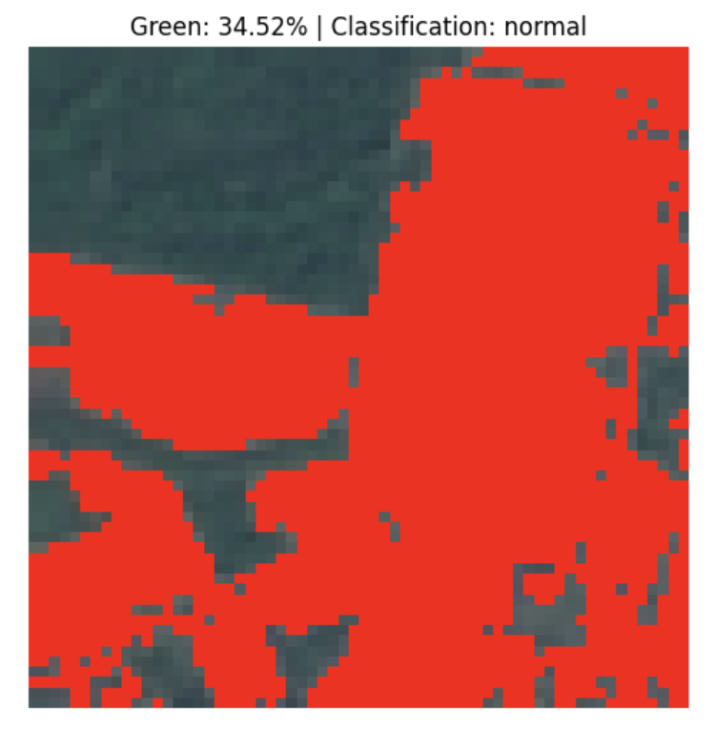

Slide 12
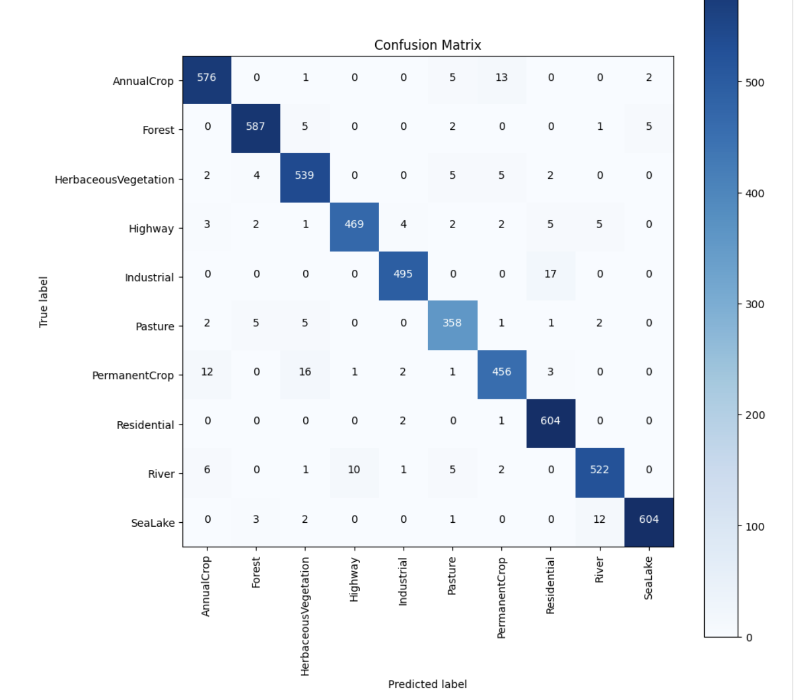
Result
Machine learning and deep learning have significantly improved remote sensing images for identifying deforestation and classifying vegetation. Traditional methods, such as algebraic methods and VZD, rely on low to medium resolution satellite imagery but struggle with high-resolution pictures due to processing power issues. Deep learning techniques like convolutional neural networks (CNP) have revolutionized change detection and target segmentation, particularly in satellite images. These models are trained on detailed multispectral imagery from data sets like Sentinel-2 and Landsat-8, and architectures like U-Net, ResNet, and SegNet have been applied for semantic segmentation tasks. Other methods, such as multimodal learning and ensemble learning, are being explored to enhance precision in deforestation detection and vegetation mapping tasks

Slide 13
Limitations
Despite the progress made, the models encounter constraints in terms of their ability to generalize and identify local deforestation regions. ResU-Net, although achieving a high level of accuracy, struggled to identify changes along polygon boundaries and tiny deforested patches, especially in high-resolution images such as Sentinel-2. The performance of the models was further influenced by seasonal fluctuations and irregular alignment of the images. Moreover, the absence of winter images and forest types observed in other biomes restricts the wider relevance of these models.

Slide 14

Future Work
1. Enhancing Deforestation Detection through Multi-Seasonal and Multi-Sensor Data Fusion: This research could explore integrating data from various satellite sources, such as Sentinel-2, Landsat-8, and radar imaging from Sentinel-1, to improve deforestation detection. The focus would be on addressing limitations like cloud cover and seasonal changes, which affect the accuracy of deep learning models used in environmental monitoring.
2. Exploring Lightweight Deep Learning Architectures for Real-Time Vegetation Monitoring: This paper could investigate the use of lightweight architectures like MobileNet or efficient neural networks tailored for real-time, on-device applications. The goal would be to optimize these models for remote sensing applications, reducing computational load without sacrificing segmentation accuracy.
3. Improving Vegetation Classification through Ensemble Learning and Multispectral Data Integration: Research could be focused on enhancing the accuracy of vegetation classification by combining ensemble learning techniques with multispectral data from various sensors. This approach could help overcome the limitations of individual models and improve the precision of land cover categorization, especially in ecologically sensitive regions.

Slide 15
Conclusion
In conclusion, the predictive modeling of deforestation and vegetation loss using sentinel-2 satellite imagery represents a substantial contribution to environmental monitoring. By leveraging advanced machine learning techniques, this research enhances conservation efforts, supports legal enforcement, and empowers local communities. The integration of high-resolution data with robust predictive tools underscores the critical role of technology in addressing environmental challenges. This study highlights the potential for real-world applications that promote sustainability, disaster risk reduction, and climate change mitigation.

Slide 16
Thank You

