Slide 1
Automated Train Controlling System
by Using Red Flag Detection
Submitted By: Group 7
Sowad Rahman (ID: 21201413)
Md. Abrar Hasan (ID: 23241115)
Mohammed Abyan Chowdhury (ID:22201204)
Submitted To: Md. Jahin Alam & Annajiat Alim Rasel

Slide 2
Table of Contents
Introduction
Datasets Collection
Annotations
Methodology
Results
Discussion
Conclusion
Important Links

Slide 3

Introduction to Our Project
Red flags represent potential safety hazards for a train, such as rail obstructions, equipment malfunctions, or environmental dangers in railway, which, if left undetected, can lead to catastrophic accidents.
Failure to detect and mitigate red flags in a timely manner can result in train derailments, collisions, and other accidents with devastating consequences, including loss of life, property damage, and disruption to transportation networks.
Addressing these challenges, our project harnesses the capabilities of YOLOv8, renowned for its efficiency and precision in image detection tasks, to create an accessible red flag detection system for railway safety.

Slide 4
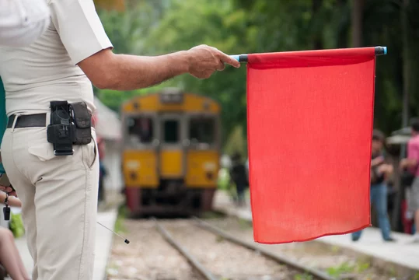
Dataset Collection
Created custom dataset consists of 5203 images.
Data have been augmentation manually.
Dataset contains most of the red flags which has a railway track on the background.
Emphasis on capturing images trackable by the system.
Aim for minimal error margin through comprehensive image coverage.

Slide 5
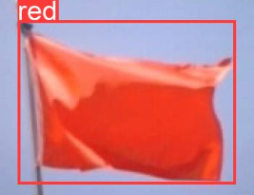
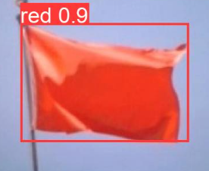
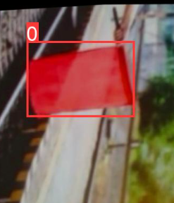
Annotations
Annotation means to add information to text, an image, a database, or any other piece of content.
For this model roboflow has used to do annotation.
Defined the red flag portion with bounding boxes with “0” text and “red”.
Taken 70% data for training the model and 20% for validation and 10% for testing the model.
Validation
Validation Prediction
Training

Slide 6

Methodology
YOLO v8x model selected as the base architecture for its efficiency and accuracy in object detection tasks.
Called an API of roboflow to access the annotated image for model.
Customization of the YOLO v8x model for the specific task of red flag detection in railway environments.
Definition of image paths for both training and testing datasets to facilitate data management in yaml file.
Conducted training for 50 epochs to allow the model to converge and achieve optimal performance.
Accuracy, precision, recall, mean Average Precision (mAP) utilized to assess the model's performance.

Slide 7
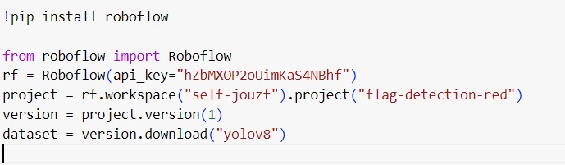
Methodology (Contd.)
(Roboflow Installation)
Installation of Roboflow Library
Importing Roboflow
Initializing Roboflow Client
Accessing Project and Version
Downloading Dataset

Slide 8
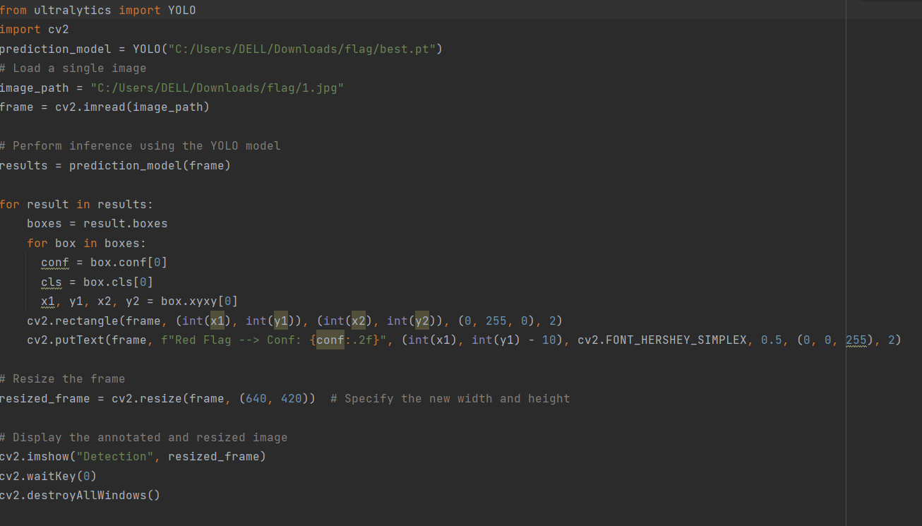
Methodology (Contd.)
Importing Libraries => ultralytics(LIB), cv2, YOLO
Initializing YOLO Model => pre-trained weight files(best.pt)
Loading Image => path of image
Performing Inference => returning detection results
Visualizing Results => confidence score class box co-ordinate
Resizing Frame => specified wide and height
Displaying Image => showing the image on the screen

Slide 9
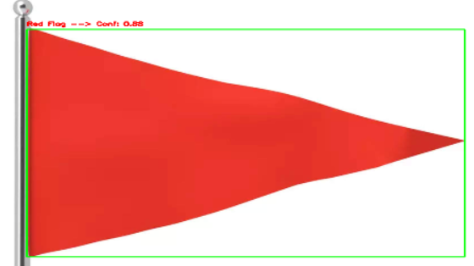
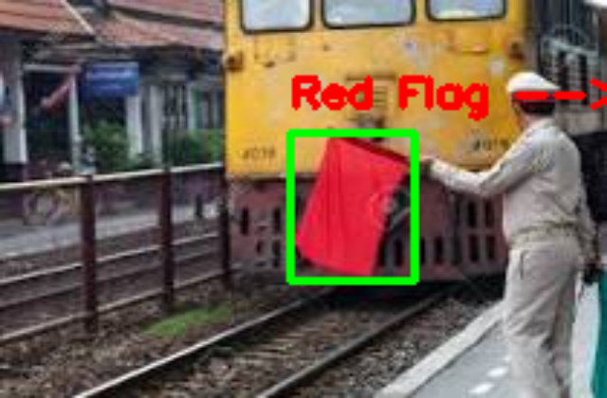
Results
The model successfully detects the red flag and the train will apply brakes.
The model confidently detects the red flag, later it can be seen the confidence score for most test cases are over 0.87.
The Accuracy score of this model is 0.94 which means that it predicts the object 94% correctly.

Slide 10
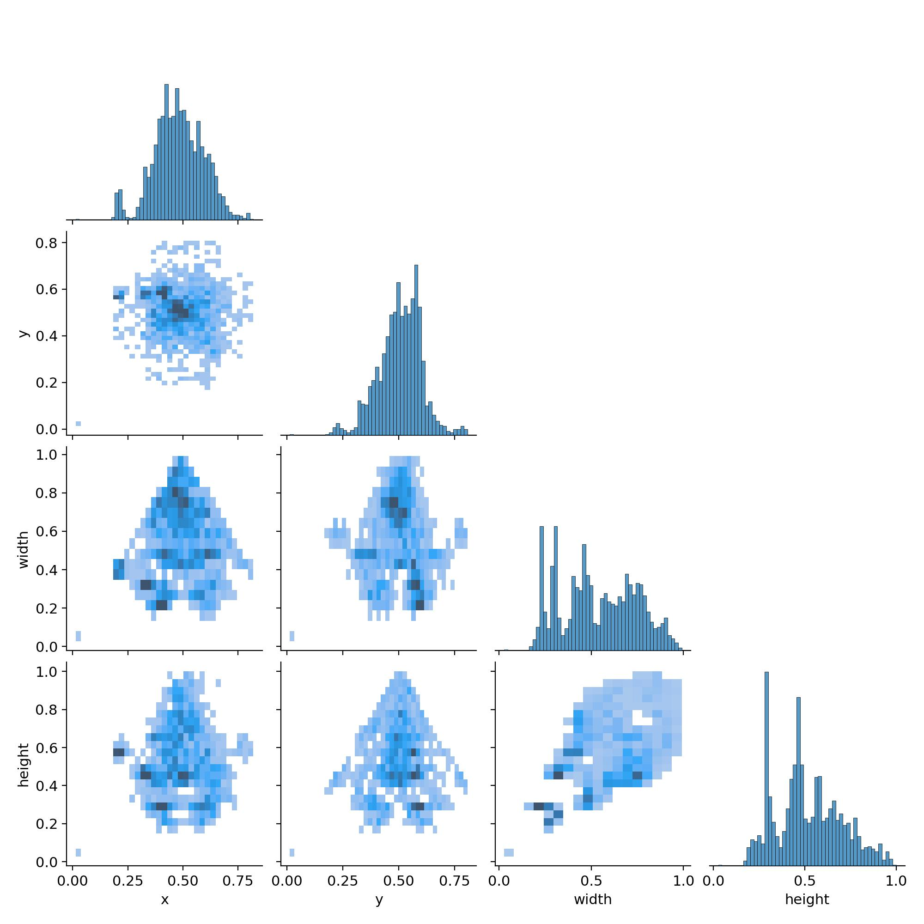
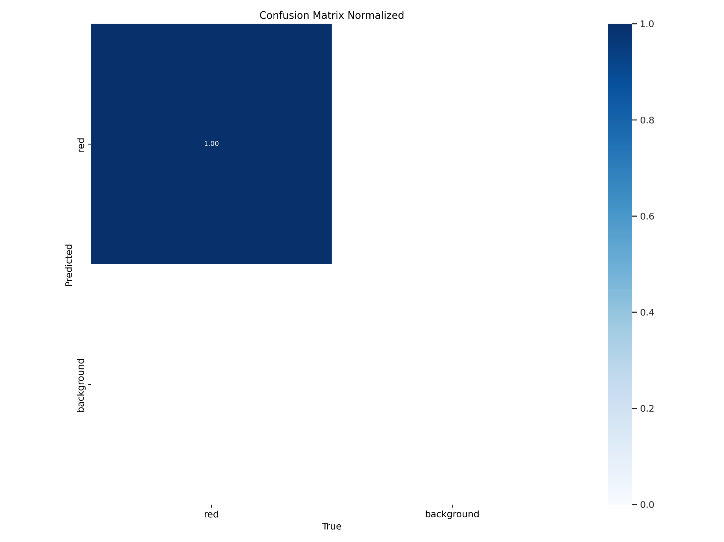
Label correlogram
Confusion matrix normalized
A label correlogram is a visualization that represents the correlation between different labels or categories in a dataset.
Here the color intensity of each cell indicates the strength of the correlation between the corresponding pair of labels.
Normalized confusion matrices provide a more intuitive understanding of the classification model's performance by accounting for class imbalances and varying class sizes.

Slide 11
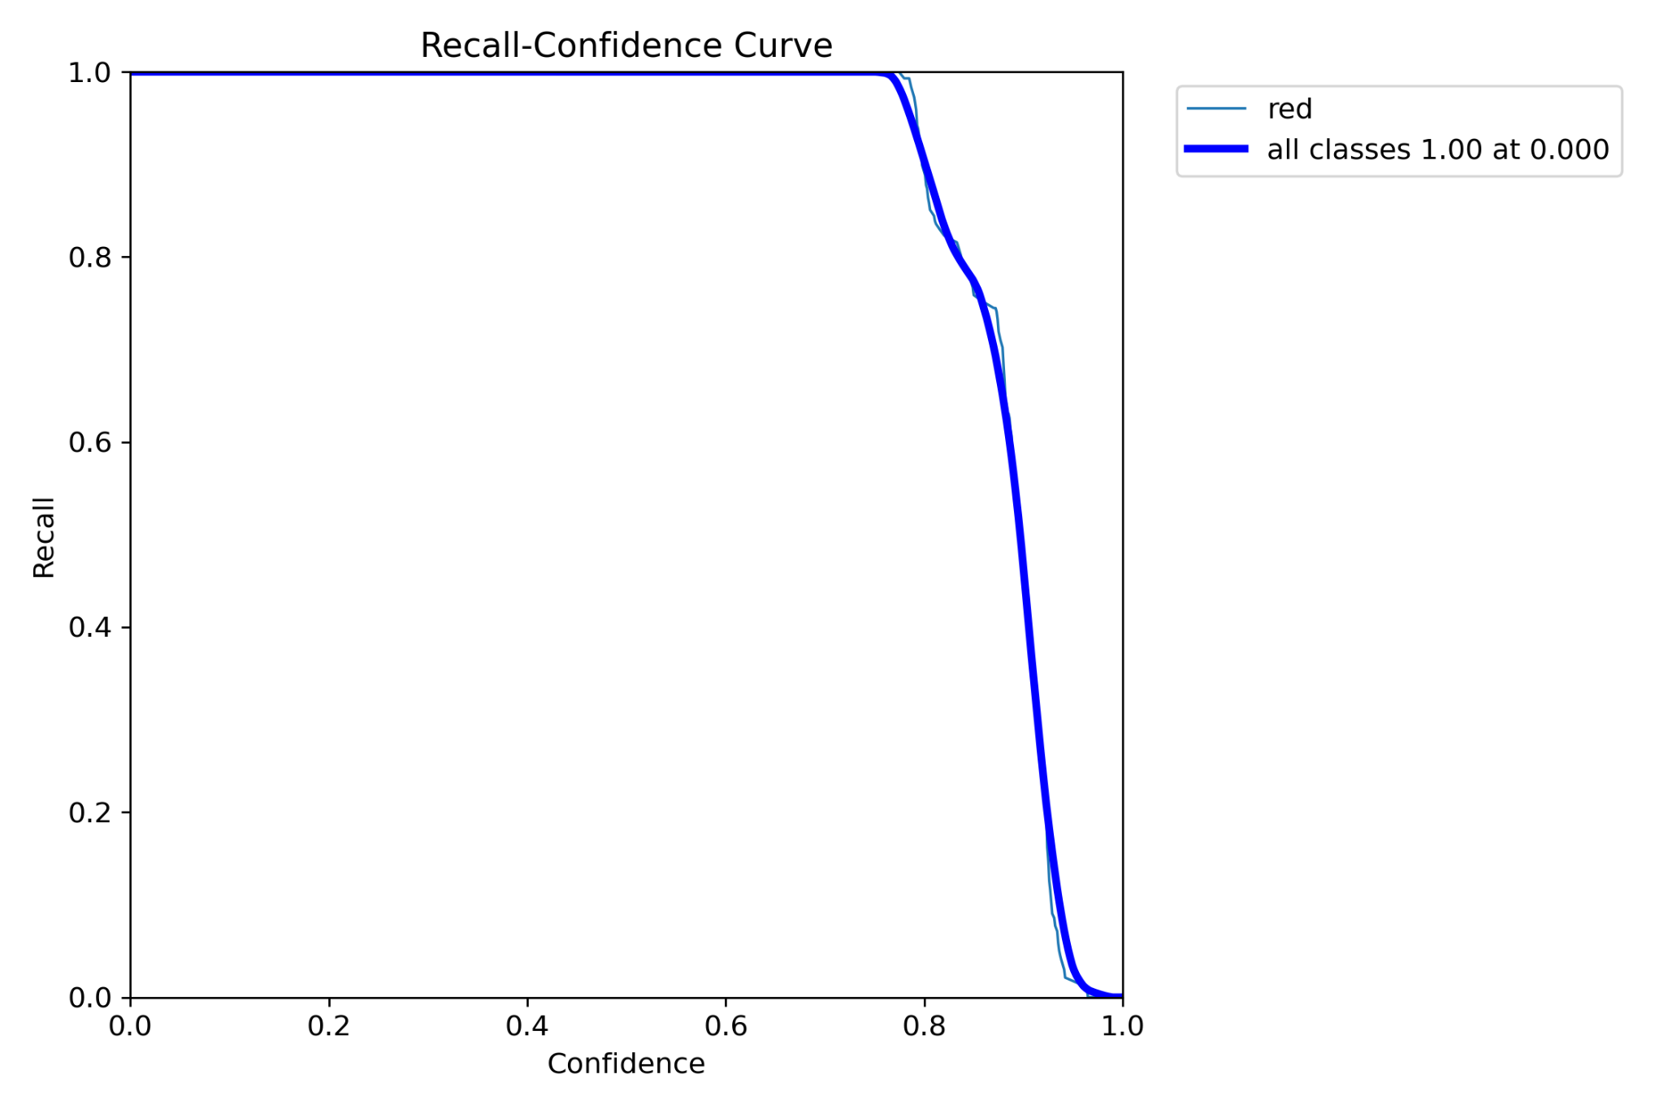
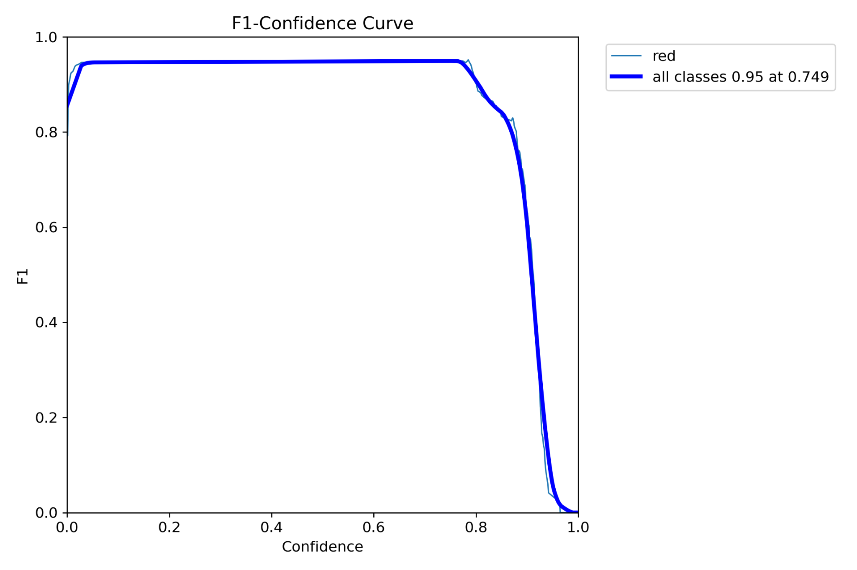
Recall means true positive rate.
Each point on the curve represents the recall achieved by the classifier.
F1 Score is a single metric that combines precision and recall into a single value.
Each point on the curve represents the F1 score achieved by the classifier.
Both recall and F1 changes as threshold changes.

Slide 12
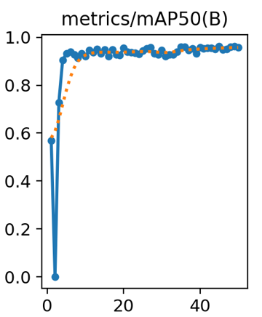
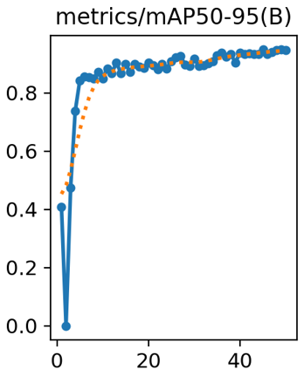
metrics/mAP50(B): Calculates the average precision across all classes at a specific IoU threshold, typically 0.5
metrics/mAP50-95(B): Similar to mAP50(B), but it calculates the average precision across a range of IoU thresholds from 0.5 to 0.95

Slide 13
Discussion
System Performance: This machine learning based system effectively detected various red flags on railways, with high accuracy during day and night.
Challenge: The main challenge was eliminating human error in case of emergencies on railway tracks risking thousands of lives at the same time.
Compared Advantages: The vision-based system outperformed infrared and radar-based methods in accuracy, though it required more initial investment.
Future Directions: Enhancement could focus on improving weather tolerance and reducing response times, with potential expansion into urban areas.

Slide 14
Conclusion
Project Achievements: Successfully developed a red flag detection system for railway safety, significantly reducing potential accidents.
Impact and Scalability: The system has shown potential to drastically improve rail safety and can be adapted globally to different ecosystem.
Overall Evaluation: The red flag detection system represents a significant technological advancement in railway safety. Its development not only showcases the potential of machine learning in solving real-world problems but also sets a foundation for future innovations in the field of smart transportation systems.

Slide 15
Important Links
Datasets: https://drive.google.com/drive/folders/1eDAcGsr14f1w4HMd1-iXnF9bpPeKwOBw?usp=sharing
Code & Graph: https://github.com/sowad223/red-flag-detection-for-train-stopping/tree/main/flag

Slide 16
Thank You!

