Slide 1
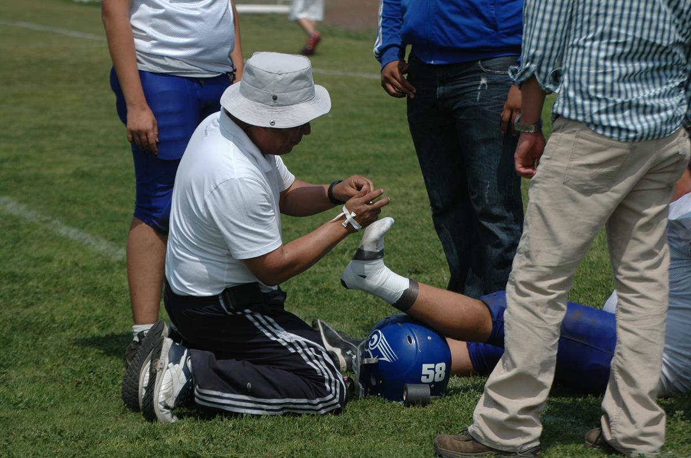
Sports injury Visualization
Sowbaranika Balasubramaniam
Goutham Kalikrishna Reddy Kuncham
Rahul Vaidya

Slide 2

Motivation
Sports injuries contribute to millions of emergency department visits in the US each year, causing concern for athletes, coaches, and medical professionals.
Understanding injury incidence patterns and related risks across different sports is essential for successful injury prevention.
Raising awareness about vulnerable areas of the human body during sports activities and recommending precautionary steps beforehand can help prevent injuries and promote better quality of life for athletes.
Adopting practical approaches to prevent injuries can lead to drastic improvements in an athlete's health and limit both the likelihood and severity of various types of sport-related traumas.

Slide 3
Task list
What are the most common types of sports injuries, and how have they changed over time?
Which sports have the highest injury rates, and are there any patterns or trends in these rates over the years?
How do injury rates vary by gender, age, or other demographic factors, and are there any disparities or inequalities in these rates?

Slide 4
Dataset
The dataset for this project is obtained on the U.S. National Electronic Injury Surveillance System (NEISS) Data on injuries, 1999-2018.
It consists of 7,352,939 rows and 31 columns.

Slide 5
Plots & encodings
Pie Chart
Tree Map
Bubble Chart
Line Chart
Human Body Heatmap
Color
Size
Shape
Position

Slide 6
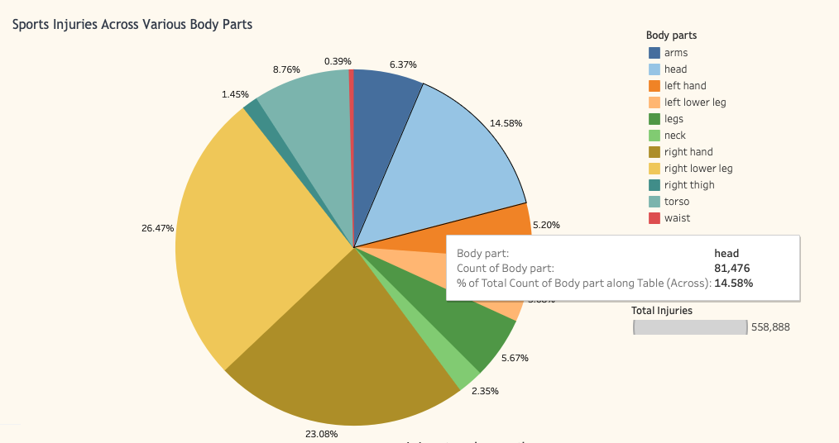
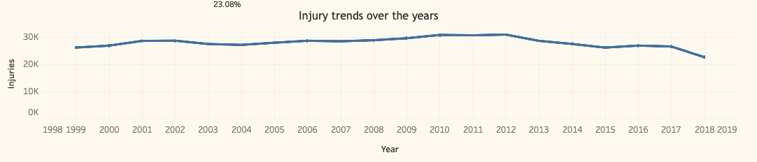
Visualizations
https://public.tableau.com/views/SportsVisualization_16817818166630/Dashboard2?:language=en-US&:display_count=n&:origin=viz_share_link

Slide 7
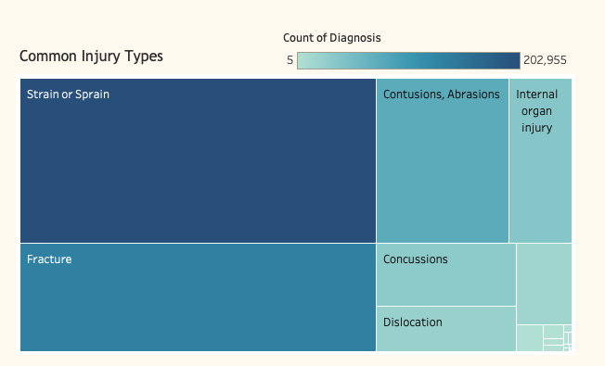
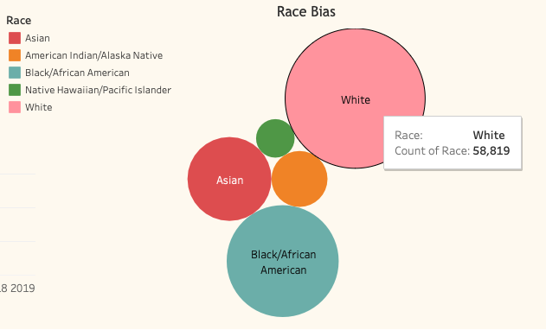
Visualizations
https://public.tableau.com/views/SportsVisualization_16817818166630/Dashboard2?:language=en-US&:display_count=n&:origin=viz_share_link

Slide 8
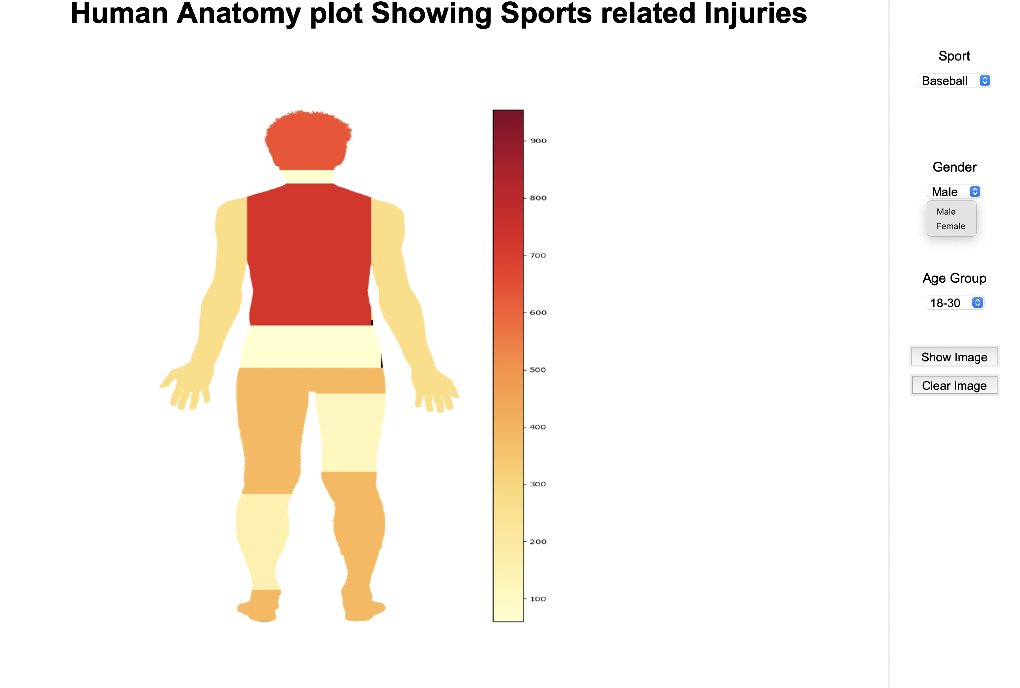
Visualizations

Slide 9
Thanks

