Slide 1

DATA ANALYSIS ON AMCAT DATASET

Slide 2
Sowjanya
Background (B-tech or M-tech): I hold a Bachelor's degree (B.Tech) in Electrical and Electronic Engineering
Why you want to learn Data Science: I am excited about the prospect of applying my analytical thinking and mathematical foundation in the field of data science.
Any work experience:
1. Accenture : Transaction Business associate.
2. Amazon: Quality Analyst

Slide 3
Problem Statement
Analyse Amcat test data to identify candidate performance trends with specific job

Slide 4
Objective of the Project
The primary objectives of analyzing the dataset include
1. Understanding Employment Trends:
Approach: Analyze the dataset to observe trends in job roles, industries, and geographical locations over time.
Methods: Create time-series visualizations, bar charts, showcase employment trends. Explore how the demand for specific skills has evolved and identify regions with the highest concentration of job opportunities
2. Predictive Modelling:
Approach: Build models to predict future employment trends, salary expectations.
3. Identifying patterns: Uncover patterns within the dataset, including relationships between variables, commonalities in job preferences among groups, and factors influencing employment patterns.
4. Policy insights: Evaluate how different variables in the dataset relate to policy objectives. Using statistical tests to assess the significance of observed patterns

Slide 5
Summary of the Data
The dataset working with contains a range of features related to the amcat data set
Attribute Information:
* Dependent variables: Salary
* Independent Variables: ID, , 'DOJ', 'DOL', 'Designation', 'JobCity',
'Gender', 'DOB', '10percentage', '10board', '12graduation','Jobtitle'
'12percentage', '12board', 'CollegeTier', 'Degree', 'Specialization',
'collegeGPA', 'CollegeState', 'GraduationYear'.

Slide 6
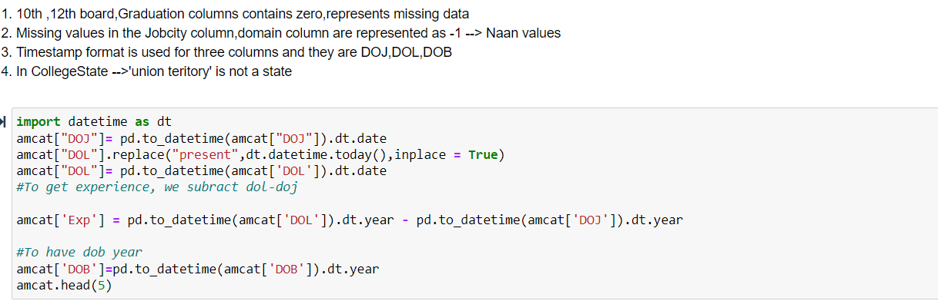
Exploratory Data Analysis:
Data Cleaning Steps
Dropping unnecessary columns:

Slide 7
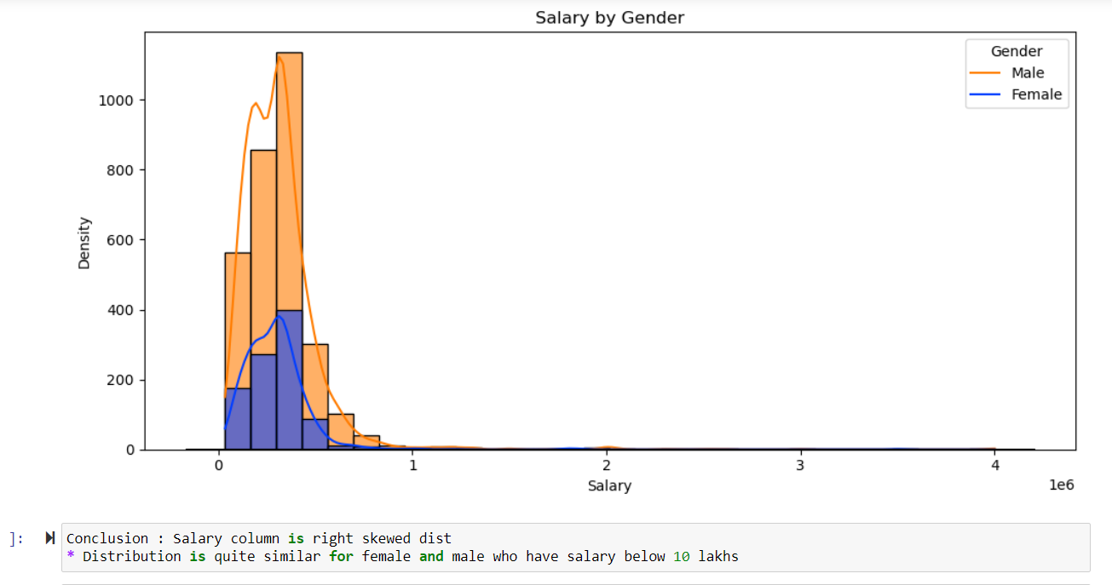
Exploratory Data Analysis:

Slide 8
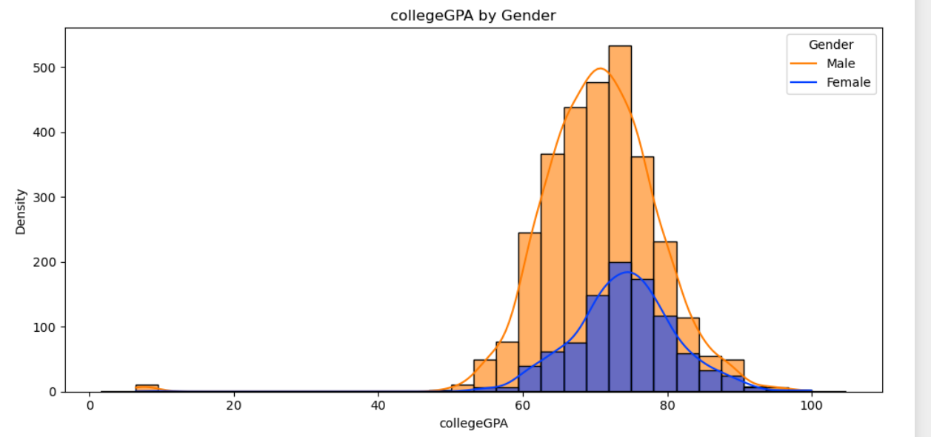
Exploratory Data Analysis:
Conclusions : The distributions of college GPA for both males and females appear to be normally distributed with a mean around 75%
* There were outliers with CGPA values below 20 and above 90%
* IQR suggests significant students are in 70-75% range

Slide 9
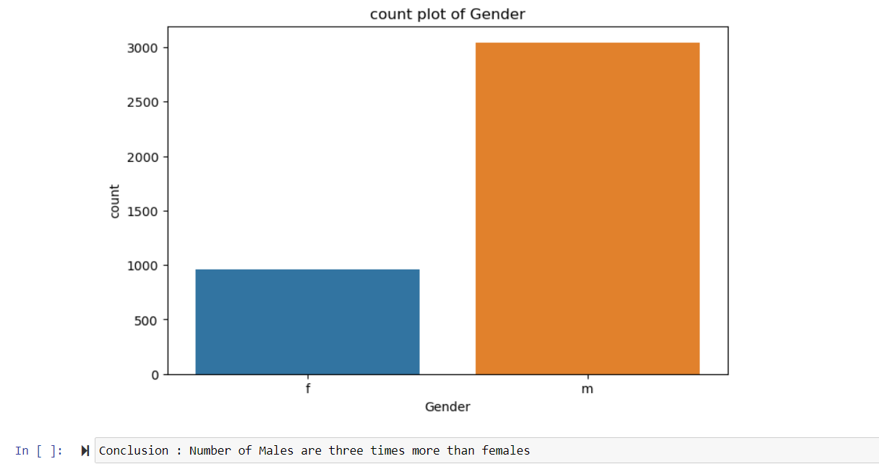
Exploratory Data Analysis:

Slide 10
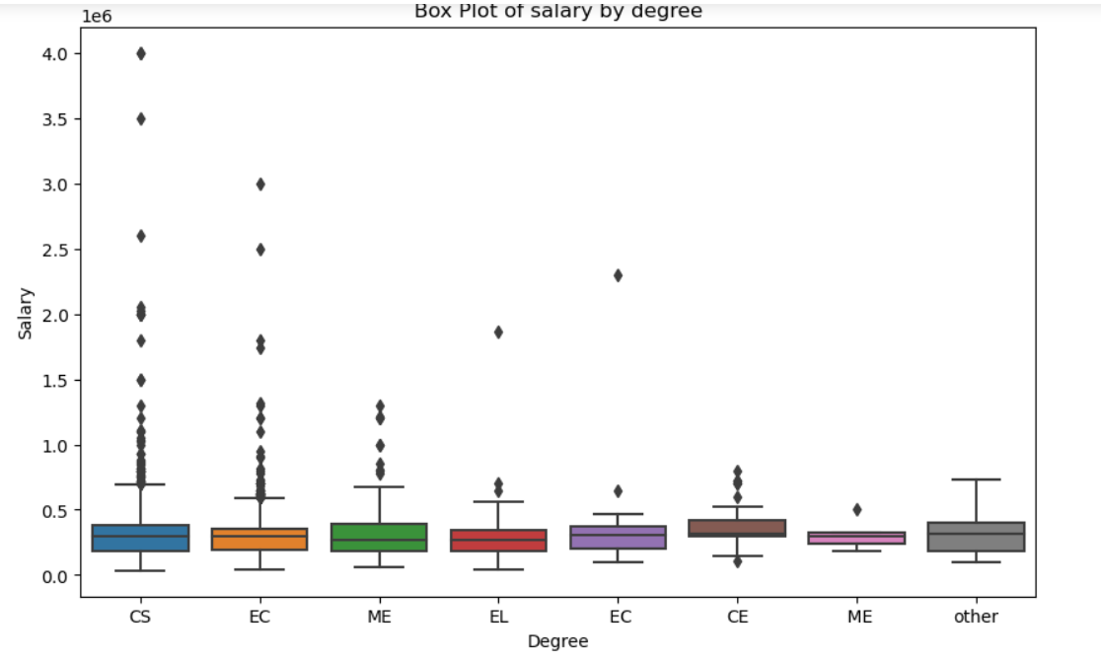
Exploratory Data Analysis:
* The median salary across all specializations is approximately level
* Individuals with specializations is CS/EC tend to receive higher salaries compared to others

Slide 11
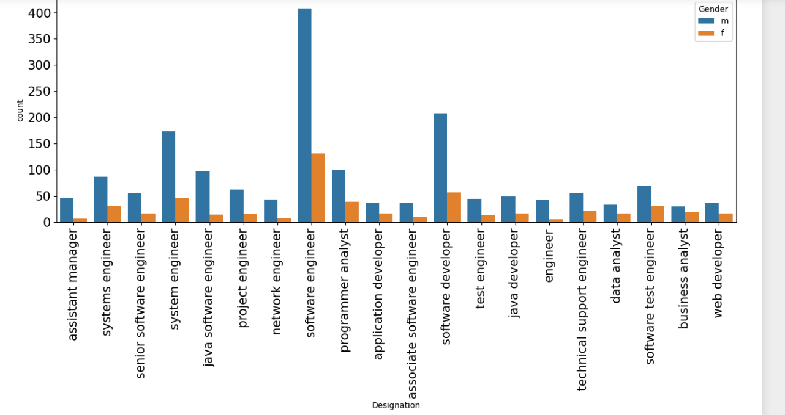
Exploratory Data Analysis:
Conclusions : We focused on the most common roles takes by AMCAT aspirants, which are predominately It roles
* Males are majorily dominent across all the professions

Slide 12
Exploratory Data Analysis:

Slide 13
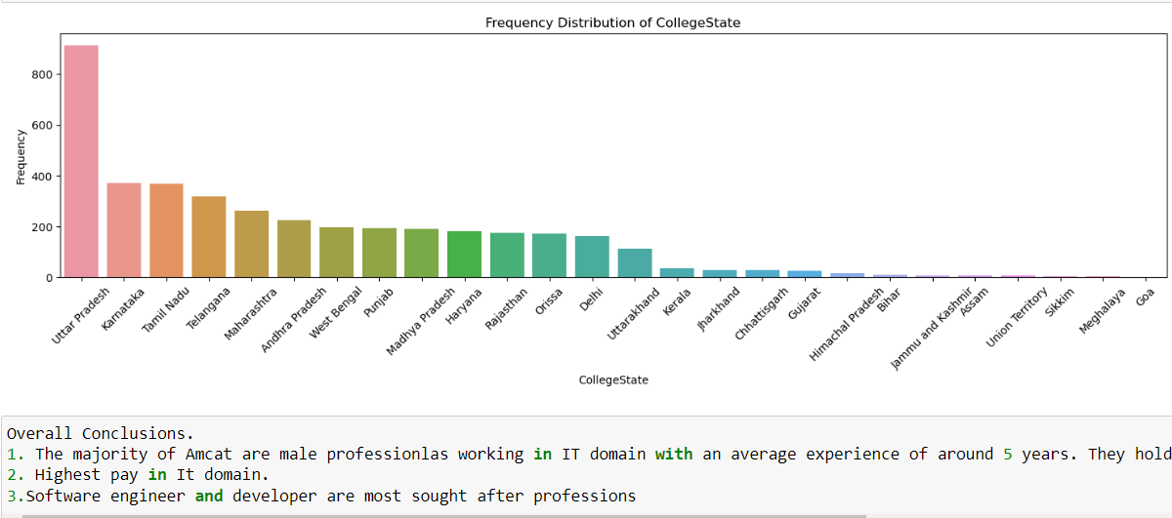
Exploratory Data Analysis:

Slide 14

THANK YOU

