Slide 1

DEPARTMENT OF COMPUTER SCIENCE AND SYSTEMS ENGINEERING ANDHRA UNIVERSITY COLLEGE OF ENGINEERING(A) ANDHRA UNIVERSITY An Intelligent Fetal Health Monitoring System using Generative AI(Gen AI)
Under the guidance of
Prof . D. Lalitha Bhaskari
Professor , HOD-IT&CA & Coordinator-IQAC
Dept .of Computer Science and Systems Engineering
Andhra University
Vishakapatnam-530003
A project Submitted by
Pamula Sowjanya
M . Tech (CST)
Reg No: 424206415006

Slide 2
ABSTRACT
Fetal health monitoring is a critical aspect of prenatal care that ensures the safety and well-being of both the mother and the fetus. Conventional monitoring techniques such as Cardiotocography require continuous observation and expert interpretation, which may lead to subjective decision-making and delayed diagnosis. With the rapid advancement of Artificial Intelligence, intelligent systems can assist clinicians by analyzing fetal health data accurately and efficiently. This project proposes an intelligent fetal health monitoring system using Generative Artificial Intelligence to analyze fetal heart rate signals and uterine contraction patterns. Deep learning models such as Long Short-Term Memory networks are employed for time-series analysis and classification of fetal conditions. Generative Adversarial Networks are used to generate synthetic fetal health data, while Large Language Models provide explainable predictions and automated clinical reports. The system aims to enhance early detection of fetal distress and improve prenatal healthcare outcomes

Slide 3
CONTENTS
Introduction
Existing System
Proposed System
Problem Statement
Methodology
Practical Application
Conclusion
Future Directions

Slide 4
INTRODUCTION
Pregnancy requires continuous monitoring to detect complications like fetal distress and hypoxia. Traditional methods such as Ultrasound Imaging and Cardiotocography (CTG) depend heavily on expert interpretation and may lead to human error. Hence, an automated and reliable system is essential.
Artificial Intelligence enables automated analysis of complex medical data. Generative AI improves performance by generating synthetic data and providing explainable insights, which are critical in medical decision-making.
The proposed system combines Long Short-Term Memory (LSTM) networks for time-series fetal data analysis, Generative Adversarial Networks (GANs) for synthetic data generation, and Large Language Models (LLMs) to convert predictions into clear medical explanations, enhancing clinical support and transparency.

Slide 5
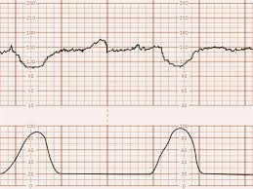
RESEARCH OVERVIEW
Uses LSTM/CNN-LSTM models to analyze fetal heart rate and classify conditions as normal, suspect, or pathological.
GANs generate synthetic fetal data to solve data scarcity and improve model accuracy.
LLMs convert predictions into simple medical explanations and automated reports for better decision support.

Slide 6
KEY CHALLENGES IN EXISTING SYSTEMS
Dependence on Manual Interpretation
Delayed Detection of Fetal Distress
Lack of Explainability in AI Models
Limited and Imbalanced Dataset
Limited Automation and Decision Support

Slide 7
PROPOSED APPROACH
Advanced Medical Data Integration
Deep Learning Models
Generative AI Integration
Explainable AI Support
Real-Time Monitoring Capability
Data Imbalance Handling
Automated Decision Support
Clinical Reliability Enhancement
Scalable System Architecture
Improved Prenatal Healthcare Outcomes

Slide 8
BENEFITS OF PROPOSED SYSTEM
Early Detection of Complications
Improved Prediction Accuracy
Reduced Human Error
Explainable AI Decisions
Data Scarcity Solution
Better Prenatal Healthcare Outcomes

Slide 9
PROBLEM STATEMENT :
Modern prenatal healthcare faces increasing challenges in ensuring continuous and accurate fetal monitoring while managing limited clinical resources.
Conventional monitoring methods such as CTG rely heavily on manual interpretation and expert supervision, which may lead to subjective decisions and delayed diagnosis.
Key Problem: The need for an intelligent, adaptable, and explainable AI-driven system that can:
Capture Medical Complexity: Analyze intricate patterns in fetal heart rate variability and uterine contraction data.
Adapt to Dynamic Conditions: Provide real-time monitoring and timely alerts for changing fetal health conditions.
Enhance Clinical Accuracy: Reduce human error and improve reliability of fetal health classification.
Address Data Scarcity: Overcome limited and imbalanced medical datasets using advanced techniques.
Ensure Fetal Safety: Support faster detection of fetal distress to improve maternal and neonatal outcomes.

Slide 10
OBJECTIVES:
To design an intelligent fetal health monitoring system
Multilingual Clinical Report Generation
Federated Learning for Data Privacy
Advanced Hybrid Deep Learning Models
Large-Scale Clinical Validation

Slide 11
METHODOLOGY
Fetal health data from CTG and PhysioNet datasets is collected, cleaned, normalized, and important features such as heart rate variability and uterine contractions are extracted
LSTM and CNN-LSTM models analyze time-series data for classification, while GANs generate synthetic data to handle data imbalance and improve model performance.
Large Language Models convert predictions into clear medical explanations and automated reports, enabling reliable and intelligent decision support.

Slide 12
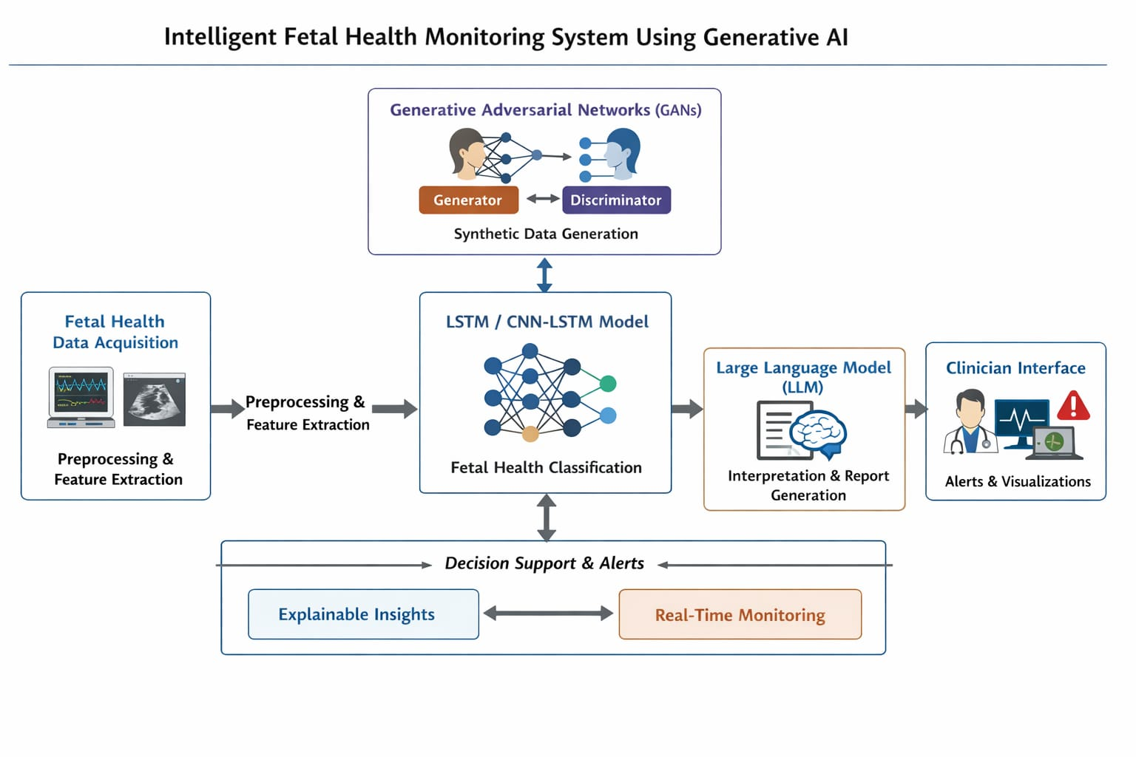
KEY COMPONENTS

Slide 13
Data Acquisition: The system begins by collecting fetal health data from publicly available datasets such as Cardiotocography (CTG) and PhysioNet, or directly from monitoring sensors. This ensures reliable time-series data for accurate analysis.
Data Preprocessing & Feature Extraction: The collected data is cleaned using noise removal and normalization techniques. Important clinical features such as fetal heart rate variability, accelerations, decelerations, and uterine contraction patterns are extracted for meaningful analysis.
Deep Learning-Based Prediction: LSTM and CNN-LSTM models analyze the processed time-series data. The trained model classifies fetal conditions into normal, suspect, and pathological categories for early detection of complications.

Slide 14
Generative AI Module: Generative Adversarial Networks (GANs) generate synthetic fetal health data to address data imbalance and improve model robustness and performance.
Explainable AI:Large Language Models (LLMs) convert complex model predictions into simple and clear medical explanations. This improves transparency and helps clinicians understand the reasoning behind the results.
Clinical Reporting & Alerts: The system generates automated clinical reports and provides visual dashboards. It also triggers real-time alerts for suspect or pathological cases to support timely medical intervention.

Slide 15
PRACTICAL APPLICATIONS
-Hospital Labor Monitoring: Can be integrated into hospital CTG systems to assist doctors in real-time fetal health assessment.
-Early Risk Detection: Helps in early identification of fetal distress and hypoxia, enabling timely medical intervention.
-Remote & Rural Healthcare Support: Supports telemedicine and remote monitoring in areas with limited access to specialist doctors.
-Medical Training & Research: Synthetic data generated using GANs can be used for medical research and training without compromising patient privacy.
-Clinical Decision Support Systems (CDSS): Acts as an intelligent assistant to clinicians by providing automated classification and explainable insights.

Slide 16
RESULTS
Improved Classification Accuracy:The deep learning models (LSTM / CNN-LSTM) achieved high accuracy in classifying fetal health conditions into normal, suspect, and pathological categories.
Enhanced Model Robustness: GAN-based synthetic data generation helped address data imbalance, improving generalization and overall model performance.
Early Detection Capability:The system successfully identified potential fetal distress patterns at an early stage, supporting timely medical intervention.
Explainable Predictions:LLM integration provided clear and structured medical explanations, increasing transparency and clinician trust.
Automated Reporting & Alerts:The system generated automated clinical reports and real-time alerts, enhancing decision support and workflow efficiency.

Slide 17
CONCLUSION
This project successfully developed an intelligent fetal health monitoring system by integrating deep learning and Generative Artificial Intelligence techniques. The use of LSTM and CNN-LSTM models enabled accurate analysis of time-series fetal data, while GANs addressed data scarcity and improved model robustness.
The incorporation of Large Language Models enhanced explainability by converting predictions into clear medical insights and automated clinical reports. Overall, the proposed system improves early detection of fetal distress, reduces dependence on manual interpretation, and strengthens clinical decision support, contributing to safer and more reliable prenatal healthcare outcomes.

Slide 18
FUTURE WORK
Real-Time Deployment in Hospitals
IoT & Wearable Device Integration
Advanced Deep Learning Models
Multilingual & Personalized Reports
Federated Learning for Data Privacy
Large-Scale Clinical Validation
Personalized Risk Prediction Models
Integration with Electronic Health Records (EHR)
Explainable AI Enhancement
Edge AI Deployment

Slide 19
Thank you

