Slide 1
disease prediction

Slide 2
INTRODUCTION
The main goal of our project is to provide the disease name by taking the symptoms from the user or patients. Nowadays everything is available on the internet, so we thought of predicting the disease based on the symptoms that are given by the customer online. It is an interactive system that takes symptoms from the customer. The customer has to provide a minimum of 2 symptoms that they are suffering from. The system responds effectively graphical user interface(GUI) to make it look like or feels like it is a live interaction. You can create this type of disease prediction using machine learning algorithms as well as artiﬁcial algorithms to enquire, identify, and respond to the custumer.

Slide 3
purpose
The main purpose of disease prediction systems using machine learning is to improve healthcare outcomes by leveraging data-driven algorithms to predict disease risk, diagnose conditions earlier, and personalize treatment plans. By detecting diseases at earlier stages, interventions can be initiated sooner, potentially leading to better outcomes and reduced healthcare costs.
Early Detection
Preventive Interventions
Optimized Healthcare Resource Allocation
Personalized Medicine
Healthcare Planning and Policy Development

Slide 4
Existing system
Before disease prediction systems using machine learning, healthcare relied on traditional diagnostic methods such as patient interviews and physical exams, which could be subjective and prone to human error. For example, a doctor's diagnosis might vary based on individual judgment. Additionally, statistical models were limited in their ability to leverage extensive healthcare data. With machine learning, algorithms can now predict diseases like diabetes based on factors like genetics and lifestyle, or detect cancerous tumors in imaging scans with higher accuracy, enabling earlier interventions and personalized treatment plans.

Slide 5
PROPOSED SYSTEM
The proposed disease prediction system using machine learning utilizes algorithms to analyze diverse datasets containing factors such as genetics, medical history, lifestyle, and environmental factors. By processing this information, the system can forecast the likelihood of an individual developing a particular disease. It aims to identify patterns and correlations within the data that may not be readily apparent to human clinicians. Ultimately, the system provides healthcare professionals with predictive insights, enabling them to take proactive measures such as implementing preventive interventions, recommending lifestyle changes, or initiating early treatment strategies.

Slide 6
Objective and scope
The objective of a disease prediction system utilizing machine learning (ML) is to forecast the likelihood of an individual developing a particular ailment based on various factors such as genetic predispositions, lifestyle choices, environmental factors, and medical history.
The scope of such a system involves leveraging ML algorithms to analyze large datasets, identify patterns, and construct predictive models that can assist healthcare professionals in early diagnosis, personalized treatment planning, and proactive disease prevention strategies.

Slide 7
REQUIREMENT SPECIFICATION
SOFTWARE SPECIFICATON:
Code editors: Visual Studio code
Coding Language: Python
GUI : Tkinter
HARDWARE SPECIFICATIONS:
Operating System: Windows
RAM: 4GB/Higher
CPU: 64bit

Slide 8
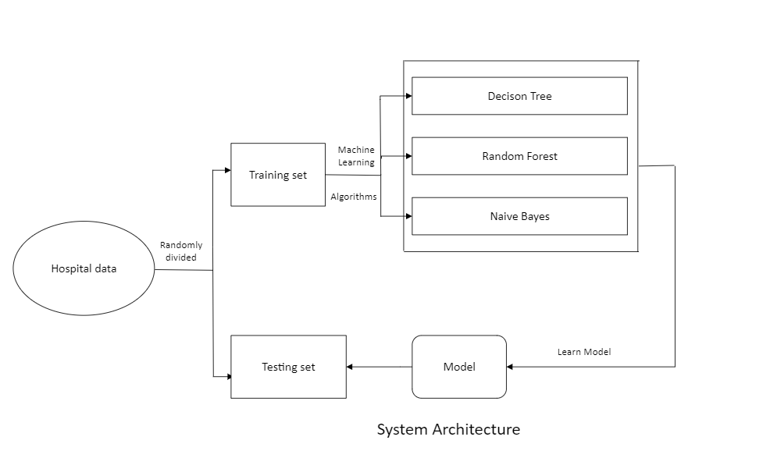
SYSTEM ARCHITECTURE

Slide 9
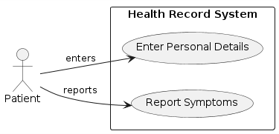
UML DIAGRAMS
Use case:

Slide 10
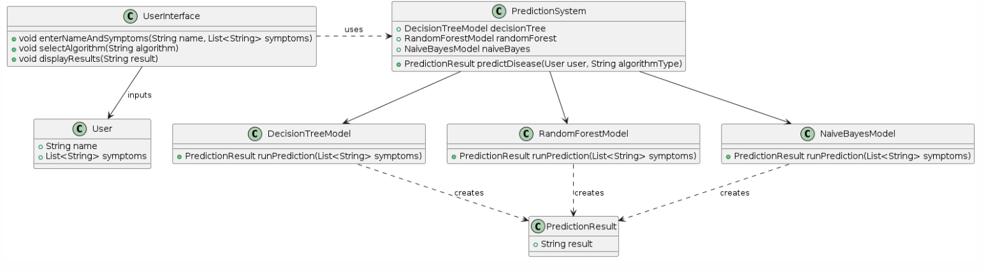
Class diagram:

Slide 11
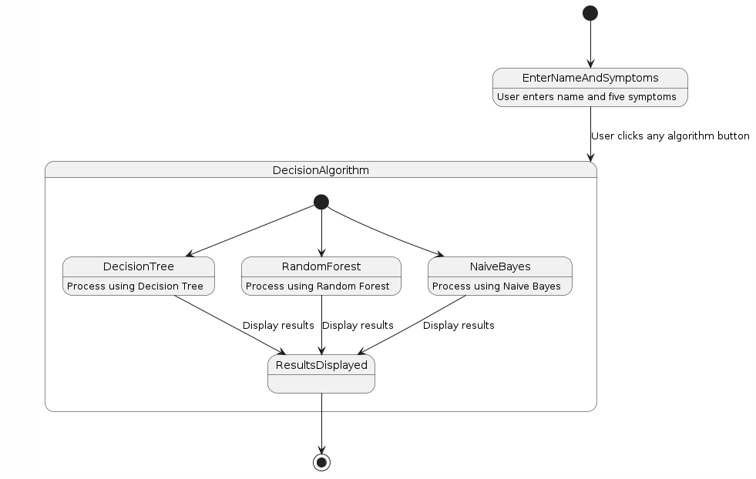
State chart diagram:

Slide 12
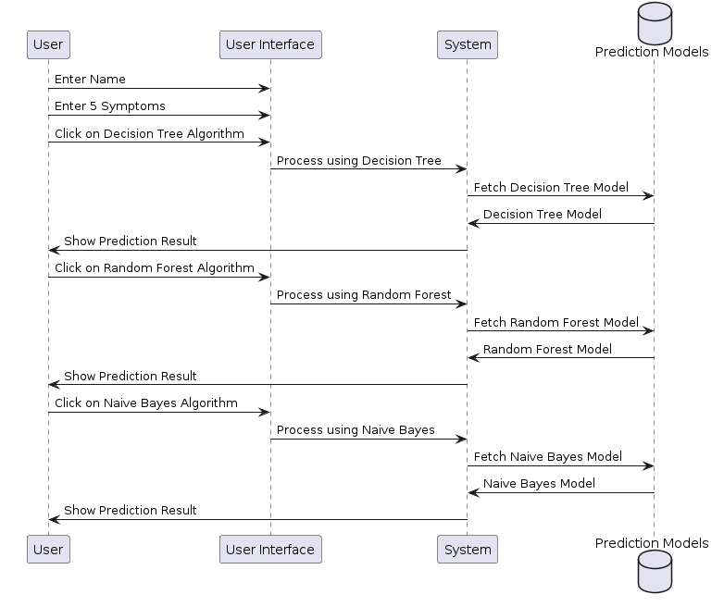
Sequence diagram:

Slide 13
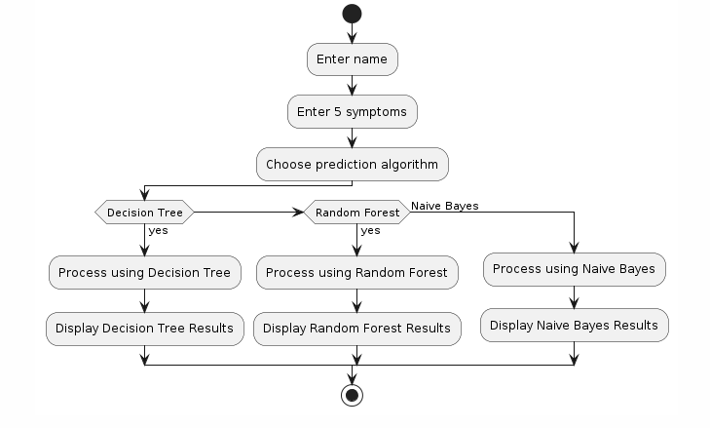
Activity diagram:

Slide 14
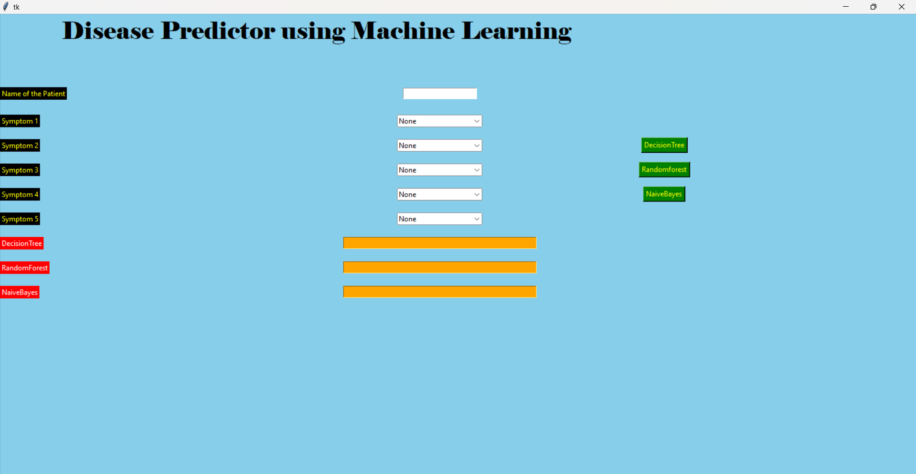
OUTPUT SCREENS

Slide 15
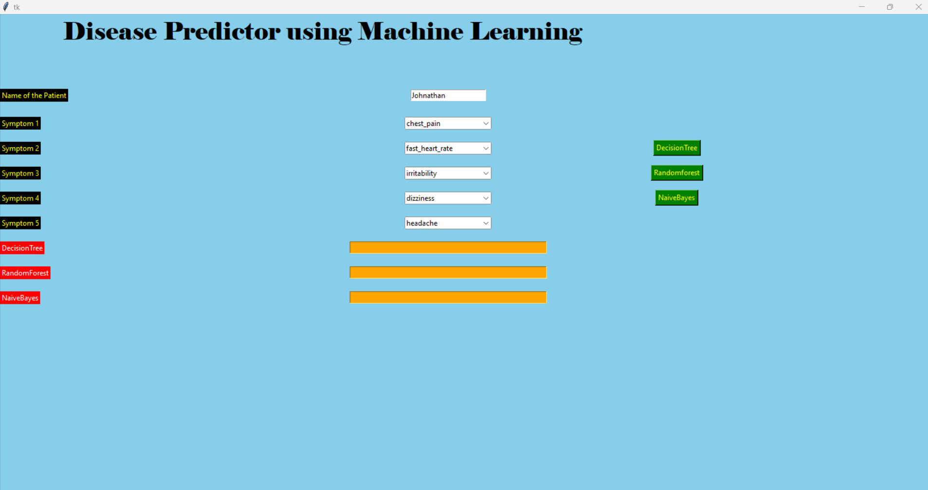

Slide 16


Slide 17
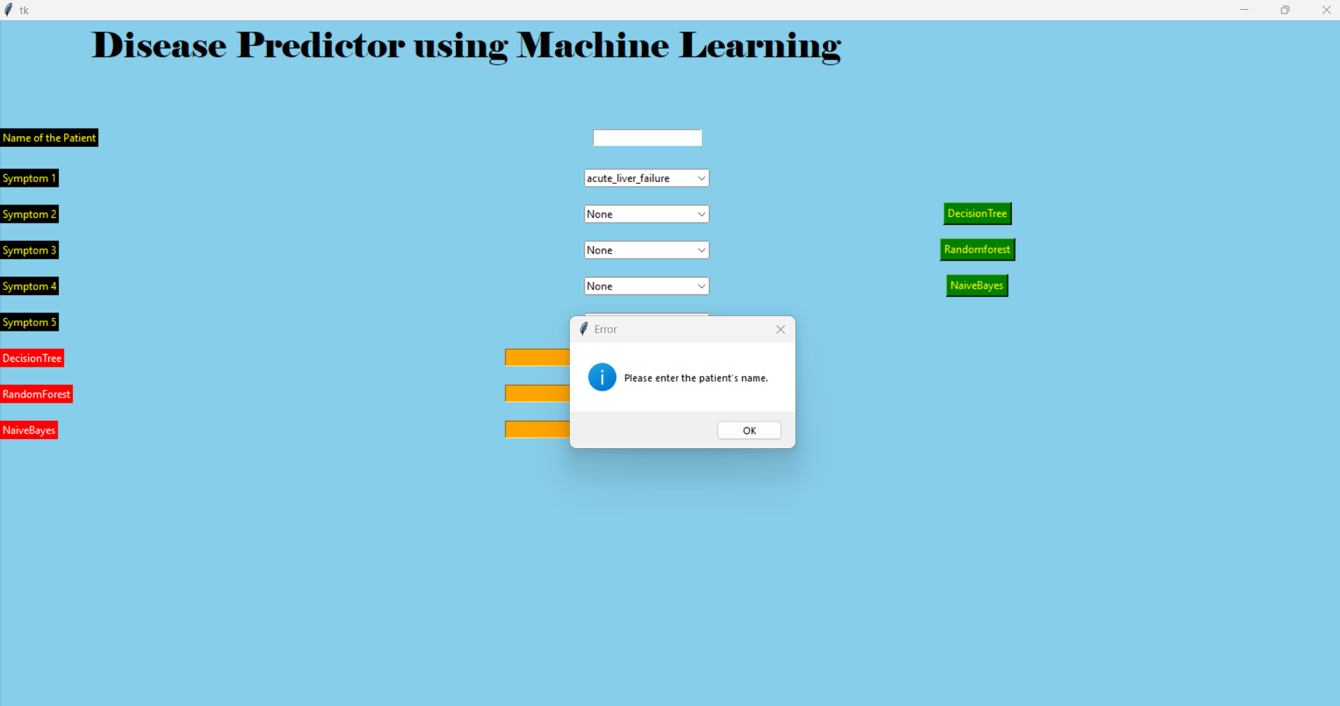

Slide 18
BENEFITS
A disease prediction system powered by machine learning offers several advantages. Firstly, it enables early detection and diagnosis by analyzing vast amounts of data to identify subtle patterns indicative of disease onset, leading to timely interventions and improved treatment outcomes. Secondly, it facilitates personalized treatment plans by considering individual factors such as genetics and lifestyle, optimizing care, and minimizing adverse effects. Thirdly, it promotes preventive healthcare by forecasting an individual's risk of developing certain conditions, allowing for proactive measures to mitigate risks. Additionally, it enables efficient resource allocation in healthcare and drives advancements in medical research by generating valuable insights and data.

Slide 19
CONCLUSION
In conclusion, the disease prediction system utilizing machine learning algorithms such as Random Forest, Decision Tree, and Naive Bayes offers a promising avenue for improving healthcare outcomes. By leveraging these algorithms, the system can effectively analyze diverse datasets and extract valuable insights to forecast disease occurrence, enabling early detection, personalized treatment plans, and proactive healthcare interventions. The combination of these algorithms allows for robust predictions, considering various factors such as genetic predispositions, lifestyle choices, and medical history. With its ability to optimize resource allocation, drive medical research advancements, and inform population health management strategies, this project represents a significant step towards transforming healthcare delivery and enhancing overall well-being.

Slide 20
REFERENCES
2020 International Conference for Emerging Technology (DNCET) Belgaum, India
M. Chen, Y. Hao, K. Hwang, L. Wang and L. Wang, Tideaze Prediction by Machine Over Learning Over Big Data From Healthcare Community, in IEBEAccece, vol. 5, pp. 8869-8879, 2017, doi: 10.1109 ACCESS 2017 2694446
J. Goo, L. Tian, J. Wang, Y. Chen, B. Song and X. Hu, "Similar Disease Prediction With Heterogeneous Dizeane Information Networks," in IEEE Transactions on Nano Bioscience, vol. 19, no. 3, pp. 571-578, July 2020, doi: 10.1109 TNB 2020 2994983
P. S. Kohli and S. Arom, "Application of Machine Learning in Dizeaze Prediction, 2018 4th International Conference on Computing Communication and Automation (ICCCA), Greater Noida, India, 2018, pp. 1-4, doi: 10.1109 CCAA 2018.8777449

