Slide 1
GIT & GITHUB
This Presentation is an informational presentation and none of the content or diagrams in it are original. I have used the www.git-scm.com for the content/diagrams of this presentation.
--Sowjanya Mudunuri

Slide 2
What and why?
GIT is a Version Control System
Created by Linus Torvalds to maintain the Linux Kernel
Handles small to large projects
Its open source
Powerful branching and merging capabilities
Other alternatives : CVS, Perforce, SCM.

Slide 3
States of Files in GIT
Committed: Safely stored in your local database
Modified: file is changed but not committed
Staged: modified file that is marked to go into next commit
Untracked: Files not in the staging area and new
Notes:
Remember that each file in your working directory can be in one of two states: tracked or untracked. Tracked files are files that were in the last snapshot; they can be unmodified, modified, or staged. Untracked files are everything else — any files in your working directory that were not in your last snapshot and are not in your staging area. When you first clone a repository, all of your files will be tracked and unmodified because you just checked them out and haven’t edited anything.

Slide 4
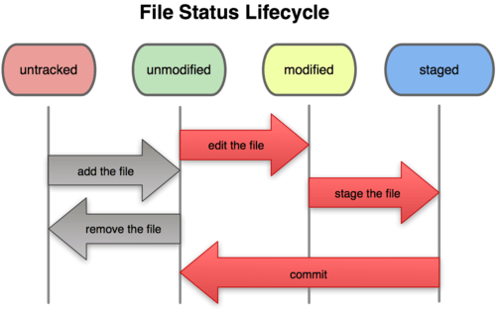
GIT Workflow

Slide 5
GIT Workflow
Modify/create files in your working directory
Stage the file in the staging area
Commit the files in the staging area so they are permanently stored
Notes:
As you edit files, Git sees them as modified, because you’ve changed them since your last commit. You stage these modified files and then commit all your staged changes, and the cycle repeats. This lifecycle is illustrated in Figure 2-1.

Slide 6
MORE ON GIT
Git thinks of its data in terms of set of snapshots of a mini filesystem
So Everytime you commit GIT takes a picture of what the files look like at the moment and stores a reference to the picture
To be Efficient, if files have not changed, GIT doesnot store the file again. Just a link to the previous identical file is stored.

Slide 7
MORE ON GIT
Everything in GIT is check-summed before stored and is then referred to by that checksum
GIT uses SHA-1hash for checksumming
The checksum is a 40-character string containing hexadecimal numbers

Slide 8
After Install and Setup
Initialize a repository in an existing Directory
$ git init
Clone an existing repository.
$ git clone <path_to_the_existing_repo>
Cloning gets a copy of an existing repository
Check the state of your files( staged/unstaged/untracked )
$ git status

Slide 9
Git commands
Adding new/modified files to staging area
$ git add <file_name>
$ git add –p
$ git add .
$ git add –A
What you have changed but not yet staged
$ git diff
What you have changed that is staged
$ git diff –cached
To list your git settings
$ git config --list

Slide 10
GIT Commands
Everytime you do a
$ git config –global user.name “sowju”
The changes are made to the file ~/.gitconfig
$git stash
$git stash pop
$git stash list

Slide 11
Git commands
Committing the changes in staging area
$ git commit
$ git commit –m “message”
Amend a previous commit
$ git commit –amend
$ git commit –amend –reset-author
Removing a file from git and the current working directory
$ git rm <file_name>
Renaming/moving a file
$ git mv file_from file_to
Notes:
Committing means taking snapshots of the changes and putting it as a record.

Slide 12
Git commands
Viewing the commit history
$ git log
Unstaging a staged file
$ git reset HEAD <file_name> if its tracked
$ git rm –cached <file_name> if its new/untracked previously
Unmodifying a modified file
$ git checkout -- <file_name>
To reset a file to a particular commit
$ git checkout <commit-SHA> <file_name>
To ignore files in git you add it to .gitignore file and commit that file

Slide 13
What is a GIT Commit?
It is a commit object that contains a pointer to the snapshot of the content you staged, the author and message meta data, and pointers to the commit/commits that were direct parents of this commit.
Zero parents for the first commit, one parent for a normal commit, and multiple parents for a commit that results from a merge of two or more branches.
$ git commit –m “My message”

Slide 14
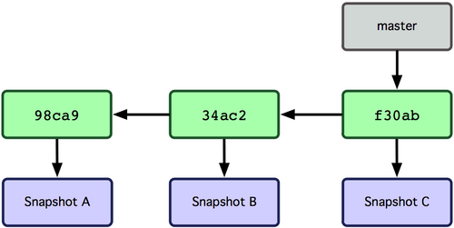
What is a GIT BRANCH ?
It’s a movable pointer to one of the commits
The default branch in GIT is master
As you initially make commits, you’re given a master branch that points to the last commit you made
Everytime you commit the pointer moves forward
--Ref git-scm.com

Slide 15
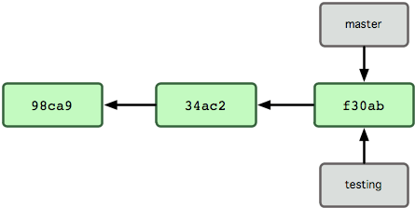
Creating a New Branch
$ git branch testing
It creates a new pointer for you to move around.
This new pointer is at the same commit you’re currently on.
Ref: git-scm.com

Slide 16
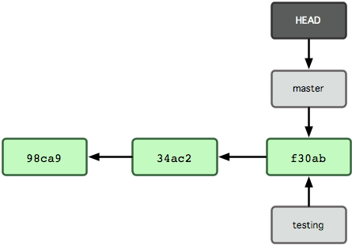
More on Branches…
HEAD – Is a pointer to the local branch you are currently on
$cat .git/HEAD
$git branch testing
The above command only created a new branch. It did not switch the branch

Slide 17
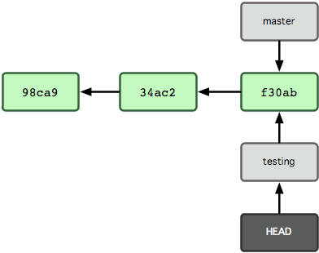
More on Branches…
To switch to an existing branch
$git checkout testing

Slide 18
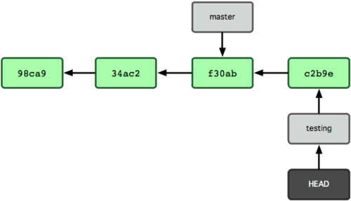
More on Branches ….
$ git commit –am “I am a new message”

Slide 19
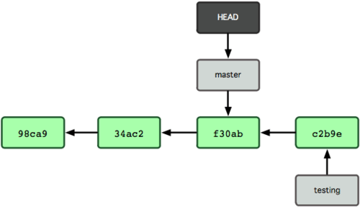
More on Branches..
$git checkout master
-- Moved the HEAD pointer back to master
-- Reverted the files in your working directory back to the snapshot that Master points to.

Slide 20
More on Branches…
Create a branch and switch to the branch
$git checkout –b my-branch-name
If you have uncommitted changes in your branch and if you want to switch branches GIT wont let u switch branches
In which case you can temporarily stash or make a WIP commit
Listing all the existing branches
$git branch
Deleing a branch
$git branch –d my-branch-name

Slide 21
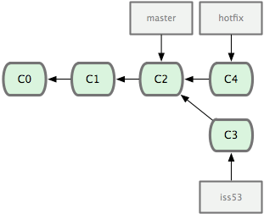
Merging
$git checkout master
$git merge hotfix
If the commit pointed to by the branch you merged in was directly upstream of the commit you’r on, git just moves the pointer forward. Hence you see “Fast forward”

Slide 22
More Merging
But if your development history has diverged and you are merging onto a branch which is not a direct ancestor then GIT does a 3-way merge instead of just moving the branch pointer forward.It creates a snapshot that results from the 3-way merge

Slide 23
Remotes
Remote repository: Versions of your project on the internet
Show the remote servers you have configured with
a)shortnames of each remote handle
$git remote
b) shortnames + the url
$git remote –v
Get data from remotes
$git fetch <remote-name>
Renaming a remote
$git remote rename me you

Slide 24
Remote branches..
They are references to the state of branch on your remote repository
Origin – it’s the remote repository you cloned from
When you first create a Github repository you do
$git remote add origin https://github.com/sowjumn/mytest.git
$git push origin master

Slide 25
More on remote branches
Pushing to a remote branch
$git push origin my_branch
So your pair can do a git fetch to get that that reference
$git fetch origin
To checkout a remote branch origin/my_branch
$git checkout –b my_branch_name origin/my_branch
Removing a remote
$git remote rm <remote_name>

Slide 26
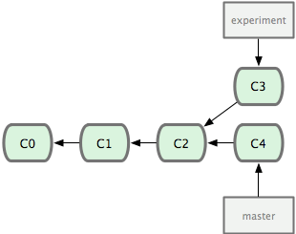
Rebasing
$git checkout experiment
$git rebase master
It takes the changes introduced in c3 and applies them on top of c4

Slide 27
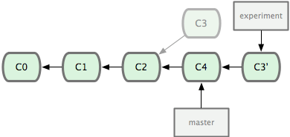
Rebasing.

Slide 28
Rebasing
$git checkout master
$git merge experiment
YAY it’s a fast forward.
More info..
http://tech.socialchorus.com/2013/06/18/Git-Squashing-Best-Practices-Tips.html

Slide 29
References
http://git-scm.com/

