Slide 1
Battle of Neighborhoods : Nature’s Platter
Coursera Capstone Project
Sowmya A

Slide 2
Introduction
Manhattan – the financial capital of New York.
Nature’s Platter – Go Organic is an established organic eatery and grocery store.
Nature’s Platter is keen on opening its franchise in Manhattan, targeting the financial firms’ employees
Explore financial firms in Manhattan, different types of eateries around them and organic eateries in the firms’ neighborhood

Slide 3
Data : Requirements & Collection
Location Data of New York and Manhattan – To visualize and explore the locations and cluster them, from https://geo.nyu.edu/catalog/nyu_2451_34572.
Venues data in Manhattan (like financial firms and eateries) – from Foursquare location provider.
Locate and visualize Manhattan on map using folium library

Slide 4
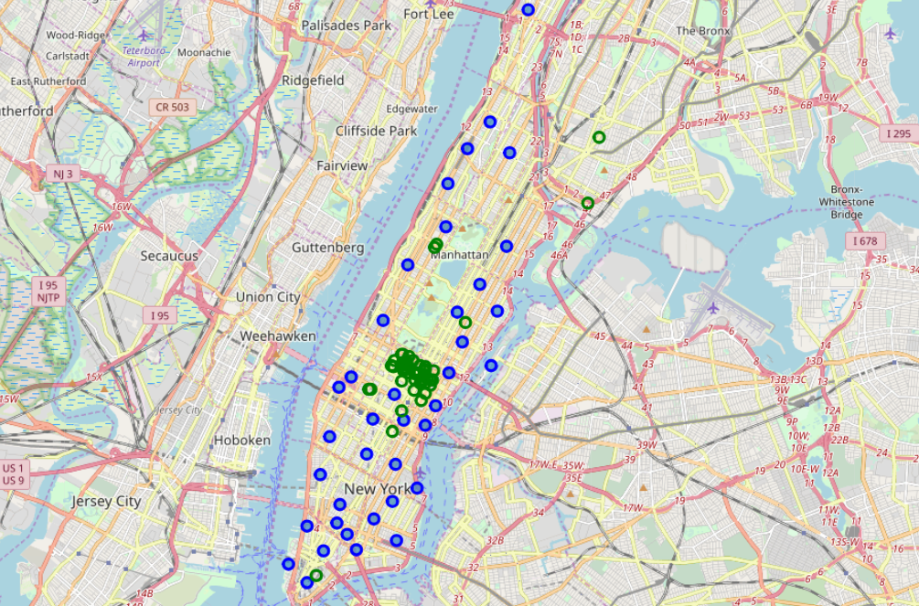
Methodology
Exploratory Data Analysis (EDA):
Extract financial firms in Manhattan within a radius of 10000m.
Visualize the financial firms and the neighborhoods in Manhattan
Blue circles depict the neighborhoods in Manhattan and green circles represent the financial firms.

Slide 5
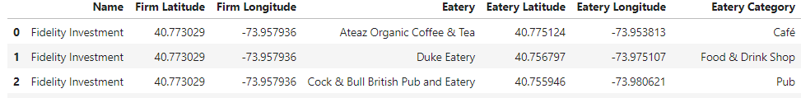
Methodology
Exploratory Data Analysis (EDA) – Explore eatery categories
Extract the different eateries around each of the financial firms, along with the name, category and geographical co-ordinates.
Around 35 unique categories of eateries are located.

Slide 6
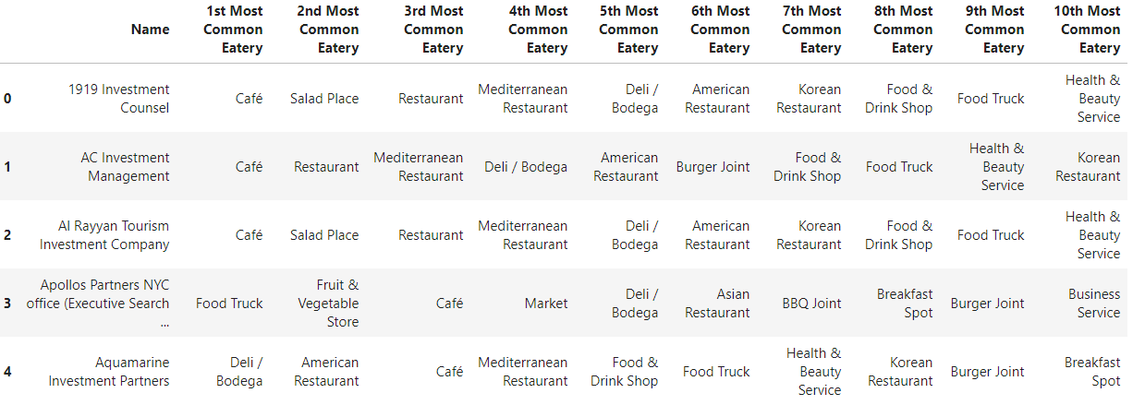
Methodology
EDA – Examine the most commonly visited eatery categories for each financial firm.
This is done by determining the frequency of occurrence of each eatery category.

Slide 7
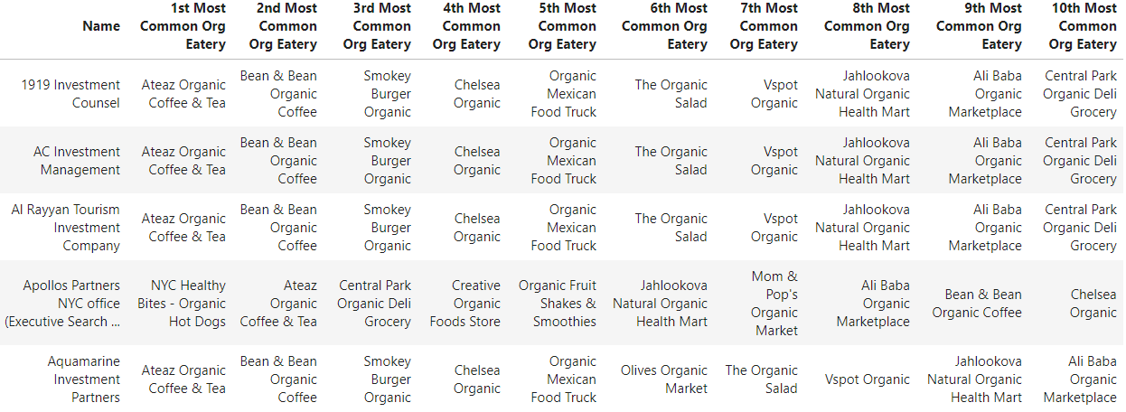
Methodology
EDA : Explore and extract the organic eateries in each firm’s neighborhood.

Slide 8
Methodology
k-Means Clustering – Financial Firms
Type of partition-based clustering of the unsupervised machine learning algorithms
Divides data into k non-overlapping subsets without any internal cluster structure.
k- means clustering is done using the k-means clustering algorithm from the scikit-learn library
Data for clustering the firms – Financial firms data with frequency of each eatery category.
Financial firms are clustered into 5 clusters/groups.

Slide 9
Methodology
Clustering the financial firms
Cluster labels are generated – 0,1,2,3,4.
Firms are clustered and structured into a data-frame along with their geographical co-ordinates, most common eatery categories and the cluster labels
Clusters are visualized on the map using folium library

Slide 10
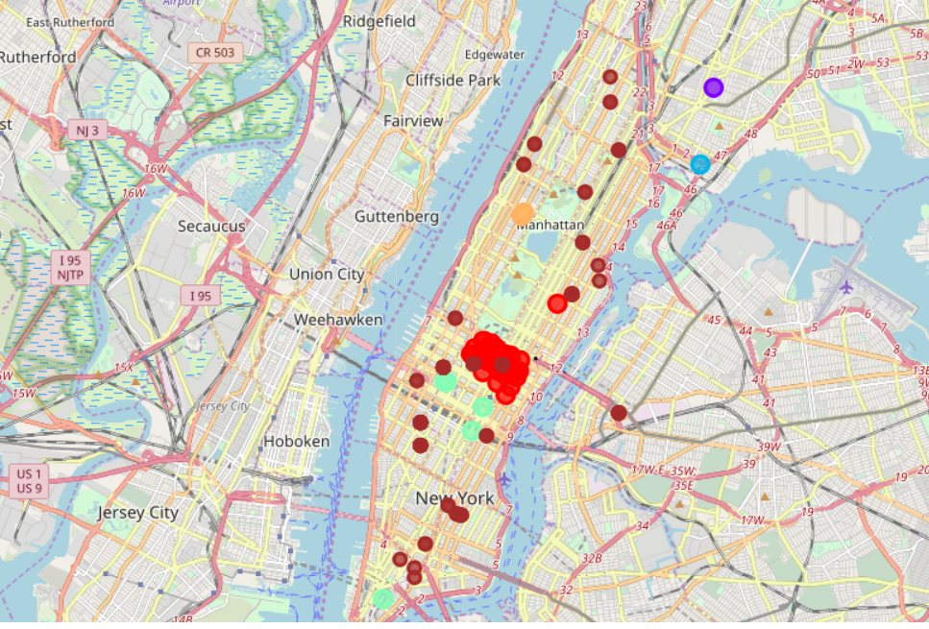
Results
Clusters are visualized on the map along with the organic eateries’ locations.
The clusters are in red, sean, light orange, light blue and purple.
Brown circles represent the organic eateries.

Slide 11
Conclusion
Surveyed the financial firms in Manhattan and explored the eateries around.
Identified the organic eateries around each firm
Investigated the most commonly visited eatery categories and organic eateries.
The study helps Nature’s Platter team to decide on whether franchise in the location is feasible, the menu and items that would attract the customers.
Assists the Nature’s Platter team in their market research and enables them in deciding their business strategy for the target location and audience.

