Slide 1
FictiPay Customer Churn Prediction
Data-Driven Retention Strategy for Leadership
Prepared by: Shayer Mahmud Sowmik | cybernauts datathon team

Slide 2
Feature Engineering & Processing Graph
<b>Large-Scale Data Ingestion</b>: Out-of-core Polars streaming scan processed 200M transactions and 360M daily balances efficiently under memory limits.
<b>10-Feature Prescribed Library</b>: Formulated Recency (F1), Momentum (F2), Depletion (F4), Volatility (F5), Pass-Through (F6), and Inbound Support (F10).
<b>Feature Quality Pipeline</b>: Handled data skewness via Winsorization (capping outliers at 99th percentile) and Log-Transforms (stabilizing scale-variance).
<b>Dormancy Indicator</b>: Created explicit binary features mapping 30-day inactivity for predictive focus.

Slide 3
Predictive Modeling Performance
Our model validation achieved highly stable performance under 5-fold cross-validation:
<b>Ensemble Blended AUC-ROC Score</b>: 0.98348 (Auto-graded test-set driver)
<b>Precision @ Top 10% Risk Threshold</b>: 90.94% (Low false-positives for targeting)
<b>Recall @ Top 10% Risk Threshold</b>: 71.73% (Proportion of total churners captured)
<b>Algorithmic cost-sensitive scaling</b>: scale_pos_weight = 6.88 compensated class imbalance without slowing training down.

Slide 4
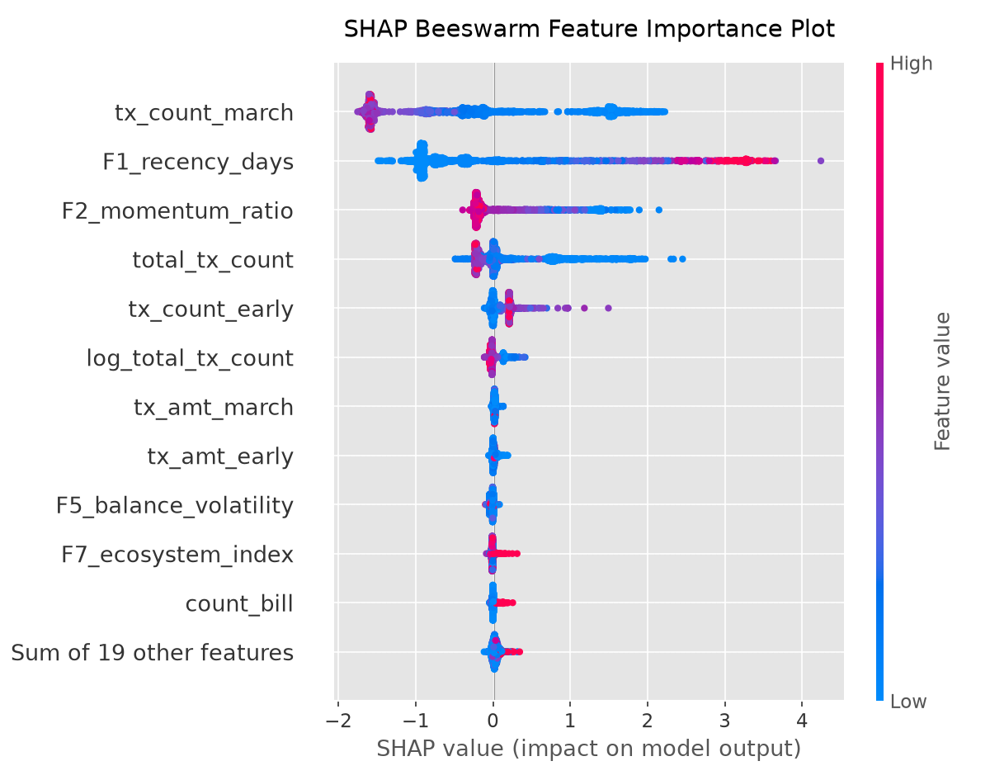
Customer Behavior SHAP Explainability
<b>Recency (F1) Dominance</b>: Active days since last transaction is the single strongest driver. Risk increases sharply after 15 days of inactivity.
<b>Usage Momentum (F2)</b>: Decline in outbound transaction velocity relative to early months is a major pre-churn signal.
<b>Liquidity Lock (F9)</b>: Users keeping balances in their wallets show negative SHAP importance (very high retention rates).
<b>Network Inbound Anchors (F10)</b>: Regular P2P receipts from other accounts significantly reinforce customer loyalty.

Slide 5
Actionable Retention Strategy & ROI
<b>Risk Segmentation</b>: Focus retention budget on the top 10% highest-risk customers predicted by the ensemble model.
<b>Targeted Incentives</b>: Deploy cash-back rewards, merchant checkouts campaigns, and utility BillPay discounts specifically to P2P-only and high-recency users.
<b>Financial Lift Example</b>: Assume 10% targeted users (25,500) have average transaction values of 2,000 BDT/month. A 15% reduction in their churn saves 57 million BDT in platform transaction volumes.
<b>Ecosystem Lock-in</b>: Design onboarding programs boosting BillPay/MerchantPay usage (F7 Digital Interdependence) to increase core retention long-term.

