Slide 1


LENDING CLUB CASE STUDY
Contributors:
Sowmily Dutta and Shounak Dutta

Slide 2
The objective of this case study is to apply Exploratory Data Analysis (EDA) techniques to a real-world problem, gain valuable insights, and present the findings in a business-focused manner through a formal presentation.
Benefits of the case study:
Provides insight into the practical application of EDA in addressing real-world business challenges.
Develops a foundational understanding of risk analytics within the banking and financial services sectors.
Demonstrates how data can be leveraged to mitigate financial losses in lending practices.
Enhances understanding of data visualization techniques and the appropriate use of charts for real-world data analysis.
Objective

Slide 3
The primary business objective is to minimize financial losses by accurately assessing loan applicants' risk profiles. Identifying default patterns allows the company to make informed decisions, such as approving loans for reliable applicants, adjusting terms for higher-risk individuals, or rejecting risky applications. This approach balances growth with risk management to ensure profitability while minimizing defaults.
After cleaning, the dataset contains information on 38,577 approved loan applicants with 37 columns. Key columns include loan_amnt, int_rate, installment, emp_length, annual_inc, home_ownership, and loan_status. Important financial metrics such as dti, delinq_2yrs, open_acc, total_pymnt, and total_rec_int are also included. Some columns have missing values.
Business Understanding

Slide 4
The Univariate Analysis provides a detailed view of individual loan attributes, including distributions of loan amounts, interest rates, monthly installments, and employment lengths. It also examines home ownership, loan purpose, loan terms, and the debt-to-income ratio, along with loan status, verification status, and loan grades.
The Segmented Bivariate analysis further explores relationships between these attributes and loan status. It investigates how credit utilization, interest rates, and loan amounts correlate with loan outcomes, including outlier detection for interest rates. The analysis also segments loan status by loan grade, annual income, loan purpose, loan terms, verification status, debt-to-income ratios, home ownership, and bankruptcy records. This comprehensive approach uncovers patterns and correlations that influence loan outcomes, enhancing risk assessment and decision-making.
Segmented Univariate and Bivariate Analysis

Slide 5
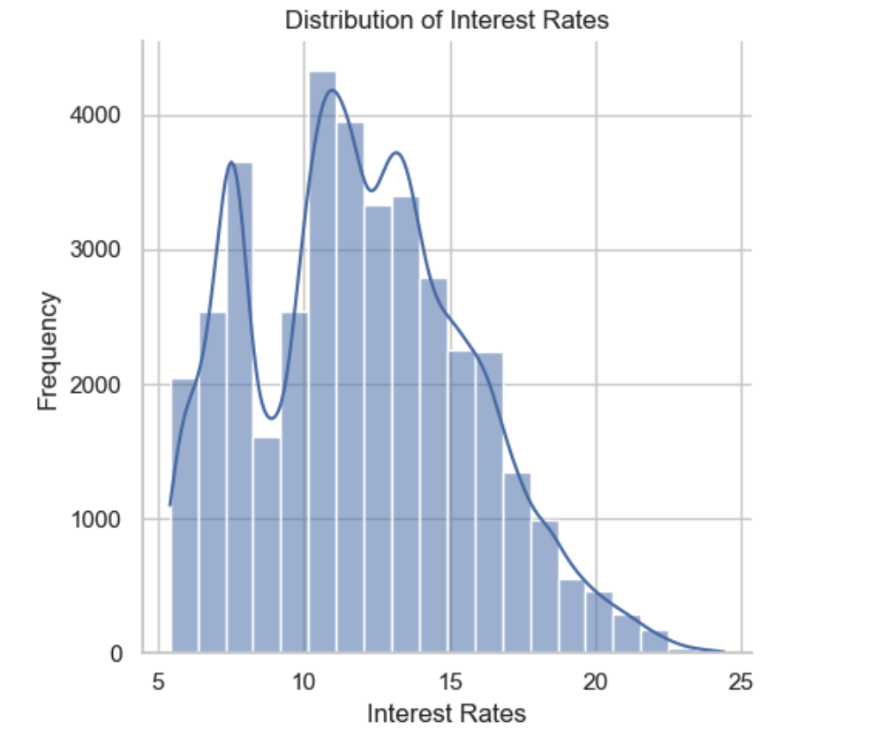
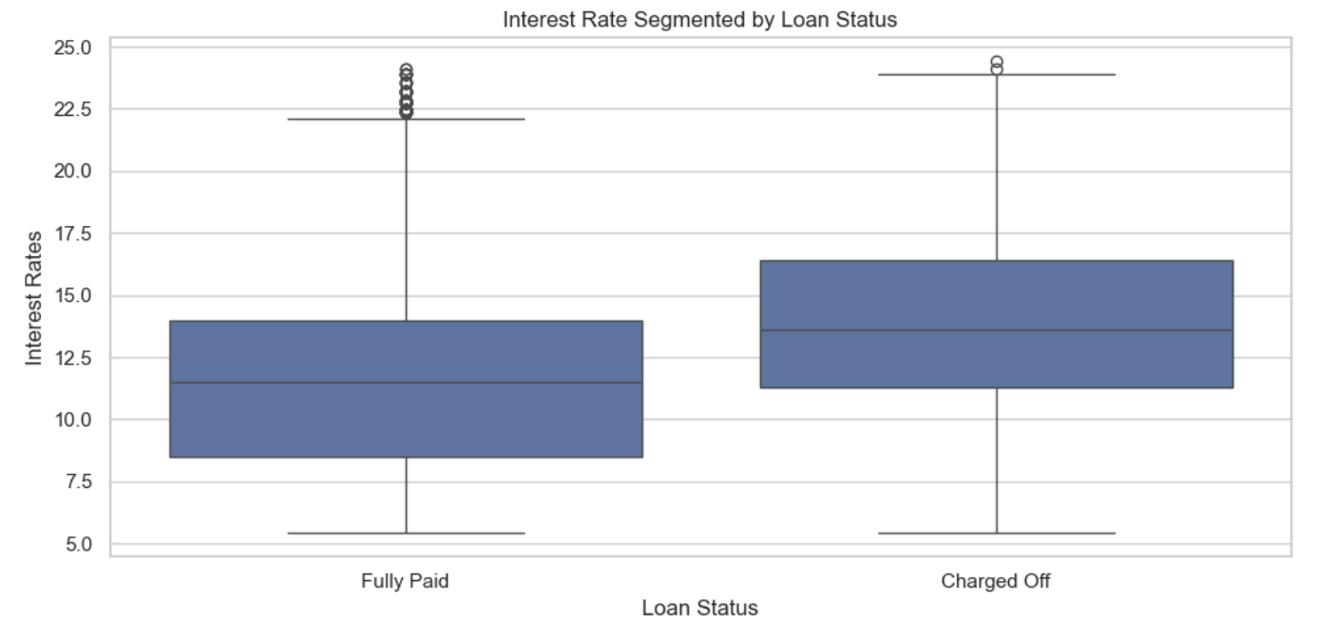
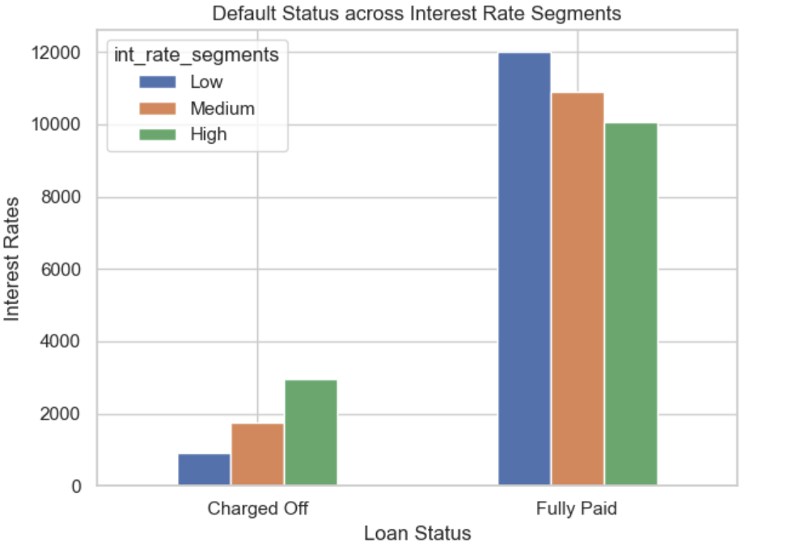
.
Interest Rate Analysis and Segmentation
Fig 1.
Fig 2.
Fig 3.
Fig 1. The Interest Rate Distribution Graph shows a rightward skew, with most loans having lower interest rates. There's a peak around 10-12%, indicating that this is a common interest rate range..
Fig 2. The Interest Rate Distribution Graph shows a rightward skew, with most loans having lower interest rates. There's a peak around 10-12%, indicating that this is a common interest rate range.
Fig 3. The Default Status across Interest Rate Segments Graph shows a significant increase in charged-off loans as interest rates rise, indicating a strong correlation between higher rates and default risk. While most loans with low interest rates are fully paid, a notable portion still default, emphasizing the role of other factors in loan outcomes.

Slide 6
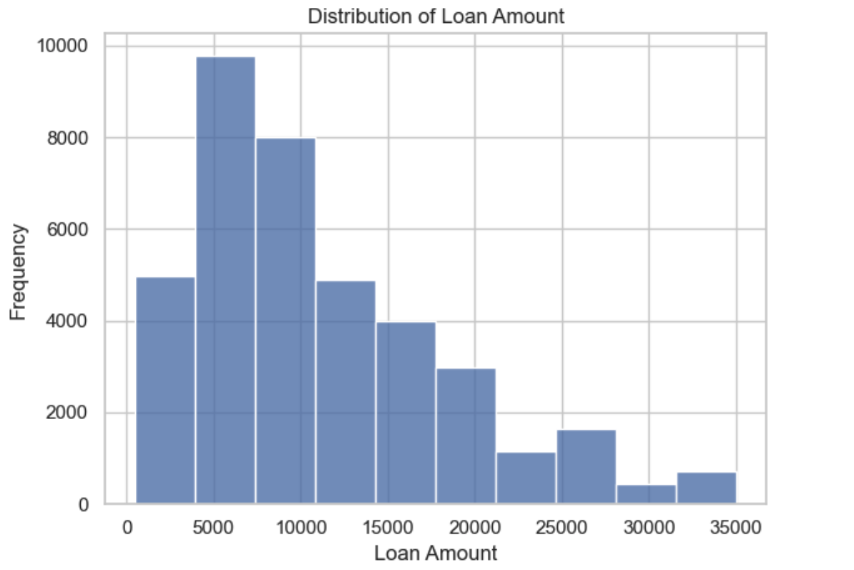
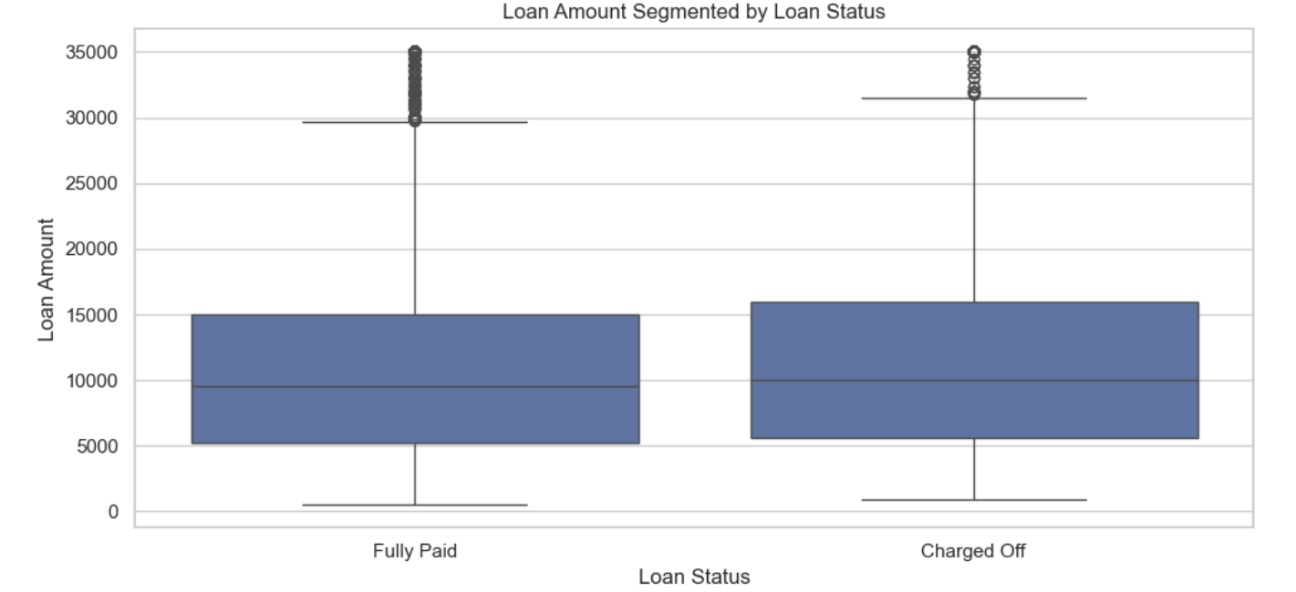
.
Loan Amount Analysis and Segmentation
Fig 4.
Fig 5.
Fig 4. The Loan Amount Distribution Graph shows that most loans are clustered between $5,000 and $15,000. There's a noticeable rightward skew, suggesting fewer loans are for much higher amounts.
Fig 5. The Loan Amount Segmented by Loan Status Graph shows that the median loan amount for fully paid loans is slightly lower than for charged-off loans, suggesting a link between larger loan amounts and higher default risk. Charged-off loans also exhibit greater variability in loan amounts.

Slide 7
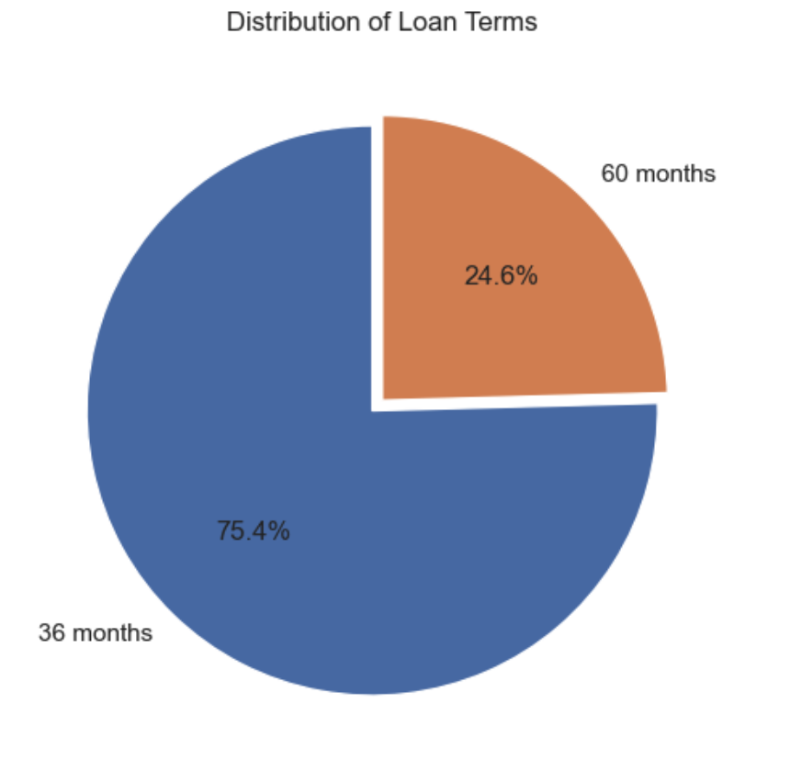
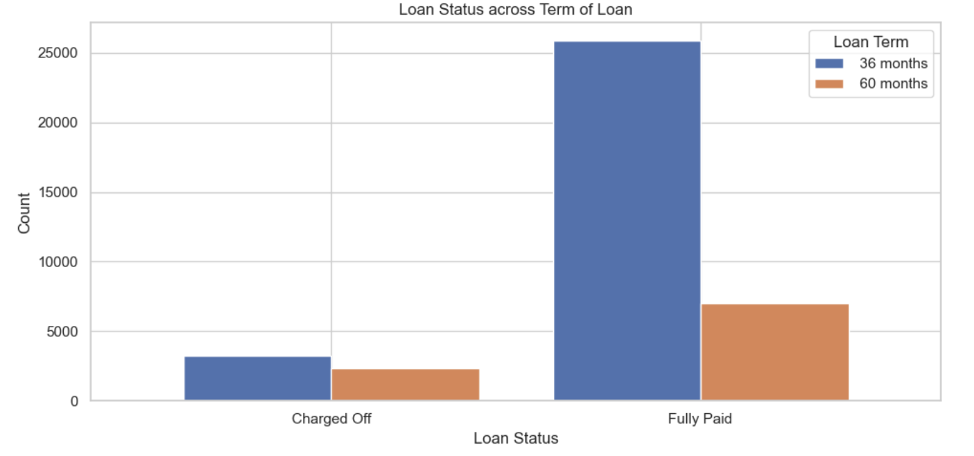
.
Loan Term Analysis and Segmentation
Fig 6.
Fig 7.
Fig 6. The Loan Term Distribution Graph shows that 75.4% of loans have a 36-month term, while 24.6% have a 60-month term.
Fig 7. The Loan Status across Term of Loan Graph shows that loan term impacts default risk. Loans with a 60-month term have a significantly lower rate of charge-offs compared to those with a 36-month term.

Slide 8
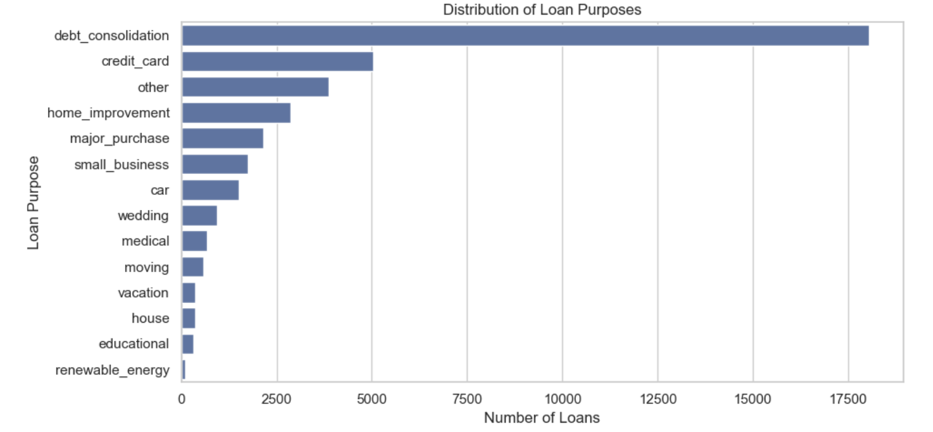
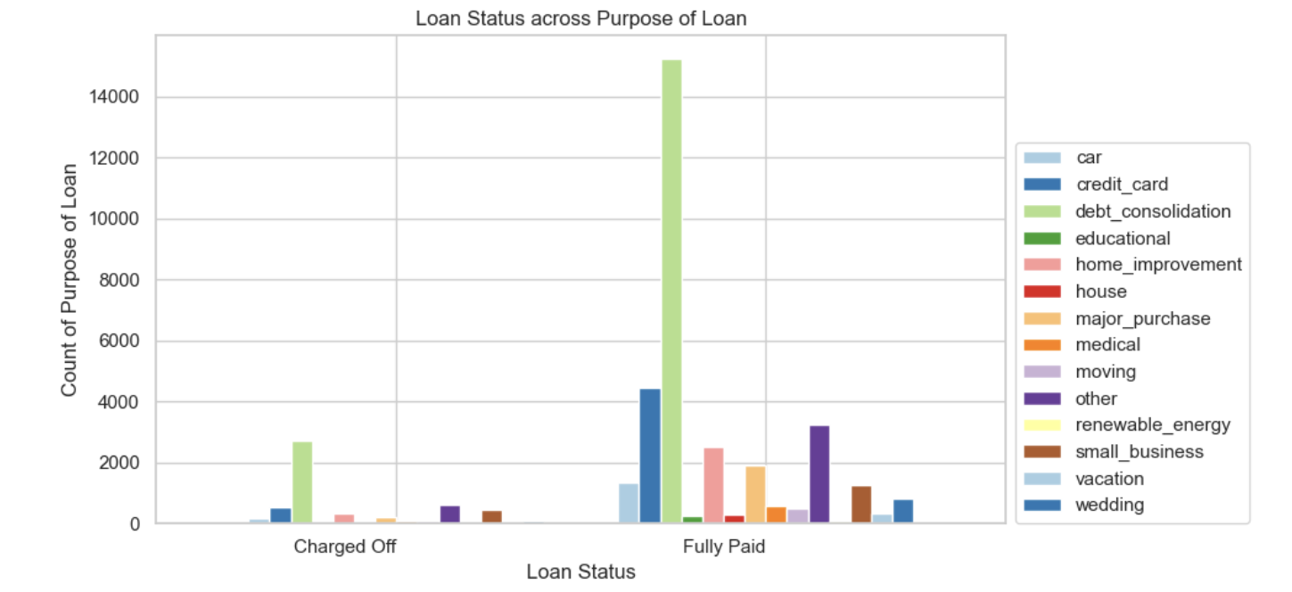
.
Loan Purpose Analysis and Segmentation
Fig 8.
Fig 9.
Fig 8. The Loan Purpose Distribution Graph shows that debt consolidation is the most common reason for loans, followed by credit card and other purposes. Home improvement, major purchases, and small businesses are also notable categories. Less frequent but still represented purposes include weddings, medical expenses, moving, vacation, house, education, and renewable energy.
Fig 9. The Loan Status across Purpose of Loan Graph shows that the purpose of the loan affects default risk. Debt consolidation, home improvement, and major purchases have the highest charge-off rates, while medical and education loans have the lowest. Although most loans are fully paid, categories like debt consolidation consistently show a higher proportion of charge-offs, highlighting the risk tied to these purposes.

Slide 9
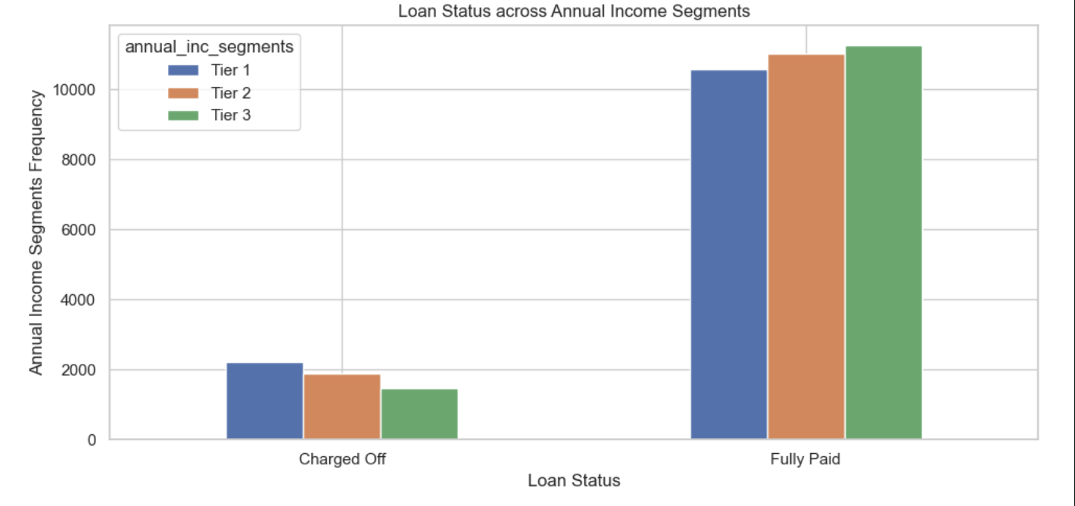
.
Income Analysis and Segmentation
Fig 10.
Fig 10. The Loan Status across Annual Income Segments Graph shows that charged-off loans decrease as annual income increases, suggesting that borrowers in Income Tier 3 are less likely to default than those in Tier 1 and Tier 2.

Slide 10
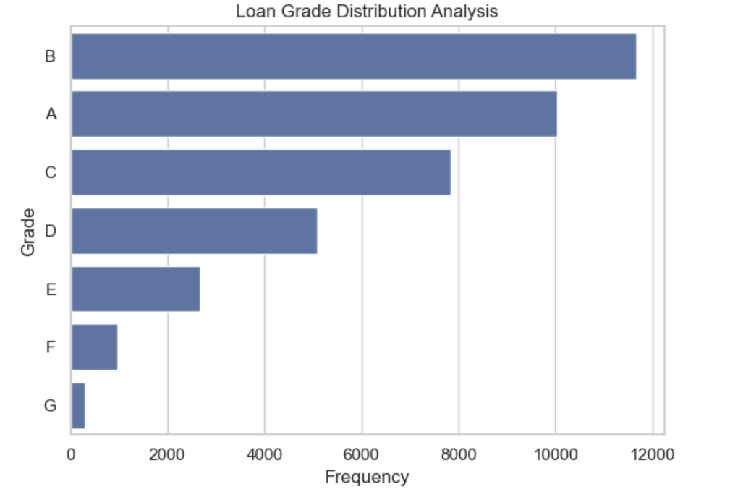
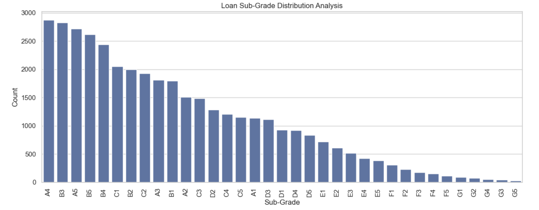
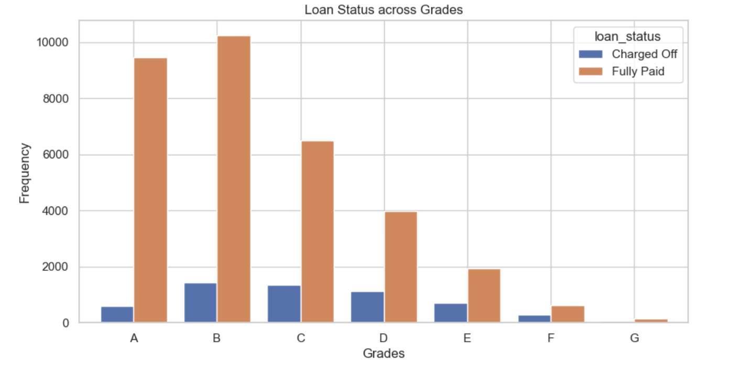
.
Grade Analysis and Segmentation
Fig 11.
Fig 12.
Fig 13.
Fig 11. The Loan Grade Distribution Graph shows that Grade B loans are the most common, followed by Grade A loans. The frequency of loans decreases from Grade D to G, likely due to the higher risk associated with lower grades.
Fig 12. The Loan Sub-Grade Distribution Graph is right-skewed, with more loans in the higher sub-grades (A1-A5). A1 is the most frequent sub-grade, followed by A2 and A3, emphasizing the concentration in higher sub-grades. The number of loans decreases steadily from A1 to G5.
Fig 13. The Loan Status across Grades Graph shows that while most loans in higher grades (A-B) are fully paid, a noticeable portion still default, suggesting that factors beyond loan grade affect loan outcomes.

Slide 11
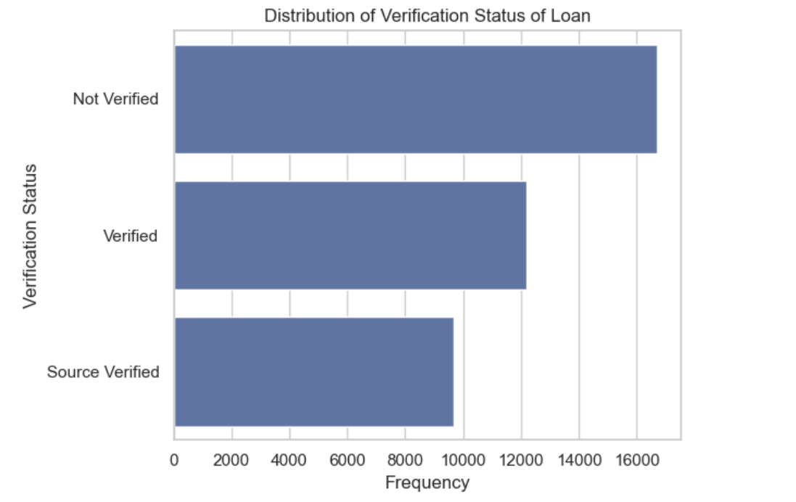
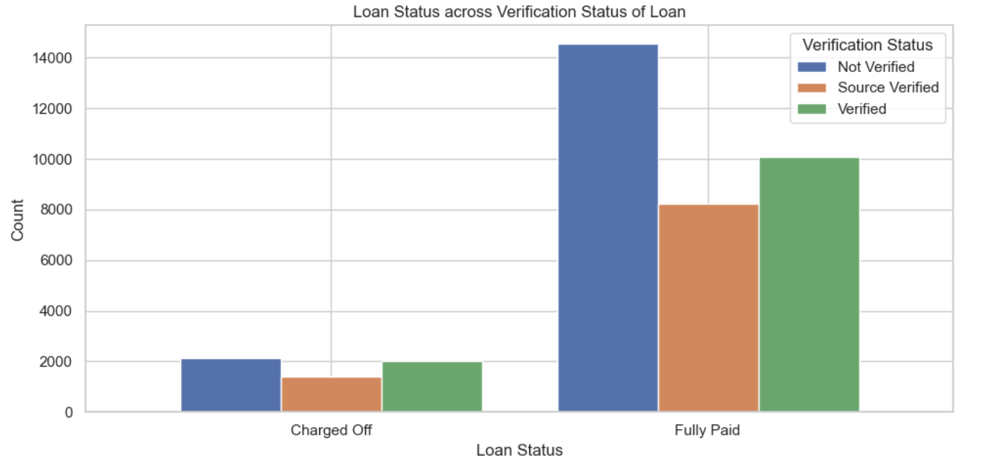
.
Verification Status Analysis and Segmentation
Fig 14.
Fig 15.
Fig 14. The Verification Status Distribution Graph shows that most loans were not verified, followed by verified loans. Source verified loans represent a much smaller portion.
Fig 15. The Loan Status across Verification Status of Loan Graph shows that verification status significantly impacts default rates. Loans with no verification have the highest default rate, followed by verified loans, with source verified loans having the lowest. While most loans in all categories are fully paid, the difference in default rates underscores the importance of verification in assessing loan risk.

Slide 12
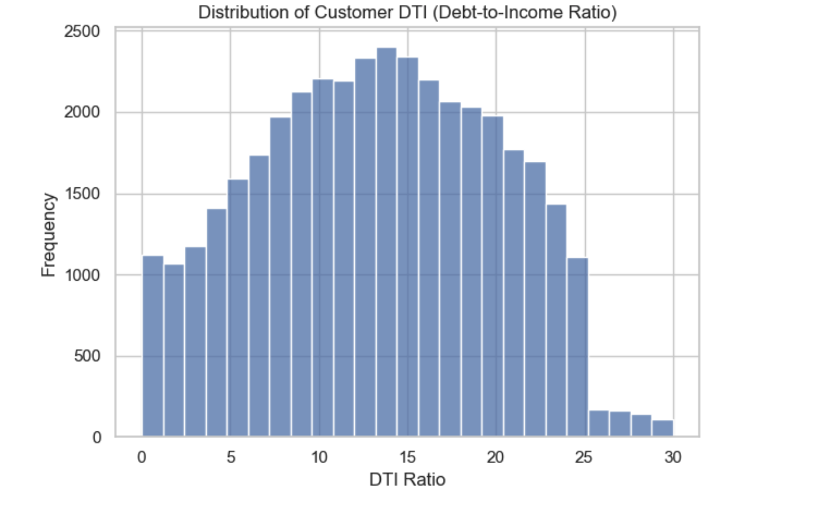
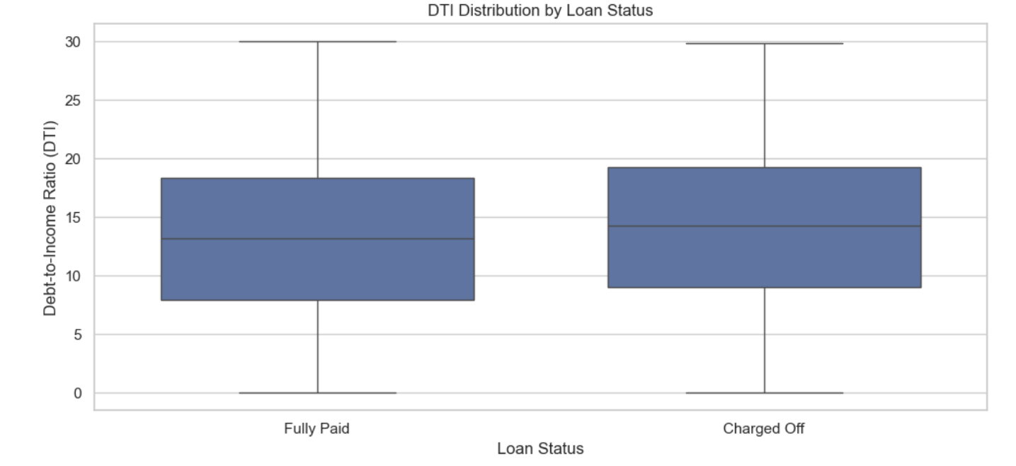
.
Debt-to-Income (DTI) Analysis and Segmentation
Fig 16.
Fig 17.
Fig 16. The Customer DTI Ratio Distribution Graph is right-skewed, indicating that most borrowers have lower DTI ratios. There is a peak around the 10-15 range, suggesting this is the most common DTI ratio among borrowers.
Fig 17. The DTI Distribution by Loan Status Graph shows that the median DTI ratio for fully paid loans is slightly lower than for charged-off loans, suggesting a link between higher DTI ratios and increased default risk. Charged-off loans also exhibit greater variability in DTI ratios compared to fully paid loans..

Slide 13
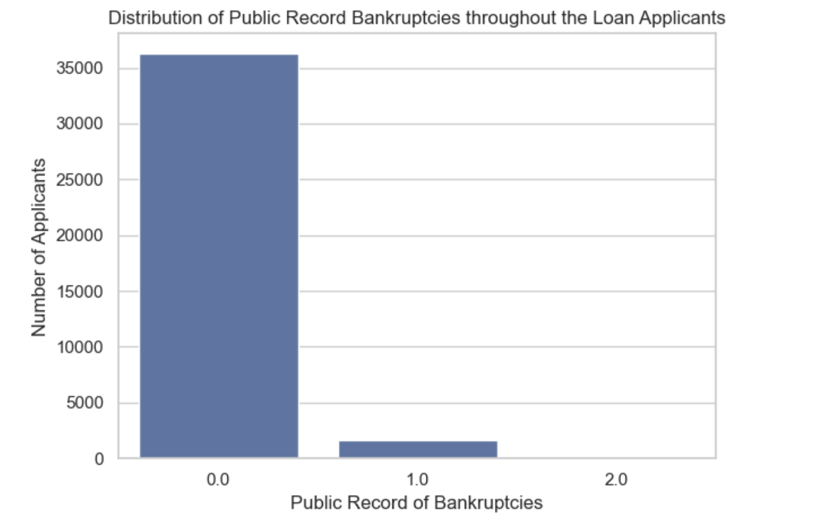
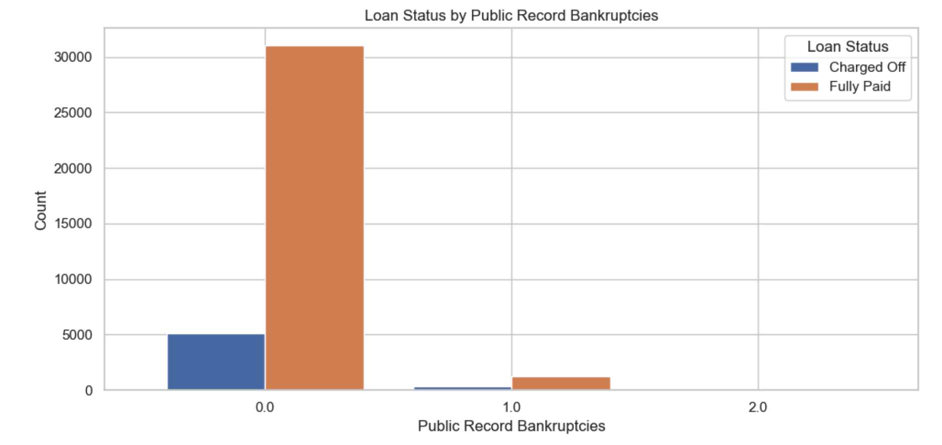
.
Public Record Bankruptcies Analysis and Segmentation
Fig 18.
Fig 19.
Fig 18. The Public Record Bankruptcies Distribution Graph shows that most loan applicants have no public record bankruptcies, with only a small number having one or two. Bankruptcies are relatively rare among the applicants in this dataset..
Fig 19. The Loan Status by Public Record Bankruptcies Graph shows that borrowers with a higher number of public record bankruptcies have a lower rate of charge-offs. This suggests that factors such as credit recovery or rehabilitation efforts might be influencing outcomes for borrowers with bankruptcies.

Slide 14
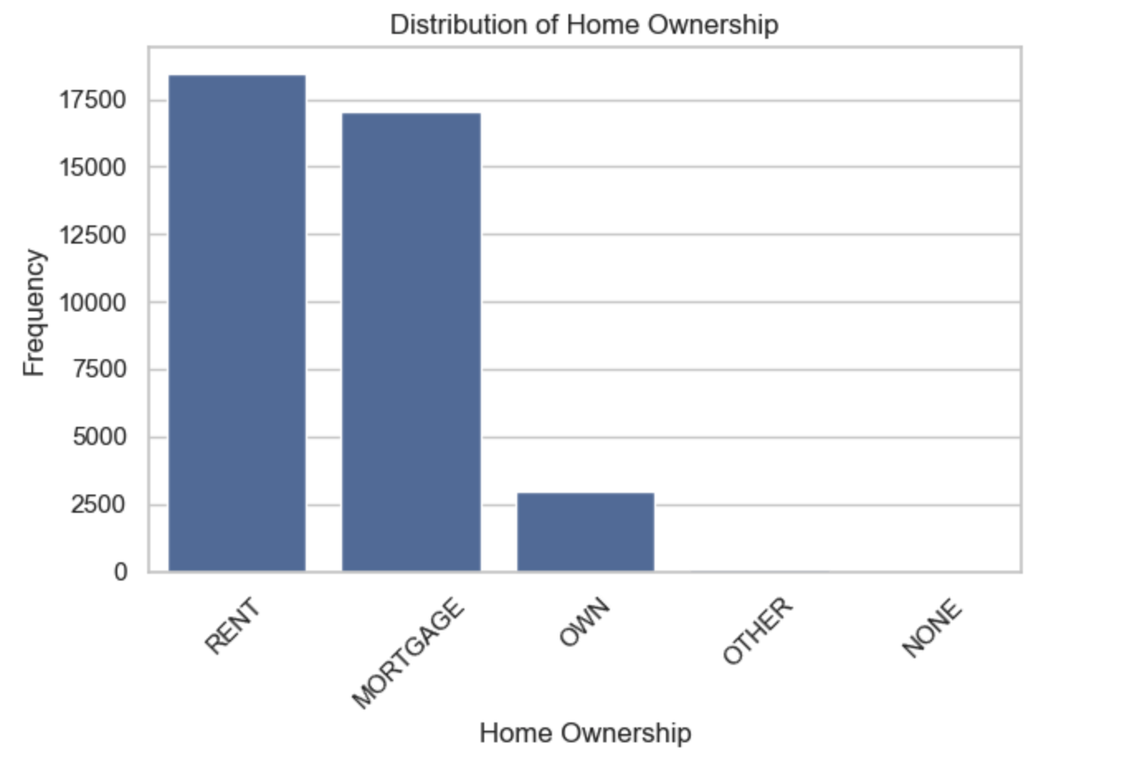
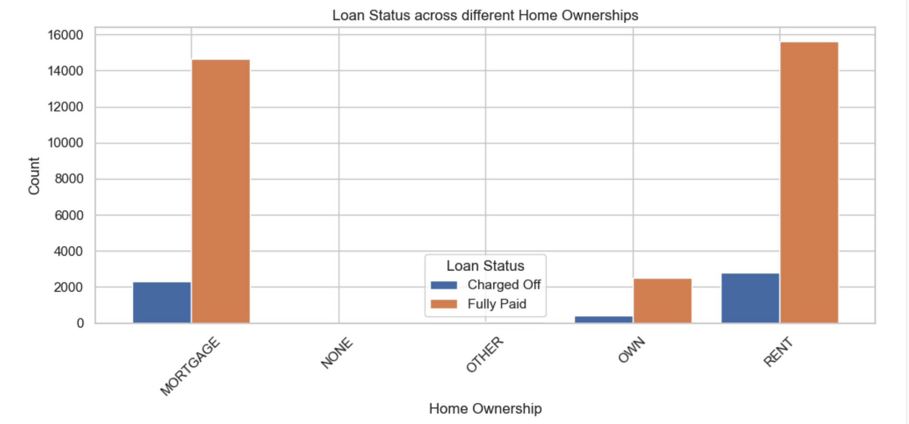
.
Home Ownership Analysis and Segmentation
Fig 20.
Fig 21.
Fig 20. The Home Ownership Distribution Graph shows that most borrowers are renters, followed by those with a mortgage. Fewer borrowers own their homes outright, and even fewer have other or no home ownership status.
Fig 21. The Loan Status across Different Home Ownership Graph shows that home ownership affects default rates. Borrowers who own their home have the lowest default rate, followed by those with a mortgage, while renters have significantly higher default rates.

Slide 15
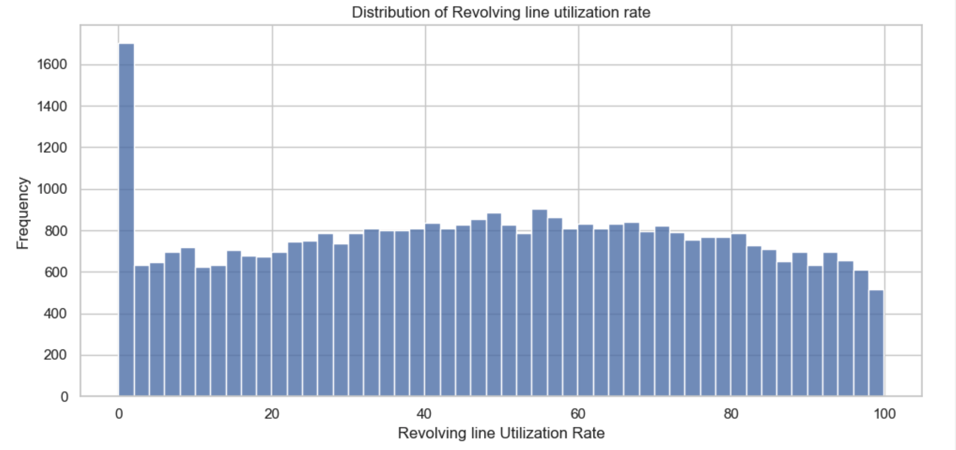
.
Revol Utilisation Analysis and Segmentation
Fig 22.
Fig 22. The Revolving Line Utilization Rate Distribution Graph shows that most customers have a utilization rate of 0, indicating low credit line usage. The distribution is right-skewed, with a longer tail on higher utilization rates, suggesting that only a small proportion of customers have very high credit line usage.

Slide 16
The multivariate analysis examines the interactions among multiple loan attributes, such as loan amount, interest rates, credit utilization, and annual income. This analysis reveals complex patterns and correlations that single-variable assessments may miss, providing a nuanced understanding of how these factors collectively influence loan outcomes. It enhances risk profiling and informs more precise decision-making strategies.
Multi-Variate Analysis

Slide 17
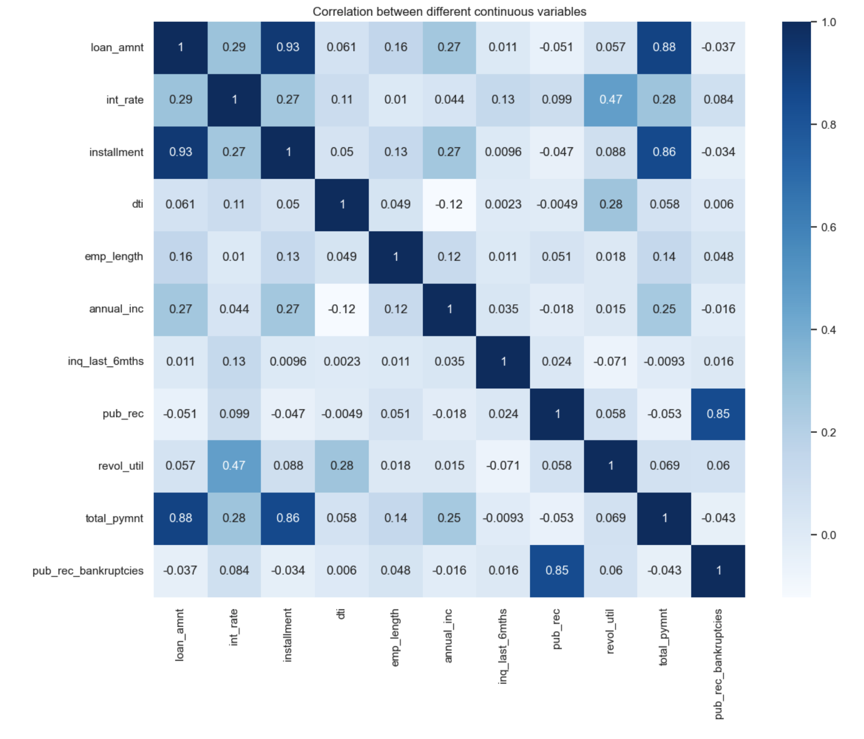
.
HeatMap Correlation for different continuous variable
Fig 23.
Fig 23. The Correlation between Different Continuous Variables Graph highlights that larger loans lead to higher installments and total payments. Higher incomes are associated with larger loans, while higher interest rates increase installment amounts. Employment length has minimal impact on other financial variables. Higher income generally reduces the debt-to-income ratio. Additionally, higher revolving credit utilization tends to correlate with higher interest rates, and more public records are linked to a higher likelihood of bankruptcies.

Slide 18
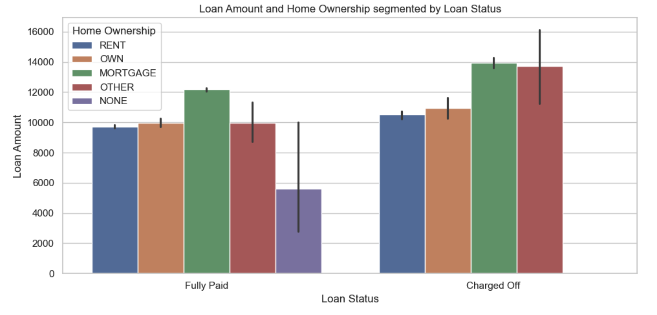
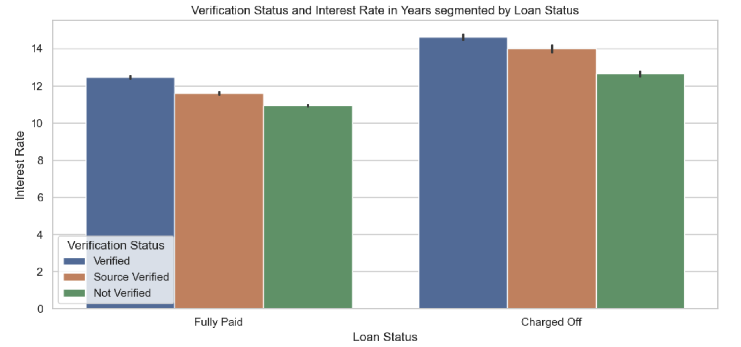
.
Multivariate Analysis
Fig 24.
Fig 25.
Fig 24. The Loan Amount and Home Ownership Graph indicates that borrowers with higher loan amounts and stable homeownership statuses (e.g., 'MORTGAGE', 'OWN') are more likely to fully repay their loans. Those with 'RENT' or 'NONE' are more prone to default. Loan amounts are generally higher for borrowers with a 'MORTGAGE' compared to those with 'RENT' or 'NONE'.
Fig 25. The Verification Status and Interest Rate Graph reveals that 'Verified' borrowers have slightly higher interest rates than 'Source Verified' or 'Not Verified' borrowers. 'Not Verified' borrowers have the highest rates, suggesting a link between verification status and default risk.

Slide 19
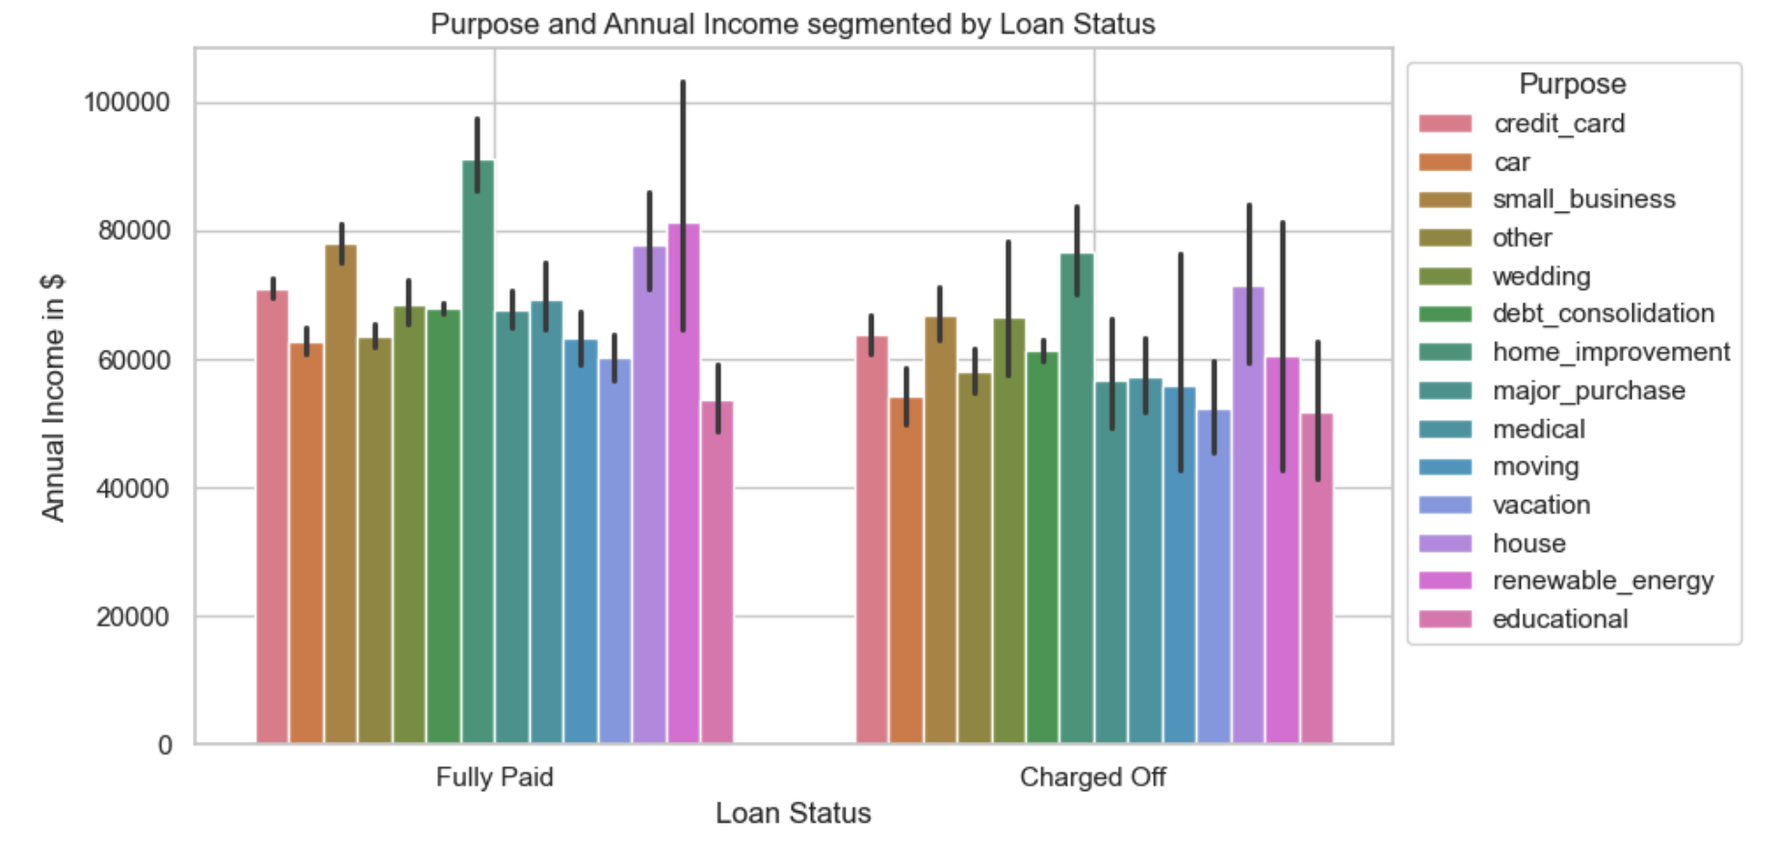
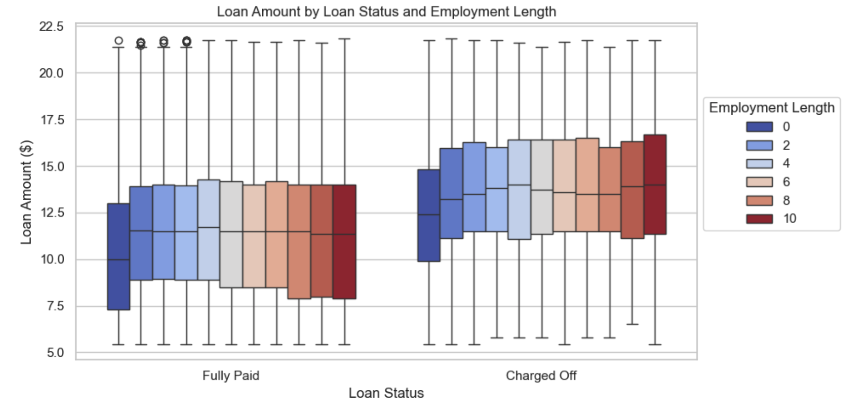
.
Multivariate Analysis
Fig 26.
Fig 27.
Fig 26. The Purpose and Annual Income Graph shows that loans for 'credit_card' and 'car' have higher repayment rates, while 'small_business' and 'debt_consolidation' loans have lower rates. Higher annual income improves repayment rates, especially for 'home_improvement' and 'house' loans. Fully paid loans more commonly include 'credit_card' and 'car', while charged-off loans more often involve 'small_business' and 'debt_consolidation'.
Fig 27. The Loan Amount by Loan Status and Employment Length Graph shows that borrowers with longer employment tend to have higher loan amounts and are more likely to fully repay their loans. Fully paid loans exhibit a wider range of amounts compared to charged-off loans, indicating that longer employment is linked to both higher loan amounts and better repayment rates.

Slide 20
Key Correlations:
Loan Amount and Installment: Larger loans lead to higher monthly payments.
Total Payment and Loan Amount: Bigger loans result in higher total payment obligations.
Annual Income and Loan Amount: Higher incomes are associated with larger loans.
Interest Rate and Installment: Higher interest rates increase installment amounts.
Debt-to-Income Ratio and Annual Income: Higher incomes generally mean lower debt-to-income ratios.
Revolving Utilization and Interest Rate: Higher credit utilization correlates with higher interest rates.
Public Records and Bankruptcies: More public records are linked to a higher likelihood of bankruptcy.
Loan Defaults:
Home Ownership: Renters and those without homeownership default more often than homeowners.
Loan Purpose: High-risk loans, like 'small_business' and 'debt_consolidation', have higher default rates.
Annual Income: Lower-income borrowers are more prone to default.
Verification Status: Loans to 'Not Verified' borrowers show higher default rates.
Employment Length: Shorter employment tenures are linked to a higher risk of default.
.
Key Correlation

Slide 21
Recommendations to Mitigate Charge-offs:
Enhance Credit Scoring Models: Include factors like revolving utilization, public records, and debt-to-income ratios for better risk assessment and credit scoring.
Tailor Loan Terms: Provide favorable terms, such as lower interest rates and shorter repayment periods, to low-risk borrowers to encourage timely repayment and reduce risk.
Strengthen Underwriting Criteria: Set stricter approval standards for high-risk loan purposes, particularly 'small_business' and 'debt_consolidation', to address elevated default rates.
Provide Financial Literacy Programs: Offer financial education to help borrowers manage debt responsibly and reduce defaults.
Expand Debt Counseling Services: Provide personalized debt counseling to at-risk borrowers to help manage debt and avoid defaults.
Implement Proactive Risk Management: Use early intervention systems to detect early signs of financial distress and take corrective actions to prevent defaults.
Promote Homeownership: Encourage homeownership to improve financial stability and lower the risk of loan defaults.
Bolster Verification Processes: Strengthen verification of borrower information to reduce the risk of credit being extended to fraudulent or misrepresented applicants.
These strategies aim to improve risk management and borrower profiling, reducing the potential for charge-offs and defaults.
.
Recommendations to Mitigate Charge-offs

