Slide 1

Towards
TCS UAP PROJECT
Technology
Robotic Process Automation
Title
Parcel Monkey
Group_E
K. Sowmith, D. Srinivasulu, T. Sai Kumar, J. Tejeswar, V. Ramya, K. Haritha.
Notes:
Good evening,
My name is Sai kumar, Our Project is Towards TCS UAP project and the technology used is Robotics Process Automation abbreviated as RPA, and the Title of our project is Parcel Monkey.
We are Group_E, a team of 6.

Slide 2

Contents:
Introduction
Detailed Use Case
Process Design Document
Solution Design Document
Detailed Bot Flow
Exceptions
Test Cases
Notes:
The presentation is divided into seven pieces, we will introduce the context of the project,
then detail the use case,
we will present out process design document and solution design document briefly,
go through the bot flow in detail
finally we will present exceptions and testcases.

Slide 3
Introduction:
Robotic Process Automation is the technology that allows anyone today to configure computer software, or a “robot” to emulate and integrate the actions of a human interacting within digital systems to execute a business process.
Bot Reads the data from the Input Excel file i.e. Source and Destination of the package, submits them in the Parcel Monkey website and fetches the details about the quote, updates them in the Input Excel file under the column name status.
Notes:
The idea of RPA is to emulate human actions and do them on a scale. Bots are substantially better than humans at repetitive tasks, Web scrapping is one such repetitive task and is an integral part of business work flows that require the management of large amounts of external data.
----------------------------------------------------------------------------------------------------------------------------------------------------
In a sentence what our project does is To collect data from a website according to defined business rules and do it on a schedule is the context of our project.

Slide 4
Use Case:
To extract the Highest rated shipping service name for a package based on its source, destination and weight among the services provided by parcel monkey.
Collect Required details of the package from Input excel file and submit them in the Parcel Monkey website.
Order the quotes based on the Highest rating and extract the highest rated shipping service name.
Continuation of the task from the last incomplete record.
Send an email with output as an attachment.
Notes:
The Use case provided is:
Bot is expected to read information from an excel sheet and based on the business rules collect data from the parcel monkey website.
The Business Rules Mentioned are:
1)Reading the source and destination of the package along with the weight of it.
2)Filter the rating with highest first.
3)Extract delivery service name and insert into data base.
4)The bot has to start from the record whose status isn’t updated.
5)After the completion bot has to send an email with output file as attachment.

Slide 5
Process Design Document:
Serves as a Base document for developer to apply RPA to the Use Case.
PDD details the following
Objectives & Prerequisites
Process Description(Manual & Automated)
Applications & Inputs used
Scope for RPA
Error & Exception Handling
Notes:
The Process Design Document abbreviated as PDD, outlines the business process chosen for automation using RPA technology.
This document describes the sequence of steps performed as part of the business process,
the conditions and rules of the process prior to automation and how they are expected to work after automating it, partly or entirely.
PDD serves as a base for developers, providing them the details required for applying robotic automation to the selected business process.
Our PDD mainly details the following:
Objectives & Prerequisites
Description(Manual & Automated)
Applications & Inputs used
Scope for RPA
Error & Exception Handling

Slide 6
Process Design Document:
Scope: The use case in total can be automated i.e. the whole use case is in the scope of RPA.
Applications Used: Two windows applications are used viz Internet Explorer and Microsoft Excel.
Input: The Input excel sheet containing parcel details is a required Input.
Notes:
Haritha
The whole business use case can be automated rom end to end.

Slide 7
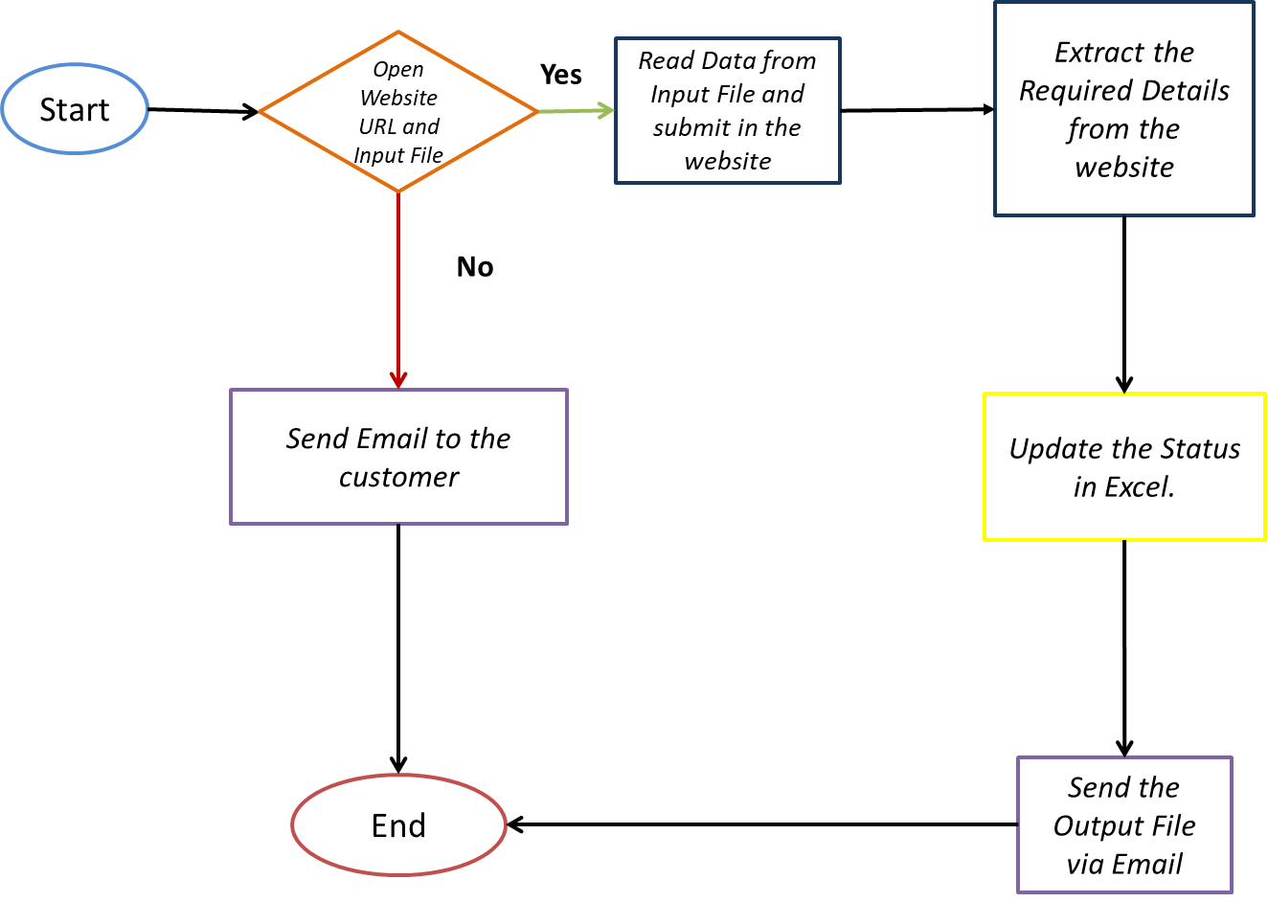
Process Design Document:
As Is/Manual process flow
Notes:
Haritha
Process Design Document:
The process design document depicts the basic flow of processing a record,
Open website URL and input file,
If there is a problem in opening either website or file, send an email to customer regarding the same.
Read required data from input file i.e. Source destination and weight of the package and submit them in the website.
Extract the required details from the website and update them as status in the excel sheet.
After the completion of all the entries send an email with output as attachment to the customer.
And end the process.

Slide 8
Solution Design Document:
A Solution Design Document (SDD) includes information about the working elements of the overall solution including,
Detailed description & diagram of Solution
Alerts
Configuration Parameters
Logging and type
Assumptions:
Presence of required folder structure.
Notes:
Srinivas

Slide 9
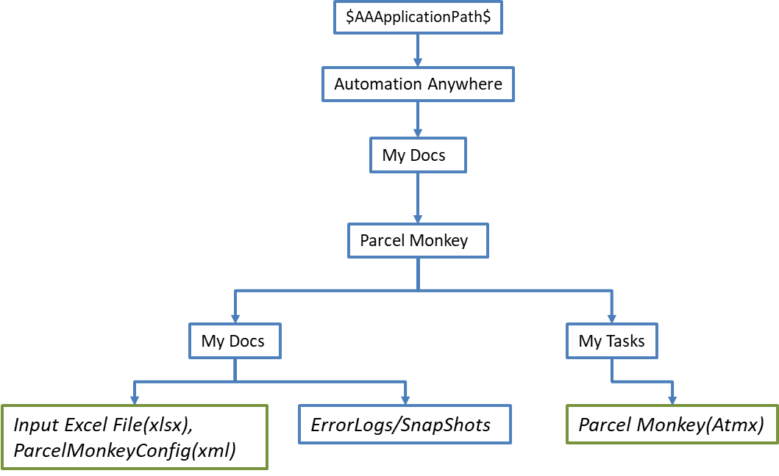
Solution Design Document:
Configuring Bot:
A Xml file is used for configuration, TO and FROM Email Id’s, Input excel file path can be configured.
Folder Structure Excepted: The following folder structure is necessary for execution of bot, Input excel path can be configured using XML config file, remaining folder structure is critical for bot functioning.
Notes:
Srinivas
To configure the bot to a new system, Configuration xml file can be used to make the bot dynamic i.e to work in a new system, config file allows us to access and change the email details and the input file location.
A folder structure is required and is critical for the functioning of the bot.

Slide 10
Solution Design Document:
Error and process logging: A csv file with current date as title is used for logging, and Error snapshots are stored.
Log File: This file is created at the first run of every day and all the logs of that particular day are stored in that file, The title of log file is DD-MM-YYYY i.e. current date.
Example:’23-07-2020.csv’
Logs are made for errors occurred and every major step in processing a record is logged along with time stamp.
Snap Shot: Snap shot of the error screen is logged in the snapshots folder with title being DD-MM-YYYY-HH-MM-SS.
Example:’23-07-2020-12-13-45.jpg’
Notes:
Ramya
What are you logging?
When is the log file created?
Process logs

Slide 11
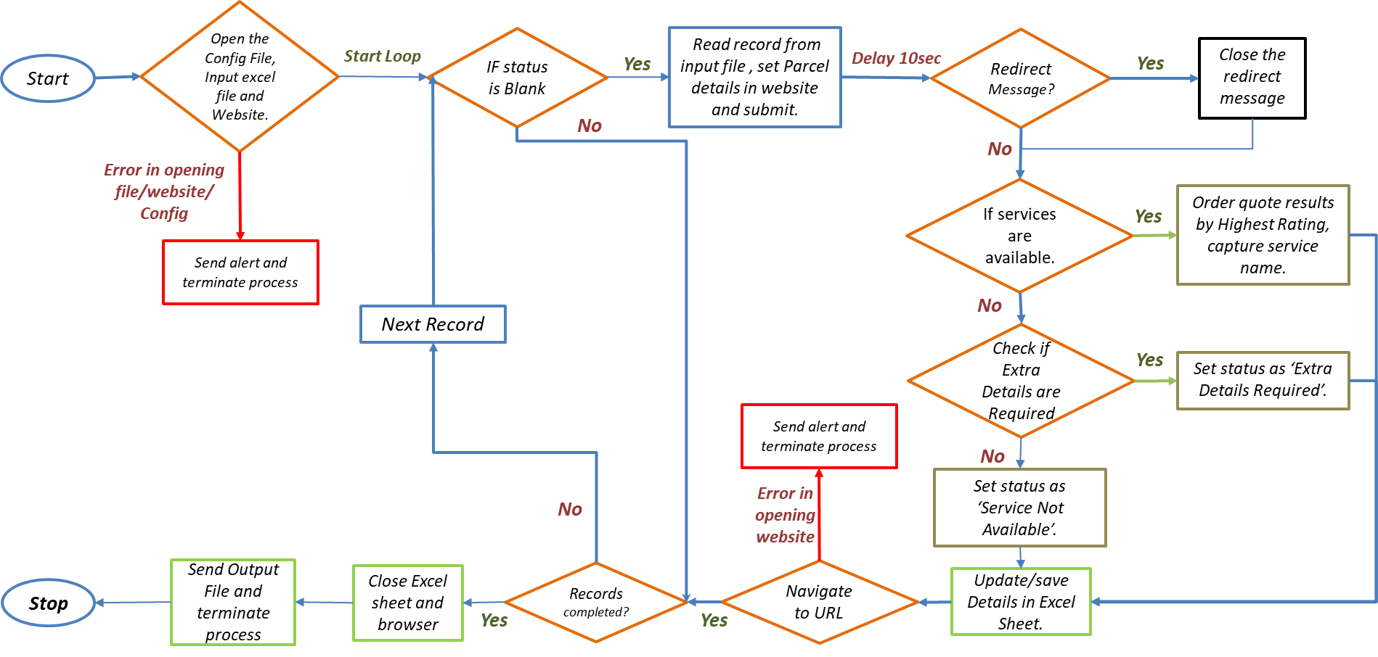
Detailed Bot Flow:

Slide 12
Exceptions:
System Exceptions:
File availability: In case of absence of required files i.e. Configuration XML file or Input Excel File, the same is logged and process will be terminated.
Internet is bad: In case of unstable/slow Internet if webpage doesn’t load properly leading to various errors, the same will be logged ,taken snapshot and the process will be terminated.
Not responding: In case of an required application not responding, the same will be logged and process will be terminated.
Business Exceptions:
Service Not Available: In case of absence of service for given parcel details the status will be updated as ‘Service Not Available’.
Extra Details Required: In case for a parcel, Extra details are required to generate quotes, status will be logged as ‘Extra Details Required’.
Invalid Weight: In case of an Invalid weight for a parcel i.e. weight is zero or negative, status will be logged as ‘Weight is Zero’.

Slide 13
Test Cases:
Test# | Test Condition | Steps to Execute | Status
1 | If the Config file is Missing. | Bot has to check for the config file available or not. If not Bot Should log the same and stop the task. | SUCCESS
2 | If Bot throws an Unexpected Exception | Bot Should log the same and stop the task. | SUCCESS
3 | If the Required Input File is Missing. | Bot has to check for the existence of required file in the location acquired from the config file and if doesn't exist, then it should the log the same and stop the task. | SUCCESS
4 | If Parcel Monkey Website doesn't launch as expected. | The bot will use Error Handling and log the error and stop the task. | SUCCESS
5 | If Weight of the Package is Zero | Bot has to check for the existence of related element in the Website, If it does, It has to set the status to "Weight is Zero". | SUCCESS
6 | If Extra Details are required to present the quote results. | Bot has to check for the existence of related element in the Website, If it does, It has to set the status to "Extra details are Required". | SUCCESS
7 | The bot should start at the entry whose status is not updated. | Bot should check for the presence of status, if present should skip the processing of the Record. | SUCCESS
8 | If The service is Not Available, the bot should update the same in the Input Excel file. | Bot has to check for the existence of related element in the Website, If it does, It has to set the status to "Service is not available". | SUCCESS
9 | If there is a Prompt after the redirecting to the international site. | The bot has identify the element, close it and continue. | SUCCESS
10 | If the Internet Explorer window, during the reload take too long to respond. | The bot has to save the excel sheet, close browser and log the same & send email to the customer. | SUCCESS
Notes:
ramya

Slide 14
Thank you

