Slide 1

FLIGHT DELAY PREDICTION
A TWO STAGE MACHINE LEARNING APPROACH
PRESENTED BY
JERRICK GERALD - 2018103031
S SOWMIYA SREE - 2018103598
I SRI GAYATRI DEVI - 2018103599

Slide 2
INTRODUCTION
Aviation Industry and delays
Over the last twenty years, air travel has been increasingly preferred among travellers because of its speed and comfort. This has led to phenomenal growth in aviation industry in turn increasing air-traffic congestion causing flight delays. A flight delay occurs when a flight departs or arrives at the airport later than the scheduled time . Factors like air traffic, weather conditions, bird strikes, mechanical problems, seasonal demands, airline policies and technical issues create flight delays.

Slide 3
WHY PREDICT DELAYS?
Flight delays have been one of the important problems in airport management and flight scheduling, blurring the efficiency of air system operations and the choice of passengers. In the domain of sustainability, it can even cause environmental harm by the rise in fuel consumption and gas emissions. In order to alleviate these negative impacts and satisfy increasing demands, an accurate prediction of flight delay is required .The predictive analysis inferred from this model can help in optimising airline and airport operations.

Slide 4
ABSTRACT
The project presents the analysis of flights operating in 15 airports in the US and predicts the possible arrival delay of flights. A two stage model was built which classifies delays in the former stage and predicts the duration of delays in the latter. Their performance was improved with analysis and incorporating techniques such as sampling, feature engineering, regularisation and hyperparameter tuning. The best analyzed classifier had 89% recall score and the best regressor had 93.5% r2 score.

Slide 5
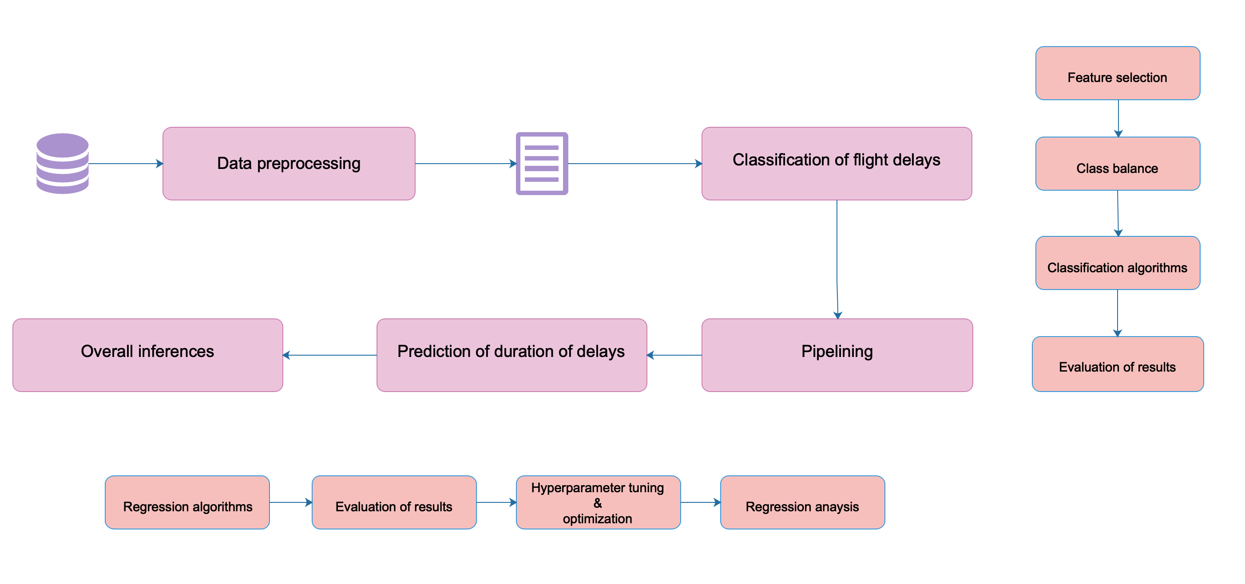
ARCHITECTURE
Raw data
Processed data file
Caption

Slide 6

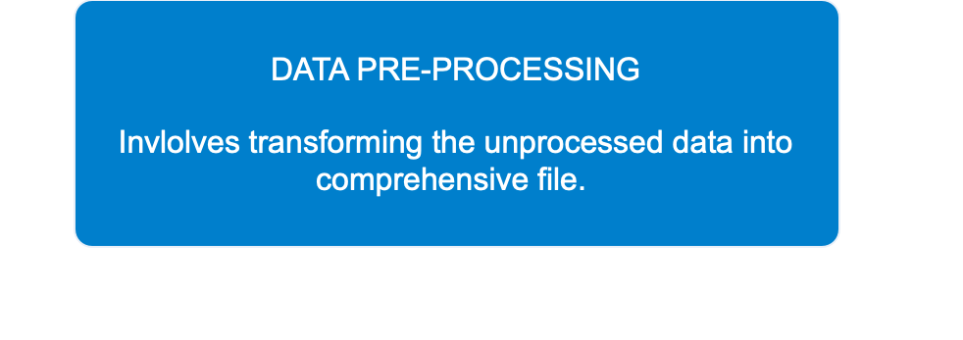
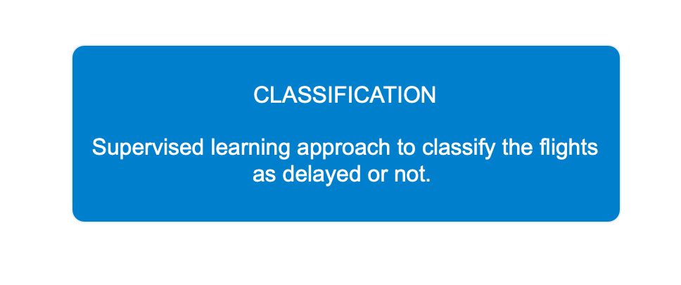
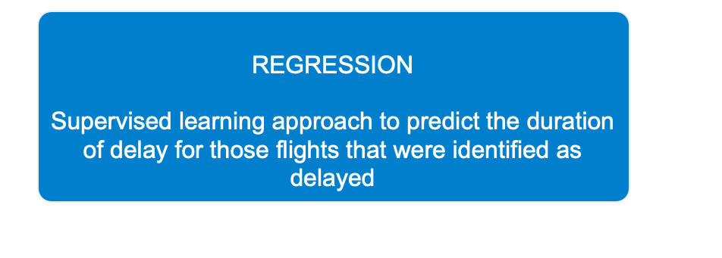
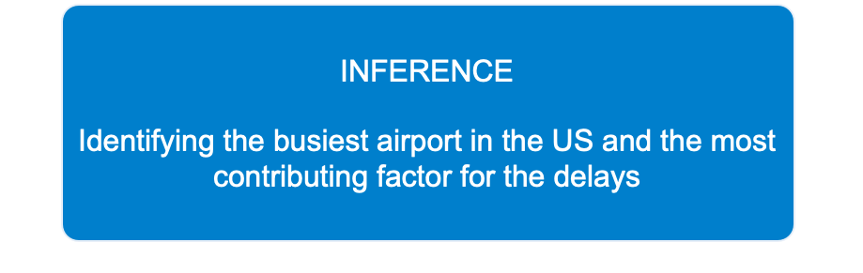
01
01
Caption
02
02
03
Caption
03
04
Caption
04
Caption

Slide 7
Module 1
Data pre-processing
Data pre-processing

Slide 8
Factors for flight delays
Open weather forecast shows that there is a significant increase in departure delay of up to 23 min depending on the weather type and intensity of the disturbance. The sudden onset events such as precipitation and wind, and slow onset events such as temperature, humidity are heterogenous reasons.
EQUIPMENT
Dolore te feugait nulla facilisi.
OTHER
Delenit augue duis dolore te feugait
48%
The weather reports of flights are combined on time performance of flights to build a predictive model
Weather
Extreme weather conditions like tornado, hurricanes, sandstorms & snowfall
RUNAWAY
Delenit augue
VOLUME

Slide 9
Data extraction
The weather and fight details of 15 airports for the years 2016 and 2017 are considered for arrival delay prediction
Weather data - The dataset is taken from the World Weather Online API which provides hourly synoptic weather observations
Flight data - BTS(United States Bureau of Transportation Services) which tracks the flight status and provide air traffic delay statistics
Unprocessed files’ details
Weather data - 2014 - 2017 - 30 airports - json file
Flight data - 2016 - 2017 - 15 airports - csv file
Flight data Weather data
Features chosen
FlightDate | Year | Quarter
DayOfMonth | DepDel15 | CRSDepTime
OriginAirportID | DestAirportID | ArrTime
Year | Month | DepDelayMinutes
CRSArrTime | ArrDel15 | ArrDelayMinutes
WindSpeedKmph | WindDirDegree | WeatherCode
precipMM | Visibility | Pressure
Cloudcover | DewPointF | WindGustKmph
tempF | WindChillF | Humidity
Time | Date | Airport

Slide 10
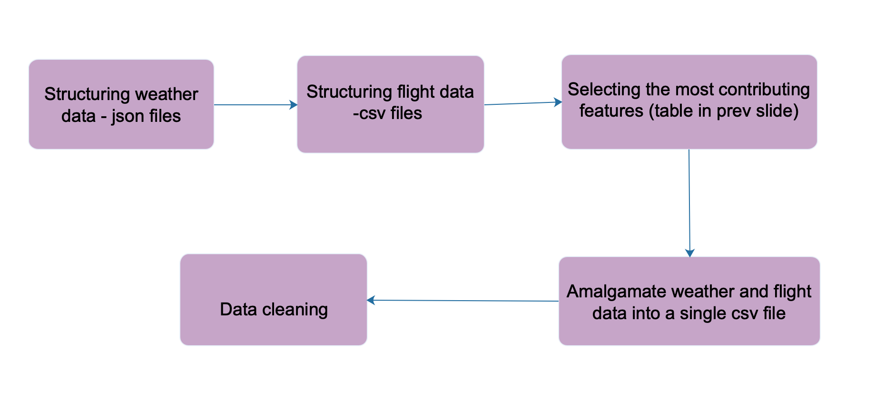
Methods in preprocessing
Final dataset for the study (csv file )
18 million observation
&
30 characteristics
Caption

Slide 11
Module 2
Classification
Data pre-processing
Classification

Slide 12
Feature selection
Extracting the top features that contribute most to the label(‘ArrDel15’)
1
2
3
Univariate selection
PCA
FEATURE IMPORTANCE
The strength of relationship of the features with
ts target variable is estimated as scores using a
statistical test ANOVA.
identification of a smaller number of uncorrelated variables known as principal components from a larger set of data
The importance score for each feature
is calculated based on its ability to make
key decisions with boosted decision trees.
Ground truth variables were neglected based on correlation values of heat map. Significant features were extracted from the intersection of above methods. Thus, among 30 features, top 17 correlated features are extracted

Slide 13
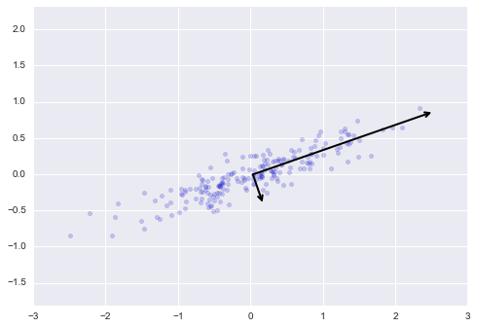
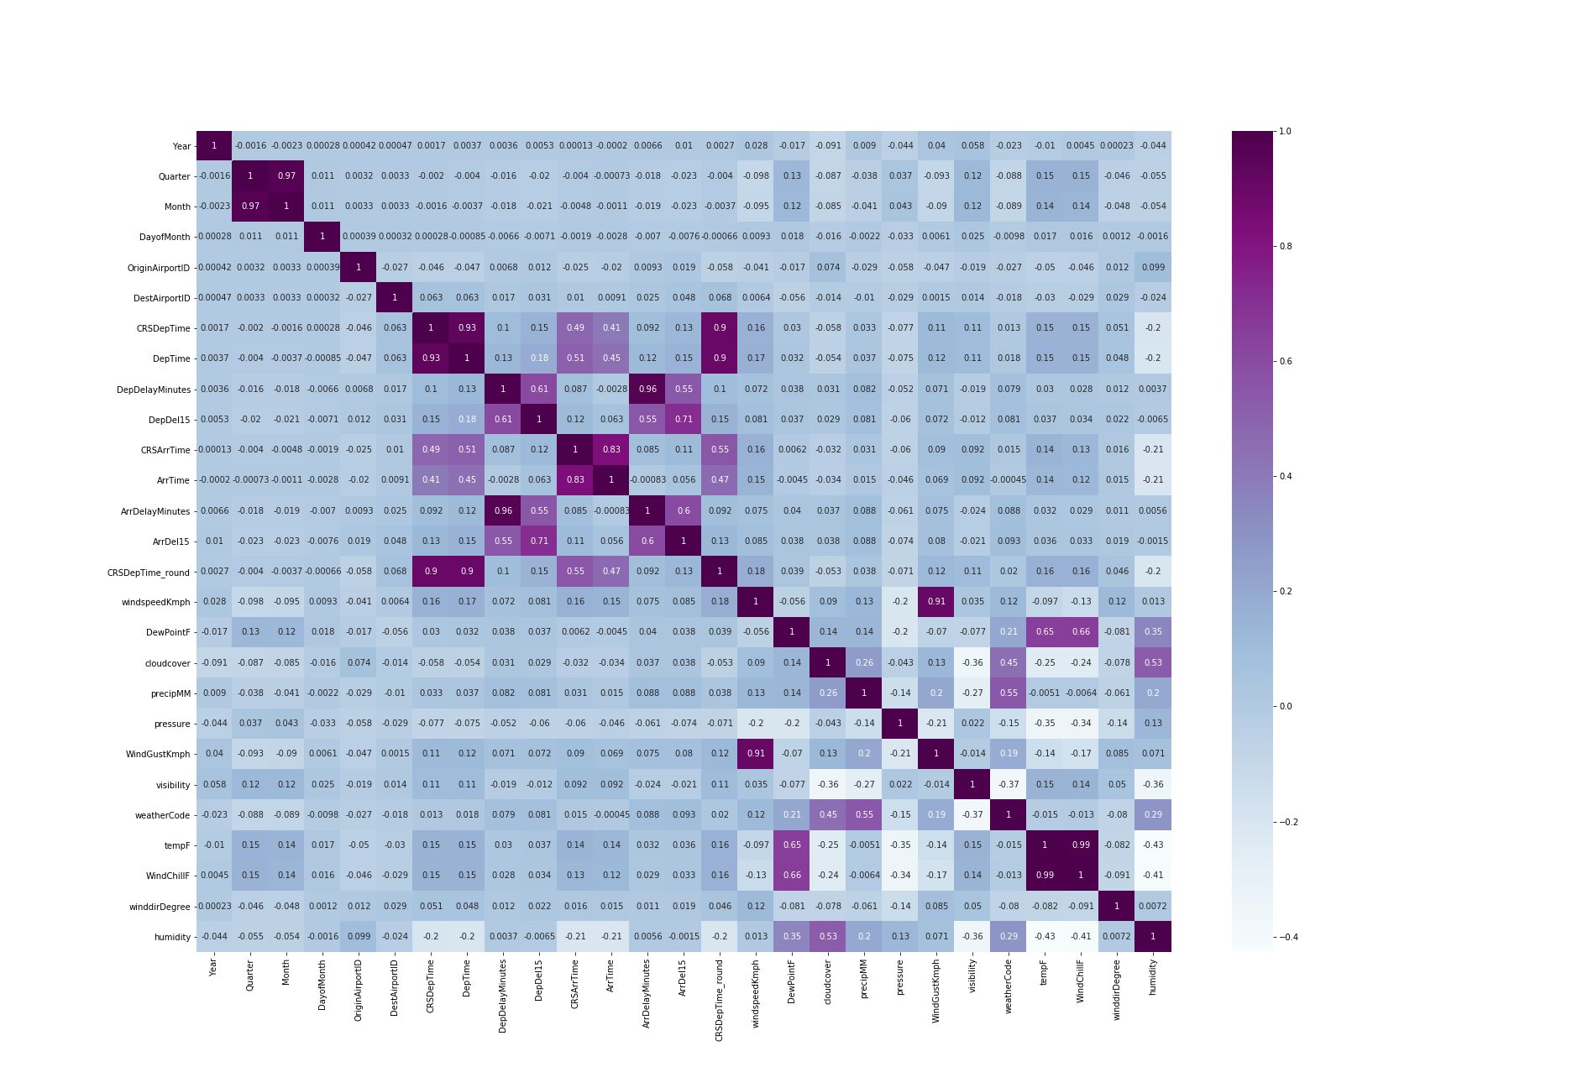
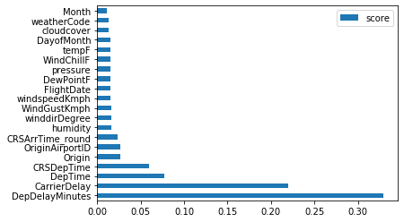
Feature selection visualization
The axes of principal components depicting the dimensional reduction of features.
Caption
The top features identified by the extra-trees in the feature importance technique

Slide 14

Classification algorithms
Flight delayed or not
1
6
Logistic Regression
Decision tree
Random Forest
2
5
XG Boost
3
Caption
4
Extra-trees
Multi layer Perceptron(MLP)
The choice of best classifier varies with the kind of dataset and the way data is distributed in the data

Slide 15
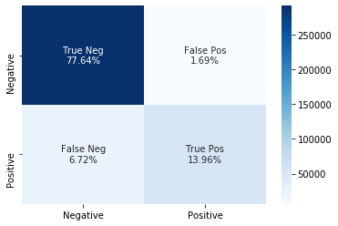
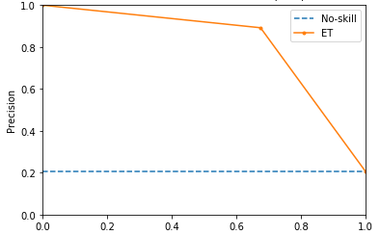
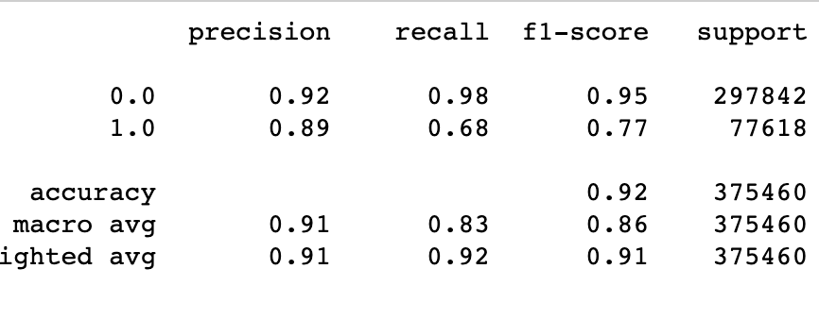
Classification performance
The performance of the classifiers are analyzed with metrics, curves and plots as follows
Caption
CLASSIFICATION REPORT
Caption
Caption
CONFUSION MATRIX
$$Precision=\frac{TruePositives}{TruePositives+FalsePositives}$$
PR CURVE - AUC
useful measure of success of prediction when the classes are very imbalanced. In information retrieval, precision is a measure of result relevancy, while recall is a measure of how many truly relevant results are returned.
The matrix compares the actual target values with those predicted by the machine learning model.
$$Recall=\frac{TruePositives}{TruePositives+FalseNegatives}$$
$$F1-score=2*\frac{Recall*Precision}{Recall+Precision}$$

Slide 16
Class imbalance
delayed
A dataset is said to be imbalanced when the number of observations per class is not equally distributed among the training dataset. There has been a heavy class imbalance in our dataset where there is more number of flights which are not delayed and less number of flights that are delayed.
Sampling techniques
Non - delayed
Random undersampling- Balances the class distribution through random elimination of majority class examples.
ADASYN oversampling - Adaptive Synthetic method produce an appropriate number of synthetic alternatives for each minority class observation where density distribution is used as a criterion to automatically decide the number of synthetic samples to be generated.
SMOTETomek combined - sampling Data is initially oversampled with SMOTE oversampling and then Tomek Links ( undersampling ) are applied as data cleaning method.

Slide 17
Random undersampling
Classification results
Classifier | Precision |  | Recall |  | F1-score
 | On-time | Delayed | On-time | Delayed | On-time | Delayed
Logistic Regression | 0.94 | 0.74 | 0.93 | 0.78 | 0.93 | 0.76
Decision Tree | 0.94 | 0.50 | 0.79 | 0.80 | 0.86 | 0.62
Random Forest | 0.95 | 0.68 | 0.90 | 0.80 | 0.92 | 0.73
Extra Trees | 0.95 | 0.66 | 0.89 | 0.83 | 0.92 | 0.74
XG Boost | 0.94 | 0.73 | 0.92 | 0.79 | 0.93 | 0.75
MLP | 0.94 | 0.71 | 0.92 | 0.79 | 0.93 | 0.75
Unsampled data results
Classifier | Precision |  | Recall |  | F1-score
 | On-time | Delayed | On-time | Delayed | On-time | Delayed
Logistic Regression | 0.92 | 0.89 | 0.98 | 0.67 | 0.95 | 0.77
Decision Tree | 0.92 | 0.68 | 0.91 | 0.70 | 0.92 | 0.69
Random Forest | 0.92 | 0.87 | 0.97 | 0.68 | 0.95 | 0.76
Extra Trees | 0.92 | 0.86 | 0.97 | 0.70 | 0.95 | 0.77
XG Boost | 0.92 | 0.89 | 0.98 | 0.68 | 0.95 | 0.77
MLP | 0.92 | 0.89 | 0.98 | 0.68 | 0.95 | 0.77
ADASYN oversampling
Classifier | Precision |  | Recall |  | F1-score
 | On-time | Delayed | On-time | Delayed | On-time | Delayed
Logistic Regression | 0.95 | 0.66 | 0.89 | 0.81 | 0.92 | 0.73
Decision Tree | 0.92 | 0.68 | 0.91 | 0.70 | 0.92 | 0.69
Random Forest | 0.93 | 0.81 | 0.92 | 0.72 | 0.94 | 0.76
Extra Trees | 0.93 | 0.78 | 0.95 | 0.75 | 0.94 | 0.76
XG Boost | 0.95 | 0.66 | 0.89 | 0.81 | 0.92 | 0.72
MLP | 0.92 | 0.56 | 0.83 | 0.84 | 0.88 | 0.67
SMOTETomek combinedsampling
Classifier | Precision |  | Recall |  | F1-score
 | On-time | Delayed | On-time | Delayed | On-time | Delayed
Logistic Regression | 0.94 | 0.74 | 0.93 | 0.78 | 0.93 | 0.76
Decision Tree | 0.92 | 0.68 | 0.91 | 0.70 | 0.92 | 0.69
Random Forest | 0.93 | 0.82 | 0.96 | 0.71 | 0.94 | 0.76
Extra Trees | 0.93 | 0.80 | 0.95 | 0.74 | 0.94 | 0.77
XG Boost | 0.94 | 0.76 | 0.94 | 0.76 | 0.94 | 0.76
MLP | 0.92 | 0.69 | 0.91 | 0.80 | 0.93 | 0.74

Slide 18
Module 3
Regression
Module 1
Data pre-processing
REGRESSION
Data pre-processing
Data pre-processing
Classification

Slide 19

Regression algorithms
Delay duration
Gradient Boosting Regressor
Linear Regressor
1
6
Random Forest
2
5
Extra Trees
Caption
3
4
Lasso regressor
Ridge Regressor
The choice of regressor varies with the kind of dataset and the way data is distributed in the data

Slide 20
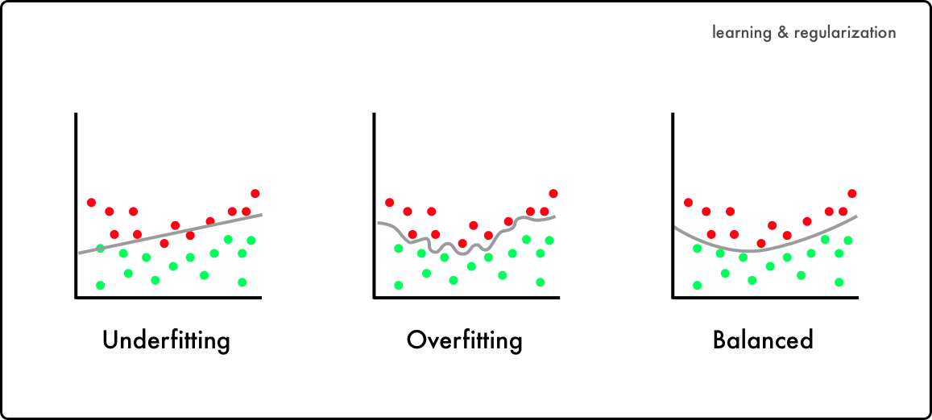
Regularization
A form of optimization, that regularizes or shrinks the coefficient estimates towards zero. The ultimate goal is to reduce the cost function. The cost function quantifies the error between predicted values and expected values. The Residual Sum of Squares(RSS) is the most commonly used cost function.
$$\overset{̂}{y_{i}}≈β_{0}+β_{1}x_{1}+β_{2}x_{2}+...+β_{p}x_{p}$$
$$RSS=\overset{n}{\underset{i=1}{∑}}(y_{i}-\overset{̂}{y_{i}})^{2}$$
Caption
n - total number of observations
p - number of features considered for prediction
x - features
yi - actual delay duration
ˆyi- predicted delay duration
β0 - constant
β1−p - coefficients
L2 regularization (Ridge)
L1 regularization(Lasso)
$$Totalcostfunction=RSS+λ\overset{p}{\underset{i=1}{∑}}β_{i}^{2}$$
$$Totalcostfunction=RSS+λ\overset{p}{\underset{i=1}{∑}}|β_{i}|$$

Slide 21
Regression performance
The performance of the regressors are analyzed with the following metrics
r-squared (coeff of determination)
MAE - Mean Absolute Error
RMSE -Root Mean Squared Error
a statistical measure that represents the proportion of the variance for a dependent variable that's explained by an independent variable or variables in a regression model.
measures the average magnitude of the errors in a set of predictions, without considering their direction. It's the average over the test sample of the absolute differences between prediction and actual observation.
a measure of how spread out the residuals are. In other words, tells how concentrated the data is around the line of best fit.
$$R^{2}=1-\frac{\frac{1}{n}∑_{i=1}^{n}(Y_{i}-\overset{̂}{Y}i)^{2}}{\frac{1}{n}∑{i=1}^{n}(Y_{i}-\overset{̂}{Y})^{2}}$$
$$MAE=\frac{1}{n}\overset{n}{\underset{i=1}{∑}}∣Y_{i}-\overset{̂}{Y_{i}}∣$$
$$RMSE=\sqrt{(\frac{1}{n})\overset{n}{\underset{i=1}{∑}}(Y_{i}-\overset{̂}{Y_{i}})^{2}}$$

Slide 22
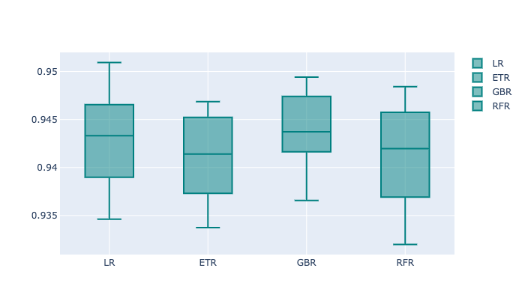
Pipelining
Regression final results
The best classifier is used to categorize the status of flights. Among those flights which are predicted as delayed are trained with best regressor.
classification is executed with Extra trees on smote tomek sampling and further trained with gradient boosting regressor.
Regressor | MAE | RMSE | R2 score
Linear Regression | 14.64 | 20.01 | 0.921
Random Forest Regression | 12.03 | 17.17 | 0.941
Gradient boosting regression | 11.76 | 16.97 | 0.943
Extra-Trees Regression | 11.90 | 17.07 | 0.942
Ridge | 12.78 | 19.20 | 0.923
Lasso | 12.96 | 19.23 | 92.18
Caption

Slide 23
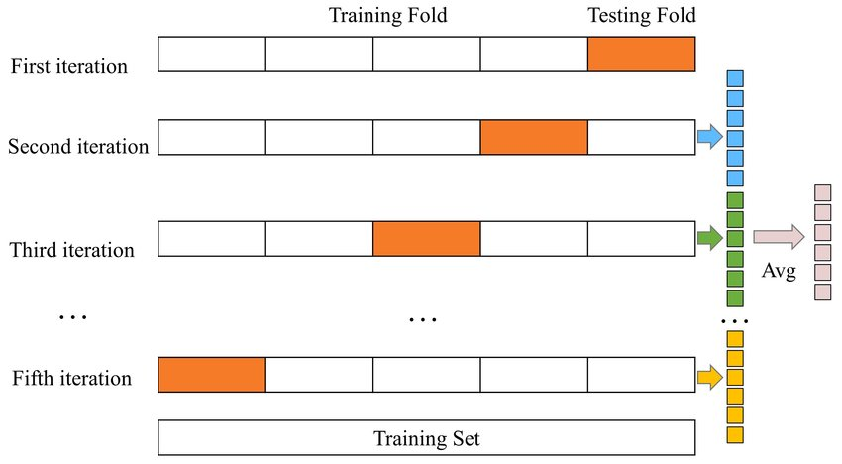
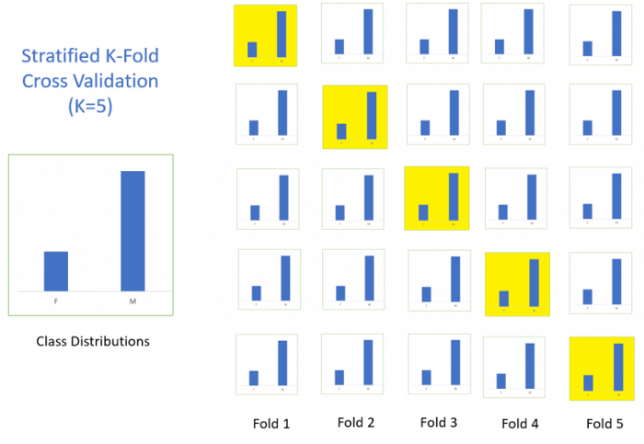
Cross validation
In order to validate the stability of the regressors , stratified k-fold cross validation was performed on each regressors
k- fold
Stratified k- fold

Slide 24
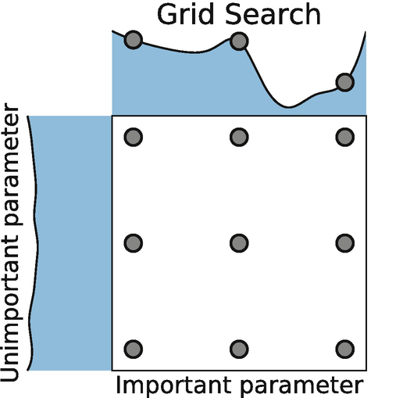
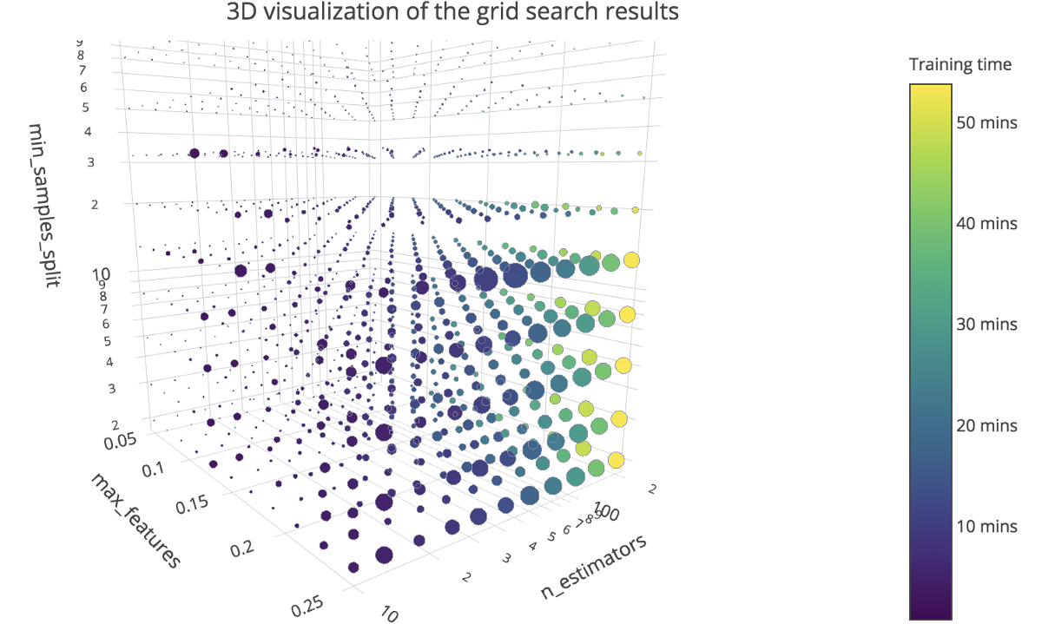
Hyperparameter Tuning
The process of choosing a set of optimal hyper parameters for a learning algorithm. These hyperparameters are tuned to optimize the performance of the model. GridSearchCV was performed on best regressor.
k- fold
Stratified k- fold

Slide 25
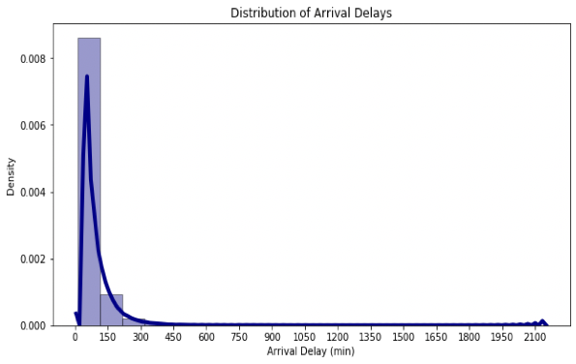
Regression Analysis
In order to evaluate the performance of the model in each interval, best performing regressor was tested on various range of inputs
Arrival Delay Minutes | MAE | RMSE
15-100 | 9.94 | 13.34
100-300 | 13.53 | 18.01
300-600 | 15.24 | 21.22
600-1000 | 14.87 | 19.29
1000-2200 | 107.67 | 114.87
80%
The model performs well not only on abundant data but also on sparse region of data. Therefore, the model is robust in such unevenly distributed data.
Of datapoint lies in range of 15-300 minutes

Slide 26
Module 4
Inference
Module 1
Data pre-processing
Module 1
Data pre-processing
REGRESSION
Inference
Data pre-processing
Data pre-processing
Data pre-processing
Classification

Slide 27
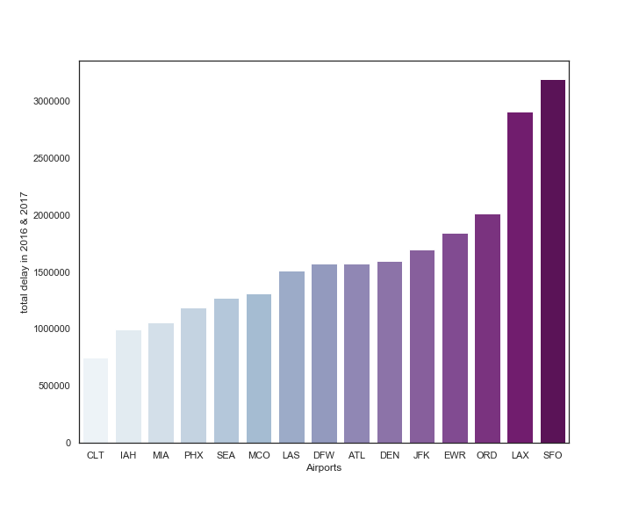
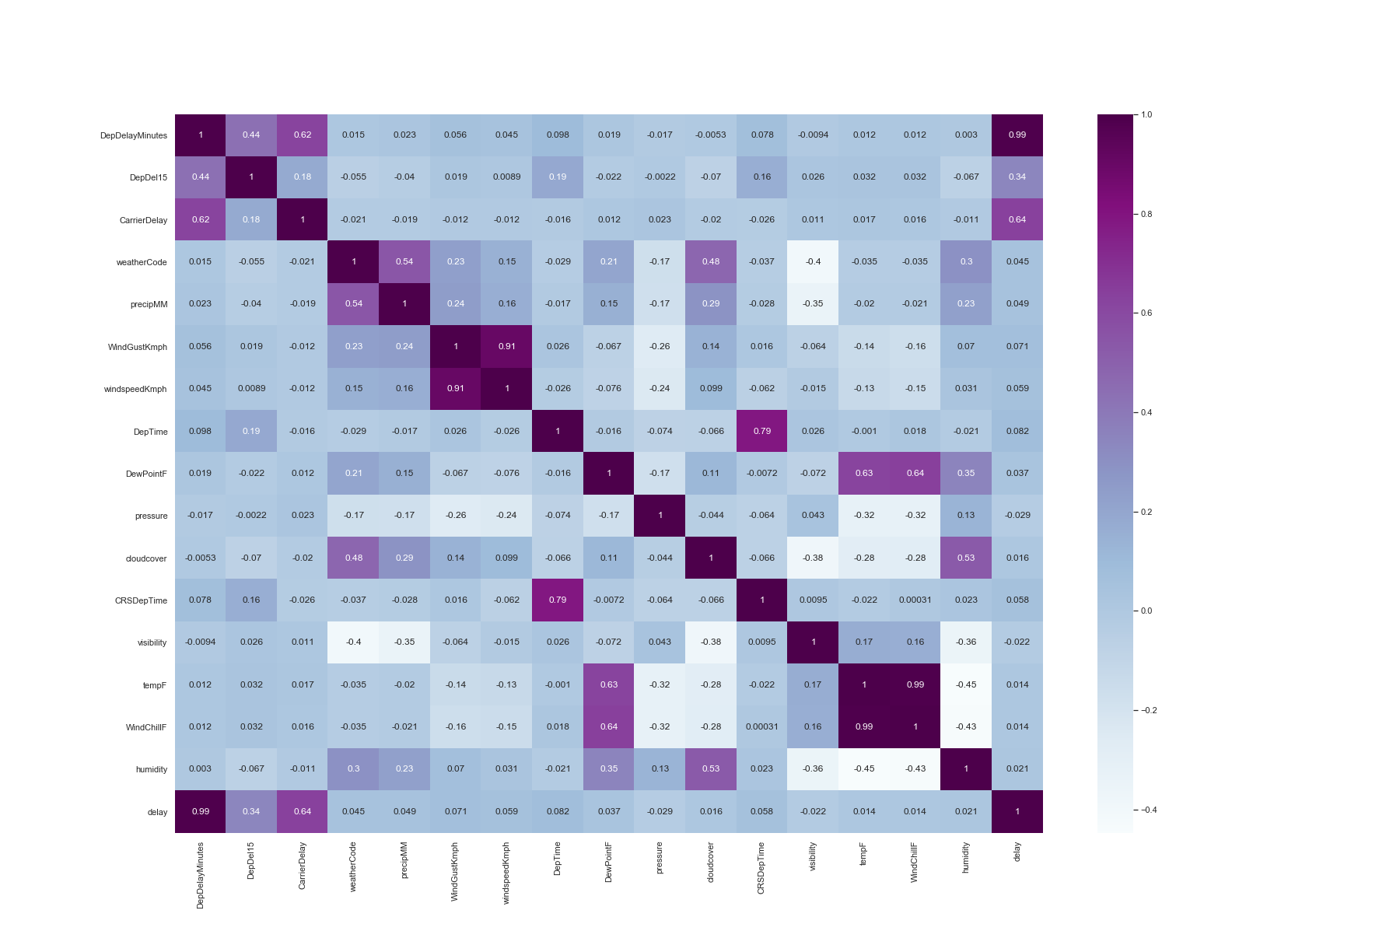
Inference
Caption
Caption
The total duration of delays in the 2 years for all 15 stations.
‘San Francisco’ - Busiest
Among the features chosen for prediction of duration of delays, departure delays & carrier delays are the most influential factors. WindGustSpeed is the most contributing weather factor

Slide 28
CONCLUSION
The paper presented a methodology for flight delay prediction by exploring supervised learning methods. The arrival delay of the flights was predicted to the best possible accuracy with supervised machine learning algorithms. The Bagging classifier, Extratrees predicted better with highest recall score on the required class i.e., Class 1. Also, the model’s prediction was reliable with combine sampled train data. The XGBoosGradient Boosting regressor predicted the duration of the delay much better than the regularized models. The regressor worked very well on the unevenly distributed target feature with very less residuals.

Slide 29
THANK YOU

