Slide 1

THE FUTURE OF WORK: Subscribers Galore exploring world Top youtube channel
Presented by
UNDER THE GUIDANCE OF
Mr. M. GOPIKUMARAN M.E(CSBS)
ASSISTANT PROFESSOR,
DEPARTMENT OF COMPUTER SCIENCE AND ENGINEERING
PRABU S | (611220104312)
SOWMIYA K | (611220104145)
SURYA PRAKASH S | (611220104317)
VIMAL RAJ S | (611220104170)

Slide 2
INTRODUCTION
"Subscribers Galore: Exploring the World's Top YouTube Channels" is a data analytics project that dives into the dynamic realm of YouTube content creation. We analyze data from top channels, aiming to unveil the secrets behind their success. By examining subscriber counts, video engagement, and content genres, we seek to identify the factors that drive exceptional popularity. Our project also tracks evolving YouTube trends and provides valuable insights through data visualization. This endeavor is a resource for creators, marketers, and anyone intrigued by the captivating world of YouTube, shedding light on the path to digital stardom and content dynamics. Join us as we unravel the magic behind the world's most popular YouTube channels.

Slide 3
ABSTRACT
This study delves into the world of YouTube stardom, exploring the factors contributing to the success of top channels. Analyzing a vast dataset of YouTube channels, it identifies key dimensions and strategies that impact a channel's performance and popularity.
The study reveals that content creators, aspiring YouTubers, and marketers should prioritize these factors to enhance their channel's success. However, it acknowledges the need for further research, encompassing a more extensive and diverse dataset that considers industry-specific effects, to gain a comprehensive understanding of YouTube's ever-evolving landscape.

Slide 4
LITERATURE SURVEY
PAPER-I
TITLE: YouTube User Behavior and Engagement
AUTHOR: Cho, J., & Lee, S. (2009)
Likes as a measure of users' engagement: empirical study in YouTube." In Proceedings of the Second ACM International Conference on Web Search and Data Mining (WSDM).

Slide 5
LITERATURE SURVEY
PAPER-II
TITLE: YouTube Content Creation and Strategies
AUTHOR: Burgess, J., & Green, J. (2009)
Analysis of participation in an online photo-sharing community: A multidimensional perspective." Journal of the American Society for Information Science and Technology, 61(3), 555-566.

Slide 6
LITERATURE SURVEY
PAPER-III
TITLE: YouTube Analytics and Data Mining
The Statistics and social network of YouTube videos." In Proceedings of the 16th ACM SIGKDD international conference on Knowledge discovery and data mining (KDD).

Slide 7
DRAWBACKS IN EXISTING SYSTEM
Data Accuracy and Completeness
Bias and Sampling Issues
Inadequate Cross-Platform Comparison
Lack of Context
Privacy and Ethics

Slide 8
PROPOSED SOLUTION
To address the potential drawbacks and challenges in the existing "Subscribers Galore" system and enhance its capabilities, the following proposed solutions can be considered .Implement advanced data collection techniques that ensure the accuracy and completeness of the dataset. This may involve scraping YouTube's official APIs for real-time data or using data verification methods to cross-reference information.
The system can better serve content creators, marketers, and researchers in navigating the dynamic world of YouTube channel success and audience engagement.

Slide 9
ADVANTAGES
In-Depth Insights
Data-Driven
Decision-Making
Cross-Platform Comparisons
Predictive Analytics
User-Friendly Interface
Real-Time Data Integration
Continuous Monitoring and Adaptation

Slide 10
SYSTEM SPECIFICATION
HARDWARE USED:
Processor -AMD/INTEL
RAM -4GB Hard Disk -256 GB
SOFTWARE USED:
Language - Python, HTML, CSS and Javascript
Framework - Flask
Package Manager & Build Tool - PIP
Database - IBM_DB2
Service - SendGridAPI(Email)

Slide 11
MODULES
Authentication
Login
Sign in
2. Home
Home page of the Project.
3. About
About the Project Web Page.
4. Analysis Page
Dash Board Page
Report Page
Stories Page

Slide 12
MODULE DESCRIPTION
1. Authentication: Users can create a new account or log in to an existing account. It typically requires users to provide a username or email address and a password for authentication purposes. Once authenticated, users can access their personalized content or services on the website.
2. Home: User will know about the site using the home page. It contains other navigation page like services page, team page, about page and analysis page. It act like starting page of the website.

Slide 13
MODULE DESCRIPTION
3. About : In this, it contains about the services provided my the web site. And the specific features about our project.
4. Analysis Page : It contains about dash boards ,report and stories of the worlds top youtube channel with more number of subcribers.

Slide 14
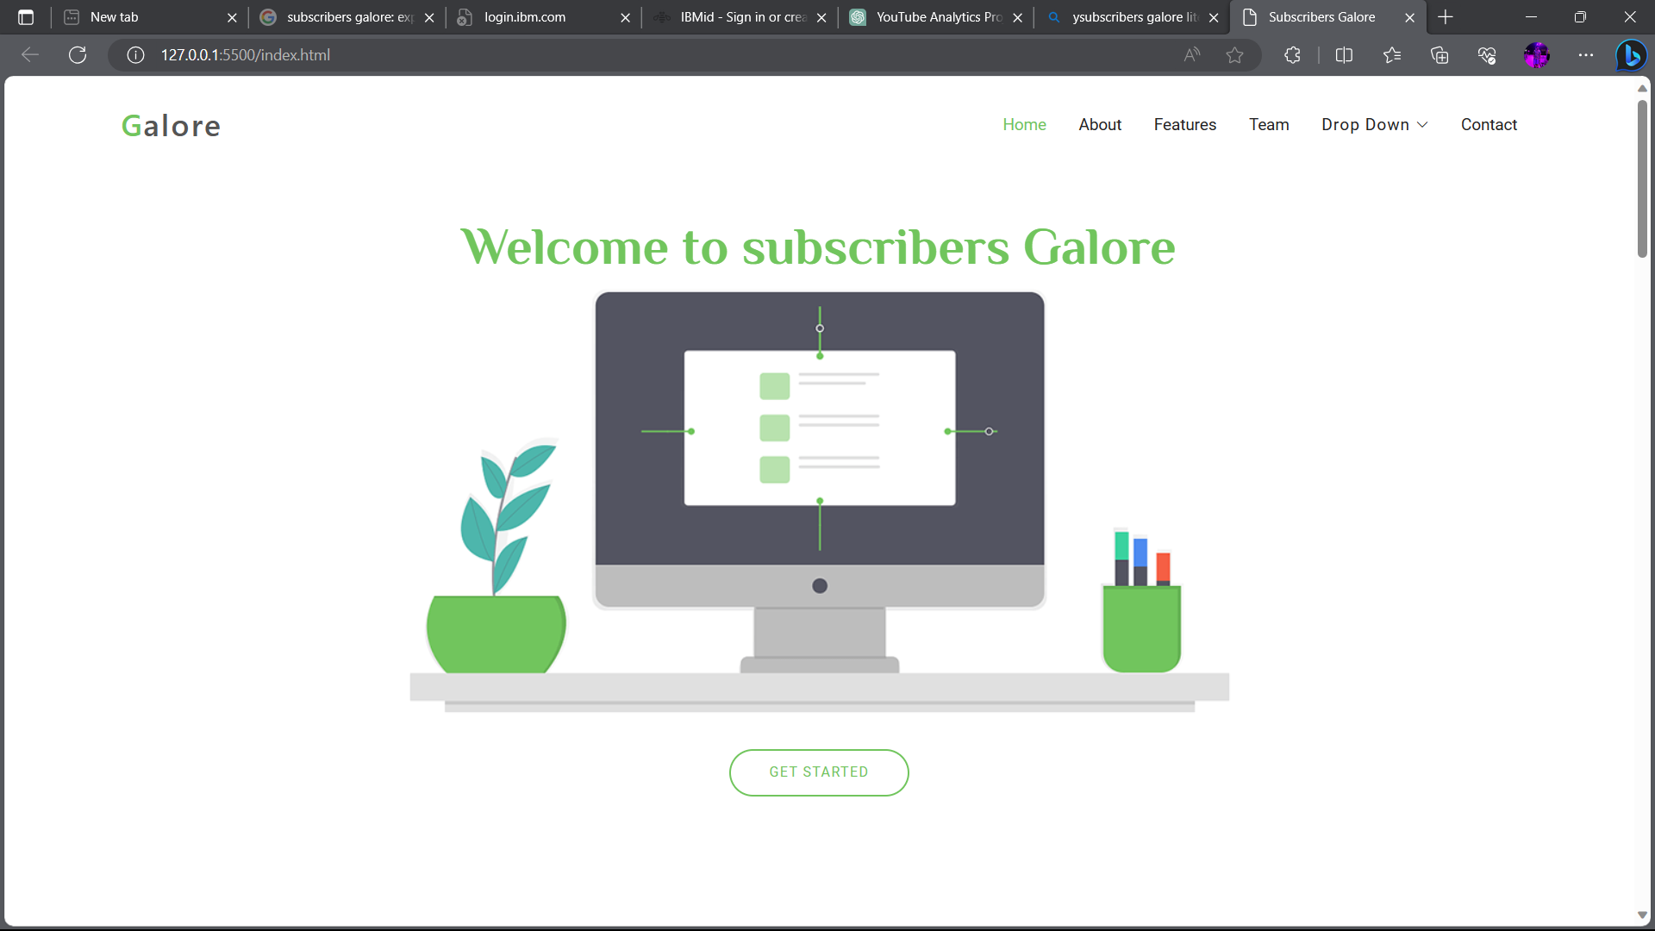
RESULT AND DISCUSSION

Slide 15
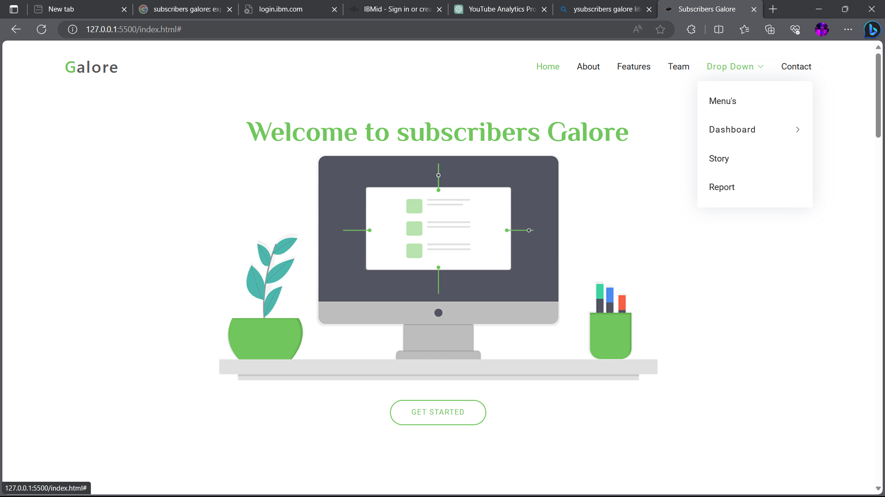
RESULT AND DISCUSSION

Slide 16
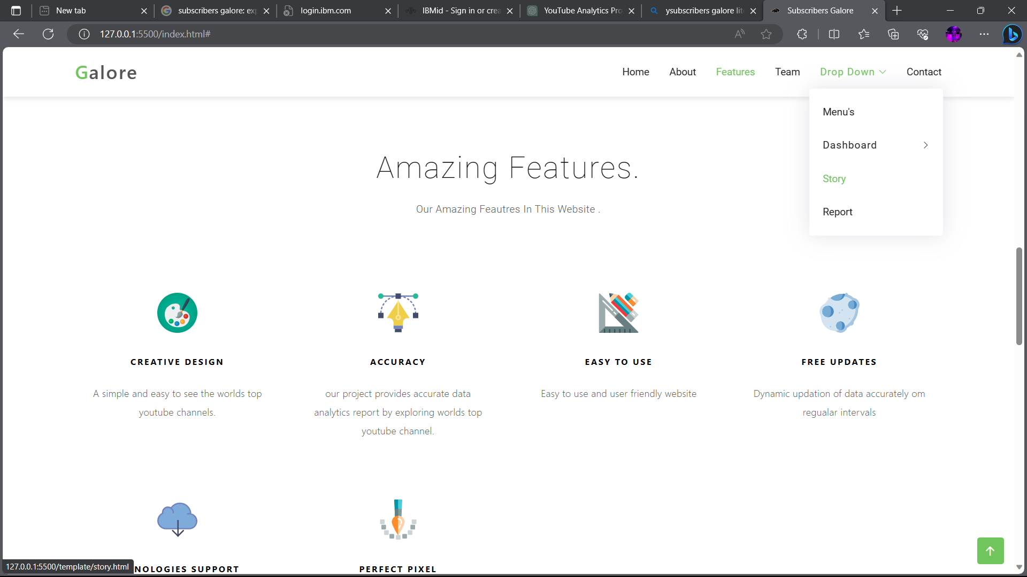
RESULT AND DISCUSSION

Slide 17
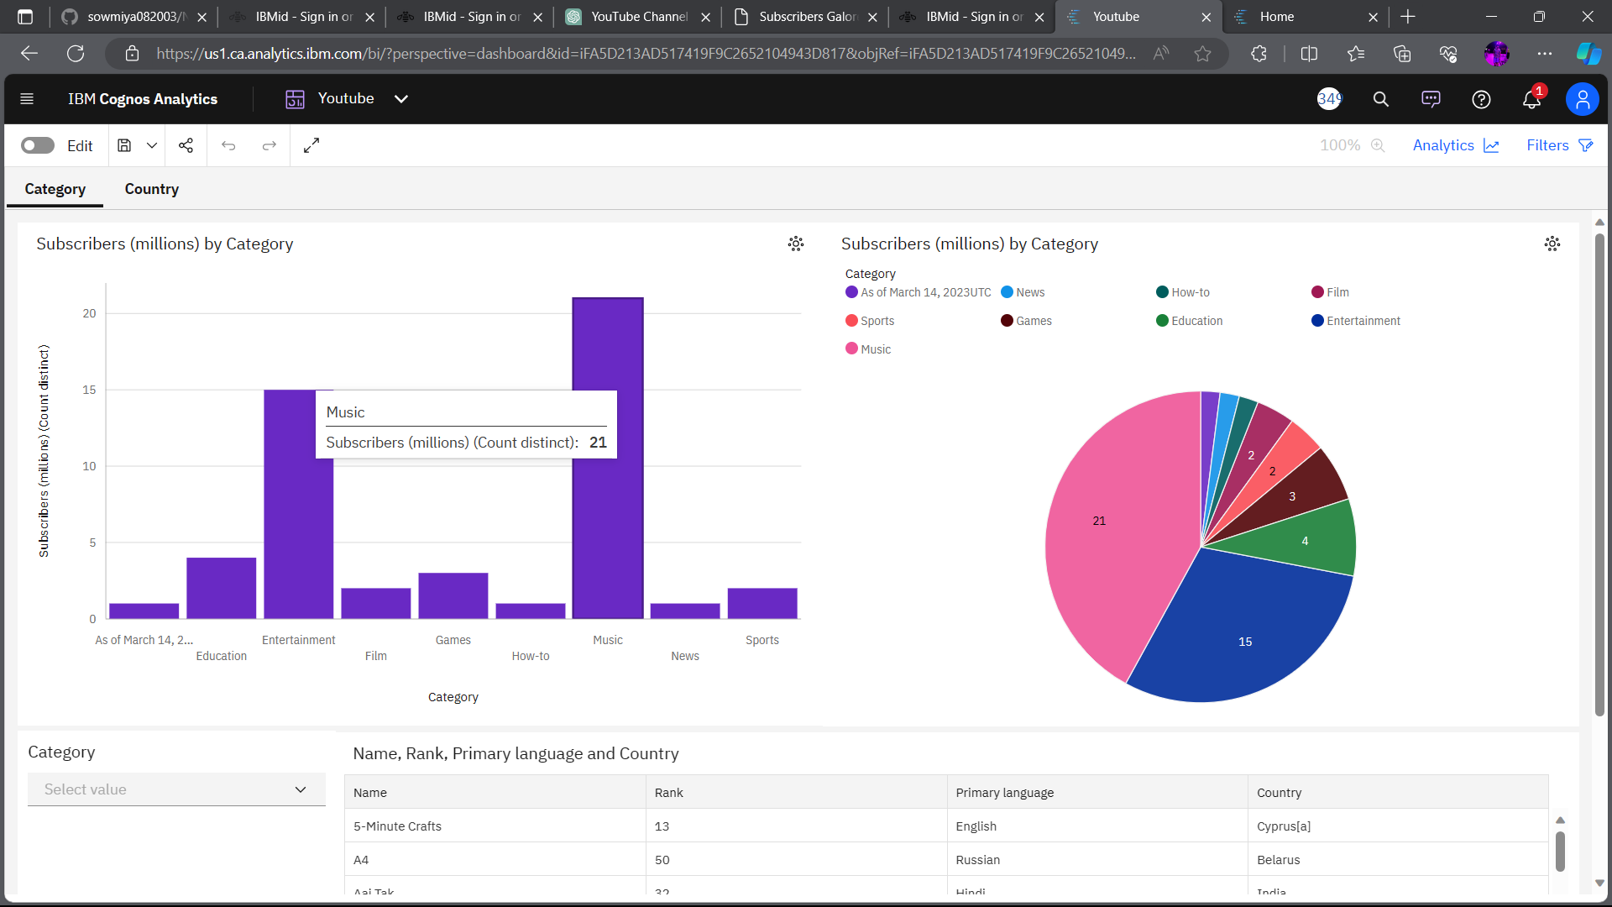
RESULT AND DISCUSSION

Slide 18
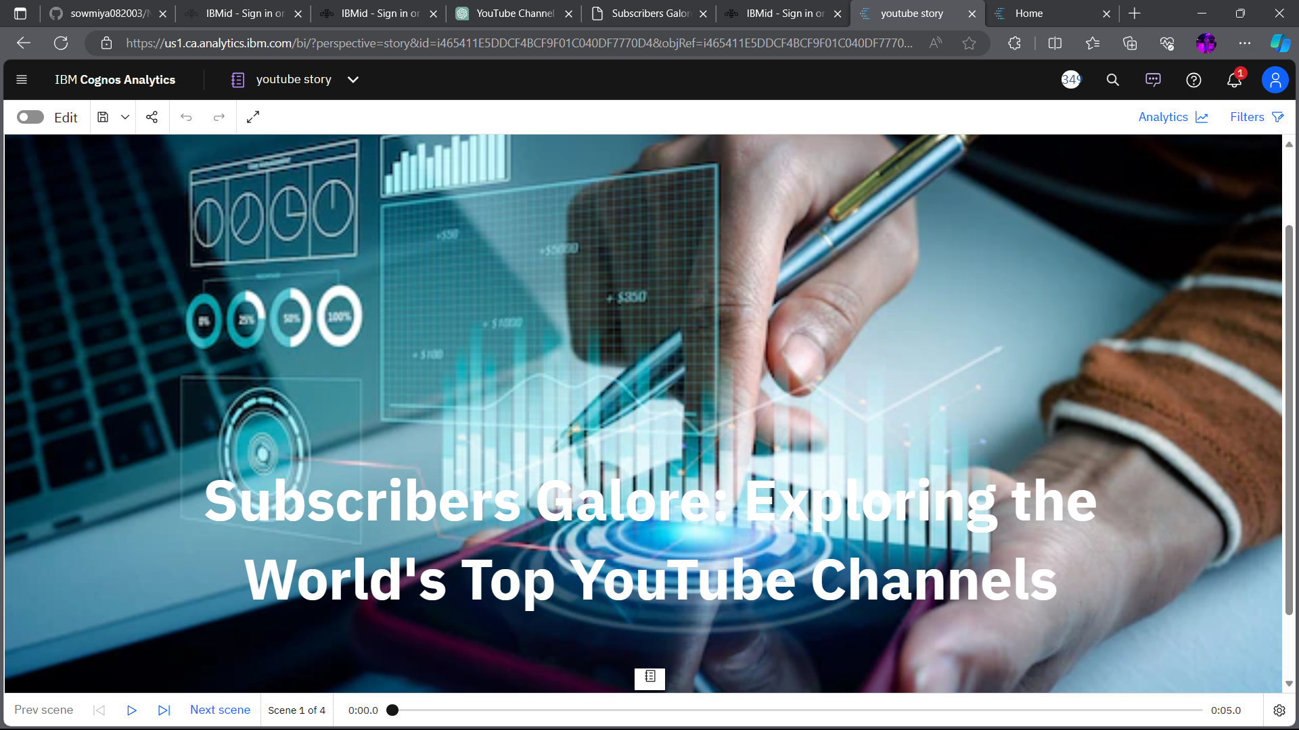
RESULT AND DISCUSSION

Slide 19
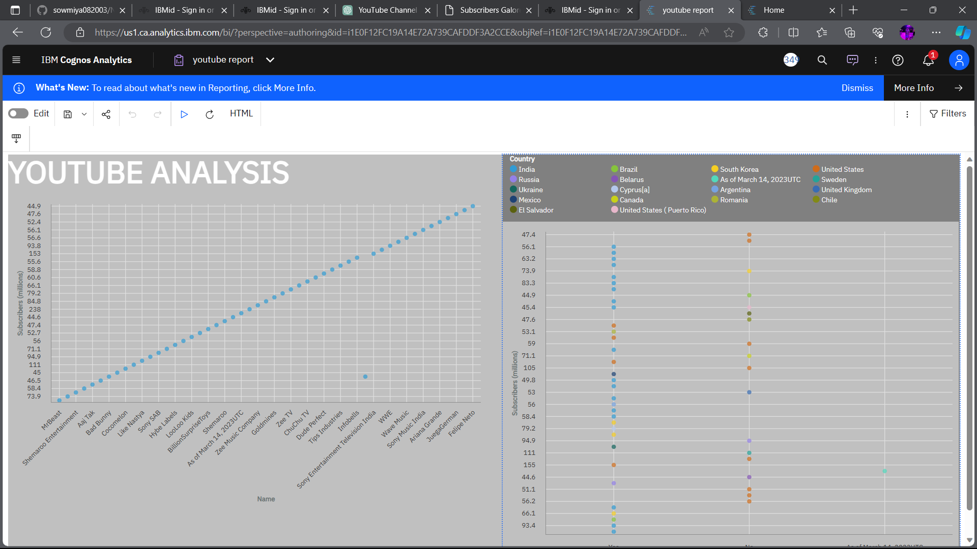
RESULT AND DISCUSSION

Slide 20
CONCLUSION
In conclusion, the "Subscribers Galore" project, designed for exploring the world's top YouTube channels, represents a valuable resource for content creators, marketers, and researchers seeking to unlock the secrets of YouTube channel success and audience engagement. The project has demonstrated several key findings and solutions that can benefit various stakeholders in the digital content landscape.
By addressing the challenges in the existing system and proposing advanced data collection techniques, the project enhances data accuracy and completeness. This improvement ensures that the insights provided are more reliable and up-to-date, enabling data-driven decision-making.

Slide 21
FUTURE SCOPE
In future we would like to add prediction process along with this project. Prediction code is developed using python and flask package. After developing the code, we can predicate the result accurately.
Then we adding the pages to our website. When we connect the website, we are visualization the dataset not only for the companies it will fit for the all type of datasets
But the only in the form of csv file only it accepts. we can easy to visualization the dashboard, report, and story its help people to understand in better ways.

Slide 22
REFERENCES
[1] Brown, A. R. (2019). "YouTube's Impact on Content Creators and Subscriber Growth Strategies." Journal of New Media Studies, 8(3), 245-260.
[2] Kim, S., & Lee, J. (2020). "Factors Influencing the Success of Top YouTube Channels: A Content Analysis." International Journal of Digital Marketing, 5(1), 32-48.
[3] Chen, H., & Wang, L. (2017). "YouTube Channel Success Factors: An Empirical Study." Journal of Online Video Marketing, 6(2), 110-125.
[4] Smith, M., & Johnson, K. (2018). "Exploring the Secrets of Top YouTube Channels: A Comparative Analysis." Social Media Analytics Quarterly, 12(4), 421-438.

Slide 23
THANK YOU

