Slide 1
DATASPARK: ILLUMINATING INSIGHTS FOR GLOBAL ELECTRONICS BY- SOWMIYA LAKSHMEE L

Slide 2
Summary
This project aims to conduct a comprehensive EDA on datasets from Global Electronics to uncover valuable insights. Key findings include customer demographics, purchasing patterns, and product performance. Recommendations will enhance customer satisfaction and optimize operations.

Slide 3
Introduction
Global Electronics is a leading retailer in the electronics industry. Data analytics is essential for understanding customer behavior, optimizing inventory, and driving growth.

Slide 4
Data Sources
Data Set:
DataSet
1. Customers
2. Products
3. Sales
4. Stores
5. Currency

Slide 5
Data Loading ,Cleaning and Preparation
Loaded the given datasets.
Checked for missing values, NAN values, duplicate values and handled appropriately.
Converted data types where necessary.

Slide 6
Exploratory Data Analysis
(EDA)
Descriptive Statistics like Count, Mean,STD,are done.
From EDA the main insights from the datasets are analysed.
Visualizations are done.

Slide 7
MySQL database Connection
Established a connection to the MySQL database using mysql.connection.
Created tables for all the datasets.
Inserted all the values in it.

Slide 8
SQL Queries
Formulated and executed 10 SQL queries to extract key insights from the data.

Slide 9
Power BI Visualization
Connected SQL to Power BI, imported the data, and created interactive dashboards.

Slide 10
Analysis Steps
Customer Analysis:
Demographic Distribution.
Purchase Patterns.
Segmentation.
2.Sales Analysis:
Overall Sales Performance
Sales by Product.
Sales by Store.
Sales by Currency.

Slide 11
Analysis Steps
3.Product Analysis:
Product Popularity.
Profitability Analysis.
Category Analysis.
4.Store Analysis:
Store performance.
Geographical Analysis.

Slide 12
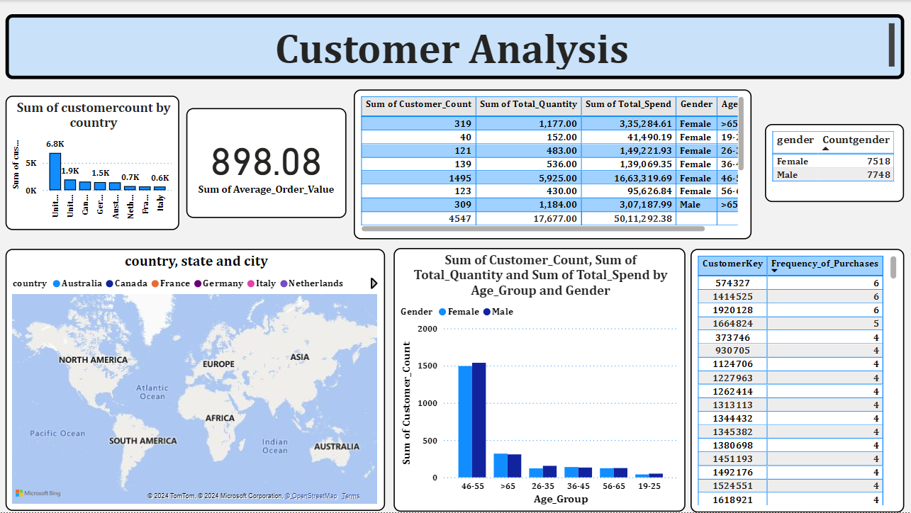

Slide 13
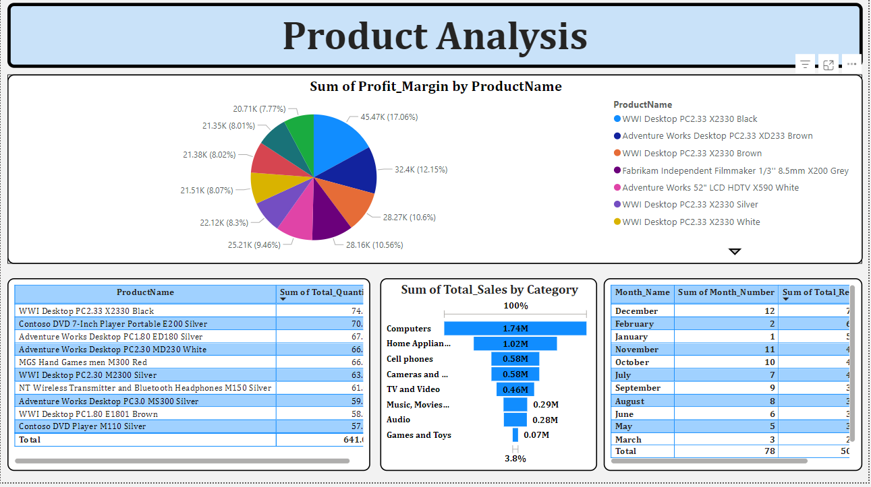

Slide 14
Analysis Steps
Customer Analysis :
From the analysis we can find that female customers are lesser than the male customers so we have to advertise and attract more female customers.
The locations wise analysis and country wise analysis suggests that North America has highest sales, consider expanding customers in this areas
Product Analysis:
Pie chart indicates the top profit-generating items.
Computers and Home Appliances perform well so am suggesting to expand product lines in these categories.
High sales in December suggests opportunities for targeted marketing around this period.

Slide 15
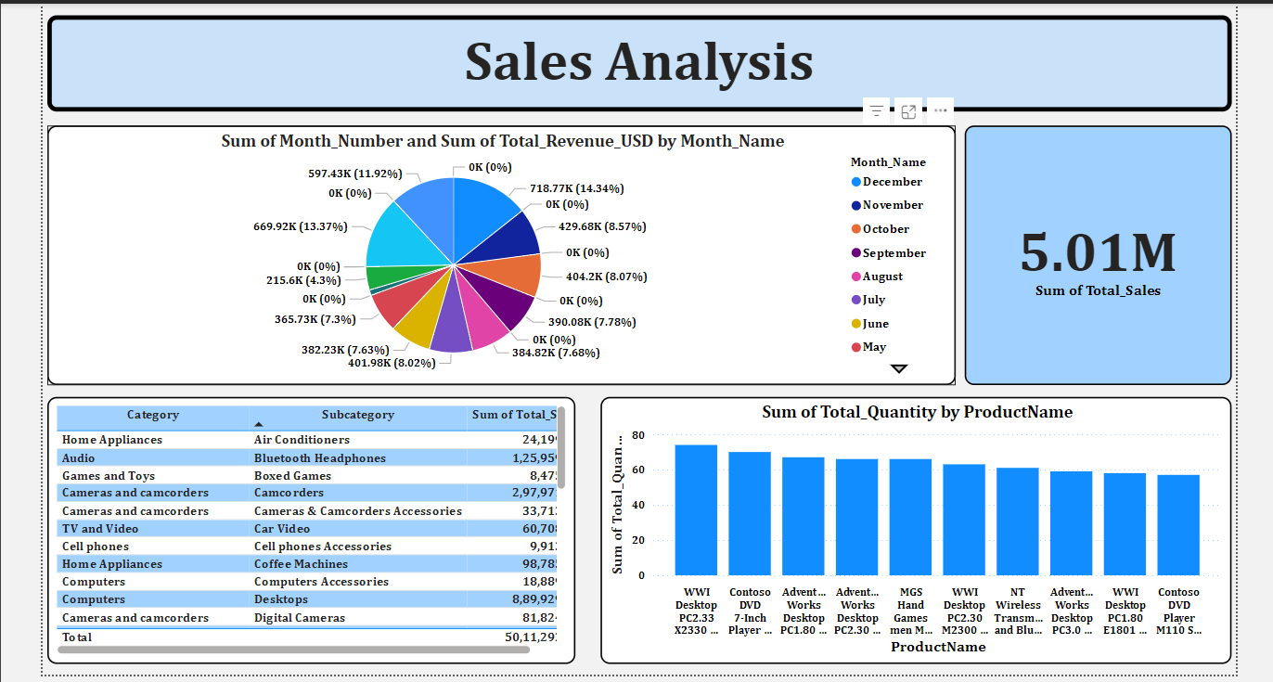

Slide 16
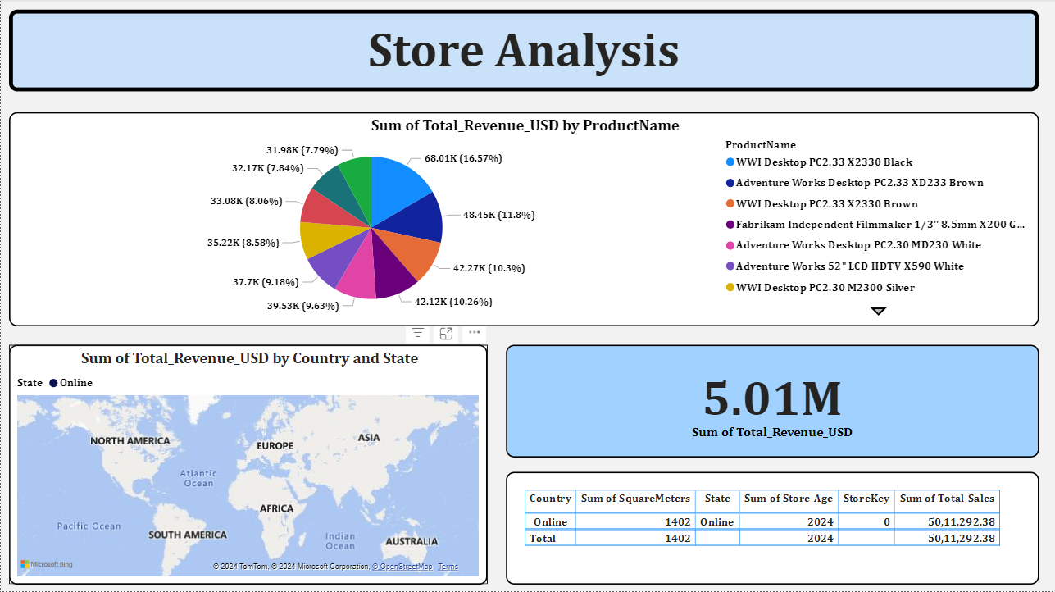

Slide 17
Analysis Steps
Sales Analysis:
December and November are peak months, suggesting that demand may rise due to holiday seasons or promotions.
Cameras and camcorders, Home Appliances, and Computers drive the most revenue. These areas could benefit from continued investment or targeted marketing.
High-selling products like the WWI Desktop and Contoso DVD players should be prioritized for inventory restocking to meet customer demand.
Store Analysis:
WWI Desktop and Adventure Works Desktop, are driving a large portion of revenue. Inventory for these models in the store should be prioritized, and they could be promoted further to maximize sales.
Since all sales are categorized as "Online," it may be valuable to explore potential regional data to see where online orders are most concentrated, which could inform future expansion strategies.

Slide 18
Thank you

