Slide 1
Digital Portfolio
STUDENT NAME: SOWMIYA . M
REGISTER NO AND NMID:24131040500122028 And asanm10424ca07
DEPARTMENT: B.C.A
COLLEGE: JAWAHAR . SCIENCE . COLLEGE / ANNAMALAI UNIVERSITY

Slide 2
PROJECT TITLE
DIGITAL PORTFOLIO

Slide 3


AGENDA
Problem Statement
Project Overview
End Users
Tools and Technologies
Portfolio design and Layout
Features and Functionality
Results and Screenshots
Conclusion
Github Link
3/21/2024 Annual Review

Slide 4

PROBLEM STATEMENT
IN TODAY’S GENERATION ERA , TRADITONALS
RESUMES ALONE ARE NOT ENOUGH TO SHOW YOUR
SKILLS AND WORK

Slide 5

PROJECT OVERVIEW
BRIEF SUMMARY OF MY PROJECT AND
MY WORK
MY PORTFOLIO CONTAINS ( ABOUT ME , SKILLS AND WORK PRESANTATION
MAIN THEME : SHOWCASE MY WORKS

Slide 6

WHO ARE THE END USERS?
STUDENTS ( RESUMES , ACADAMIC PROJECT )
JOBSEEKERS ( TO SHARE WITH RECRUITERS )
FREELENCERS ( TO SHOW CLIENTS )

Slide 7

TOOLS AND TECHNIQUES
HTML : STRUCTURE ( PAGES , SECTION )
CSS : STYLING ( COLORS , LAYOUT )
JAVASCRIPT : INTERACTIVITY ( MENU BAR , VALIDATION )
CODE EDITOR→( VS CODE ) AND HOSTING PLATFORM→ ( GITHUB PAGES )

Slide 8
POTFOLIO DESIGN AND LAYOUT
SECTION
HOME
PROJECT
SKILLS
CONTACT
8

Slide 9
FEATURES AND FUNCTIONALITY
NAVIGATION BAR ( WITH SMOOTH SCROOLING )
IMAGE DETAILS / HYPER LINK
INTRACTIVE ELEMENTS

Slide 10
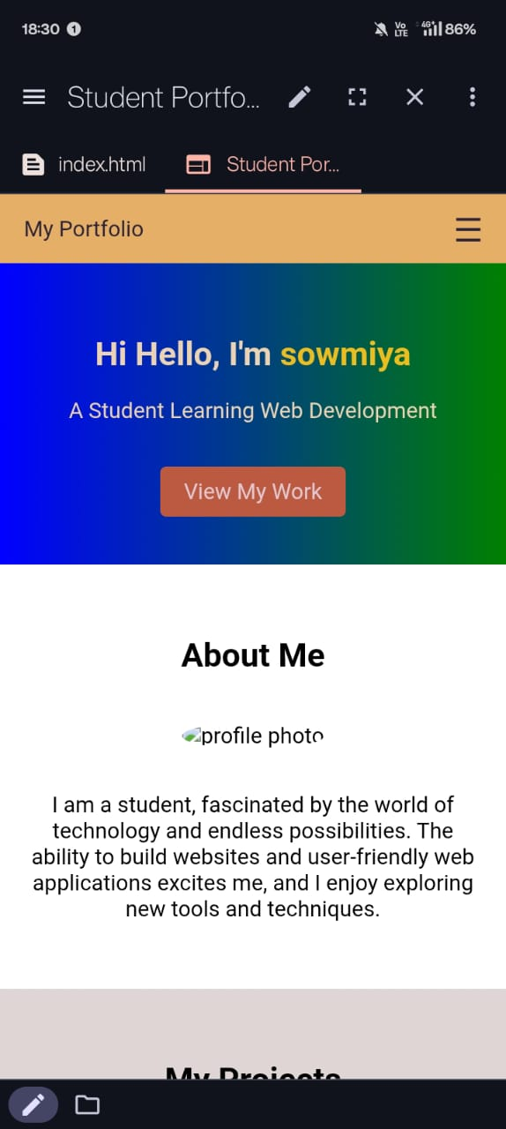

RESULTS AND SCREENSHOTS
3/21/2024 Annual Review
10

