Slide 1

Text Summarization
By
Team-23
Team Members
19K41A0518 – N.Vinusha
19K41A0520 – P. Shiva Sowmya
19K41A0577– Anasri
Guide
Dadi Ramesh
Assistant Professor of CSE

Slide 2
Abstract
Introduction
Objectives & Beneficiaries
Design
Project Workflow
Dataset Insights
Data Pre-processing
Text Vectorisarion
Building the model
Result Analysis
Conclusion & FutureScope
Agenda

Slide 3
Abstract
Natural Language Processing is one part of Artificial Intelligence and Machine Learning to make an understanding of the interactions between computers and human (natural) languages. Text Summarization is the most popular problem in this modern era.
“Text Summarizer” is used to convert huge amount data into small lines of data the summarizer data. This summarizer data gives the total meaning of the huge amount of data.
So that, we can read and understand a lot of data in small amount of time. We used seq2seq modeling and LSTM to develop our model.In our project we got an accuracy of 84.86% for the 1,00,000 records.

Slide 4
Introduction
Text summarization is the process of generating short, fluent, and most importantly accurate summary of a respectively longer text document.
The main idea behind automatic text summarization is to be able to find a short subset of the most essential information from the entire set and present it in a human-readable format.
.
Since we have a good amount of data in today’s world, we can use various algorithms to analyze the data for hidden patterns. And predict the summarised text.

Slide 5
Project Objectives Beneficiaries
To get good accuracy
Time Saving Process
When researching documents, summaries
make the selection process easier.
The human eye can miss out on crucial details that can be found in your text. However, the softwares do not miss it.
This software save from the stress by reducing the size of the text to about just 20%.
Our proposed model should be able
to predict the summarised text for the
given input with good accuracy.

Slide 6
Design
Hardware Requirements
System : Pentium 4, Intel Core i3, i5, i7 and 2GHz Minimum
RAM : 4GB or above
Hard Disk : 10GB or above
Input : Keyboard and Mouse
Output : Monitor or PC
Software Requirements
OS : Windows 8 or Higher Versions
Platform : Kaggle Notebook
Program Language : Python

Slide 7
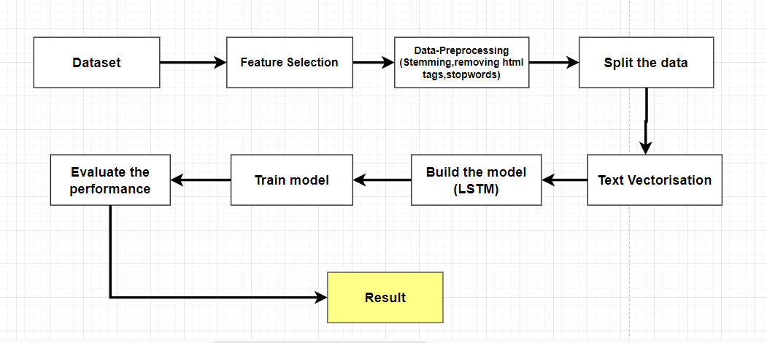
Project Workflow

Slide 8
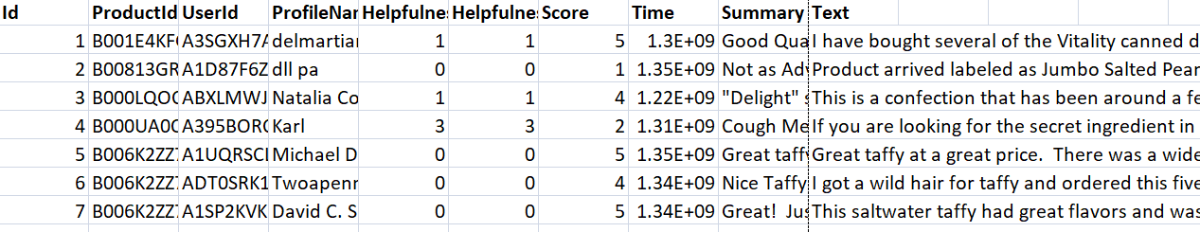
Dataset Insights
To develop this model, we collected amazon fine food reviews dataset from Kaggle. It has 5,68,454 customer reviews and 10 attributes. But we are using only 2 columns(summary ,text). And we are using 1,00,000 rows for training.

Slide 9
Data Pre-processing
Removing Unnecessary Columns:
The columns like time, profile name, product id, user id ,score is not necessary for building the model. So, we are deleting all the unnecessary columns and using only text, summary columns. Dataset after deleting all the un-necessary columns.
Removing Duplicate Data:
The Values in the dataset may be duplicate so, there is a need to check for data that is repeating and remove it so that it does not affect the model training and the accuracy that it is giving.
Removing Null Data:
The Values in the dataset may be Null so, there is a need to check for data that is null or not, so that it does not affect the model training and the accuracy that it is giving.
Removing Html tags:
The reviews contains some html tags in between which is not useful and it also affect the model which decreases the accuracy. BeautifulSoup is used for removing html tags.

Slide 10
Converting to Lower Case:
Converting the text present in the reviews column into lower case is necessary since it will be helpful while converting the text data into vectors. These vectors will be later used for training the model and validating it using the validation data. All the text should be in same format for this process.
Removal of Stop Words:
Stop word removal is one of the most used preprocessing steps across different NLP applications. The idea is simply removing the words that occur commonly across all the documents in the corpus. Typically, articles and pronouns are generally classified as stop words.
Stemming
Stemming is the process of reducing a word to its word stem that affixes to suffixes and prefixes or to the roots of words known as a lemma.
Padding
As we know all the neural networks needs to have the inputs that should be in similar shape and size. When we pre-process the texts and use the texts as an input for our Model. Where we know that we need to have the inputs with the same size, now here padding comes into picture. The inputs should be in same size at that time padding is necessary. The Padding method from Keras library is used to add zeroes to the formed vectors.

Slide 11
Text Embedding
SEQ2SEQ MODEL
Seq2Seq model is a model that takes a stream of sentences as an input and outputs another stream of sentences.
It mainly has two components :
→ Encoder: Encoder model is used to transform the input sentences and generate feedback after every step.
→ Decoder : The decoder model is used to predict the target sentences word by word. It takes the input of target sentences and predicts the next word which is then fed into the next layer for the prediction.

Slide 12
Model Construction
LSTM: now we will create 3 stacked LSTM layers where the first lstm layer will have input of encoder and like that create a continuous sequence of lstm layers.
Attention Layer: we will pass the encoder and decoder outputs into the attention layer and then we will concatenate attention layer outputs with the decoder outputs.
Dense Layer is the output layer for our model. it will have the shape of the total number of target words and a softmax activation function.

Slide 13
Results
No. Of Epochs=10
From split data 80% of training data, we made a machine model to predict.
The machine model predicts the other 20 % of data as data testing to see how our model work. We use 3 stacked Long Short-Term Memory to make the machine model good enough to predict.
Accuracy:
The results of this machine model are having 84.86% accuracy. It is explained from 20% data, that is classified for testing in which the training data is used to predict the machine correct around the trained model.

Slide 14
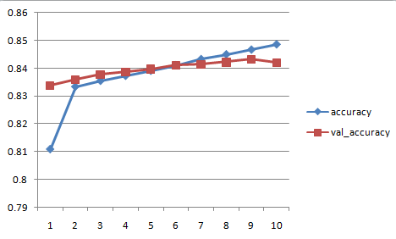
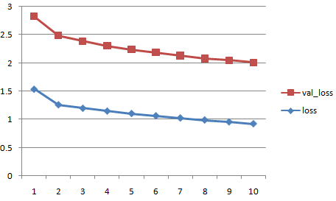
Accuracy Vs Epochs
Loss Vs Epochs

Slide 15
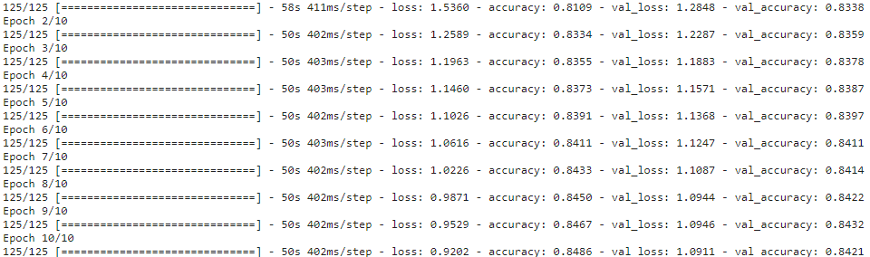

Slide 16
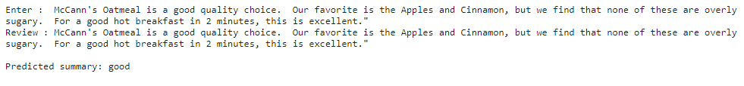
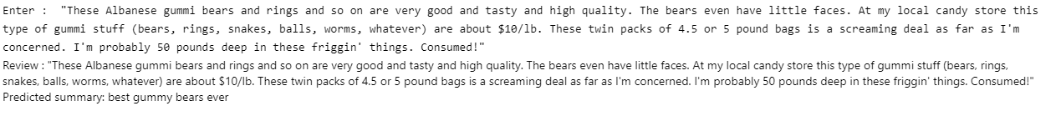
Ouput 1:
Output 2:

Slide 17
Conclusion & Future Scope
CONCLUSION :
Now we can predict Summarised text with best accuracy
Future Scope :
Increase in accuracy in predicting the result.

Slide 18


