Slide 1
Data Science CAPSTONE PROJECT The Battle of Neighbourhoods
By: Sowmya Prakash

Slide 2
Table of Contents
Introduction
Business Background
Target Audience
Data Overview
Methodology
Results
Conclusion
References

Slide 3
Introduction
The demographics of Toronto, Ontario, Canada makes Toronto one of the most multicultural and multiracial cities in the world. In 2016, 51.5% of the residents of the city proper belonged to a visible minority group, compared with 49.1% in 2011,and 13.6% in 1981.Toronto also has established ethnic neighbourhoods such as the multiple Chinatowns, Corso Italia, Little Italy, Little India, Greektown, Koreatown, Little Jamaica, Little Portugal and Roncesvalles, which celebrate the city's multiculturalism
In this project we will try to analyse all the Indian Restaurants currently present in Toronto's different neighbourhood and check the top few Indian restaurant's popularity from its Likes, ratings, tips etc and will be able to provide a final result/analysis at the end of this project.

Slide 4
Business Background
Here in our project we will check all the Indian Restaurants that are present in different Postal code, Boroughs and Neighbourhoods of Toronto. We will analyse the data of Toronto's Borough and Neighbourhoods and see where the Indian restaurants are in highest number and in high demand and then we will compare all the Indian Restaurants according to their Likes, Tips and Rating. We will visualize all the great Indian Restaurants in different types of graphs and map.

Slide 5
Target Audience
This project will help business investors to set up Indian restaurants in neighbourhoods with major Indian population. It will help them analyze and set up restaurants according to their competition.
This project will also help foreign students and residents to find Indian cuisine restaurants nearby.

Slide 6
Data Overview
Data Preparation
In this project we will be needing the below data :
Web Scrape the City of Toronto data that contains PostalCode, Boroughs, and Neighbourhoods.
Data: https://en.wikipedia.org/wiki/List_of_postal_codes_of_Canada:_M_
For scraping the data we will be using BeautifulSoup package.
We will need geopy library to get the latitude and longitude values of Toronto City.
https://cocl.us/Geospatial_data
Venues of all Indian Restaurant in Toronto city and their rating, likes and tips information data.
Data : Foursquare API
Visualize the data in form of Boundary Map.
Data : Folium package (Folium is a python library that can create interactive leaflet map using coordinate data.)
Sk-learn package & yellowbrick package

Slide 7
Data Processing
Firstly we will web scrap data and collect Toronto city's data that contains PostalCode, Borough, and Neighbourhood and put it in a dataframe.
We will then clean the data according to our need, remove unassigned values in borough or unwanted features and merge different neighbourhood with same borough etc.
Foursquare api will help to get the coordinates i:e latitude and longitude of all the neighbourhoods of Toronto city via Geopy Client.
Filter out the Venues of all Indian Restaurant present in Toronto city.
We will then collect the likes, rating , tips etc for each of the Indian restaurants and then sort them according to their values .
The comparison data and the ranking will be plotted on Bar Chart graphs using matplotlib library, Seaborn library , Sk-learn package & yellowbrick package library .
We will Visualize the data of top Neighbourhood based on the venue categories in a Toronto City map using Folium Package.
Finally, we will cluster these top Neighbourhood based on the venue categories and use K-Means clustering Machine learning technique to build a model using Elbow point method.

Slide 8
Methodology
Importing all the Important python packages and libraries that will be used in this project.
I have extracted the data as per the direction mentioned above through Web scraping and geopy client etc.

Slide 9
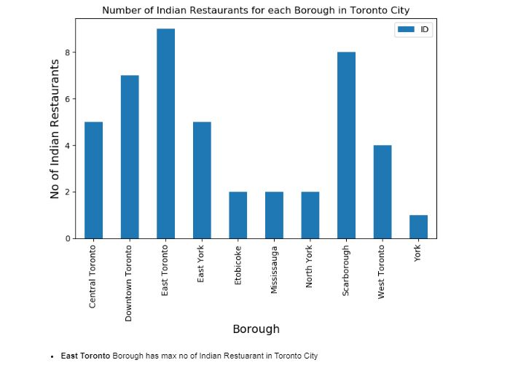
Exploratory Data Analysis
Now analysis will done on the data that we have prepared and different calculation and decisions will be taken accordingly. We have plot the data in bar chart and bar graph to see the outcome which will make us decide to move further on our analysis for Indian Restaurants.

Slide 10
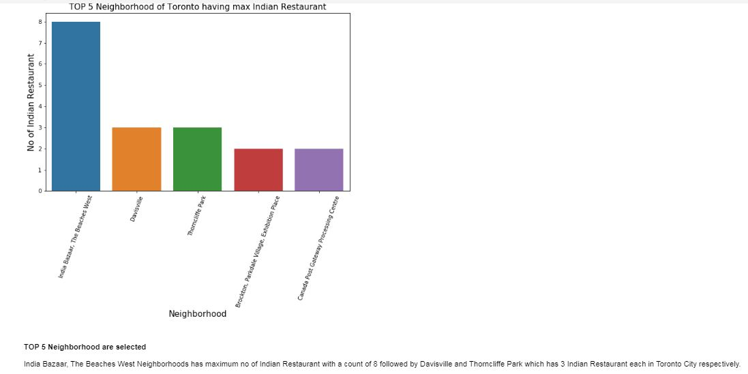

Slide 11
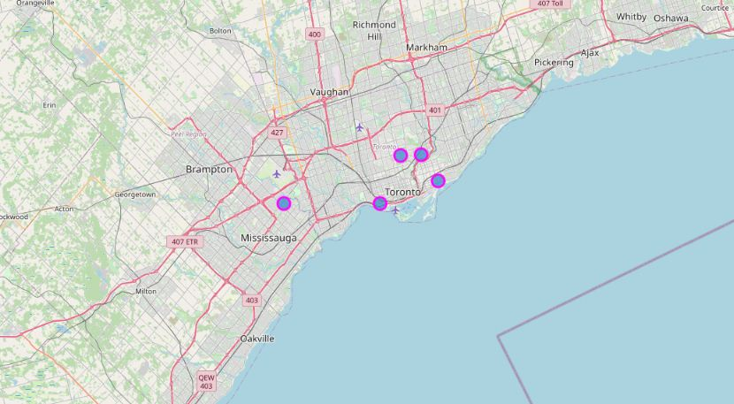
Visualize the data using map by importing folium.

Slide 12
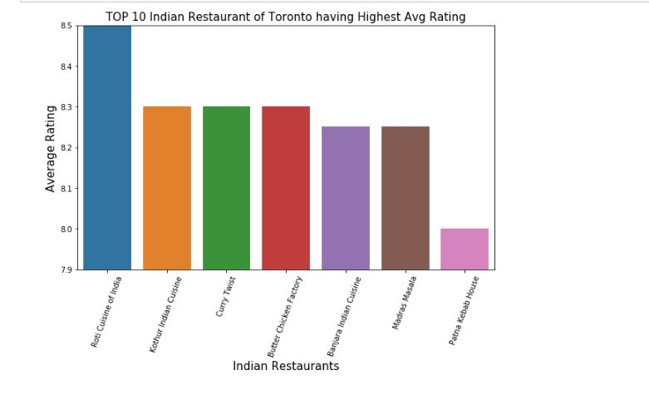

Slide 13
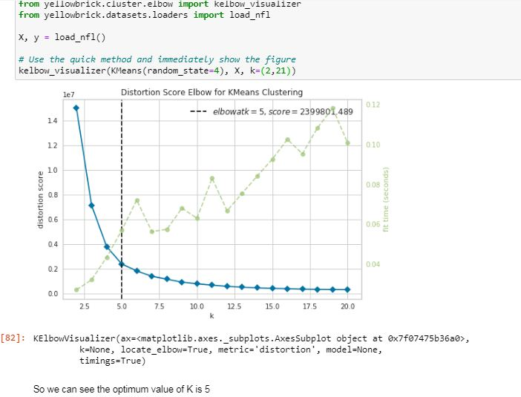
Machine Learning- Clustering of the neighborhoods We will use K-means clustering technique with Elbow visualizer to get the best K.

Slide 14
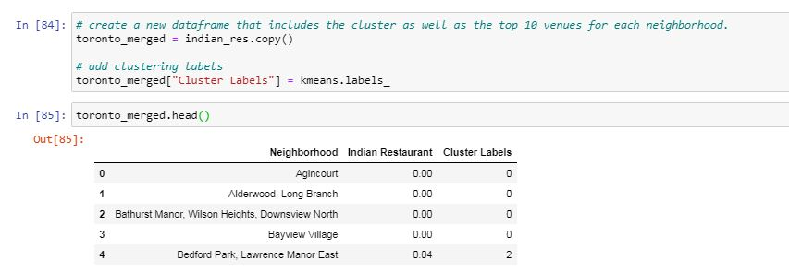

Slide 15
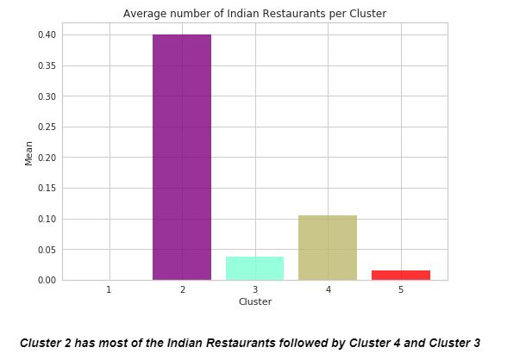
Plotting the graph for all the Neighbourhood Cluster to see the Indian Restaurants occurrence.

Slide 16
Results
After analyzing the data we observe different results as follows:-
East Toronto Borough has max no of Indian Restaurant in Toronto City
East Toronto Borough has 11 Indian Restaurants followed by Scarborough and Downtown Toronto which has 7 Indian Restaurants where as York Borough has least Indian Restaurants present its count being 1.India Bazaar, The Beaches West Neighbourhoods has maximum no of Indian Restaurant with a count of 7 followed by Davisville and Thorncliffe Park which has 3 Indian Restaurant each in Toronto City respectively.
It is under the East Toronto Borough The Indian Bazaar, The Beaches West Neighbourhood falls, which has maximum no of Indian Cuisine Restaurant in Toronto city.
We can observe Banjara Indian Cuisine of Indian Restaurant got the Max Likes , Rating & Tips. It belongs to Christie Neighbourhood and of Downtown Toronto Borough.
The Annex, North Midtown, Yorkville Neighbourhood has the Highest average Rating in Toronto City with 8.70 rating.
Roti Cuisine of India has the Highest Rating followed by Kothur Indian cuisine, Curry Twist and Butter Chicken Factory.

Slide 17
Conclusion
Through this capstone project, I have got a small glimpse of how real life data-science projects look like. In this project I have imported different types of python libraries and packages such as panda, numpy, matplotlib, sk-learn, seaborn, Folium etc . I have also used BeautifulSoup package to web scrape data.
I have also used Foursquare api to get the latitude and longitude data of Toronto City by Geopy Client. I have explored the different Borough, Neighbourhood of Toronto city and analyse the data to get different outcome for Indian Restaurants of different parts of the city.
I have also used Machine learning technique K-Means clustering to cluster the neighbourhoods and predicted a result which may help many business enthusiasts for opening Indian Restaurant in Toronto city where profit will be maximum and the demand is high.
This kind of analysis will provide me initial guidance to take more real-life challenges using data-science.

Slide 18
References
Coursera.org
wikipedia.org
https://cocl.us/Geospatial_data
https://foursquare.com/

Slide 19
Thank you ☺

