Slide 1
STUDENT-FACULTY FEEDBACK PORTAL
Tutor: Dr. Santosh Biswas
Presented by…
K Sowmya – 130101028
L Bhavana – 130101043
Y Pallavi - 130101081

Slide 2
CONTENTS
Objectives
Tools Used
Data Flow Chart
Functionalities
Conclusion
<number>

Slide 3
Objectives
The main objective of our portal is to provide an essence of feedback portal via simple and a powerful interface.
It has been designed to make the students and faculty meet and share their views regarding the course and teaching.
It gets the job done easier without any hassles.
The course feedback is sent to the administration.
Any user can login and perform the following activities.
STUDENT- leave feedback, share ideas, post complaints, raise questions &
give compliments
FACULTY – check his performance comprehensively and consistently,
receive posts from students
ADMIN – can add/delete questions from feedback form,
view any faculty’s feedback page and can disable or
enable the feedback form
<number>

Slide 4
Tools Used
HTML 5.0
CSS 3
PHP 5.2.4
jQuery
JAVA SCRIPT
AJAX
MySQL
LINUX
<number>

Slide 5
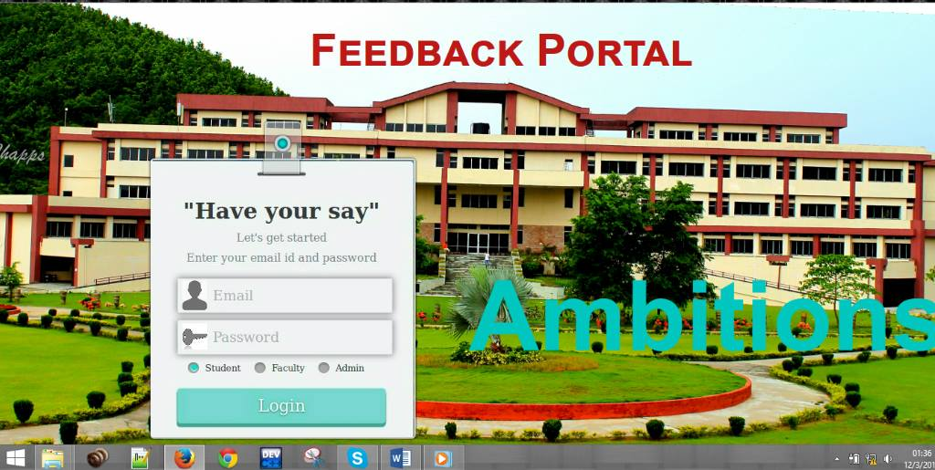
Login page
<number>

Slide 6
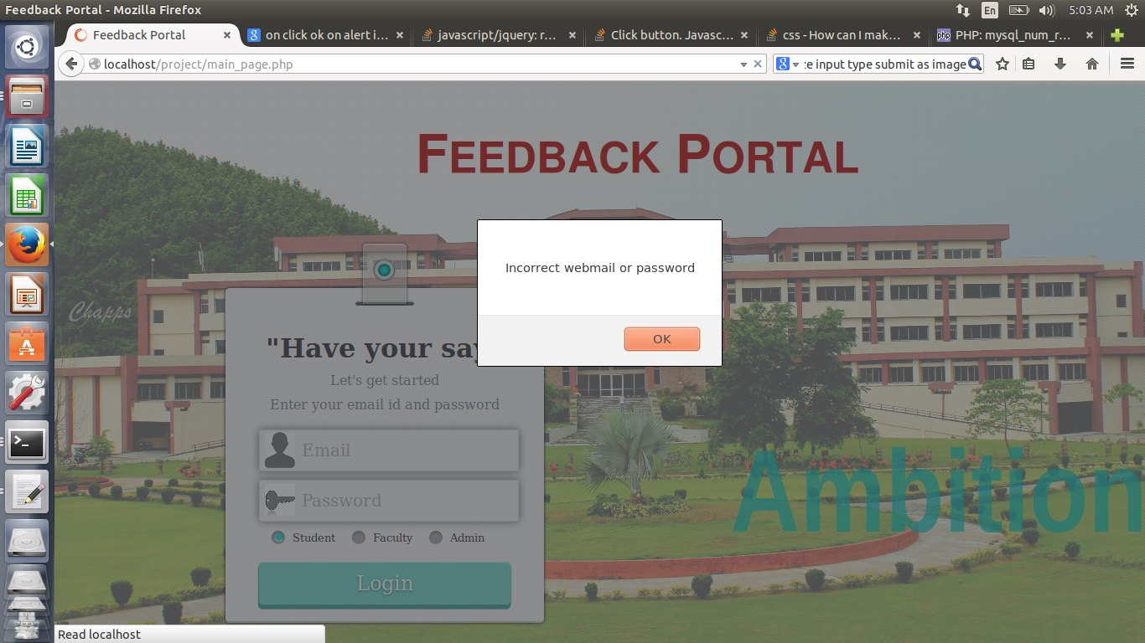
Incorrect Credentials
<number>

Slide 7
Data Flow Chart
Student login
YES NO
Valid user name and password
Entry to student page
leave feedback to
course and concerned faculty
share ideas, post complaints, raise questions & give compliments
Student logout
<number>

Slide 8
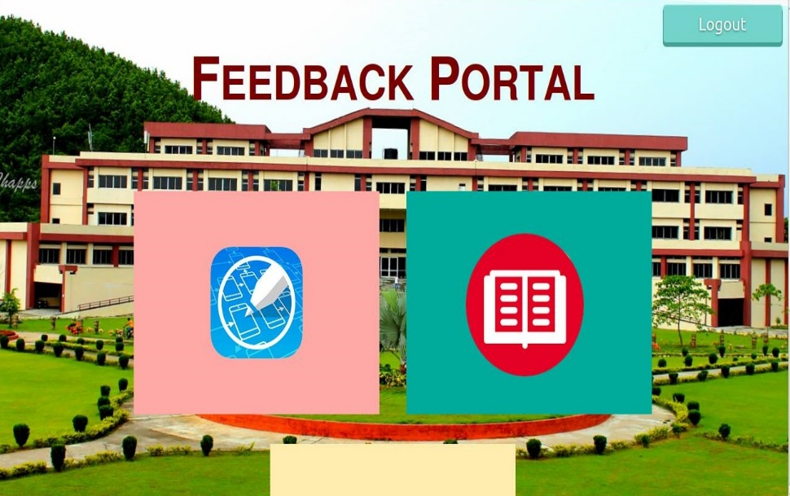
Screenshots (contd…)
Student Page
<number>

Slide 9
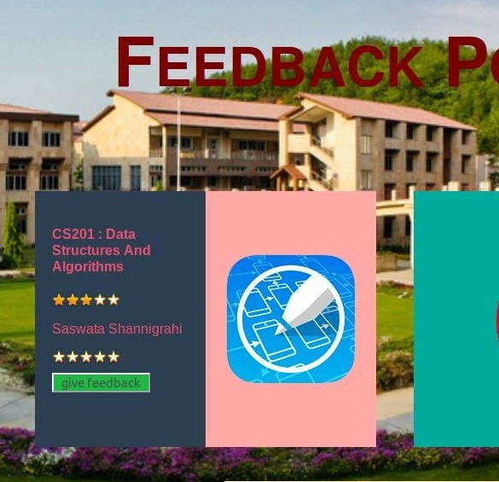
Screenshots (contd…)
give feedback
<number>

Slide 10
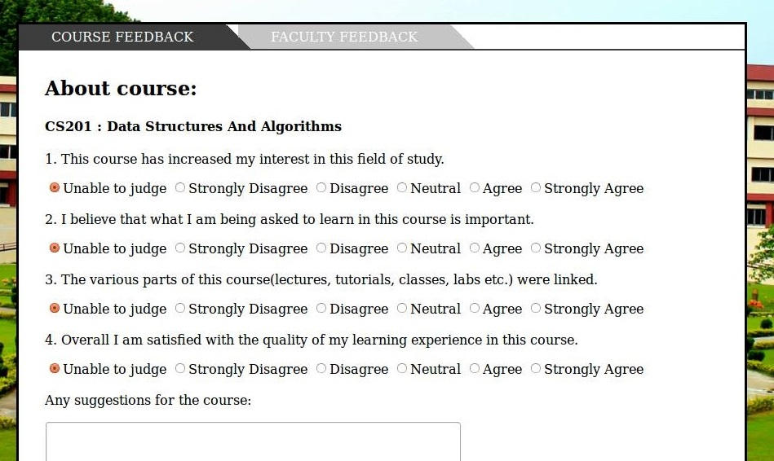
Give course feedback
Screenshots (contd…)
<number>

Slide 11
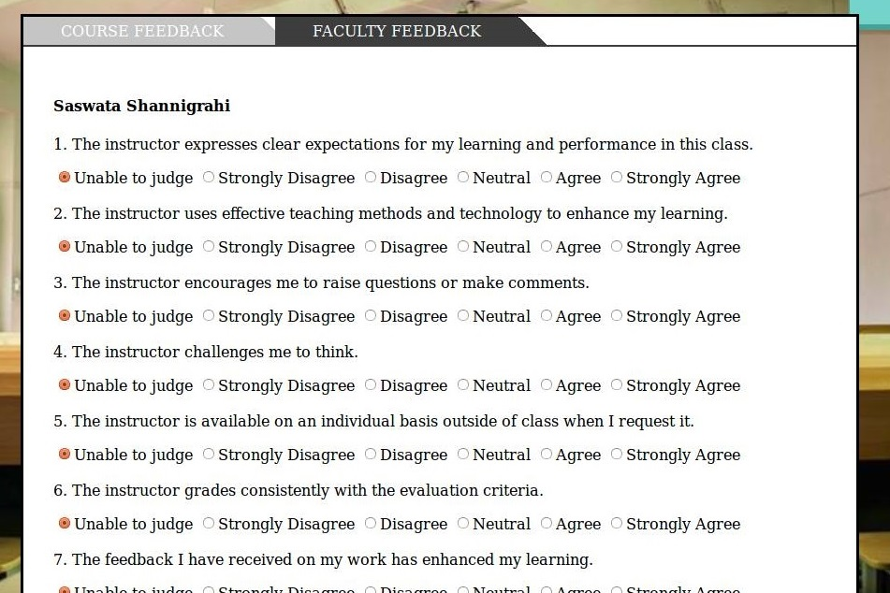
Faculty feedback
Screenshots (contd…)
<number>

Slide 12
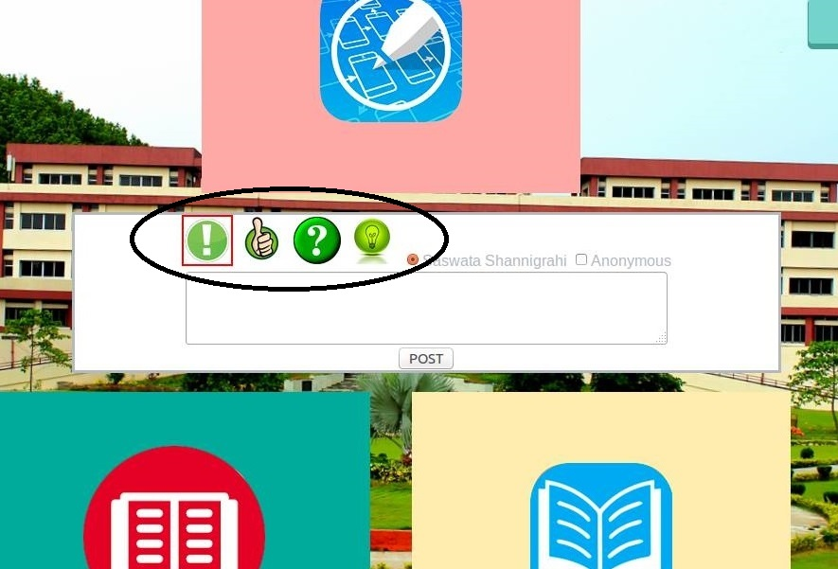
Screenshots (contd…)
Give ideas,
compliments,
complaints,
ask questions
and post them.
<number>

Slide 13
Data Flow Chart
Student login
YES NO
Valid user name and password
Entry to student page
leave feedback to
course and concerned faculty
share ideas, post complaints, raise questions & give compliments
Student logout
<number>

Slide 14
Flow chart (contd…)
Faculty login
Is valid user name or password
YES
NO
Entry to faculty page
Check comprehensive and consistent performance
view the compliments, complaints,questions and ideas posed by the students
Faculty logout
<number>

Slide 15
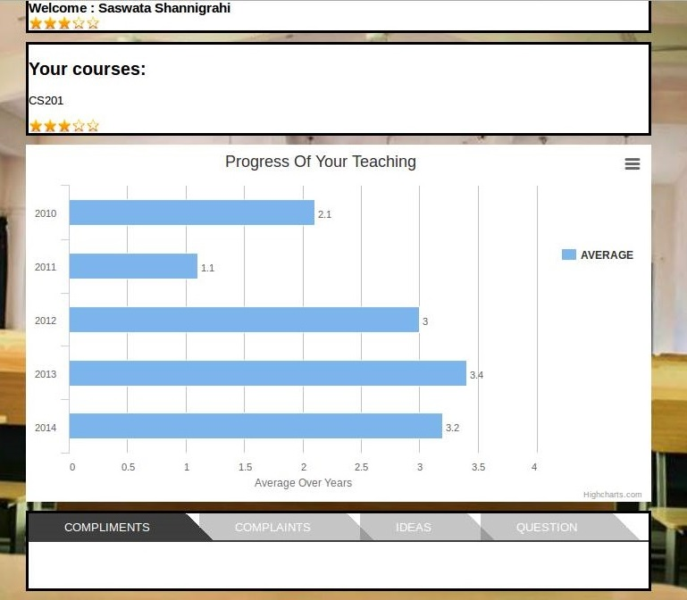
Screenshots (contd…)
Faculty page
<number>

Slide 16
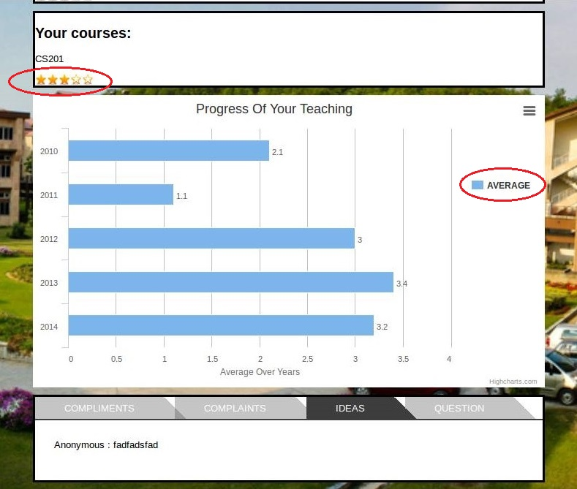
Screenshots (contd…)
Check
average
rating out of 5
represents
Check average
comprehensive
performance
year wise
<number>

Slide 17
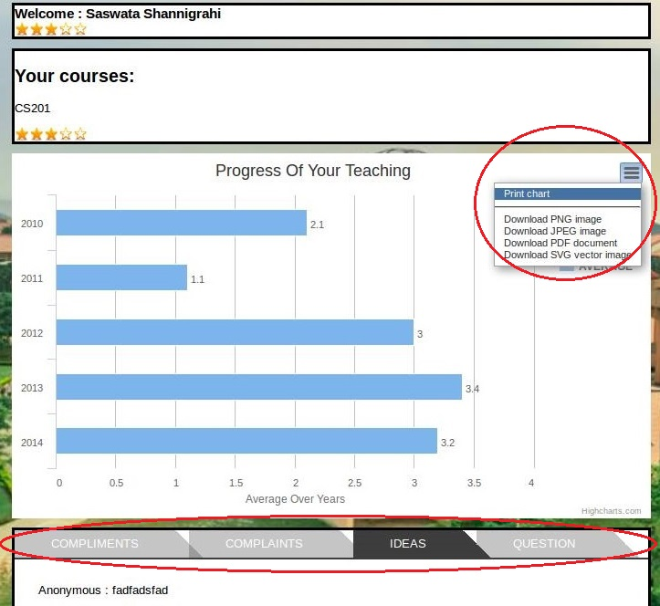
Screenshots (contd…)
Download
and
print the chart
View and reply to posts by students
\
<number>

Slide 18
Flow chart (contd…)
Faculty login
Is valid user name or password
YES
NO
Entry to faculty page
Check comprehensive and consistent performance
view the compliments, complaints,questions and ideas posed by the students
Faculty logout
<number>

Slide 19
Flow chart (contd…)
Admin login
Is valid user name or password
YES
NO
Entry to admin page
can add/delete questions from feedback form,
view any faculty’s feedback page and can disable or enable the portal
Admin logout
03/12/14
<number>

Slide 20
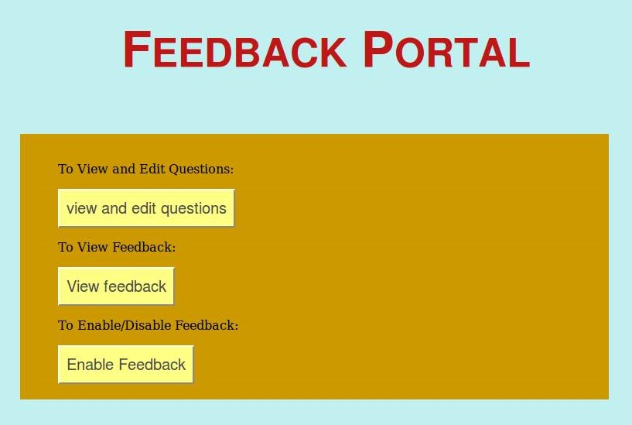
Screenshots (contd…)
Admin Page
<number>

Slide 21
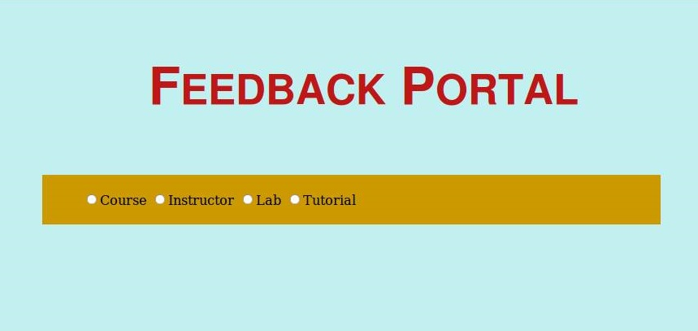
Screenshots (contd…)
03/12/14
.
<number>

Slide 22
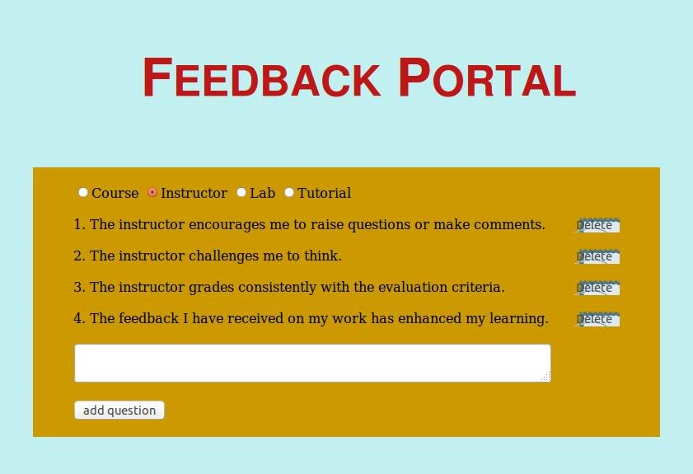
Screenshots (contd…)
can add/delete questions from feedback form
.
<number>

Slide 23
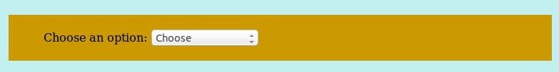
Screenshots (contd…)
03/12/14
<number>

Slide 24
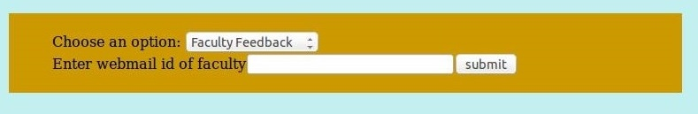
Screenshots (contd…)
03/12/14
<number>

Slide 25
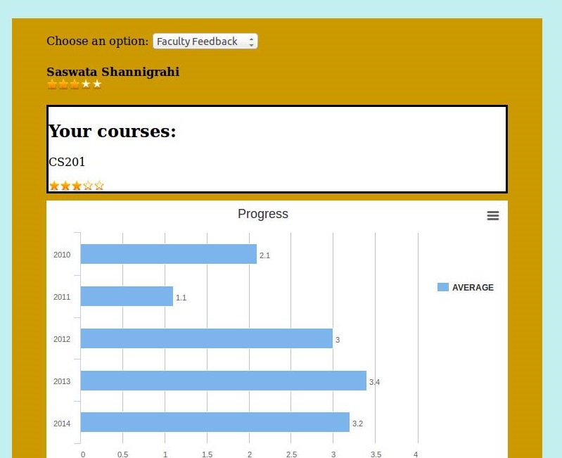
Screenshots (contd…)
view any faculty’s feedback page and can disable or
enable the portal
03/12/14
<number>

Slide 26
Flow chart (contd…)
Admin login
Is valid user name or password
YES
NO
Entry to admin page
can add/delete questions from feedback form,
view any faculty’s feedback page and can disable or enable the portal
Admin logout
03/12/14
<number>

Slide 27
Conclusions
Feedback portal meets the needs of students, faculty and administration effectively
Encourages student involvement and responsibility.
Helps to link teaching and learning and can be incorporated with best teaching practices.
The consistent and regular feedback helps in finding new and better ways of teaching.
Sharing of one’s ideas to the faculty directly either anonymously or directly will be helpful for the students as they can proceed further regarding that
<number>

Slide 28
More to come..!!
Features:
Instant notifications when a student, share ideas, post complaints, raise questions & give compliments to a faculty
The faculty can also send a reply regarding the same for which the student gets the notification
Thumbs up or Thumbs down button
A student can give a class a thumbs up or down for each and every class and this will be counted in the faculty’s page
03/12/14
.
<number>

