Slide 1
PROJECT TITLE
FREELANCING APPLICATION MERN
TEAM MEMBERS
Srinidhi V
Shruthi.S
Sowmya. P
Shanmuga Priyadharshini .C.S

Slide 2
ABSTRACT
The Freelancing Application Website named Fiverr aims to connect freelancers with clients seeking services across various domains. The platform allows users to find job opportunities, apply for jobs, and hire freelancers based on their skills. The system supports seamless job searching, freelancer discovery, and real-time application submission, ensuring secure payments and 24/7 support. The website is designed to provide a user-friendly experience with a straightforward navigation system and efficient filtering options.

Slide 3
INTRODUCTION
Freelancing has become an increasingly popular career choice due to its flexibility and the global shift towards remote work. However, finding the right freelance opportunities and matching them with suitable candidates can be a challenge. The Freelancing Application Website aims to bridge this gap by creating an efficient system that allows freelancers to browse and apply for jobs while enabling clients to find and hire skilled professionals for their projects. The system focuses on simplicity, ease of use, and effective job matching, ensuring a seamless experience for both parties.

Slide 4
PROPOSED SYSTEM
The proposed system comprises two main user roles: clients and freelancers. Clients can post job opportunities, while freelancers can search for jobs and submit applications.
It is a full-featured freelancing platform with functionalities that include: Job posting and job searching capabilities, Freelancer profiles and skill listings, Secure payment handling with protected transactions, Real-time browsing, filtering, and communication between clients and freelancers.
The system also provides business-focused solutions for teams, including enhanced tools for managing teamwork, improving productivity, and getting matched with top talent.

Slide 5
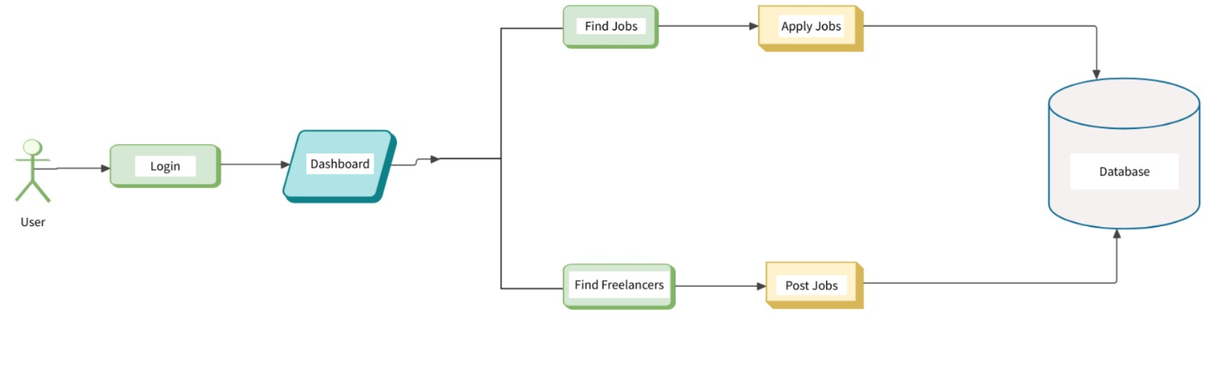
ARCHITECTURE DIAGRAM

Slide 6
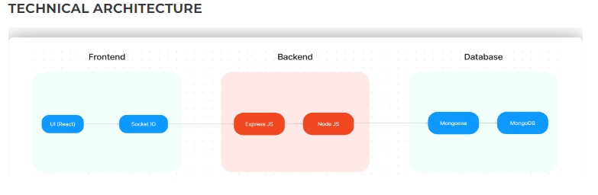
TECHNICAL ARCHITECTURE

Slide 7
FRONT-END DEVELOPMENT
The frontend is built using React for efficient rendering and UI development. The core components of the homepage include:
Featured Section: Highlights key features of the platform.
TrustedBy Component: Displays trust markers from recognized brands and companies.
Slide Component: A carousel showcasing various job categories or projects.
CatCard & ProjectCard Components: Render individual category cards or project details dynamically.
Marketplace Exploration: Users can browse different categories like Graphics & Design, Digital Marketing, Writing & Translation, Programming, etc.
Business Solutions: A special section to promote Fiverr Business, which caters to teams and organizations.
Socket ID integration ensures real-time updates between users, freelancers, and clients.

Slide 8
BACKEND DEVELOPMENT
The backend of Fiverr is developed using Node.js, Express.js and connects to a database (MongoDB) for data storage. The backend handles:
User authentication and authorization for secure login and registration.
Managing job postings, freelancer profiles, and client requests.
Secure transactions for job applications and payments.
Data storage using MongoDB to handle user data, job postings, and transaction records.
The backend also integrates with real-time communication channels for quick response times between clients and freelancers.

Slide 9
INTEGRATION
Integration between the frontend and backend is done using REST APIs. The React frontend communicates with the Express.js backend, which processes requests and queries the MongoDB database. Key integrations include:
Job searching and filtering.
Applying for jobs and managing freelancer profiles.
Payment transactions and order management.
The platform also uses Socket ID for real-time notifications and updates, ensuring users are notified when new jobs are posted or applications are accepted.

Slide 10

MODEL SCREENSHOTS

Slide 11
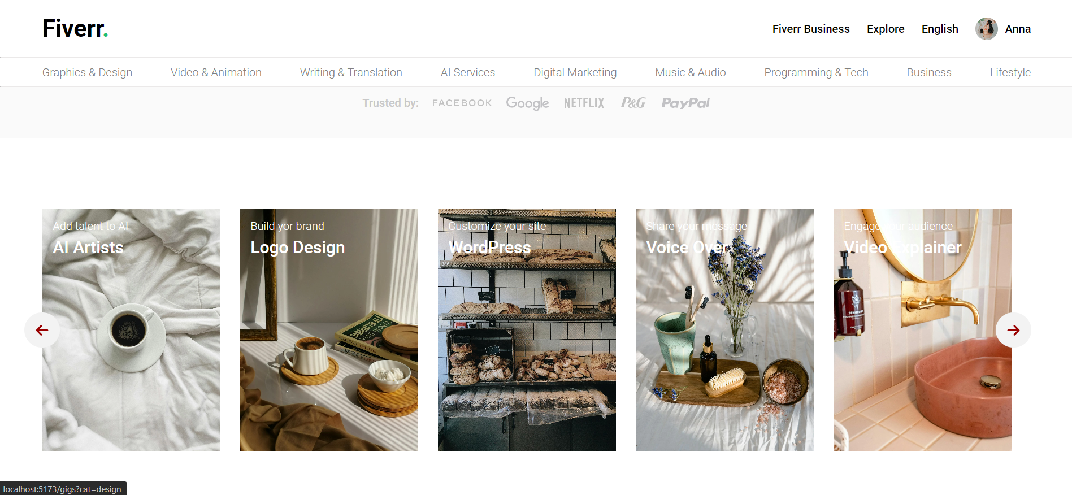

Slide 12
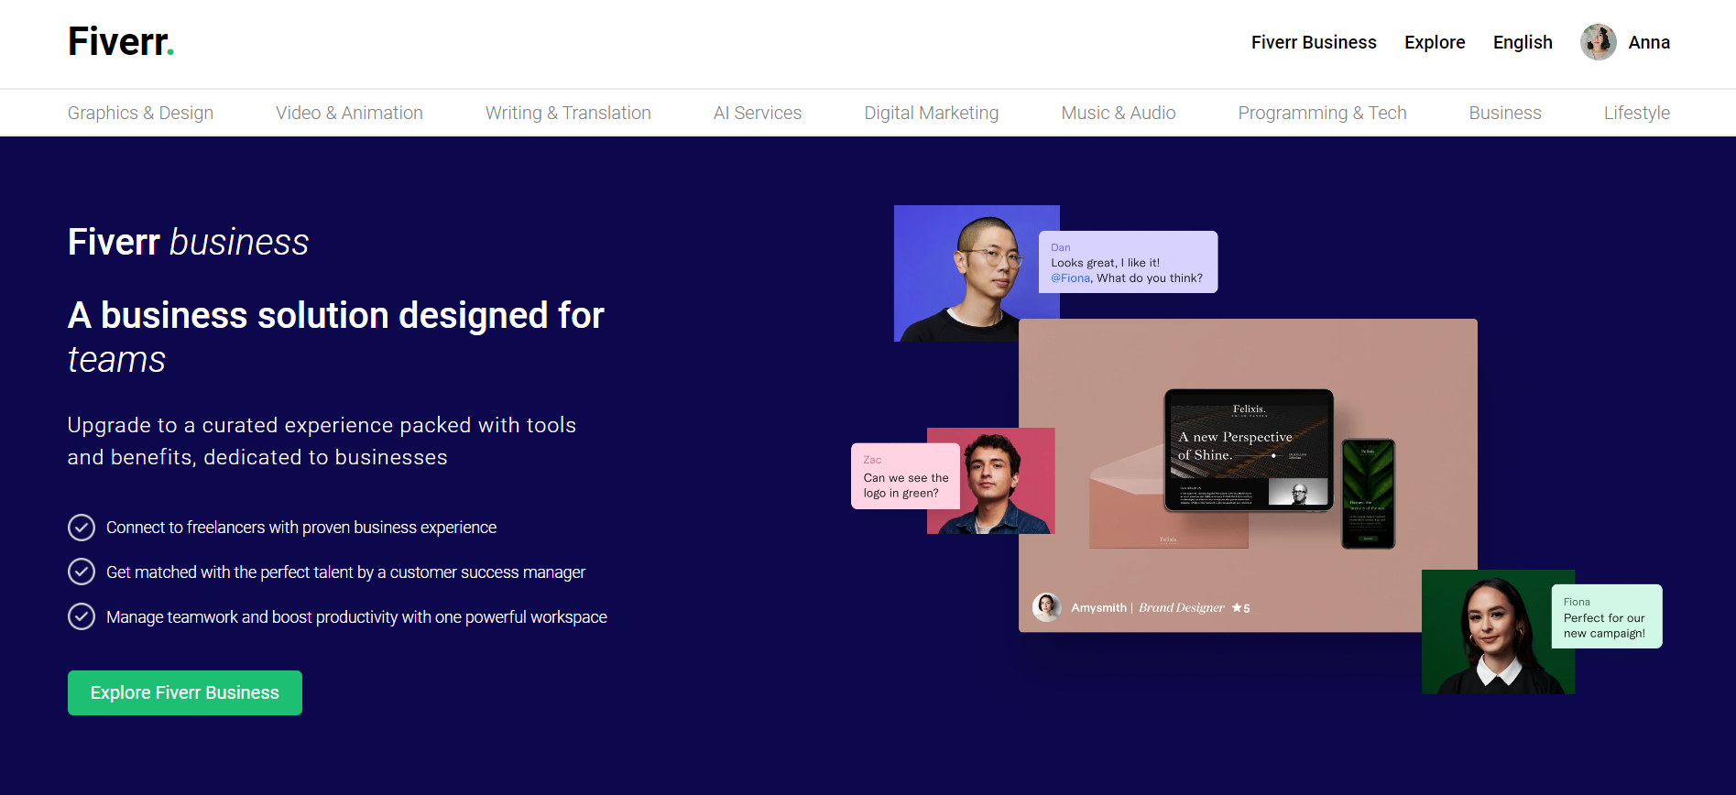

Slide 13
CONCLUSION
The Fiverr Freelancing Platform is an effective solution for connecting freelancers and clients in various industries. With a robust frontend built using React and Socket ID for real-time updates, coupled with a powerful backend using the MERN stack, this platform ensures seamless job searching, freelancer discovery, and secure transactions. The system also offers advanced business solutions for teams, making it a versatile tool for both individual users and organizations.

Slide 14
THANK YOU!

