Slide 1
SENTIMENT ANALYSIS – YELP Dataset
Sai Sowmya Bandaluppi

Slide 2
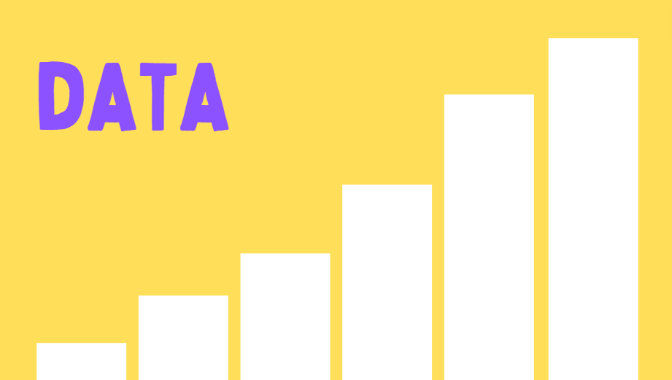
OBJECTIVE
Restructure a flattened and/or de-normalized dataset so it can be loaded into a SQL or Graph database. Identify and demonstrate a form of analysis that is made easier by restructuring the data.
Dataset: Yelp Dataset (https://www.kaggle.com/yelp-dataset/yelp-dataset)

Slide 3
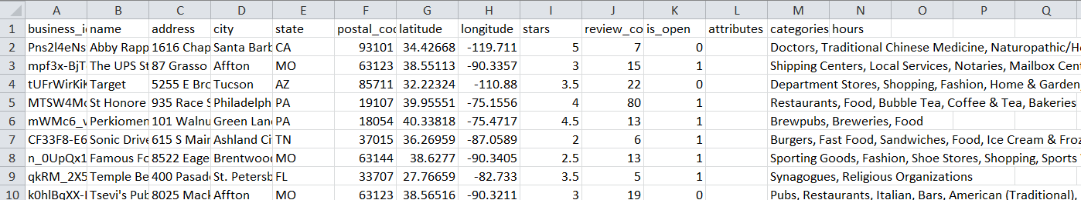
DATASET
Dataset:
Yelp Dataset
3 entities(business, user, reviews)
Worked on 1 entity: Business
A valuable resource for understanding the landscape of businesses across various regions.

Slide 4

SQL DATABASE
SQLite
Minimal Setup and Configuration with no need of a server in specific
SQLite is efficient and performs well for many common database operations, including querying, indexing, etc.
Easy-to-use database solution with full SQL support and portability across different platforms

Slide 5
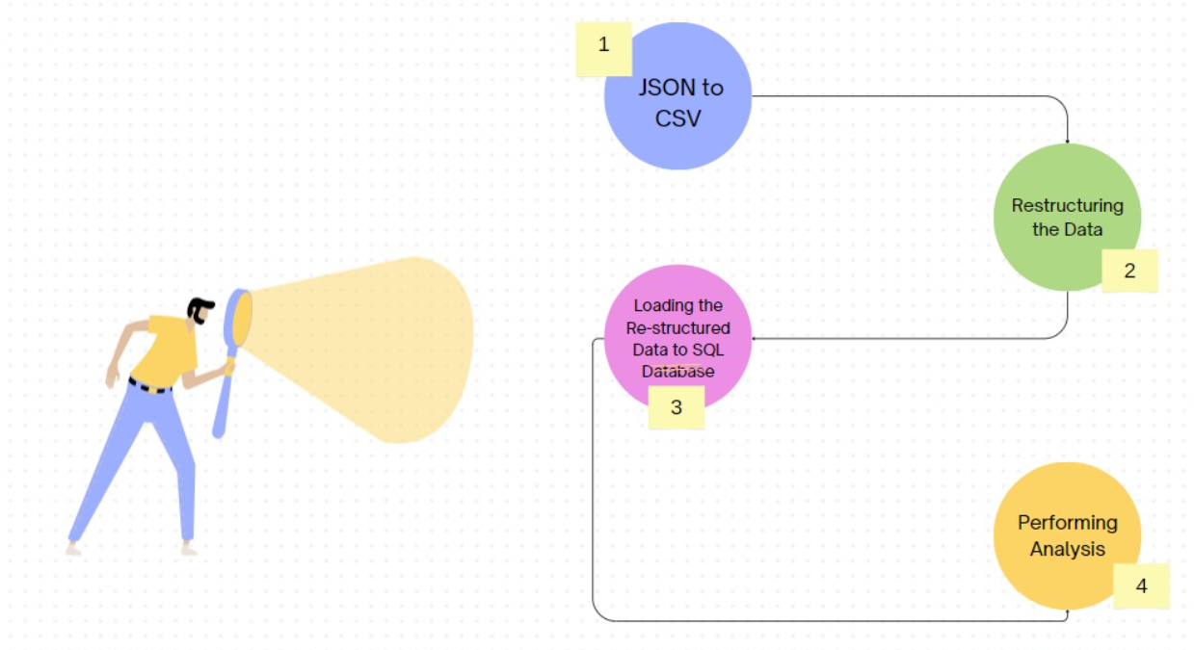
WORKFLOW

Slide 6
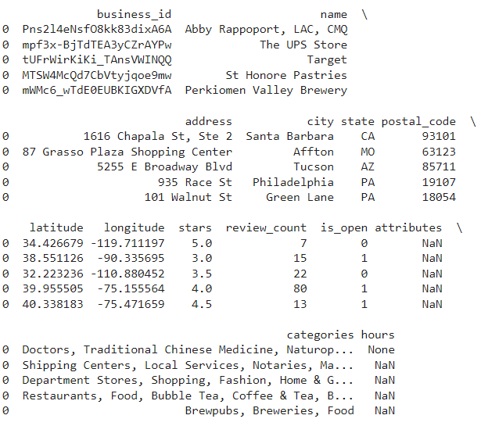
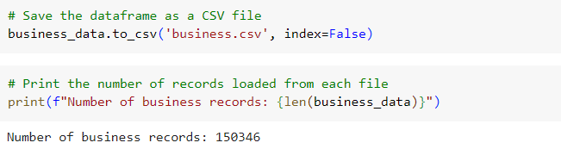
DATA

Slide 7
RESTRUCTURING THE DATA
Restructuring a de-normalized dataset includes
Normalization of de-normalized data:
Organizing data to reduce redundancy(duplication of data) and dependency(relationship between attributes or columns)
Redundancy leads to data inconsistency and difficulties in maintaining data integrity
Identifying dependencies is crucial for database design and normalization processes, as it helps in organizing data efficiently
Database Schema for restructuring:
Creating Relationships between tables for better organization

Slide 8
RESTRUCTURING DENORMALIZED DATASET
Understanding De-normalization in Database
De-normalization simplifies queries but can lead to data redundancy
Identifying Key Relationships
Establish connections between data tables for seamless integration
Optimizing Data
Enhance data organization to reduce redundancy and improve consistency
Implementing Normal Form Rules
Apply Normalization Principles to ensure data integrity and scalability
“NORMALIZATION BRINGS ORDER TO CHAOTIC DATASETS”

Slide 9
DATA NORMALIZATION
First Normal Form(1NF)
Each column contain indivisible values, and there are no repeating groups or arrays of values within a row. In the denormalized dataset, each row represents a business entity, and columns contain multiple values (e.g., 'categories' column). To achieve 1NF, we split the denormalized dataset into separate tables: 'address_df', 'categories_df', and 'business_category_df'.
Second Normal Form(2NF)
In 2NF, the dataset must be in 1NF, and all attributes must be fully functionally dependent on the primary key. Each table ('address_df', 'categories_df', 'business_category_df') contains attributes that are fully functionally dependent on the primary key ('business_id').
Third Normal Form(3NF)
In 3NF, the dataset must be in 2NF, and there should be no transitive dependencies. Here, the 'address_df' table, the 'categories_df' table and 'business_category_df' table are directly dependent on the primary key. These categories have no transitive dependencies

Slide 10
DATA NORMALIZATION CONTD.
# Separate address information into a separate table
address_df = business_df[['business_id', 'address', 'city', 'state', 'postal_code']].drop_duplicates().reset_index(drop=True)
# Separate category information into a separate table
categories_df = business_df[['business_id', 'categories']].explode('categories').dropna().reset_index(drop=True)
# Create a mapping table for many-to-many relationship between businesses and categories
business_category_df = business_df[['business_id', 'categories']].explode('categories').dropna().reset_index(drop=True)
# Extract and format reviews data (assuming a single 'stars' column)
reviews_df = business_df[['business_id', 'stars']].dropna().reset_index(drop=True)
# Save the normalized tables to CSV files
address_df.to_csv('address.csv', index=False)
categories_df.to_csv('categories.csv', index=False)
business_category_df.to_csv('business_category.csv', index=False)
reviews_df.to_csv('reviews.csv', index=False)

Slide 11
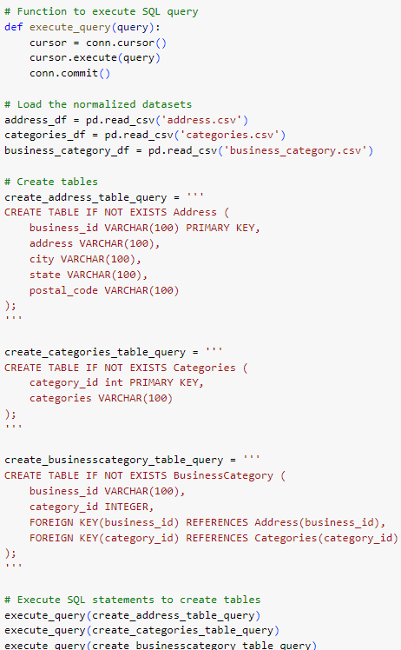
LOADING DATA INTO SQLite

Slide 12
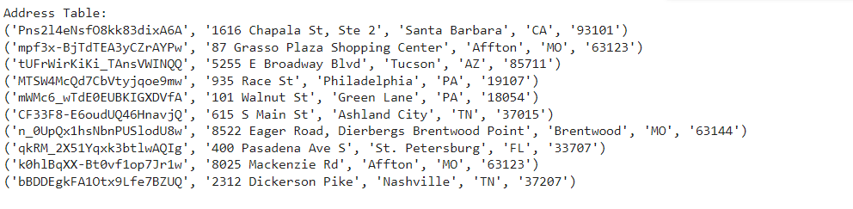
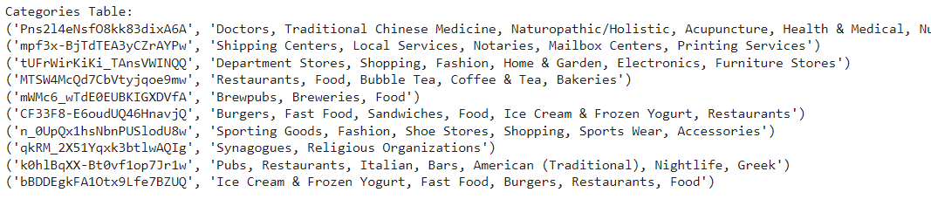
LOADING DATA INTO SQLite CONTD.

Slide 13
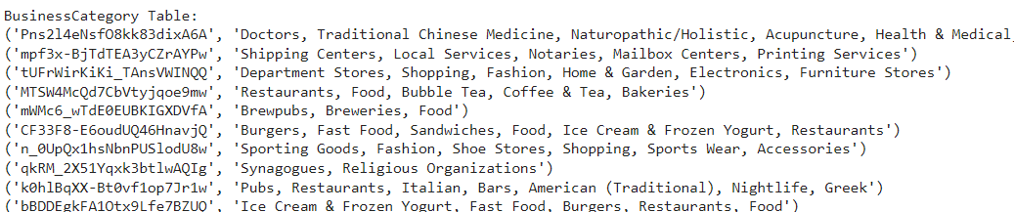
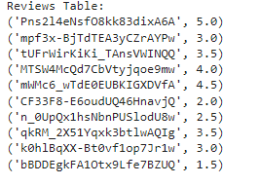
LOADING DATA INTO SQLite CONTD.

Slide 14
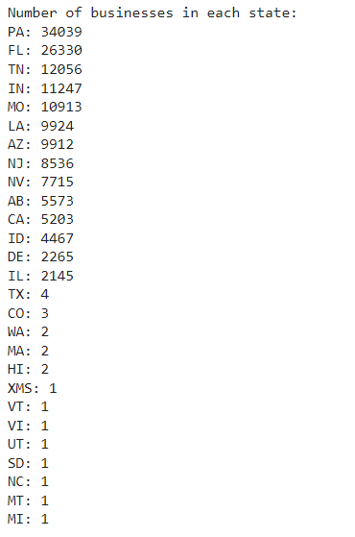
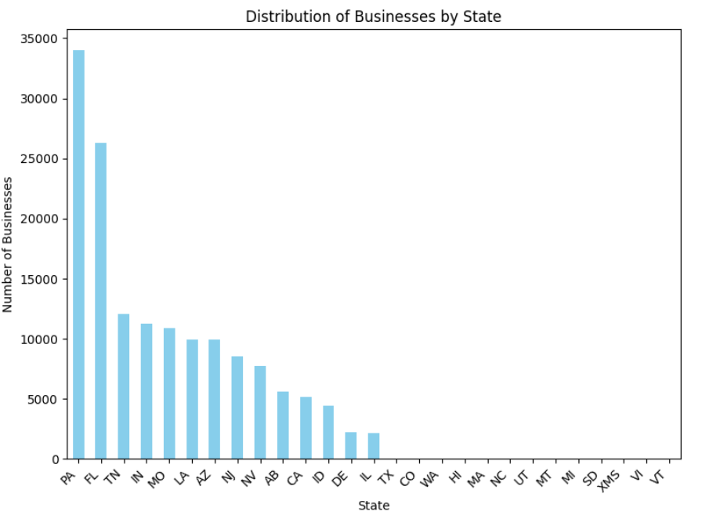
ANALYSIS

Slide 15
SENTIMENT ANALYSIS
Sentiment analysis is the process of automatically identifying the emotional tone within the data.
Performs a preliminary sentiment analysis based on the star ratings provided in the Reviews table.
It assigns sentiment categories ("Very Positive" to "Very Negative") to businesses based on the average star rating.
While star ratings provide a general idea of sentiment, they lack nuance. A 5-star review might not always reflect "Very Positive" reasons, and vice versa.

Slide 16
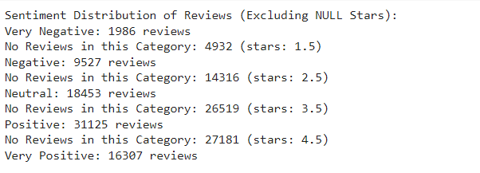
RESULTS

Slide 17
Conclusions/Future Work
Restructuring the data or normalization helps in easier analysis
It decreases the redundancy leading to cleaner and more organized dataset
Efficient Queries i.e. Instead of joining complex tables with many columns, we can join smaller, more focused tables based on relationships
Future Works Includes:
Working on the remaining entities too
Working on in-depth sentiment analysis

Slide 18


