Slide 1
Database Translation – YELP Dataset
Sai Sowmya Bandaluppi

Slide 2

OBJECTIVE
Restructure a flattened and/or de-normalized dataset so it can be loaded into a SQL or Graph database. Identify and demonstrate a form of analysis that is made easier by restructuring the data.
Dataset: Yelp Dataset (https://www.kaggle.com/yelp-dataset/yelp-dataset)

Slide 3
DATASET AND DATABASES
Dataset:
Yelp Dataset
3 entities(business, user, reviews)
Worked on 1 entity: Business
Database:
SQLite
Minimal Setup and Configuration with no need of a server in specific
Easy-to-use database solution with full SQL support and portability across different platforms

Slide 4
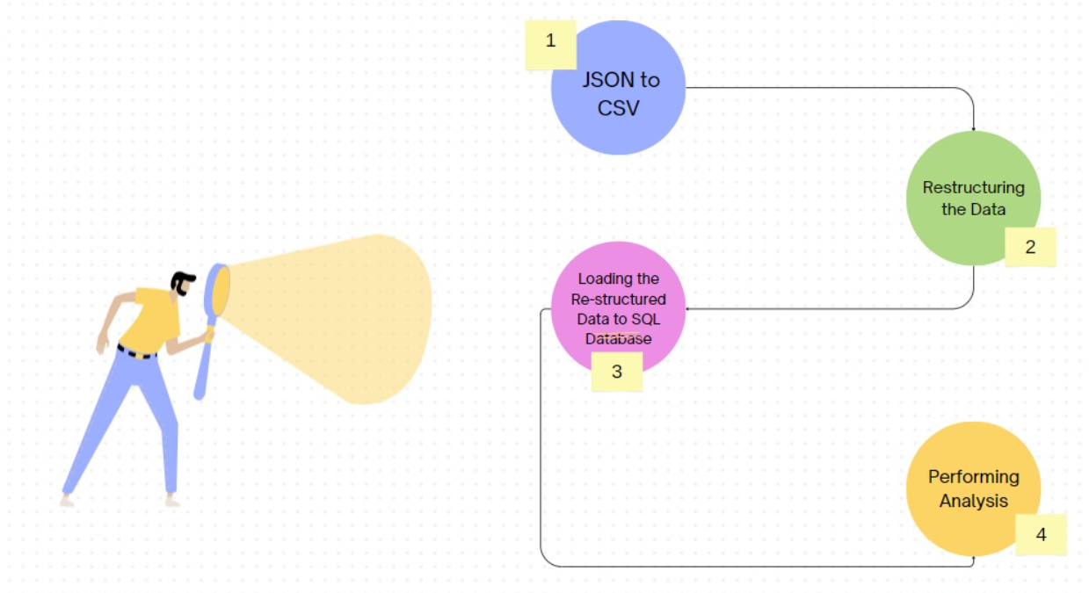
WORKFLOW

Slide 5
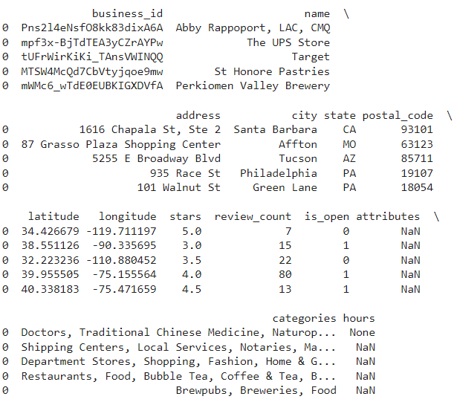
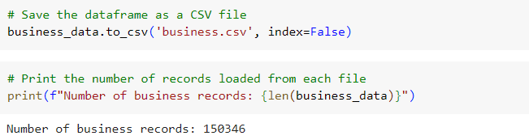
DATA

Slide 6
RESTRUCTURING THE DATA
Restructuring a de-normalized dataset includes
Normalization of de-normalized data:
Organizing data to reduce redundancy and dependency
Database Schema for restructuring:
Creating Relationships between tables for better organization

Slide 7
RESTRUCTURING DENORMALIZED DATASET
Understanding De-normalization in Database
De-normalization simplifies queries but can lead to data redundancy
Identifying Key Relationships
Establish connections between data tables for seamless integration
Optimizing Data
Enhance data organization to reduce redundancy and improve consistency
Implementing Normal Form Rules
Apply Normalization Principles to ensure data integrity and scalability
“NORMALIZATION BRINGS ORDER TO CHAOTIC DATASETS”

Slide 8
DATA NORMALIZATION
First Normal Form(1NF)
Each column contain indivisible values, and there are no repeating groups or arrays of values within a row. In the denormalized dataset, each row represents a business entity, and columns contain multiple values (e.g., 'categories' column). To achieve 1NF, we split the denormalized dataset into separate tables: 'address_df', 'categories_df', and 'business_category_df'.
Second Normal Form(2NF)
In 2NF, the dataset must be in 1NF, and all attributes must be fully functionally dependent on the primary key. Each table ('address_df', 'categories_df', 'business_category_df') contains attributes that are fully functionally dependent on the primary key ('business_id').
Third Normal Form(3NF)
In 3NF, the dataset must be in 2NF, and there should be no transitive dependencies. Here, the 'address_df' table, the 'categories_df' table and 'business_category_df' table are directly dependent on the primary key. These categories have no transitive dependencies

Slide 9
DATA NORMALIZATION CONTD.
import pandas as pd
# Load the denormalized dataset
business_df = pd.read_csv('business.csv')
# Separate address information into a separate table
address_df = business_df[['business_id', 'address', 'city', 'state', 'postal_code']].drop_duplicates().reset_index(drop=True)
# Separate category information into a separate table
categories_df = business_df[['business_id', 'categories']].explode('categories').dropna().reset_index(drop=True)
# Create a mapping table for many-to-many relationship between businesses and categories
business_category_df = business_df[['business_id', 'categories']].explode('categories').dropna().reset_index(drop=True)
# Save the normalized tables to CSV files
address_df.to_csv('address.csv', index=False)
categories_df.to_csv('categories.csv', index=False)
business_category_df.to_csv('business_category.csv', index=False)

Slide 10
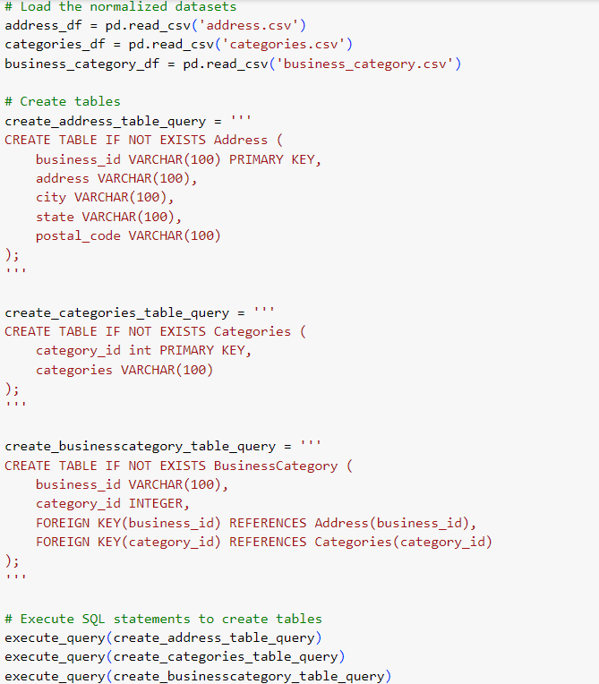
LOADING DATA INTO SQLite

Slide 11
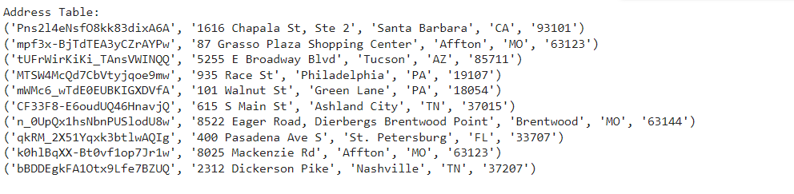
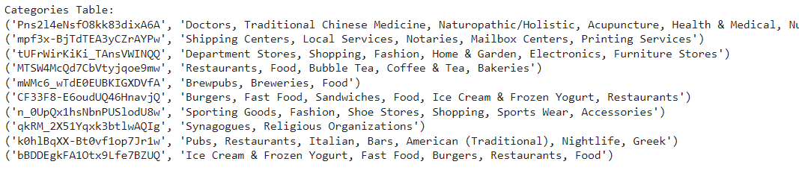
LOADING DATA INTO SQLite CONTD.

Slide 12
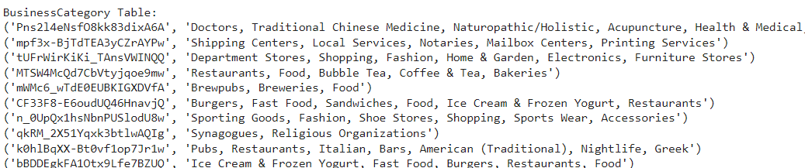
LOADING DATA INTO SQLite CONTD.

Slide 13
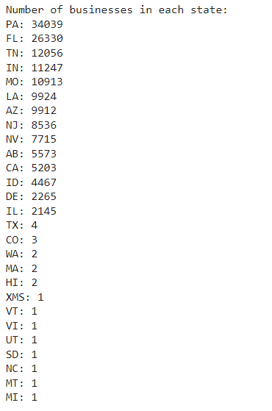
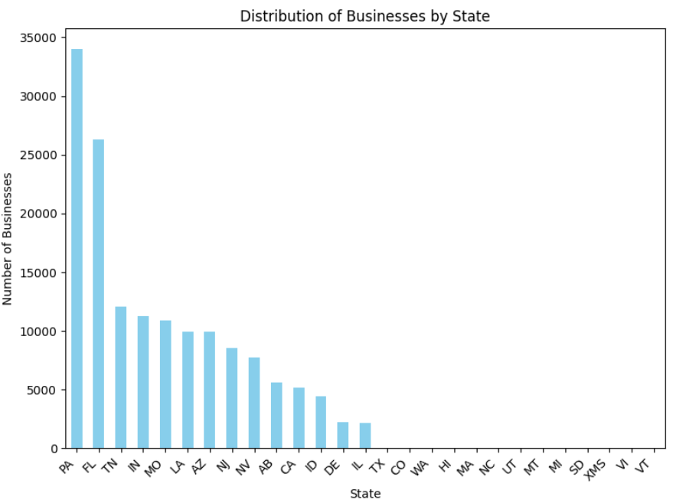
ANALYSIS

Slide 14
Conclusions/Future Work
Restructuring the data or normalization helps in easier analysis
It decreases the redundancy
Work on the remaining entities too
Can work on sentiment analysis using Textblob

Slide 15


