Slide 1
🚌
[ Suggested visual: flat-style bus / road
illustration or EasyBus Pro logo mark ]
EasyBus Pro
Bus Ticket Booking System
Internship Project Presentation
Student
S. Sowmya | 2023003449
College
GITAM (Deemed to be University), Hyderabad
Department
Computer Science and Engineering
Company
DayLearner Private Limited, Kakinada
Mentor
<< Mentor Name >>
Academic Year
2025 - 2026
Notes:
PRESENTER NOTES: Greet the panel, introduce yourself, and state the project name and one-line purpose: 'EasyBus Pro is a bus ticket booking web application built during my internship at DayLearner Private Limited using Python, Flask and SQLite3.' Keep this slide on screen for under 30 seconds.
ANIMATION SUGGESTION: Fade-in the title text, then a subtle wipe-in for the detail rows (top to bottom, 0.2s stagger).
TRANSITION SUGGESTION: Morph or Fade into Slide 2.

Slide 2
INTERNSHIP OVERVIEW
About the Internship
🏢
⏱
💻
📋
ORGANIZATION
DURATION
DOMAIN
PROJECT ASSIGNED
DayLearner Private Limited, Kakinada
8 weeks (2 months) — 25 May to 25 Jul 2026
Python Full-Stack Web Development with AI & Prompt Engineering
Design & build a working bus ticket booking web app
Responsibilities Timeline
W1-2
W3-4
W5-6
W7-8
Orientation, Python/Flask setup,
database design
Landing page, registration,
login, sessions
Search, results, seat
selection, payment UI
Booking confirmation, testing,
documentation, demo
EasyBus Pro | Internship Project Review
2
Notes:
PRESENTER NOTES: Briefly explain the internship structure — 8 weeks at DayLearner Private Limited, working under weekly milestone reviews. Mention that the objective was to learn the full web development cycle (not just theory) by building one complete project end-to-end.
ANIMATION SUGGESTION: Animate the four info cards with a 'Fly in from bottom' effect (staggered 0.15s each), then animate the timeline dots left-to-right with 'Appear'.
TRANSITION SUGGESTION: Push (left) from Slide 1.

Slide 3
PROJECT INTRODUCTION
Why EasyBus Pro?
Problem Statement
🎫
1
Single platform to search, compare & book
Most small & medium bus operators still rely on counter or phone-based booking. Passengers cannot compare operators, cannot see seat layouts, and get only a paper slip as proof — with no digital record of their journey.
🗃
3
Linked database tables (users, bus, bookings)
Objective
■ Build a working, database-driven booking web app
■ Cover the full cycle: search → select → pay → confirm
■ Apply Flask, SQLite and web fundamentals practically
⏱
8
Weeks to design, build, test & document
EasyBus Pro | Internship Project Review
3
Notes:
PRESENTER NOTES: State the real-world problem in one sentence, then pivot to what the project achieves. Keep the tone practical — this is the 'why' slide before you show 'how'.
ANIMATION SUGGESTION: Left card content 'Fade' in as one block; right stat cards 'Fly in from right' staggered.
TRANSITION SUGGESTION: Fade.

Slide 4
BACKGROUND
Existing System & Its Limitations
Traditional Counter / Telephone Booking Process
Passenger
calls / visits
counter
Operator checks
register for
availability
Fare & seat
quoted
verbally
Seat noted by
hand, cash
collected
Paper slip
issued
Key Limitations
⏰
🔀
❌
📄
Restricted Hours
No Comparison
Manual Errors
No Digital Record
Bookings possible only during counter/call hours
Each operator must be contacted separately
Double booking & illegible register entries
Paper slip is easily lost, no booking history
EasyBus Pro | Internship Project Review
4
Notes:
PRESENTER NOTES: Walk through the manual process quickly (5 steps), then highlight the four problem cards. Use a real example if asked: 'I had to call three operators separately to compare fares before a trip.'
ANIMATION SUGGESTION: Animate the 5-step flow left-to-right with connecting arrows using 'Wipe' entrance; problem cards 'Fly in from bottom' staggered.
TRANSITION SUGGESTION: Push (left).

Slide 5
SOLUTION
Proposed System — EasyBus Pro
A single web application that replaces every manual step above with an automated, database-backed flow.
Search
Compare
Select Seats
Pay Online
Confirmed
E-Ticket
Advantages
⚡
🔐
🗄
🎨
Automation
Secure Login
Database Integration
Modern UI
No manual register updates; data flows straight into the database
Session-based authentication protects personal booking data
Every booking permanently linked to user & bus records
Clean, responsive interface usable on desktop and mobile
EasyBus Pro | Internship Project Review
5
Notes:
PRESENTER NOTES: Mirror the structure of the previous slide so the panel sees a direct before/after contrast. Emphasize that every advantage maps to a limitation just shown.
ANIMATION SUGGESTION: Flow boxes animate with 'Zoom' one after another; advantage cards use 'Fade' staggered.
TRANSITION SUGGESTION: Morph (to visually connect from Slide 4's flow into this one).

Slide 6
TECH STACK
Technologies Used
🐍
🏴
🗄
🌐
Python
Flask
SQLite3
HTML5
Core programming language — simple syntax, huge ecosystem
Lightweight web framework — full control over routes & logic
Zero-config relational database bundled with Python
Semantic page structure for every screen
🎨
🧩
💻
CSS3
Jinja2
VS Code
Hand-written responsive styling, no framework dependency
Server-side templating with reusable base layout
Primary editor — integrated terminal & Python tooling
EasyBus Pro | Internship Project Review
6
Notes:
PRESENTER NOTES: For each technology, give ONE reason it was chosen (already written on-card). If asked 'why not Django/Bootstrap?', explain the internship goal was to learn fundamentals directly (raw SQL, hand-written CSS) rather than rely on an abstraction layer.
ANIMATION SUGGESTION: Grid cards 'Wipe' in row by row.
TRANSITION SUGGESTION: Push (left).

Slide 7
ARCHITECTURE
System Architecture
🖥
USER / BROWSER
How It Works
HTML5 + CSS3 pages rendered via Jinja2
1. Browser sends an HTTP
request (GET / POST)
2. Flask matches the route and
runs the view function
3. A parameterised SQL query
reads or writes SQLite
4. Jinja2 renders the final
HTML page
5. Response is sent back to
the browser
⚙
FLASK APPLICATION
15 routes handle requests, sessions & logic
🗄
SQLITE DATABASE
users, bus, bookings tables (database.db)
✅
BOOKING CONFIRMED
E-ticket generated & stored permanently
EasyBus Pro | Internship Project Review
7
Notes:
PRESENTER NOTES: Explain this as the request-response cycle. Point out that the browser NEVER talks to the database directly — Flask is the only layer allowed to do that. This is the three-tier architecture (presentation / application / data).
ANIMATION SUGGESTION: Reveal each layer box top-to-bottom with 'Fade', arrows appearing right after each box; right-hand steps appear in sync with each layer.
TRANSITION SUGGESTION: Fade.

Slide 8
DATA MODEL
Database Design — ER Diagram
USERS
BOOKINGS
BUS
PK id
PK booking_id
PK id
name
1 : N
FK user_id
N : 1
bus_name
email (unique)
FK bus_id
from_city / to_city
phone
journey_date
departure / arrival
password
seat_numbers
price
passengers
available_seats
amount
payment_method
Key Design Points
■ Every booking stores bus_id and user_id — no duplicated text data across rows
■ email carries a UNIQUE constraint, enforced by SQLite itself at insert time
EasyBus Pro | Internship Project Review
8
Notes:
PRESENTER NOTES: Point at BOOKINGS in the middle and explain it is the 'linking' table — one user can have many bookings, one bus can appear in many bookings. This is exactly the 1:N relationship pattern taught in DBMS.
ANIMATION SUGGESTION: USERS and BUS tables 'Fly in' from left/right respectively, BOOKINGS 'Fades' in the centre, then both relationship arrows 'Wipe' in.
TRANSITION SUGGESTION: Push (left).

Slide 9
END-TO-END FLOW
Project Workflow
1
2
3
4
Landing
Page
Login
Search
Bus
Bus
Results
5
6
7
8
Seat
Selection
Payment
Booking
Confirmation
My
Bookings
EasyBus Pro | Internship Project Review
9
Notes:
PRESENTER NOTES: Walk through the numbered path exactly as a real user would experience it. Mention that state (login session) and journey data (route/seats/amount) travel forward through this entire chain until the booking is written to the database.
ANIMATION SUGGESTION: Reveal boxes 1-8 in numeric order using 'Appear', arrows drawing in between each ('Wipe').
TRANSITION SUGGESTION: Push (left).

Slide 10
MODULES
Project Modules at a Glance
🏠
📝
🔑
📊
🔍
📋
Landing Page
Registration
Login
Dashboard
Search
Results
Hero, search box & feature highlights
New account with validation
Session-based authentication
Personalised post-login home
Route, date & passenger input
Matching buses with fare & timing
💺
💳
✅
📄
👤
🚪
Seat Selection
Payment
Booking Confirm.
My Bookings
Profile
Logout
Interactive coach seat layout
UPI / Card / Net Banking choice
E-ticket generated & saved
Full booking history via JOIN
Account details of user
Clears session securely
EasyBus Pro | Internship Project Review
10
Notes:
PRESENTER NOTES: Do not read every card aloud — summarise: 'The application has 12 functional modules covering the complete journey from registration to logout, each backed by its own Flask route and template.' Point to 2-3 cards only (e.g. Seat Selection, Booking Confirmation).
ANIMATION SUGGESTION: Grid 'Wipe' in row by row, fast (0.05s stagger) since there are 12 cards.
TRANSITION SUGGESTION: Fade.

Slide 11
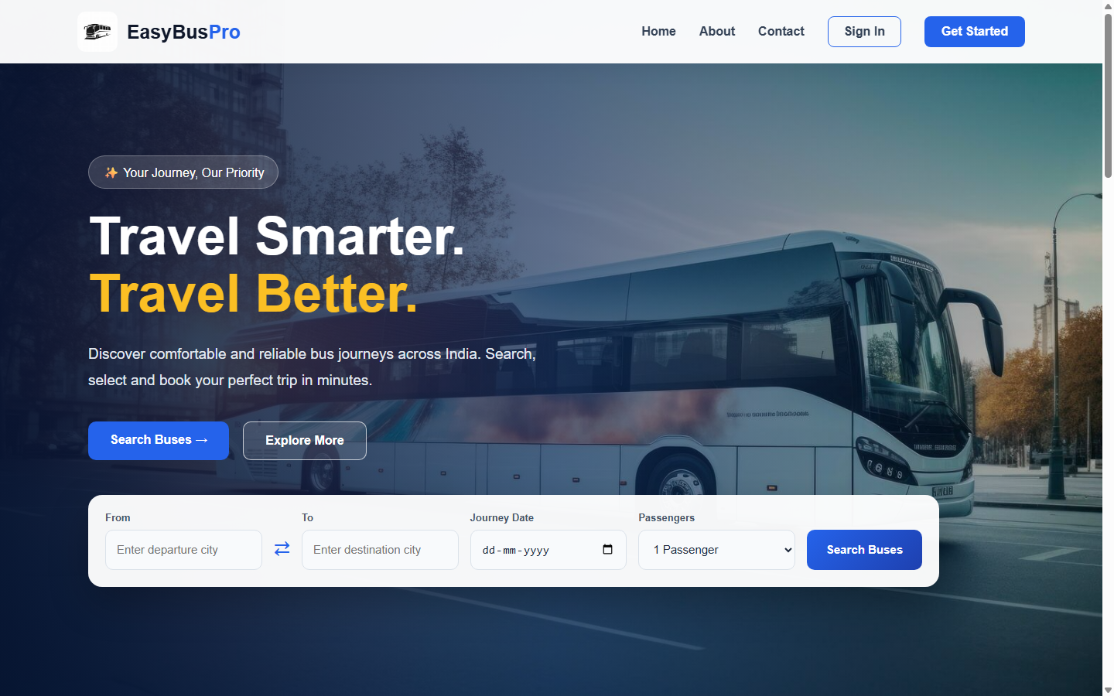
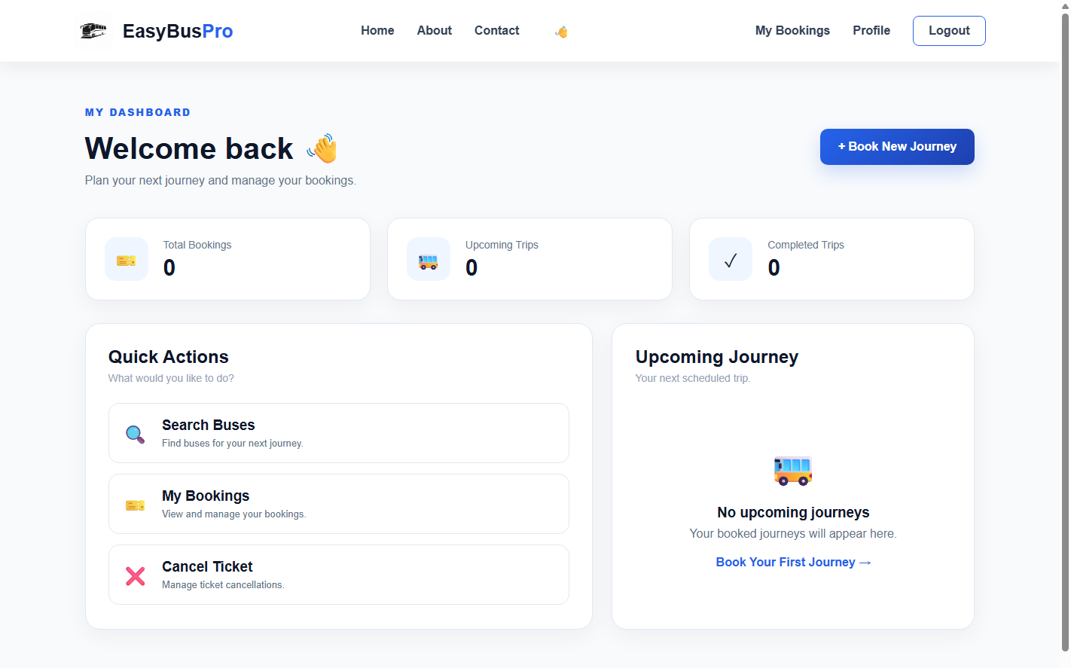
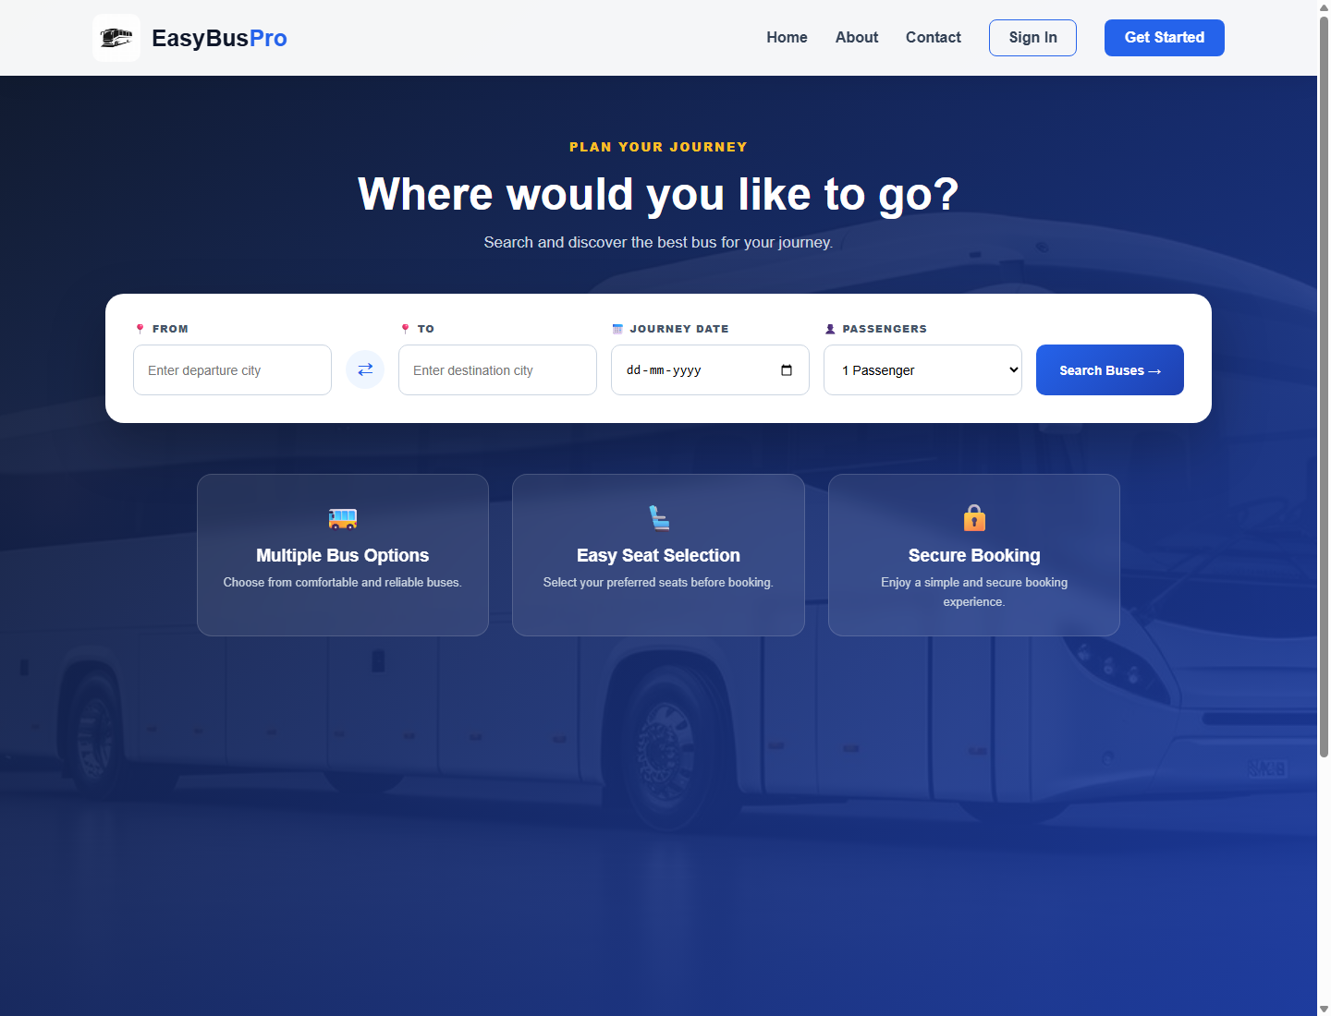
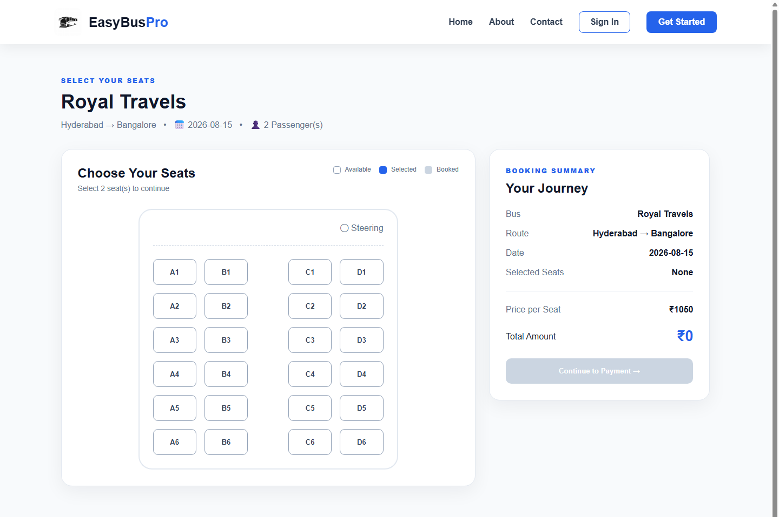
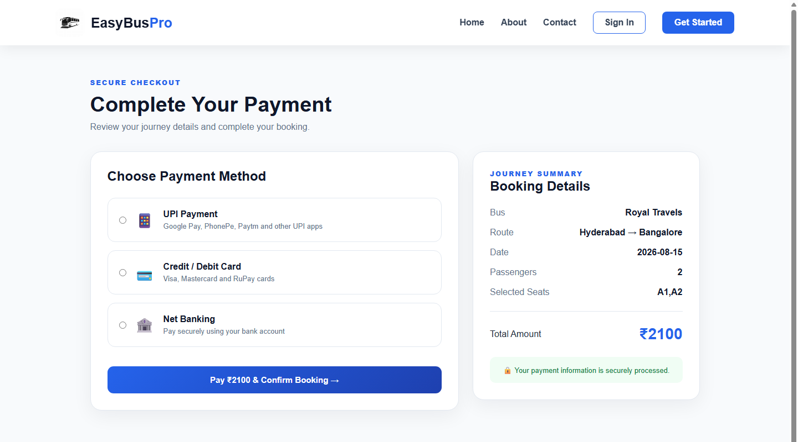
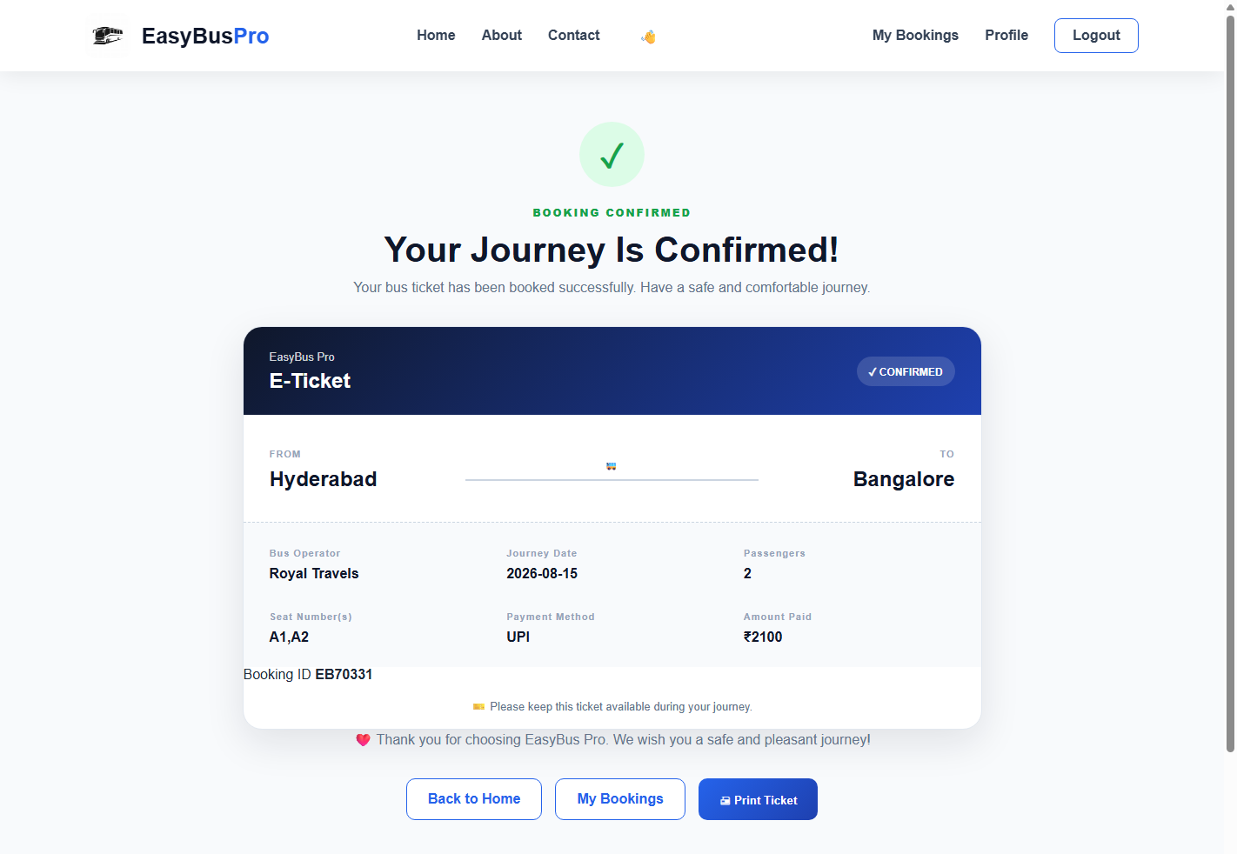
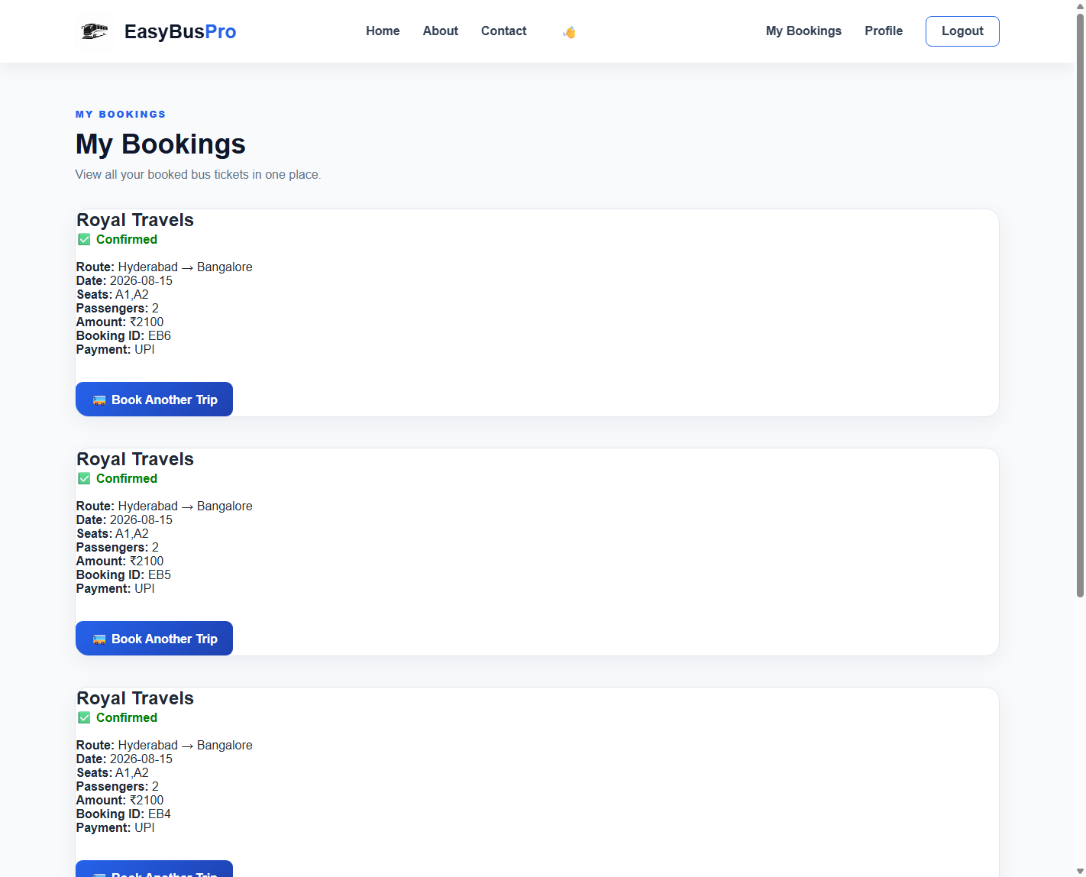
SCREENS
User Interface Walkthrough
Landing Page
Dashboard
Search Page
Seat Selection
First screen — search bar & highlights
Post-login personal home screen
Route, date & passenger input form
Click-to-select interactive coach layout
Payment
Success Page
My Bookings
UPI / Card / Net Banking checkout
Confirmed e-ticket after booking
Complete booking history (JOIN query)
EasyBus Pro | Internship Project Review
11
Notes:
PRESENTER NOTES: These are live screenshots captured directly from the running application (same set used in the written internship report). Briefly narrate each screen in the order shown — 15-20 seconds total, since the live demo slide covers this in more depth.
ANIMATION SUGGESTION: Screenshot cards 'Fade' in row by row.
TRANSITION SUGGESTION: Push (left).

Slide 12
BACKEND
Database Integration
🔌
SQLite Connection
sqlite3.connect() opens database.db; closed after every request
🔄
CRUD Operations
Create (INSERT), Read (SELECT + JOIN) used; Update/Delete planned
🔐
Authentication
Parameterised SELECT checks email & password on login
🎫
Booking Storage
Confirmed bookings INSERTed with user_id & bus_id references
🍪
Session Handling
Flask session cookie (signed) tracks the logged-in user
EasyBus Pro | Internship Project Review
12
Notes:
PRESENTER NOTES: Emphasize that all SQL statements use ? placeholders (parameterised queries), which prevents SQL injection — demonstrated live during testing. Mention that UPDATE/DELETE are listed under Future Enhancements (profile edit, cancellation).
ANIMATION SUGGESTION: Rows 'Fly in from left' top to bottom, 0.1s stagger.
TRANSITION SUGGESTION: Fade.

Slide 13
REAL DIFFICULTIES
Challenges Faced & Solutions
⚠
TemplateNotFound error
⚠
OperationalError: no such table
✅
Moved all HTML files into the required templates/ folder
✅
Re-ran database.py after adding the bookings table
⚠
Duplicate seed data on re-run
⚠
from is a Python reserved word
✅
Switched INSERT to INSERT OR IGNORE for idempotency
✅
Built that particular link inside the Jinja2 template instead of app.py
⚠
Booking duplicated on page refresh
⚠
Wrong seat total (string concat)
✅
Documented as a known issue; Post/Redirect/Get fix planned
✅
Wrapped values with Number() before arithmetic in JavaScript
EasyBus Pro | Internship Project Review
13
Notes:
PRESENTER NOTES: Pick 2-3 of these to narrate in detail if time-limited (the 'from' keyword issue is a good technical talking point — shows genuine debugging depth). State that every fix came from reading the actual error message, not guessing.
ANIMATION SUGGESTION: Cards 'Fade' in two-by-two (row by row).
TRANSITION SUGGESTION: Push (left).

Slide 14
QUALITY ASSURANCE
Testing
✔
Registration Testing
Duplicate e-mail rejected; password-mismatch rejected
✔
Login Testing
Valid/invalid credentials; SQL-injection attempt blocked
✔
Search Testing
Valid route returns buses; unknown route shows clear message
✔
Booking Testing
Full flow (search → seats → pay → confirm) verified end-to-end
✔
Database Testing
Verified rows in database.db using DB Browser for SQLite
EasyBus Pro | Internship Project Review
14
Notes:
PRESENTER NOTES: State that testing was manual (unit + functional + integration + user acceptance) and reference the test-case tables in the written report (Tables 4.13-4.15). Mention automated testing with pytest as a noted gap / future improvement.
ANIMATION SUGGESTION: Checkmarks 'Appear' one by one top to bottom with a short pause, like a checklist being ticked off live.
TRANSITION SUGGESTION: Fade.

Slide 15
GROWTH
Learning Outcomes
Technical Skills
Professional Skills
■ Flask routing, sessions & the request-response cycle
■ SQLite database design, CRUD & JOIN queries
■ HTML5, hand-written CSS3 (Flexbox / Grid)
■ Jinja2 template inheritance
■ Systematic debugging using tracebacks
■ Problem solving under real constraints
■ Structuring & organising a full project
■ Following the software development lifecycle
■ Reporting progress & issues honestly
■ Time management against weekly deadlines
EasyBus Pro | Internship Project Review
15
Notes:
PRESENTER NOTES: This is a reflection slide — speak personally here rather than reading bullets. Give one concrete example per column (e.g. 'I learned to read a traceback bottom-up instead of guessing fixes').
ANIMATION SUGGESTION: Left panel 'Fade', right panel 'Fly in from right'.
TRANSITION SUGGESTION: Push (left).

Slide 16
ROADMAP
Future Enhancements
Payment Gateway
QR Ticket
Live Bus Tracking
OTP Login
💳
🔱
📍
📲
Email Notifications
Ratings & Reviews
Admin Dashboard
Booking Analytics
📧
⭐
📊
📈
Cloud Deployment
AI Chatbot Support
Password Hashing
Online Cancellation
☁
🤖
🔐
🗑
EasyBus Pro | Internship Project Review
16
Notes:
PRESENTER NOTES: Present this as a realistic roadmap, not a wish-list — mention that these arise directly from limitations documented during testing (e.g. plain-text passwords → hashing).
ANIMATION SUGGESTION: Grid tiles 'Wipe' in row by row, quick stagger.
TRANSITION SUGGESTION: Fade.

Slide 17
LIVE WALKTHROUGH
Project Demonstration
Live demo will show the complete booking journey on the running application.
▶
▶
▶
▶
▶
▶
Registration
Login
Search &
Booking
Payment
Success
Page
My
Bookings
Talking Points During Demo
■ Point out the seat-count restriction enforced during seat selection
■ Show the e-ticket generated immediately after payment confirmation
■ Open My Bookings to prove the record was saved permanently in SQLite
EasyBus Pro | Internship Project Review
17
Notes:
PRESENTER NOTES: Switch to the live application (or a recorded screen capture as backup) here. Follow the six steps in order. Keep narration short — let the working software speak for itself. Have the DB Browser for SQLite open in a second window to show the row appearing live.
ANIMATION SUGGESTION: None needed — this slide is a launch pad into the live demo, keep it static so you can switch windows without a distracting animation mid-flow.
TRANSITION SUGGESTION: Cut / None (minimise distraction before switching to the live app).

Slide 18
WRAP-UP
Conclusion
🎓
Internship Experience
Hands-on exposure to a real development process, weekly reviews and mentor feedback
💡
Knowledge Gained
Full-stack fundamentals: Flask, SQLite, HTML/CSS, Jinja2, debugging & testing
🏁
Project Outcome
A fully working, end-to-end bus booking application delivered and demonstrated
🌱
Personal Growth
Improved patience, discipline and honest self-assessment while debugging
💼
Career Impact
A concrete, explainable project for interviews and a clearer sense of web development as a career path
EasyBus Pro | Internship Project Review
18
Notes:
PRESENTER NOTES: Close the technical narrative here. Speak in first person and be genuine rather than reading verbatim — this slide should feel like a personal summary, not a repeat of earlier slides.
ANIMATION SUGGESTION: Rows 'Fade' in one at a time, slower pace (0.3s) to let the panel absorb each point.
TRANSITION SUGGESTION: Fade.

Slide 19
GRATITUDE
Acknowledgement
🏢
👨‍🏫
🏫
DayLearner Private Limited
Mentor
GITAM University & Faculty
For the opportunity to work on a real project
For weekly guidance, code reviews & honest feedback
For academic supervision and support throughout
👥
❤
Friends
Parents
For testing the application and reporting issues
For constant encouragement and patience
EasyBus Pro | Internship Project Review
19
Notes:
PRESENTER NOTES: Read the names out if slide is being shown to the actual mentor/HOD/faculty in the room — fill in the mentor's actual name before presenting (currently a placeholder in the written report too).
ANIMATION SUGGESTION: Cards 'Fly in from bottom' staggered.
TRANSITION SUGGESTION: Fade.

Slide 20
🚌
Thank You
Questions & Discussion Welcome
S. Sowmya | 2023003449
GITAM (Deemed to be University), Hyderabad
Internship Project: EasyBus Pro | DayLearner Private Limited
<< student e-mail / contact placeholder >>
Notes:
PRESENTER NOTES: Stop talking once this slide is shown — pause, smile, and invite questions. Have the live application still open in a background tab in case the panel wants to see a specific screen again.
ANIMATION SUGGESTION: Icon badge 'Zoom' in, title 'Fade' in after, subtitle lines follow with a gentle stagger.
TRANSITION SUGGESTION: Fade to black (end of deck).

