Slide 1
Tableau
Tableau is one of the BI tool(Business intelligence)
It is a powerful and fastest growing data visualization tool used in the Business Intelligence Industry.
It helps in simplifying raw data in a very easily understandable format. Tableau helps in creating the data that can be understood by professionals at any level in an organization.
Tableau doesn't require coding.
It is used around the world for its quick, interactive, and beautiful visualizations through dashboards.

Slide 2
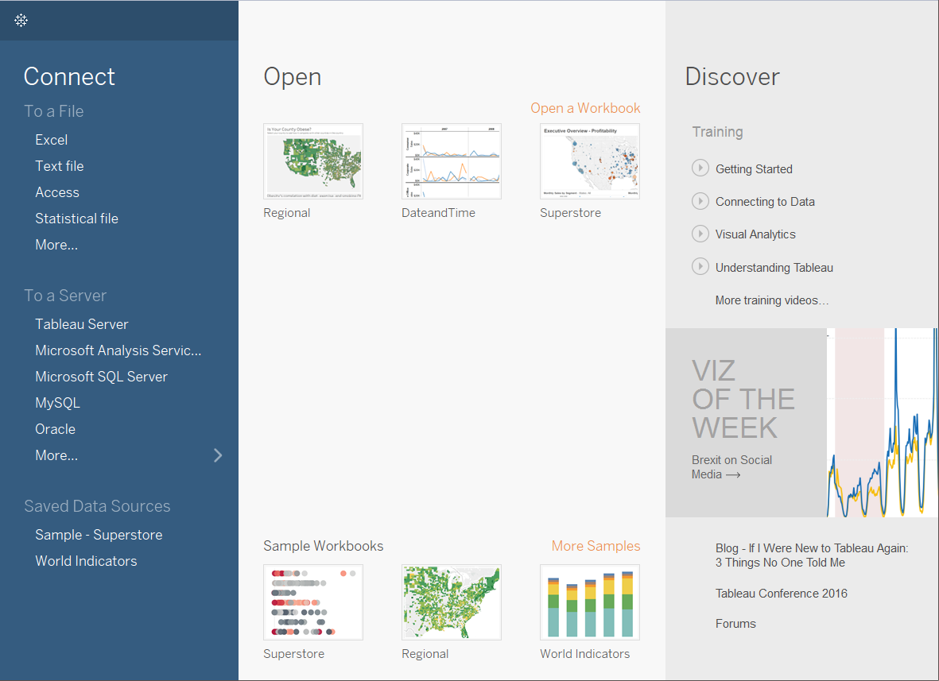
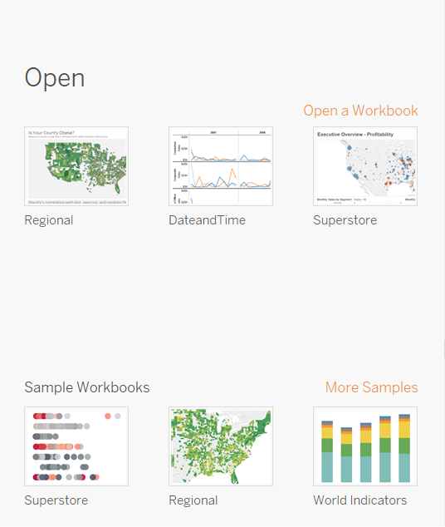
Several options of the start page of tableau desktop
The start page consists of 3 panes: Connect, Open, Discover
1) Connect: It is used to connect to data and open saved data sources
Under To a File, we can connect to the data stored in Microsoft Excel files, text files, Access files, Tableau extract files, and statistical files.
Under To a Server, we can connect to the data stored in databases like Microsoft SQL Server or Oracle.
2) Open: Open recent workbooks, pin workbooks to the start page, and explore sample workbooks.
Explore sample workbooks: Open and explore sample workbooks.
3) Discover: See popular views in Tableau Public, read blog posts and news about Tableau, and find training videos and tutorials to help you get started.

Slide 3
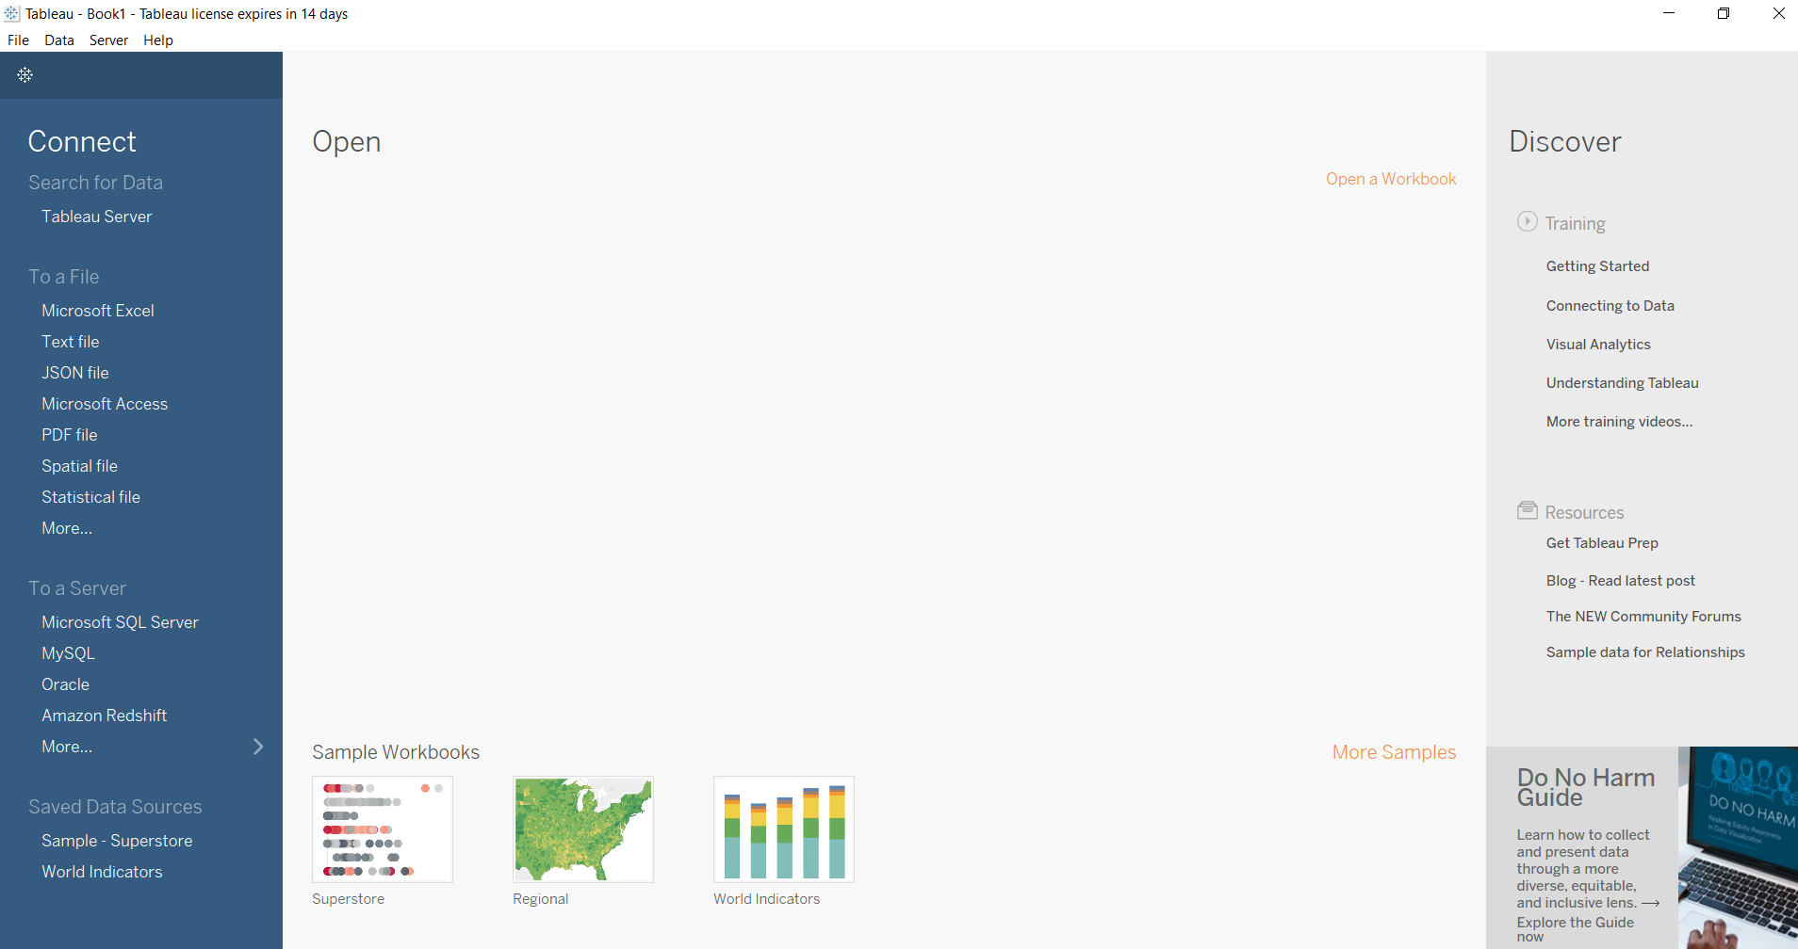
Toggle

Slide 4
Process of BI project
Business Understanding
Data Understanding
Data Preparation
Modeling
Evaluation
Deployment

Slide 5
Business Understanding: This where the Business problem is defined, understanding the business problem is key in coming up with a good model because it makes you understand the Business objective.
Data Understanding: A correct solution to the problem involves a correct understanding of the problem.
Data Preparation: Data preparation is the process of cleaning and transforming raw data prior to processing and analysis.
Modeling: It is the process of creating a data model for the data to be stored in a database.
Evaluation: It includes identification of research aim, presence of a research question, type of methodology, data collection processes, sample information, data analysis techniques and study outcomes.
Deployment: It refers to the application of a model for prediction using a new data.

