Slide 1
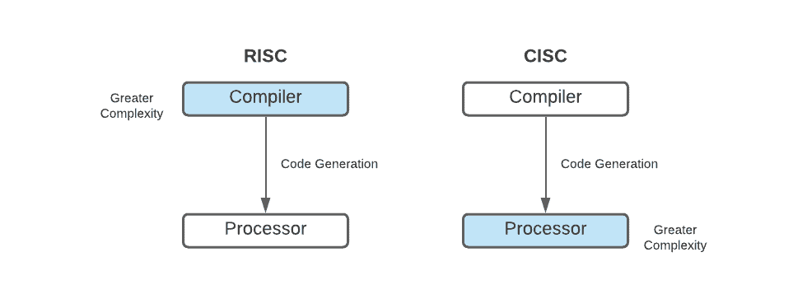
Introduction to CPU Architectures(CISC Characteristics and RISC Characteristics)
NAME:G.SOWMYA
ROLL NO:22H51A0588

Slide 2
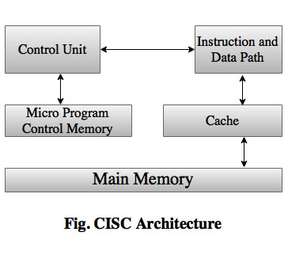
CISC (Complex Instruction Set Computer)
A type of computer processor architecture that features a large and complex set of instructions in its instruction set, designed to provide a wide range of functionality and flexibility.

Slide 3
Characteristics of CISC
Complex Instructions
Variable Instruction Length
Microcode
Register-based
CISC processors often use microcode, a layer of software that translates high-level instructions into a sequence of simpler, low-level operations that the processor can execute directly. This adds complexity but improves efficiency.
CISC architectures are typically register-based, meaning they rely on a set of internal registers to store and manipulate data. This allows for faster access to frequently used data compared to memory-based approaches.
CISC architectures feature a large and complex instruction set, with each instruction capable of performing multiple low-level operations. This allows for more efficient programming, as complex tasks can be accomplished with fewer lines of code.
The instructions in a CISC architecture can have variable lengths, ranging from 8 to 48 bits or more. This allows for more efficient use of memory, as instructions can be tailored to the specific task at hand.

Slide 4
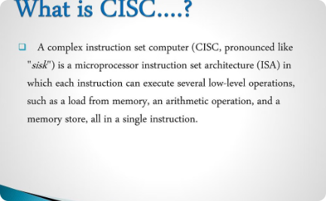
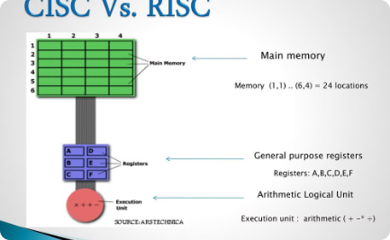
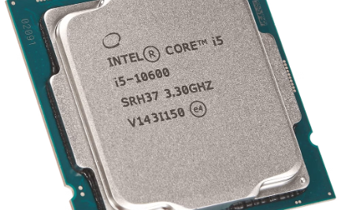
Advantages of CISC
Powerful Instructions
Optimized Performance
Backward Compatibility
CISC processors can execute a wide range of complex instructions in a single operation, allowing for more efficient and compact code.
The complex instructions in CISC architectures are designed to closely match common programming constructs, leading to optimized performance for many real-world applications.
CISC processors are often designed to maintain backward compatibility with older software, ensuring a smooth transition and continued access to established applications.

Slide 5



Disadvantages of CISC
Complexity
Performance
Power Consumption
CISC processors have a large and complex instruction set, which can make the hardware design more complicated and difficult to optimize.
The complexity of CISC instructions can lead to longer instruction execution times, potentially reducing overall processor performance compared to simpler RISC designs.
The additional logic required for CISC instructions can increase power consumption and heat generation, making CISC processors less energy-efficient.

Slide 6
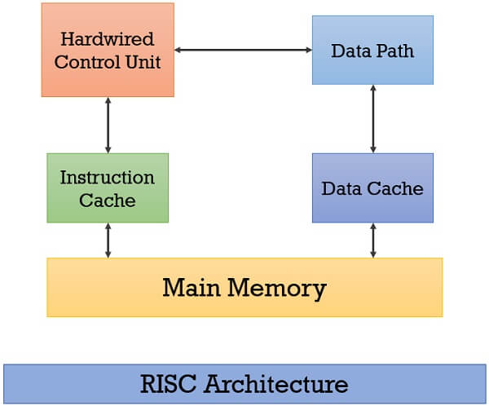
RISC (Reduced Instruction Set Computer)
RISC is a CPU design philosophy that emphasizes simplicity and efficiency. RISC processors have a smaller and more streamlined instruction set compared to CISC processors, focusing on performing a few core operations quickly and consistently.

Slide 7
Characteristics of RISC
1
Simplified Instruction Set
2
Pipelining
RISC processors have a smaller and more streamlined instruction set compared to CISC, focusing on basic operations that can be executed efficiently.
RISC architectures heavily utilize pipelining, allowing multiple instructions to be executed concurrently for improved performance.
3
Load/Store Architecture
4
Uniform Instruction Format
RISC processors separate data manipulation from memory access, using dedicated load and store instructions to move data between registers and memory.
RISC instructions typically have a consistent length and format, simplifying the design of the CPU and enabling faster execution.

Slide 8

Advantages of RISC
Simpler Design
Higher Performance
Efficient Pipelining
RISC processors have a streamlined architecture with fewer and simpler instructions, leading to faster execution times and reduced power consumption.
The simplified instruction set allows RISC processors to operate at higher clock speeds, improving overall system performance.
RISC architectures excel at pipelining, where multiple instructions can be executed concurrently, further boosting performance.

Slide 9



Disadvantages of RISC
Higher Cost
Larger Code Size
Performance Trade-offs
RISC processors can be more expensive to manufacture due to the complexity of their design and the additional hardware required to support their reduced instruction set.
RISC architectures often require more instructions to perform the same task as a CISC processor, leading to larger program code sizes and potentially higher memory usage.
While RISC processors can achieve high performance in certain tasks, they may not be as efficient as CISC processors for specific applications that heavily rely on complex instructions.

Slide 10
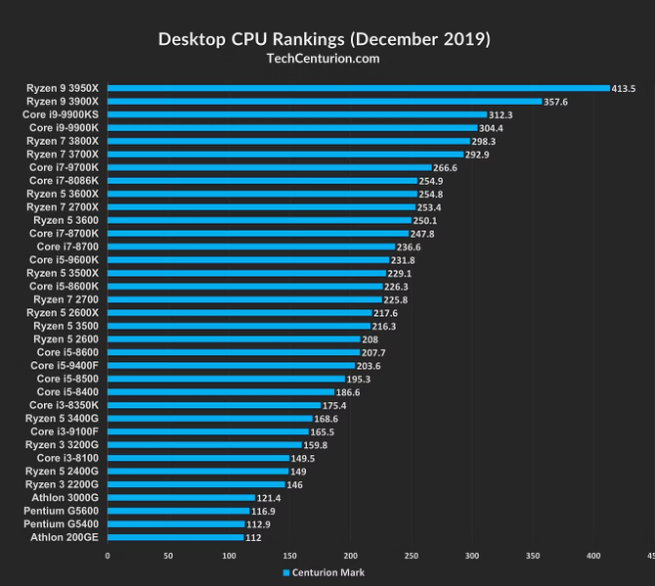
Comparison and Conclusion
CISC and RISC architectures have distinct advantages and disadvantages. CISC excels in complex operations but may be slower, while RISC is more efficient but requires more instructions. The choice depends on the specific application and performance requirements.
Ultimately, both architectures have their place in modern computing, offering different tradeoffs in terms of power, speed, and complexity. The ongoing evolution of CPU design continues to blur the lines between these two approaches.

Slide 11
THANK YOU

