Slide 1
INTRODUCTION, EXCEPTION HANDLING IN ADA
NAME:G.SOWMYA
ROLL NO:22H51A0588

Slide 2
INTRODUCTION
02
03
Ada is a structured, statically typed, high-level programming language designed for developing large-scale systems with a strong emphasis on safety, security, and reliability. It was originally created in the late 1970s and early 1980s by Jean Ichbiah and his team at CII Honeywell Bull under contract to the United States Department of Defense (DoD). The language was named after Ada Lovelace, who is often considered the world's first computer programmer.

Slide 3
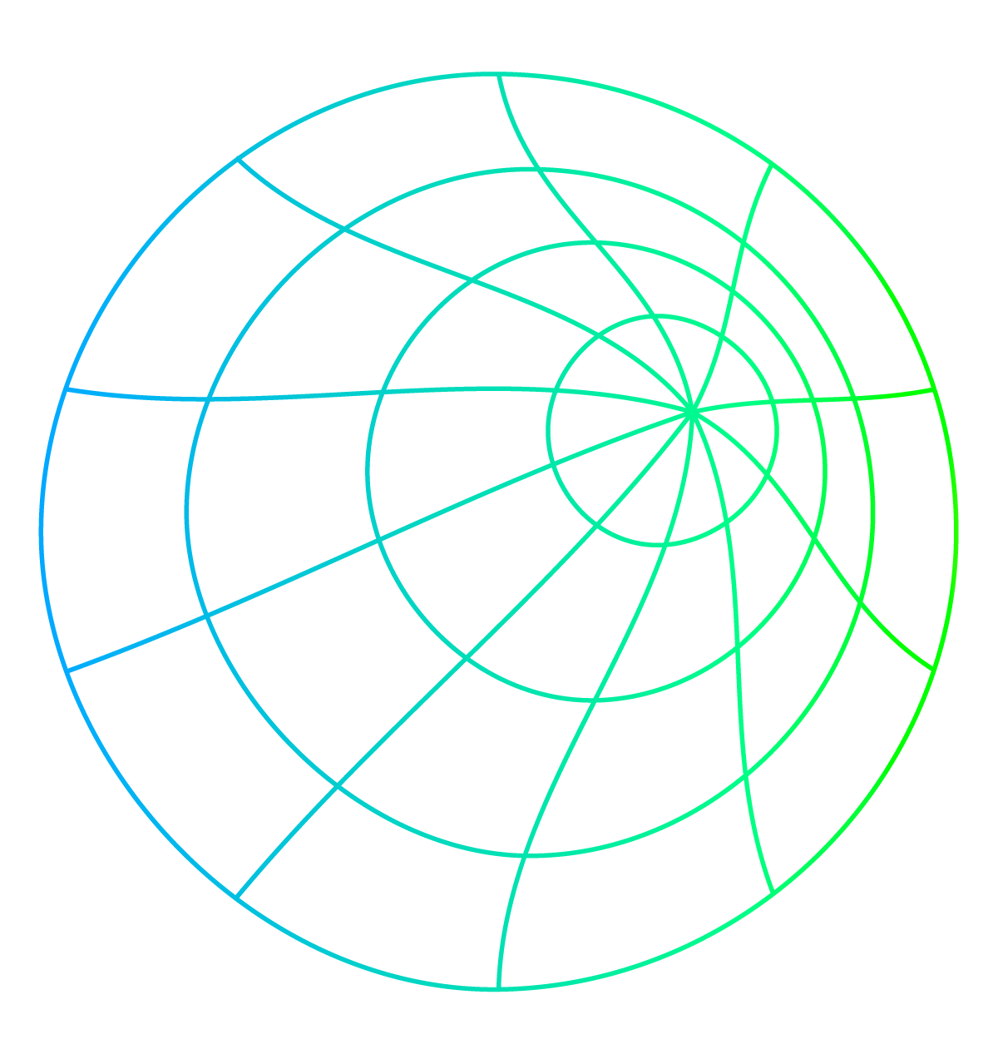
KEY FEATURES OF ADA
Strong Typing: Ada is a strongly typed language, which helps prevent errors related to data types.
Modularity: Supports modular programming with packages that allow code organization and reuse.
Concurrency: Ada has built-in support for concurrent programming through tasks, which makes it well-suited for real-time systems.
Exception Handling: Ada has robust exception handling mechanisms to manage runtime errors.
Safety and Reliability: The language includes features to prevent common programming errors, such as buffer overflows and null pointer dereferencing.
Standardization: Ada is standardized by the International Organization for Standardization (ISO), ensuring that implementations are consistent across different platforms.

Slide 4
EXCEPTION HANDLING IN ADA
Exception handling in Ada is a powerful mechanism that allows a program to manage runtime errors, making it more robust and reliable. Exceptions in Ada are used to handle unexpected events or conditions that arise during program execution, such as division by zero, file access errors, or memory allocation failures.
In Ada, an exception is an event that disrupts the normal flow of a program. When an exception is raised, the program jumps to the corresponding exception handler to deal with the error.
These are blocks of code that are executed when a specific exception is raised. They allow the program to recover from errors or perform necessary cleanup tasks.

Slide 5
SYNTAX FOR EXCEPTION HANDLING
Exception handling in Ada uses the begin, exception, and when keywords. Here's the basic structure:
begin
-- Normal code block
-- Operations that might raise exceptions
exception
when <exception_name> =>
-- Code to handle the specific exception
when others =>
-- Code to handle any other exceptions
end;

Slide 6
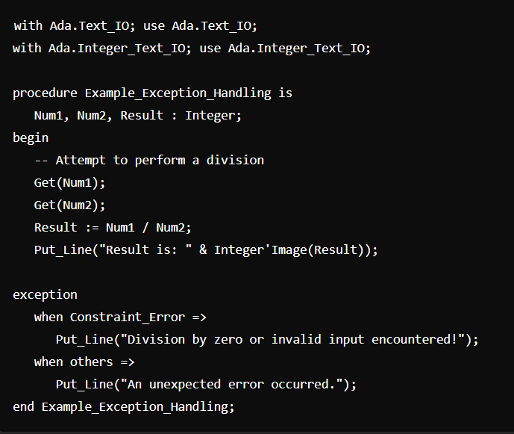
EXAMPLE

Slide 7
CONCLUSION
Ada is a high-level programming language designed with a strong emphasis on reliability, safety, and maintainability, making it particularly well-suited for systems where failure is not an option, such as in defense, aerospace, and medical applications. Its structured and statically typed nature, coupled with built-in support for concurrency and modularity, allows developers to write robust, secure, and efficient code.
A key feature that enhances Ada's reliability is its comprehensive exception handling mechanism. Exception handling in Ada provides a systematic way to detect and manage runtime errors, ensuring that programs can handle unexpected situations gracefully. By separating error-handling logic from the main program flow, Ada promotes cleaner, more maintainable code. This mechanism not only prevents program crashes but also allows for better user feedback, error logging, and resource management, contributing to the overall robustness and resilience of Ada-based systems.

Slide 8
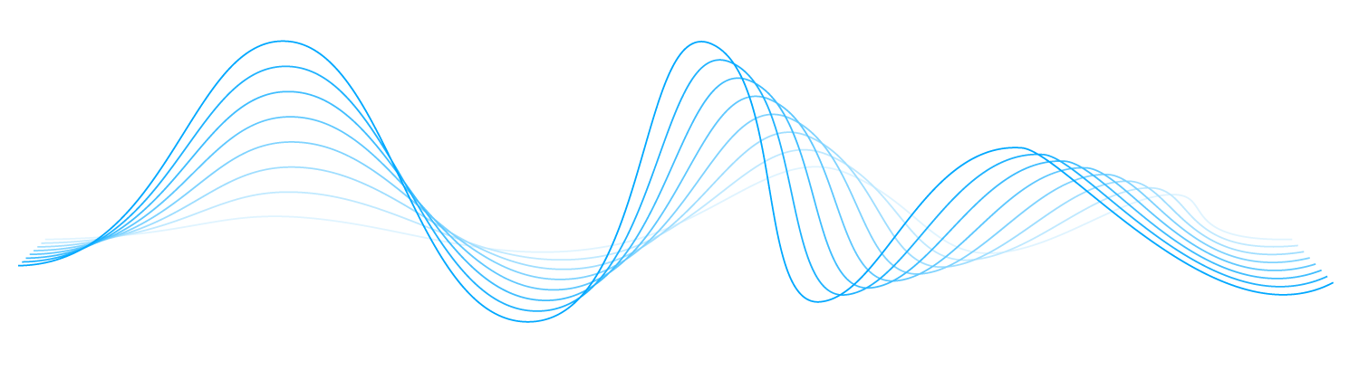
THANK YOU

