Slide 1
USER REQUIREMENTS
NAME:G.SOWMYA
ROLLNO:22H51A0588

Slide 2
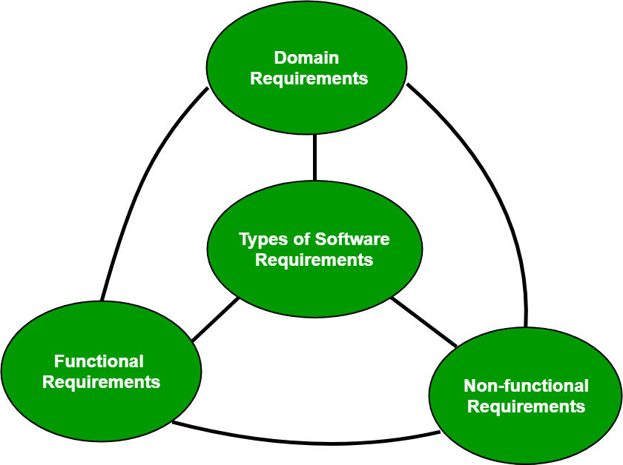
SOFTWARE REQUIREMENTS
A condition or capability needed by a user to solve a problem or achieve an objective
A condition or capability that must be met or possessed by a system or system component to satisfy a contract, standard, specification or other formally imposed documents
There are three types of software requirements:
1.Functional requirements
2.Non functional requirements
3.Domain requirements

Slide 3
SOFTWARE REQUIREMENTS
FUNCTIONAL REQUIREMENTS: These are the functions that a system should be able to perform.These are represented or stated in the form of input to be given to the system, the operation performed and the output expected.
NON FUNCTIONAL REQUIREMENTS: These are basically the quality constraints that the system must satisfy according to the project contract. Nonfunctional requirements, not related to the system functionality, rather define how the system should perform. Examples: security, portability, maintenance etc.
DOMAIN REQUIREMENTS : Domain requirements are expectations related to a particular type of software , according to this functional and non functional requirements.

Slide 4
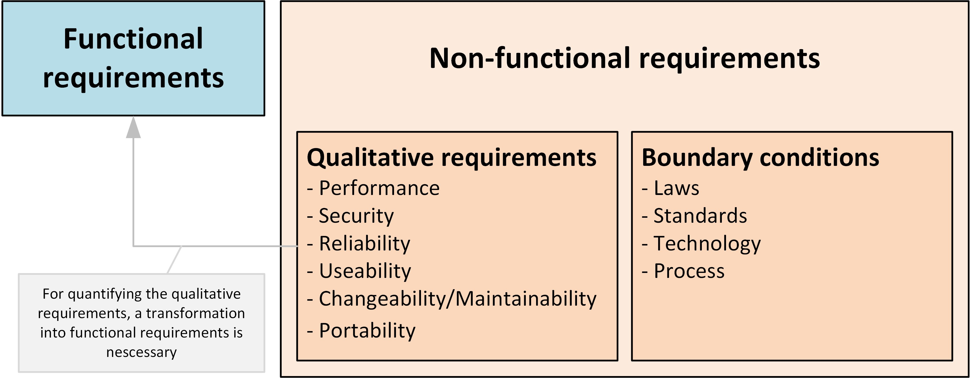

Slide 5
USER REQUIREMENTS
These requirements describe what the end-user wants from the software system. User requirements are usually expressed in natural language and are typically gathered through interviews, surveys, or user feedback.
Basically user is a who uses the final software product , so user gives a brief outline ,how the product must perform , etc.
To notedown all these user requirements companies and stakeholders or clients use a requirement document which is a legal one.

Slide 6
Importance of user requirements
Properly defined requirements serve as a boundary that helps the project stay on track.
User requirements are the foundation for building software that meets the needs and expectations of its intended user.
Gathering requirements up front can minimize the need for costly corrections later in the development process.
Meeting user requirements leads to higher stakeholder satisfaction.
When user requirements are not properly gathered and documented, there is a higher likelihood of misunderstandings and errors in the final product.

Slide 7
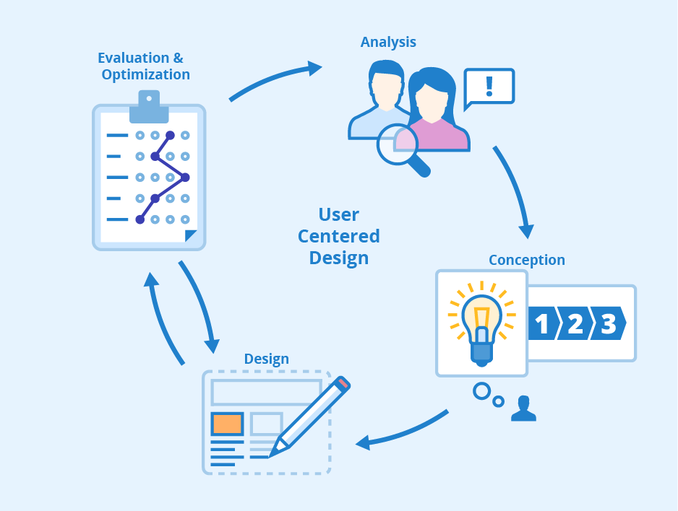
STEPS INVOLVED
Identify Stakeholders
Conducting Interviews and Surveys
Prioritize and Document Requirements
Involving the Development Team
Reviewing and Validating Requirements

Slide 8
Conclusion
User requirements are the bedrock of successful software development.
It increases stakeholder satisfaction.
It increases success rate of companies.
Improves predicting completion of project in given time.
Documenting clears miscommunication between companies and stakeholder.

Slide 9
THANK YOU

