Slide 1
IDENTIFYING BOTTLENECKS AND EXAMPLE
NAME:N.VIBHAS
ROLL NO:22H51A05B2

Slide 2
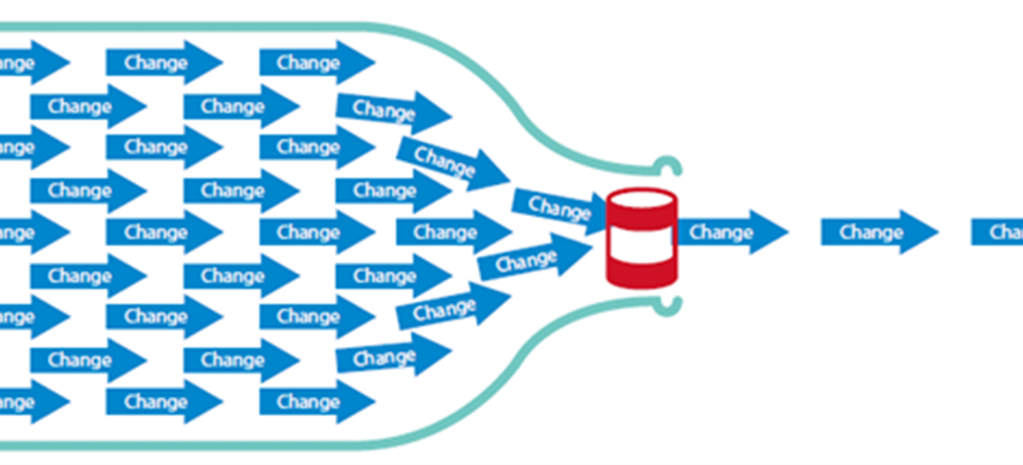
BOTTLENECKS
Bottlenecks are points in the development or deployment process where the flow of work is slowed down, leading to delays and inefficiencies. Identifying these bottlenecks is crucial for optimizing the pipeline and ensuring smooth, continuous delivery.

Slide 3
BOTTLENECKS
INCONSISTENT ENVIRONMENT:
Code that works in the development environment may fail when deployed to staging or production due to differences in configuration or software versions. This can lead to unexpected issues, requiring additional time to diagnose and fix.
MANUAL INTERVENTION:
Manual intervention in DevOps pipelines can create significant bottlenecks by slowing down processes, increasing the risk of human error, and reducing consistency. Relying too much on manual steps can delay feedback loops and limit scalability, making it harder to achieve frequent, reliable deployments. To mitigate this, automation of repetitive tasks, implementation of CI/CD pipelines, and using Infrastructure as Code (IaC) are key strategies to minimize the need for manual intervention and improve overall efficiency.

Slide 4
BOTTLENECKS
SDLC MATURITY:
low SDLC maturity can be a significant bottleneck in software development. When an organization operates at a lower maturity level, processes are often unstructured, inconsistent, and reliant on individual effort, leading to inefficiencies, delays, and increased risks. This lack of standardized and repeatable processes can slow down development, cause quality issues, and make it difficult to scale or improve.
Technical Debt:
Older systems and technologies can be difficult to integrate into modern DevOps practices, leading to slowdowns.
Accumulation of poor-quality code can slow down development as more time is spent fixing bugs and addressing issues.

Slide 5
BOTTLENECKS
Not Accounting for Scale:
Failing to account for scale can lead to problems when the volume of work or users increases. For example, an organization without properly designed automation processes or infrastructure to handle a large volume of requests will experience delays and disruptions.
Insufficient resources such as servers or bandwidth when failing to plan for increased demand or usage. This results in performance issues or outages.
Limited scalability makes it difficult to handle increased demand or usage. An organization needs tools or processes designed to scale to avoid delays and disruptions in delivering new features or updates.
Lack of monitoring and capacity planning complicates identifying when an organization's infrastructure is approaching its limits. This leads to unexpected outages or performance issues.

Slide 6
TOOLS
Docker, Kubernetes, Vagrant: To ensure consistent environment during entire Devops lifecycle.
Selenium, JUnit, TestNG, Jenkins:To automate the testing process.
Jenkins, CircleCI, GitHub Actions:To reduce manual intervention and increase efficiency.
Grafana, Nagios, Splunk:To minimize delays and implement continuous monitoring.
GitLab CI/CD, Jenkins, Azure Pipelines:Automates the workflows by integrating them into the CI/CD pipeline.(continuous integration and continuous delivery&deployment.

Slide 7
CONCLUSION
In conclusion, understanding, identifying, and mitigating bottleneck conditions are crucial for maintaining a high-performing and resilient system. By implementing effective identification techniques, proactive mitigation strategies, and adhering to best practices, organizations can ensure smooth operations, enhanced user experiences, and optimized system performance in the dynamic digital landscape.

Slide 8
THANK YOU!

