Slide 1
RECURSION
Notes:
RECURSION

Slide 2
NAME:G.SOWMYA
ROLL.NO:22H51A0588
SECTION:CSE-B

Slide 3
RECURSION
Recursion is a process by which a function calls itself repeatedly until some specific condition has been satisfied.
A recursive function solves a particular problem by calling a copy of itself and solving smaller sub problems of the original problems.
A recursion uses divide and conquer strategy
for problem solving.

Slide 4
Rules for designing a recursive function:
Determine the base.
Determine the general case.
Combine base case and general case into a function.

Slide 5
Generating Fibonacci series using recursion
Example of Fibonacci series: 0,3,3,6,9,15,24…..
Base case: fib(0)=0
fib(1)=3
General case: fib(n)= fib(n-1)+fib(n-2)

Slide 6
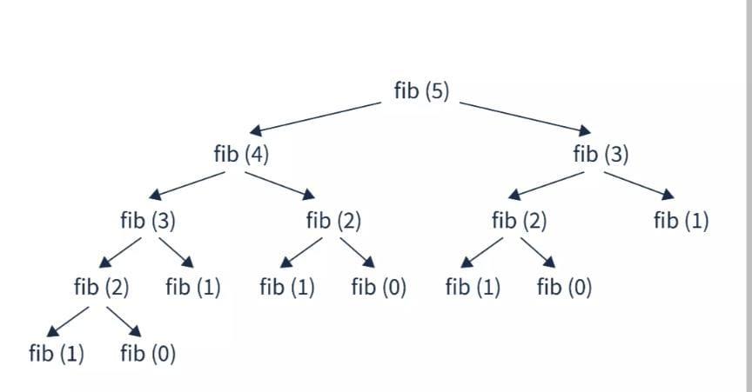

Slide 7
Program:
#include <stdio.h>
Int fibonacci(int n)
{
if (n <= 0)
return 0;
else
if (n == 1)
return 1;
else
return fibonacci(n-1) + fibonacci(n-2);}
int main()
{
int i, n;
int fibonacci ( int n );
printf("Enter the number of terms: ");
scanf("%d", &n);
printf("The first %d terms of the Fibonacci series are: \n", n); for (i = 0; i < n; i++)
{
fibonacci (n);
printf("%d, ", fibonacci(i));
}
return 0;
}

Slide 8
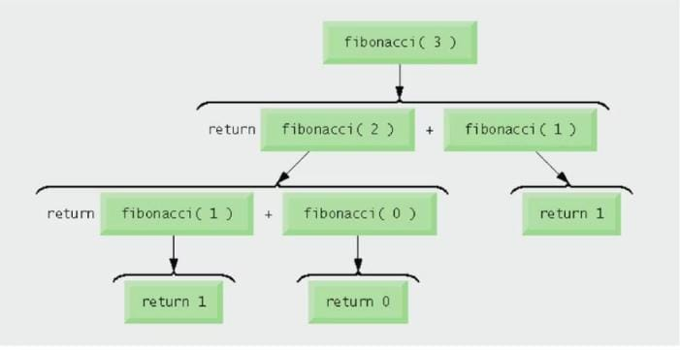
Output: Enter the number of terms:10
Fibonacci series:
0,1,1,2,3,5,8,13,21,34

Slide 9
Recursion vs Iteration
Space complexity
- Iteration- no extra memory gets allocated.
Recursion - In the recursive program, due to each recursive call, some memory gets allocated in the stack to store parameters and local variables.
Time complexity
Iteration –takes less time compared to recursion
- Recursion - It will take more time to execute due to the overhead of function calls, which is much higher than that of iteration.
Both involve a termination test
Iteration-loop-termination test.
- Recursion-base case.

Slide 10
Conclusion
Recursion is useful when the problem you are trying to solve can be broken down into smaller sub-problems that are similar to the original problem. Examples include computing the factorial of a number, or generating a permutation of a set of elements.
However, there are also cases where a problem can be solved using either iteration or recursion, and the choice between the two often depends on personal preference and the specific requirements of the problem.

Slide 11
Thank you

