Slide 1
DNS
Dr. Yingwu Zhu
Chapter 2.5

Slide 2
DNS: Domain Name System
Internet hosts, routers:
IP address (32 bit) - used for addressing datagrams
“name”, e.g., www.seattleu.edu - used by humans
Q: map between IP addresses and name ?
Domain Name System:
distributed database implemented in hierarchy of many name servers
application-layer protocol host, routers, name servers to communicate to resolve names (address/name translation)
note: core Internet function implemented as application-layer protocol
complexity at network’s “edge”

Slide 3
DNS name servers
Why not centralize DNS?
single point of failure
traffic volume
distant centralized database
Maintenance
DoS attacks?
doesn’t scale!
no server has all name-to-IP address mappings
local name servers:
each ISP, company has local (default) name server
host DNS query first goes to local name server
authoritative name server:
for a host: stores that host’s IP address, name
can perform name/address translation for that host’s name

Slide 4
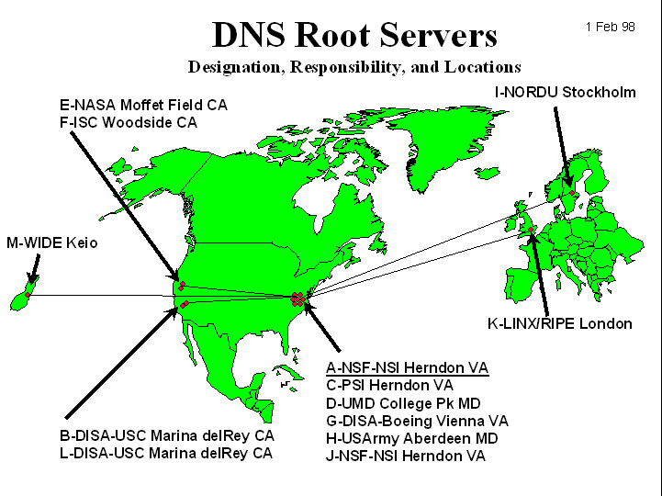
DNS: Root name servers
contacted by local name server that can not resolve name
root name server:
contacts authoritative name server if name mapping not known
gets mapping
returns mapping to local name server
13 root DNS servers: replication for security and reliability
Top-level DNS server: org, edu, com, jp,cn, fr, uk

Slide 5
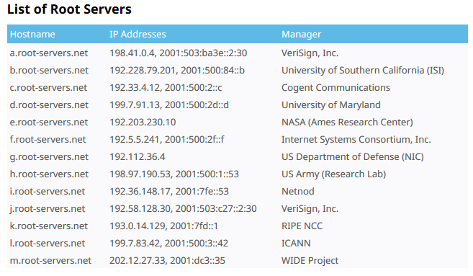
https://www.iana.org/domains/root/servers

Slide 6
Simple DNS example
root name server
host surf.eurecom.fr wants IP address of cs1.seattleu.edu
1. Contacts its local DNS server, dns.eurecom.fr
2. dns.eurecom.fr contacts root name server, if necessary
3. root name server contacts authoritative name server, dns.seattleu.edu, if necessary
2
4
5
3
local name server
dns.eurecom.fr
authorititive name server
dns.seattleu.edu
1
6
requesting host
surf.eurecom.fr
cs1.seattleu.edu

Slide 7
DNS example
root name server
Root name server:
may not know authoratiative name server
may know intermediate name server: who to contact to find authoritative name server
6
2
7
3
local name server
dns.eurecom.fr
intermediate name server
dns.someserver.edu
4
5
1
8
authoritative name server
dns.seattleu.edu
requesting host
surf.eurecom.fr
cs1.seattleu.edu

Slide 8
DNS: iterated queries
root name server
recursive query:
puts burden of name resolution on contacted name server
heavy load?
iterated query:
contacted server replies with name of server to contact
“I don’t know this name, but ask this server”
iterated query
2
3
4
7
local name server
dns.eurecom.fr
intermediate name server
dns.someserver.edu
5
6
1
8
authoritative name server
dns.seattleu.edu
requesting host
surf.eurecom.fr
cs1.seattleu.edu

Slide 9
DNS: caching and updating records
once (any) name server learns mapping, it caches mapping
cache entries timeout (disappear) after some time = TTL
update/notify mechanisms under design by IETF
RFC 2136
http://www.ietf.org/html.charters/dnsind-charter.html

Slide 10
DNS records
DNS: distributed DB storing resource records (RR)
RR format: (name, value, type,ttl)
Type=A
name is hostname
value is IP address
Type=CNAME
name is an alias name for some “cannonical” (the real) name
value is cannonical name
Type=NS
name is domain (e.g. foo.com)
value is authoritative name server for this domain
Type=MX
value is hostname of mailserver associated with name

Slide 11
DNS records
For a particular hostname
If a DNS server is authoritative, it contains
a Type A record for the hostname
Otherwise
Maybe a Type A record for the hostname in cache
a Type NS record for the domain of the hostname
a Type A record for the DNS server for that domain
Host: cs1.seattleu.edu
(seattleu.edu, dns.seattleu.edu, NS)
(dns.seattleu.edu, 192.168.122.1, A)

Slide 12
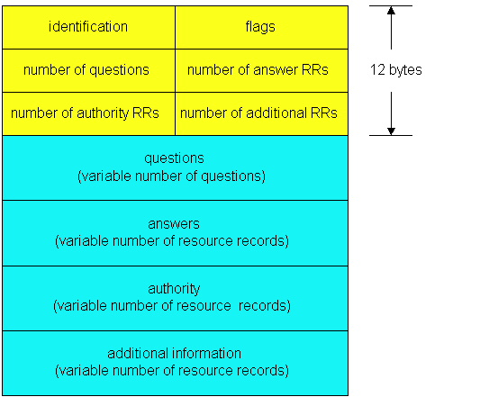
DNS protocol, messages
DNS protocol : query and repy messages, both with same message format
msg header
identification: 16 bit # for query, reply to query uses same #
flags:
query or reply
recursion desired
recursion available
reply is authoritative

Slide 13
DNS protocol, messages
Name, type fields
for a query
RRs in reponse
to query
records for
authoritative servers
additional “helpful”
info that may be used

Slide 14
nslookup
[zhuy@cs1 ~]$ nslookup www.yahoo.com
Server: 172.17.61.24
Address: 172.17.61.24#53
Non-authoritative answer:
www.yahoo.com canonical name = fd-fp3.wg1.b.yahoo.com.
Name: fd-fp3.wg1.b.yahoo.com
Address: 206.190.36.105
Name: fd-fp3.wg1.b.yahoo.com
Address: 206.190.36.45

Slide 15
Mystery: How to set up your DNS server?
You setup a company: mynet.com
Step 1: register your domain name with a registrar
Provide name and IP address mapping
Primary authoritative DNS server: dns1.mynet.com, 212.212.212.1
Optional: secondary DNS server: dns.mynet.com, 212.212.212.2
Registrar will insert type NS and A records for you
(mynet.com, dns1.mynet.com, NS)
(dn1.mynet.com, 212.212.212.1, A)
Step 2: insert records into your DNS server
For web server (www.mynet.com, 212.212.212.3,A)
For mail sever (mail.mynet.com, 212.212.212.4, MX)
Then, others can access your web server and send emails

Slide 16
Summary
DNS: fundamental building block for Internet
Fast
Not 100% accuracy
Stale data due to caching
OK to retry
Scalable
Partition
Replication & Caching

