Slide 1
Content Delivery Networks (CDNs)
Dr. Yingwu Zhu

Slide 2
Single Server, Poor Performance
Single server
Single point of failure
Easily overloaded
Far from most clients
Popular content
Popular site
“Flash crowd” (aka “Slashdot effect”)
Denial of Service attack

Slide 3
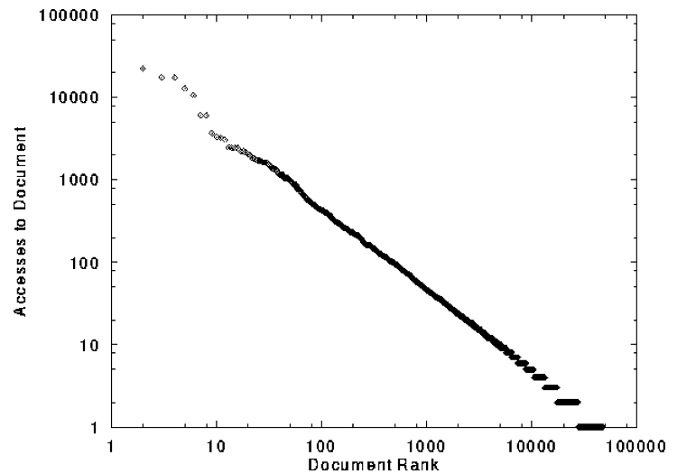
Skewed Popularity of Web Traffic
“Zipf” or “power-law” distribution
Characteristics of WWW Client-based Traces
Carlos R. Cunha, Azer Bestavros, Mark E. Crovella, BU-CS-95-01

Slide 4
Web Caching

Slide 5
Web Cache Architecure
Local ISP
Reverse
Proxy
Content
Server
Reverse
Proxy
Content
Server
Reverse
Proxy
Content
Server
Reverse
Proxy
Content
Server
cache
cdn
L4 Switch
Data Center
ISP
Intranet
cache
Browser
Browser
cache
cache
Browser
cache
cdn

Slide 6
Proxy Caches
6
origin
server
Reactively replicates popular content
Smaller round-trip times to clients
Reduces load on origin servers
Reduces network load, and bandwidth costs
Maintain persistent TCP connections
Proxy
server
HTTP request
HTTP request
client
HTTP response
HTTP response
HTTP request
HTTP response
client

Slide 7
Forward Proxy
Cache close to the client
Improves client performance
Reduces network provider’s costs
Explicit proxy
Requires configuring browser
Implicit proxy
Service provider deploys an “on path” proxy
… that intercepts and handles Web requests
Proxy
server
HTTP request
client
HTTP response
HTTP request
HTTP response
client

Slide 8
Reverse Proxy
Cache close to server
Improve client performance
Reduce content provider cost
Load balancing, content assembly, transcoding, etc.
Directing clients to the proxy
Map the site name to the IP address of the proxy
origin
server
Proxy
server
HTTP request
HTTP response
HTTP request
HTTP response
origin
server

Slide 9

Google Design
. .
.
Servers
Data Centers
Servers
Router
Router
Private Backbone
Reverse Proxy
Reverse Proxy
Internet
Requests
Client
Client
Client

Slide 10
Limitations of Web Caching
Much content is not cacheable
Dynamic data: stock prices, scores, web cams
CGI scripts: results depend on parameters
Cookies: results may depend on passed data
SSL: encrypted data is not cacheable
Analytics: owner wants to measure hits
Stale data
Or, overhead of refreshing the cached data

Slide 11
Content Delivery Networks

Slide 12
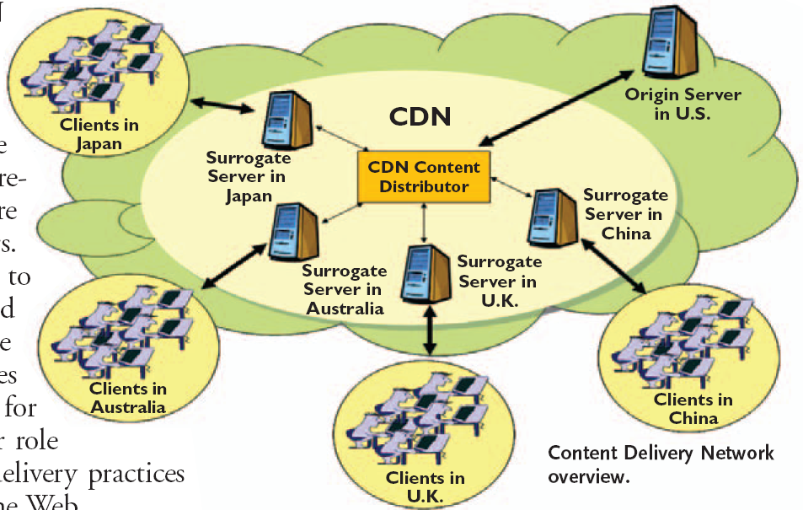
A Big Picture

Slide 13
Advantages of using CDN
Reduce customers’ needs in investing web site infrastructures and decrease operational cost of managing such infrastructures
Bypass traffic jams on the web
Requested data is close to the clients
Avoid traversing bottleneck links
Improve content delivery quality, speed, and reliability
Reduce load on the original server
Load balancing?

Slide 14
Content Delivery Network
origin server
in North America
Proactive content replication
Content provider (e.g., CNN) contracts with a CDN
CDN replicates the content
On many servers spread throughout the Internet
Updating the replicas
Updates pushed to replicas when the content changes
CDN distribution node
CDN server
in S. America
CDN server
in Asia
CDN server
in Europe

Slide 15
Server Selection Policy
Live server
For availability
Lowest load
To balance load across the servers
Closest
Nearest geographically, or in round-trip time
Best performance
Throughput, latency, …
Cheapest bandwidth, electricity, …
Requires continuous monitoring of liveness, load, and performance

Slide 16
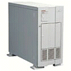

Server Selection Mechanism
16
Application
HTTP redirection
Advantages
Fine-grain control
Selection based on client IP address
Disadvantages
Extra round-trips for TCP connection to server
Overhead on the server
GET
Redirect
GET
OK

Slide 17
Server Selection Mechanism
17
Routing
Anycast routing
Advantages
No extra round trips
Route to nearby server
Disadvantages
Does not consider network or server load
Different packets may go to different servers
Used only for simple request-response apps
1.2.3.0/24
1.2.3.0/24

Slide 18
Server Selection Mechanism
Naming
DNS-based server selection
Advantages
Avoid TCP set-up delay
DNS caching reduces overhead
Relatively fine control
Disadvantage
Based on IP address of local DNS server
“Hidden load” effect
DNS TTL limits adaptation
1.2.3.4
DNS
query
1.2.3.5
local DNS server
Notes:
The hidden load has implications on a CDN's load balancing algorithm. For example, a DNS request from a local DNS server of a large ISP may result in many more Web requests than a DNS request from a local DNS server of a small site. CDNs need to be able to properly weigh individual DNS requests to distribute Web requests among its CDN servers.

Slide 19
How Akamai Works

Slide 20
Akamai Statistics
Distributed servers
Servers: ~61,000
Networks: ~1,000
Countries: ~70
Many customers
Apple, BBC, FOX, GM IBM, MTV, NASA, NBC, NFL, NPR, Puma, Red Bull, Rutgers, SAP, …
Client requests
Hundreds of billions per day
Half in the top 45 networks
15-20% of all Web traffic worldwide

Slide 21
How Akamai Uses DNS
21
cnn.com (content provider)
HTTP
DNS root server
GET index.html
Akamai
cluster
http://cache.cnn.com/foo.jpg
Akamai global
DNS server
1
2
HTTP
Akamai regional
DNS server
Nearby Akamai
cluster
End user

Slide 22
How Akamai Uses DNS
22
cnn.com (content provider)
HTTP
DNS root server
DNS lookup
cache.cnn.com
Akamai
cluster
Akamai global
DNS server
1
2
3
ALIAS:
g.akamai.net
4
Akamai regional
DNS server
Nearby Akamai
cluster
End user

Slide 23
How Akamai Uses DNS
23
cnn.com (content provider)
HTTP
DNS root server
DNS lookup
g.akamai.net
Akamai
cluster
Akamai global
DNS server
5
1
2
3
4
6
Akamai regional
DNS server
ALIAS
a73.g.akamai.net
Nearby Akamai
cluster
End user

Slide 24
How Akamai Uses DNS
24
cnn.com (content provider)
HTTP
DNS root server
Akamai
cluster
Akamai global
DNS server
5
1
2
3
4
6
Akamai regional
DNS server
7
DNS a73.g.akamai.net
8
Address
1.2.3.4
Nearby Akamai
cluster
End user

Slide 25
How Akamai Uses DNS
25
cnn.com (content provider)
HTTP
DNS root server
Akamai
cluster
Akamai global
DNS server
5
1
2
3
4
6
Akamai regional
DNS server
7
8
9
Nearby Akamai
cluster
End user
GET /foo.jpg
Host: cache.cnn.com

Slide 26

How Akamai Uses DNS
26
cnn.com (content provider)
HTTP
DNS root server
GET foo.jpg
11
12
Akamai
cluster
Akamai global
DNS server
5
1
2
3
4
6
Akamai regional
DNS server
7
8
9
Nearby Akamai
cluster
End user
GET /foo.jpg
Host: cache.cnn.com

Slide 27
How Akamai Uses DNS
27
cnn.com (content provider)
HTTP
DNS root server
11
12
Akamai
cluster
Akamai global
DNS server
5
1
2
3
4
6
Akamai regional
DNS server
7
8
9
Nearby Akamai
cluster
End user
10

Slide 28
How Akamai Works: Cache Hit
cnn.com (content provider)
DNS root server
Akamai server
GET index.html
Akamai high-level DNS server
1
2
Akamai low-level DNS server
7
8
Nearby
hash-chosen Akamai
server
9
End user
10
GET /cnn.com/foo.jpg

Slide 29
Mapping System
Equivalence classes of IP addresses
IP addresses experiencing similar performance
Quantify how well they connect to each other
Collect and combine measurements
Ping, traceroute, BGP routes, server logs
E.g., over 100 TB of logs per days
Network latency, loss, and connectivity

Slide 30
Mapping System
Map each IP class to a preferred server cluster
Based on performance, cluster health, etc.
Updated roughly every minute
Map client request to a server in the cluster
Load balancer selects a specific server
E.g., to maximize the cache hit rate

Slide 31
Adapting to Failures
Failing hard drive on a server
Suspends after finishing “in progress” requests
Failed server
Another server takes over for the IP address
Low-level map updated quickly
Failed cluster
High-level map updated quickly
Failed path to customer’s origin server
Route packets through an intermediate node

Slide 32
Akamai Transport Optimizations
Bad Internet routes
Overlay routing through an intermediate server
Packet loss
Sending redundant data over multiple paths
TCP connection set-up/teardown
Pools of persistent connections
TCP congestion window and round-trip time
Estimates based on network latency measurements

Slide 33
Akamai Application Optimizations
Slow download of embedded objects
Prefetch when HTML page is requested
Large objects
Content compression
Slow applications
Moving applications to edge servers
E.g., content aggregation and transformation
E.g., static databases (e.g., product catalogs)
E.g. batching and validating input on Web forms

Slide 34
Conclusion
Content distribution is hard
Many, diverse, changing objects
Clients distributed all over the world
Reducing latency is king
Content distribution solutions
Reactive caching
Proactive content delivery networks

Slide 35
More Recent …
The CDN is one of the fastest revenue generating market for the existing as well as for the new players. Rapid explosion of web-based content, mainly online music, online video, online transaction-based services, has enhanced the demand for CDNs.
CDN is estimated to grow from $3.71billion in 2014 to $12.16 billion by 2019, at a Compound Annual Growth Rate (CAGR) of 26.3% from 2014 to 2019.

