Slide 1
Network Layer
Dr. Yingwu Zhu

Slide 2
IP Protocol Stack: Key Abstractions
Application
Applications
Transport
Reliable streams
Messages
Network
Best-effort global packet delivery
Best-effort local packet delivery
Link

Slide 3
Best-Effort Global Packet Delivery
Host-to-Host delivery
Analogy: Airport-to-Airport delivery

Slide 4
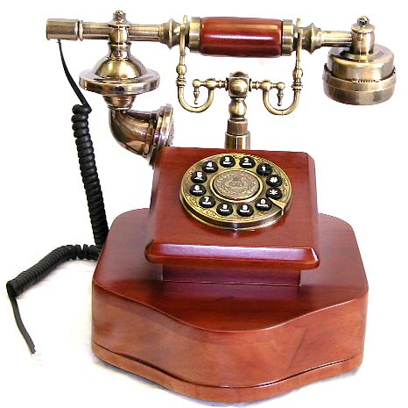
Circuit Switching (e.g., Phone Network)
Source establishes connection
Reserve resources along hops in the path
Source sends data
Transmit data over the established connection
Source tears down connection
Free the resources for future connections

Slide 5
Circuit Switching: Static Allocation
Q: Frequency-Division vs. Time-Division
time
time

Slide 6
Circuit Switching: Static Allocation
Time-division
Each circuit allocated certain time slots
Frequency-division
Each circuit allocated certain frequencies
frequency
time
time

Slide 7
Packet Switching
Message divided into packets
Header identifies the destination address
Packets travel separately through the network
Forwarding based on the destination address
Packets may be buffered temporarily
Destination reconstructs the message

Slide 8





Packet Switching: Statistical (Time Division) Multiplexing
Packets
Intuition: Traffic by computer end-points is bursty!
Versus: Telephone traffic not bursty (e.g., constant 56 kbps)
One can use network while others idle
Packet queuing in network: tradeoff space for time
Handle short periods when outgoing link demand > link speed
Notes:
STDM can be with cirtcuits (packets tagged with ID and preestablished state in switches) or with full packet switching (need full addressing in each packet)

Slide 9
Best Effort: Celebrating Simplicity
Packets may be lost, corrupted, reordered
Never having to say you’re sorry…
Don’t reserve bandwidth and memory
Don’t do error detection and correction
Don’t remember from one packet to next
Easier to survive failures
Transient disruptions are okay during failover
Easier to support on many kinds of links
Important for interconnecting different networks
9

Slide 10
Is Best Effort Good Enough?
Packet loss and delay
Sender can resend
Packet corruption
Receiver can detect, and sender can resend
Out-of-order delivery
Receiver can put the data back in order
Packets follow different paths
Doesn’t matter
Network failure
Drop the packet
Network congestion
Drop the packet

Slide 11
Packet vs. Circuit Switching?
Predictable performance
Network never blocks senders
Reliable, in-order delivery
Low delay to send data
Simple forwarding
No overhead for packet headers
High utilization under most workloads
No per-connection network state
Circuit
Packet
Circuit
Packet
Circuit
Circuit
Packet
Packet

Slide 12
Network Addresses

Slide 13
IP Address (IPv4)
A unique 32-bit number
Identifies an interface (on a host, on a router, …)
Represented in dotted-quad notation
12
34
158
5
00001100
00100010
10011110
00000101

Slide 14
Grouping Related Hosts
The Internet is an “inter-network”
Used to connect networks together, not hosts
Need to address a network (i.e., group of hosts)
host
host
...
host
host
host
...
host
LAN 1
LAN 2
router
router
router
WAN
WAN
LAN = Local Area Network
WAN = Wide Area Network

Slide 15
Scalability Challenge
Suppose hosts had arbitrary addresses
Then every router would need a lot of information
…to know how to direct packets toward every host
1.2.3.4
5.6.7.8
2.4.6.8
1.2.3.5
5.6.7.9
2.4.6.9
host
host
...
host
host
host
...
host
LAN 1
LAN 2
router
router
router
WAN
WAN
1.2.3.4
1.2.3.5
forwarding table

Slide 16
Hierarchical Addressing in U.S. Mail
Addressing in the U.S. mail
Zip code: 08540
Building: 35 Olden Street
Room in building: 308
Name of occupant: Mike Freedman
Forwarding the U.S. mail
Deliver to the post office in the zip code
Assign to mailman covering the building
Drop letter into mailbox for building/room
Give letter to the appropriate person
???
16

Slide 17
Hierarchical Addressing: IP Prefixes
Network and host portions (left and right)
12.34.158.0/24 is a 24-bit prefix with 2⁸ addresses
12
34
158
5
00001100
00100010
10011110
00000101
Network (24 bits)
Host (8 bits)

Slide 18
IP Address and 24-bit Subnet Mask
Address
12
34
158
5
00001100
00100010
10011110
00000101
11111111
11111111
11111111
00000000
Mask
255
255
255
0

Slide 19
Scalability Improved
Number related hosts from a common subnet
1.2.3.0/24 on the left LAN
5.6.7.0/24 on the right LAN
1.2.3.4
1.2.3.7
1.2.3.156
5.6.7.8
5.6.7.9
5.6.7.212
host
host
...
host
host
host
...
host
LAN 1
LAN 2
router
router
router
WAN
WAN
1.2.3.0/24
5.6.7.0/24
forwarding table

Slide 20
Easy to Add New Hosts
No need to update the routers
E.g., adding a new host 5.6.7.213 on the right
Doesn’t require adding a new forwarding-table entry
1.2.3.4
1.2.3.7
1.2.3.156
5.6.7.8
5.6.7.9
5.6.7.212
host
host
...
host
host
host
...
host
LAN 1
LAN 2
router
router
router
host
WAN
WAN
5.6.7.213
1.2.3.0/24
5.6.7.0/24
forwarding table

Slide 21
History of IP Address Allocation

Slide 22
Classful Addressing
In the olden days, only fixed allocation sizes
Class A: 0*
Very large /8 blocks (e.g., MIT has 18.0.0.0/8)
Class B: 10*
Large /16 blocks (e.g,. Princeton has 128.112.0.0/16)
Class C: 110*
Small /24 blocks (e.g., AT&T Labs has 192.20.225.0/24)
Class D: 1110* for multicast groups
Class E: 11110* reserved for future use
This is why folks use dotted-quad notation!

Slide 23
Classless Inter-Domain Routing (CIDR)
Use two 32-bit numbers to represent network:
Network number = IP address + Mask
IP Address : 12.4.0.0 IP Mask: 255.254.0.0
Address
00001100
00000100
00000000
00000000
Mask
11111111
11111110
00000000
00000000
Network Prefix
for hosts
Written as 12.4.0.0/15

Slide 24
Hierarchical Address Allocation
Hierarchy is key to scalability
Address allocated in contiguous chunks (prefixes)
Today, the Internet has about 400,000 prefixes
12.0.0.0/16
12.1.0.0/16
:
:
:
12.3.0.0/24
12.2.0.0/16
12.3.1.0/24
12.3.0.0/16
:
:
:
:
:
12.0.0.0/8
12.3.254.0/24
12.253.0.0/19
12.253.32.0/19
:
:
12.254.0.0/16
12.253.160.0/19

Slide 25
Obtaining a Block of Addresses
Internet Corporation for Assigned Names and Numbers (ICANN)
Allocates large blocks to Regional Internet Registries
Regional Internet Registries (RIRs)
E.g., ARIN (American Registry for Internet Numbers)
Allocates to ISPs and large institutions
Internet Service Providers (ISPs)
Allocate address blocks to their customers
Who may, in turn, allocate to their customers…
25

Slide 26
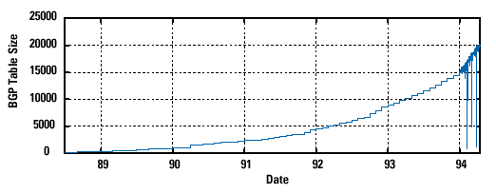
Pre-CIDR (1988-1994): Steep Growth
Growth faster than improvements in equipment capability

Slide 27
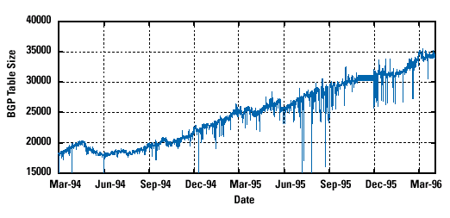
CIDR (1994-1996): Much Flatter
Efforts to aggregate

Slide 28
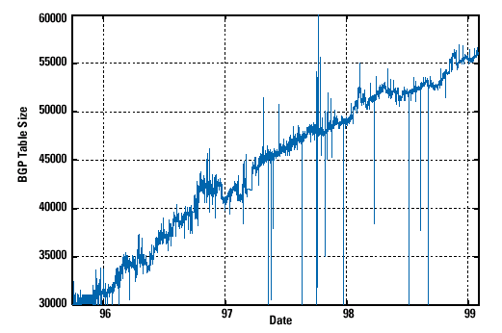
CIDR Growth (1996-1998): Roughly Linear
Good use of aggregation, and peer pressure!

Slide 29
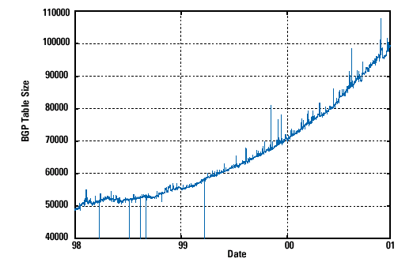
DotCom Boom (1998-2001): Steep Growth
Internet boom and increased multi-homing

Slide 30
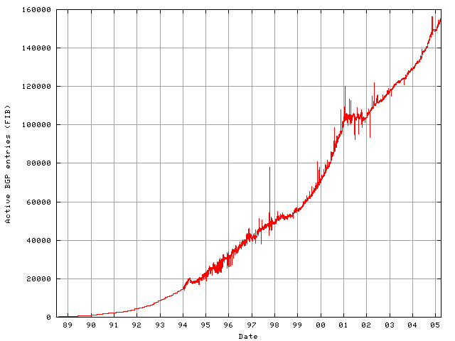
Long Term Growth (1989-2005)
Pre CIDR
CIDR’s
effect
DotCom
Boom
Post Boom
Today we are up to ~400,000 prefixes

Slide 31
Packet Forwarding

Slide 32
Hop-by-Hop Packet Forwarding
Each router has a forwarding table
Maps destination address to outgoing interface
Upon receiving a packet
Inspect the destination address in the header
Index into the table
Determine the outgoing interface
Forward the packet out that interface
Then, the next router in the path repeats

Slide 33
IP Router
Processor
control plane
data plane
Switching
Fabric
Adapter
Adapter
Adapter
Adapter
Adapter
Adapter

Slide 34
Switch Fabric: From Input to Output
Data
1
1
Hdr
Header Processing
Queue
Packet
Lookup
Address
Update
Header
Address
Table
Buffer
Memory
Data
2
2
Hdr
Header Processing
Queue
Packet
Lookup
Address
Update
Header
Address
Table
Buffer
Memory
Data
Hdr
Header Processing
N
N
Queue
Packet
Lookup
Address
Update
Header
Address
Table
Buffer
Memory

Slide 35
Separate Forwarding Entry Per Prefix
Prefix-based forwarding
Map the destination address to matching prefix
Forward to the outgoing interface
1.2.3.4
1.2.3.7
1.2.3.156
5.6.7.8
5.6.7.9
5.6.7.212
host
host
...
host
host
host
...
host
LAN 1
LAN
router
router
router
WAN
WAN
1.2.3.0/24
5.6.7.0/24
forwarding table

Slide 36
CIDR Makes Packet Forwarding Harder
Forwarding table may have many matches
E.g., entries for 201.10.0.0/21 and 201.10.6.0/23
The IP address 201.10.6.17 would match both!
201.10.0.0/21
201.10.6.0/23
Provider 1
Provider 2
201.10.0.0/22
201.10.4.0/24
201.10.5.0/24
201.10.6.0/23

Slide 37
Longest Prefix Match Forwarding
Destination-based forwarding
Packet has a destination address
Router identifies longest-matching prefix
Cute algorithmic problem: very fast lookups
forwarding table
4.0.0.0/8
4.83.128.0/17
201.10.0.0/21
201.10.6.0/23
126.255.103.0/24
destination
201.10.6.17
outgoing link
Serial0/0.1

Slide 38
Creating a Forwarding Table
Entries can be statically configured
E.g., “map 12.34.158.0/24 to Serial0/0.1”
But, this doesn’t adapt
To failures
To new equipment
To the need to balance load
That is where the control plane comes in
Routing protocols

Slide 39
Data, Control, & Management Planes
Processor
Switching
Fabric
 | Data | Control | Management
Time-scale | Packet (ns) | Event (10 ms to sec) | Human (min to hours)
Tasks | Forwarding, buffering, filtering, scheduling | Routing, signaling | Analysis, configuration
Location | Line-card hardware | Router software | Humans or scripts
39

Slide 40
Q’s: MAC vs. IP Addressing
Hierarchically allocated
A) MAC B) IP C) Both D) Neither
Organized topologically
A) MAC B) IP C) Both D) Neither
Forwarding via exact match on address
A) MAC B) IP C) Both D) Neither
Automatically calculate forwarding by observing data
A) Ethernet switches B) IP routers C) Both D) Neither
Per connection state in the network
A) MAC B) IP C) Both D) Neither
Per host state in the network
A) MAC B) IP C) Both D) Neither

Slide 41
Q’s: MAC vs. IP Addressing
Hierarchically allocated
A) MAC B) IP C) Both D) Neither
Organized topologically
A) MAC B) IP C) Both D) Neither
Forwarding via exact match on address
A) MAC B) IP C) Both D) Neither
Automatically calculate forwarding by observing data
A) Ethernet switches B) IP routers C) Both D) Neither
Per connection state in the network
A) MAC B) IP C) Both D) Neither
Per host state in the network
A) MAC B) IP C) Both D) Neither

Slide 42
IP Packet Format

Slide 43
IP Packet Structure
4-bit
Version
4-bit
Header
Length
8-bit
Type of Service
(TOS)
16-bit Total Length (Bytes)
16-bit Identification
3-bit
Flags
13-bit Fragment Offset
8-bit Time to
Live (TTL)
8-bit Protocol
16-bit Header Checksum
32-bit Source IP Address
32-bit Destination IP Address
Options (if any)
Payload

Slide 44
IP Fragmentation & Reassembly
Problem: A router may receive a packet larger than the maximum transmission unit (MTU) of the outgoing link.
different link types, different MTUs
Solution: large IP datagram divided (“fragmented”) within net
one datagram becomes several datagrams
“reassembled” only at final destination, why?
IP header bits used to identify, order related fragments
fragmentation:
in: one large datagram
out: 3 smaller datagrams
reassembly
E.g., bytes. Ethernet frames carry up to 1500 bytes, frames for some wide-area links carry no more than 576 (MTU: the max of data a link-layer frame can carry)

Slide 45
IP Fragmentation and Reassembly
length
=4000
ID
=x
fragflag
=0
offset
=0
Example
4000 byte datagram
MTU = 1500 bytes
One large datagram becomes
several smaller datagrams
length
=1500
ID
=x
fragflag
=1
offset
=0
1480 bytes in data field
length
=1500
ID
=x
fragflag
=1
offset
=185
offset =
1480/8
length
=1040
ID
=x
fragflag
=0
offset
=370
Note: the offset value is specified in units of 8-byte chunks!!!

Slide 46
Fragmentation
Fragments are re-assembled by the destination host; not by intermediate routers.
To avoid fragmentation, hosts commonly use path MTU discovery to find the smallest MTU along the path.
Path MTU discovery involves sending various size datagrams until they do not require fragmentation along the path.
Most links use MTU>=1500bytes today.
Try: traceroute www.berkeley.edu 500 –F and traceroute www.berkeley.edu 1501 -F
-F: Set the "don't fragment" bit, return error it is too long

Slide 47
Conclusion
Best-effort global packet delivery
Simple end-to-end abstraction
Enables higher-level abstractions on top
Doesn’t rely on much from the links below
IP addressing and forwarding
Hierarchy for scalability and decentralized control
Allocation of IP prefixes
Longest prefix match forwarding

Slide 48
Backup Slides

Slide 49
IP Header: Version, Length, ToS
Version number (4 bits)
Necessary to know what other fields to expect
Typically “4” (for IPv4), and sometimes “6” (for IPv6)
Header length (4 bits)
Number of 32-bit words in the header
Typically “5” (for a 20-byte IPv4 header)
Can be more when “IP options” are used
Type-of-Service (8 bits)
Allow different packets to be treated differently
Low delay for audio, high bandwidth for bulk transfer

Slide 50
IP Header: Length, Fragments, TTL
Total length (16 bits)
Number of bytes in the packet
Max size is 63,535 bytes (2¹⁶ -1)
… though most links impose smaller limits
Fragmentation information (32 bits)
Supports dividing a large IP packet into fragments
… in case a link cannot handle a large IP packet
Time-To-Live (8 bits)
Used to identify packets stuck in forwarding loops
… and eventually discard them from the network

Slide 51
IP Header: Transport Protocol
Protocol (8 bits)
Identifies the higher-level protocol
E.g., “6” for the Transmission Control Protocol (TCP)
E.g., “17” for the User Datagram Protocol (UDP)
Important for demultiplexing at receiving host
Indicates what kind of header to expect next
protocol=6
protocol=17
IP header
IP header
TCP header
UDP header

Slide 52
IP Header: Header Checksum
Checksum (16 bits)
Sum of all 16-bit words in the header
If header bits are corrupted, checksum won’t match
Receiving discards corrupted packets
134
+ 212
= 346
Mismatch!
134
+ 216
= 350

Slide 53
IP Header: To and From Addresses
Destination IP address (32 bits)
Unique identifier for the receiving host
Allows each node to make forwarding decisions
Source IP address (32 bits)
Unique identifier for the sending host
Recipient can decide whether to accept packet
Enables recipient to send a reply back to source

