Slide 1
Introduction
Dr. Yingwu Zhu
Textbook: Chapter one
Paper: End-to-end argument

Slide 2
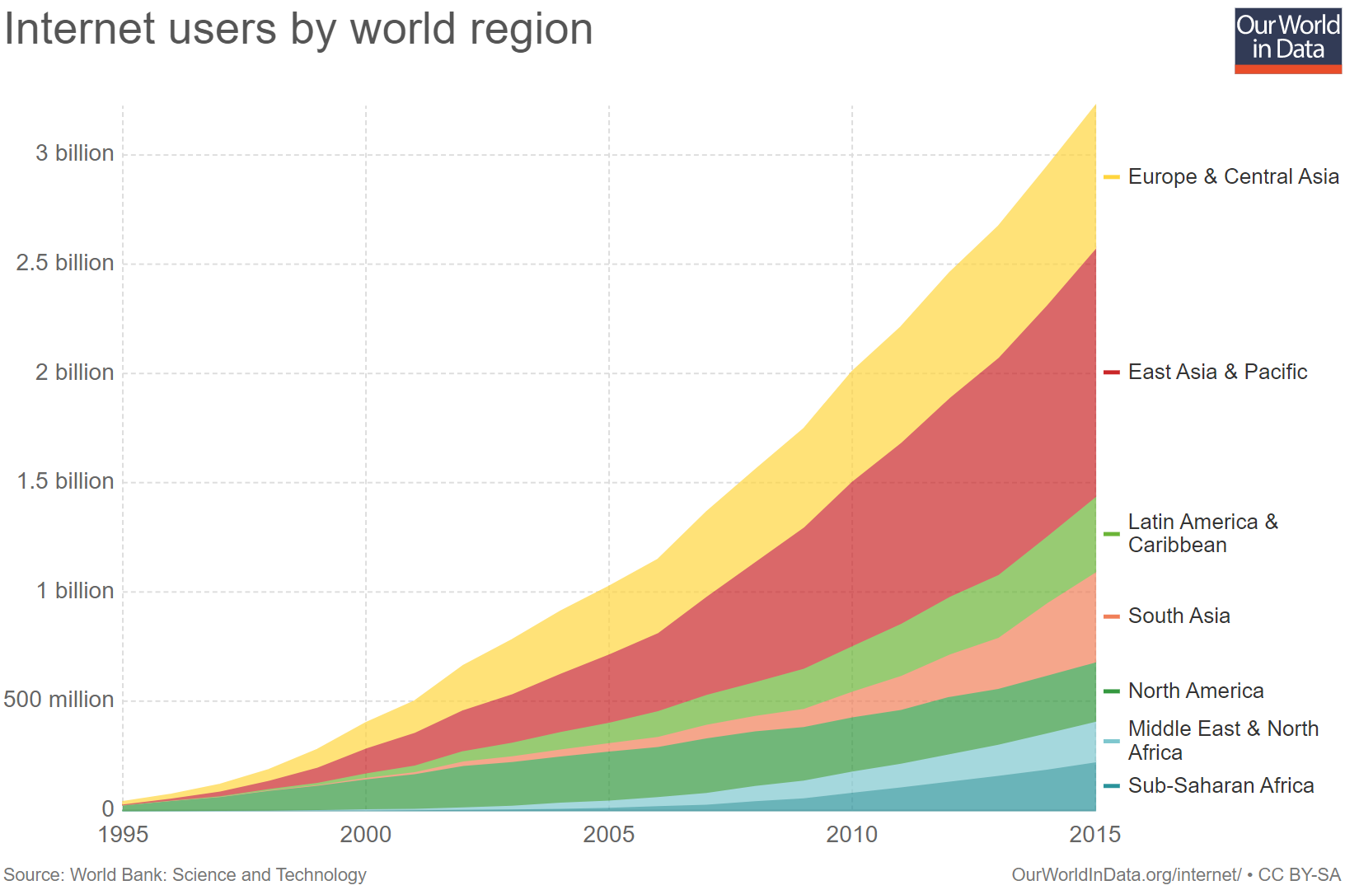
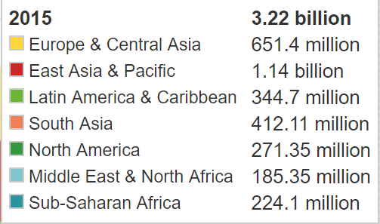
Internet growth
12/1996: 16 million
06/2017: 3.885 billion

Slide 3
What is the Internet?

Slide 4
From Wikipedia
The Internet is the worldwide, publicly accessible network of interconnected computer networks that transmit data by packet switching using the standard Internet Protocol (IP).
It is a "network of networks" that consists of millions of smaller domestic, academic, business, and government networks, which together carry various information and services.
http://en.wikipedia.org/wiki/Internet

Slide 5
What’s the Internet: “nuts and bolts” view
router
workstation
millions of connected computing devices: hosts, end-systems
  pc’s workstations, servers
  Mobile devices, toasters
  running network apps
communication links
  fiber, copper, radio, satellite
routers: forward packets (chunks) of data thru network
server
mobile
local ISP
regional ISP
company
network

Slide 6
What’s the Internet: “nuts and bolts” view
protocols: control sending, receiving of msgs
  e.g., TCP, IP, HTTP, FTP, PPP
Internet: “network of networks”
  loosely hierarchical
  public Internet versus private intranet
Internet standards
  RFC: Request for comments
  IETF: Internet Engineering Task Force
router
workstation
server
mobile
local ISP
regional ISP
company
network

Slide 7
What’s the Internet: a service view
communication infrastructure enables distributed applications:
  WWW, email, games, e-commerce, database., voting,
  more?
communication services provided:
  connectionless
  connection-oriented

Slide 8
Perspective (I)
Network users: Does the network support the users’ applications
  Reliability
  Error-free service
  Performance: speed of data transfer
  Even more: security? Privacy?
Network designers: Cost-efficient network design
  Good utilization of network resources
  Cost of building the network
  Types of services to be supported

Slide 9
Perspective (II)
Network providers: Network administration and customer service
  Maximize Revenue
  Minimize Operations Expenses
  Survivability and Resiliency

Slide 10
A closer look at network structure:
network edge: applications and hosts
network core:
  routers
  network of networks
access networks, physical media: communication links

Slide 11
Connectivity
We may want a set of hosts (or devices) to be directly connected! WHY ?
We may not always strive for global connectivity! WHY?
Building Blocks to connect at the physical level:
  links: coaxial cable, optical fiber...
  nodes: general-purpose workstations… (though sometimes very specialized)

Slide 12
Basic Connectivity
Two types of direct connectivity:
  point-to-point
  multiple access

Slide 13
Discussions
If all computers had to be directly connected, networks would be either very limited or expensive and unmanageable!
Question: If n computers were to be completely and directly connected by point-to-point links of cost C, what would be the total cost of the net?
Question: Would it be less expensive to use a multiple-access network? What are the drawbacks and limitations?

Slide 14
Building Blocks
Switches, Routers, Gateways
  Special network components responsible for “moving” packets across the network from source to destination.
Network hosts, workstations, etc.
  they generally represent the source and sink (destination) of data traffic (packets)
We can recursively build large networks by interconnecting networks via gateways and routers.

Slide 15
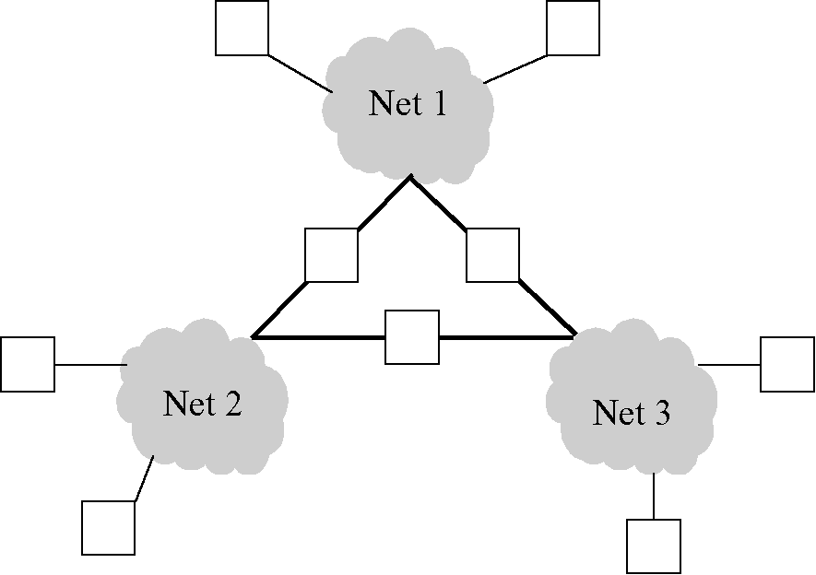
An Interconnection Network

Slide 16
What’s a protocol?
human protocols:
“what’s the time?”
“I have a question”
introductions
… specific msgs sent
… specific actions taken when msgs received, or other events
network protocols:
machines rather than humans
all communication activity in Internet governed by protocols
protocols define format, order of msgs sent and received among network entities, and actions taken on msg transmission & receipt

Slide 17


What’s a protocol?
a human protocol and a computer network protocol:
Hi
TCP connection
req.
Hi
TCP connection
reply.
Got the
time?
Get http://gaia.cs.umass.edu/index.htm
2:00
<file>
time
Q: Other human protocol?

Slide 18
Protocols
Building blocks of a network architecture
Each protocol object has two different interfaces
  service interface: defines operations on this protocol
  peer-to-peer interface: defines messages exchanged with peer
Term “protocol” is overloaded
  specification of peer-to-peer interface
  module that implements this interface

Slide 19
The network edge:
end systems (hosts):
  run application programs
  e.g., WWW, email
  at “edge of network”
client/server model
  client host requests, receives service from server
  e.g., WWW client (browser)/ server; email client/server
peer-peer model:
  host interaction symmetric
  e.g.: teleconferencing, Gnutella, Kazza, BitTorrent

Slide 20
Network edge: connection-oriented service
Goal: data transfer between end sys.
handshaking: setup (prepare for) data transfer ahead of time
  Hello, hello back human protocol
  set up “state” in two communicating hosts
TCP - Transmission Control Protocol
  Internet’s connection-oriented service
TCP service [RFC 793]
reliable, in-order byte-stream data transfer
  loss: acknowledgements and retransmissions
flow control:
  sender won’t overwhelm receiver
congestion control:
  senders “slow down sending rate” when network congested

Slide 21
Network edge: connectionless service
Goal: data transfer between end systems
  same as before!
UDP - User Datagram Protocol [RFC 768]: Internet’s connectionless service
  unreliable data transfer
  no flow control
  no congestion control
App’s using TCP:
HTTP (WWW), FTP (file transfer), Telnet (remote login), SMTP (email)
App’s using UDP:
streaming media, teleconferencing, Internet telephony,
Skype

Slide 22
The Network Core
mesh of interconnected routers
the fundamental question: how is data transferred through net?
  circuit switching: dedicated circuit per call: telephone net
  packet-switching: data sent thru net in discrete “chunks”

Slide 23
Different Types of Switching
Different Types of Switching:
  Circuit Switching (telephone network)
    dedicated circuit, sending and receiving bit streams
  Packet Switching
    store and forward, sending and receiving packets
  Message Switching
  Virtual Circuit Switching
  Cell Switching (ATM)
What are Packets?
  Data to be transmitted is divided into discrete blocks

Slide 24
Network Core: Circuit Switching
End-end resources reserved for “call”
link bandwidth, switch capacity
dedicated resources: no sharing
circuit-like (guaranteed) performance
call setup required

Slide 25
Cost-Effective Resource Sharing
Must share (multiplex) network resources among multiple users.
Common Multiplexing Strategies
  Time-Division Multiplexing (TDM)
  Frequency-Division Multiplexing (FDM): Frequency band → bandwidth
Multiplexing multiple logical flows over a single physical link.

Slide 26
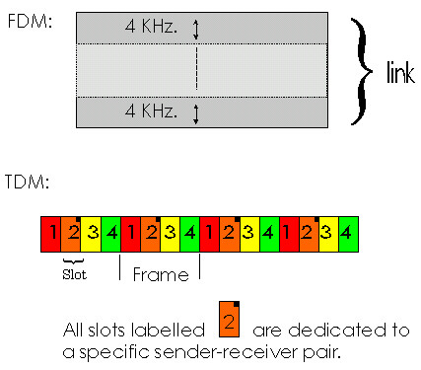
Network Core: Circuit Switching
network resources (e.g., bandwidth) divided into “pieces”
pieces allocated to calls
resource piece idle if not used by owning call (no sharing)
dividing link bandwidth into “pieces”
  frequency division
  time division

Slide 27
Network Core: Packet Switching
each end-end data stream divided into packets
user A, B packets share network resources
each packet uses full link bandwidth
resources used as needed,
resource contention:
aggregate resource demand can exceed amount available
congestion: packets queue, wait for link use
store and forward: packets move one hop at a time
  transmit over link
  wait turn at next link
Bandwidth division into “pieces”
Dedicated allocation
Resource reservation

Slide 28
Network Core: Packet Switching
On-demand sharing
10 Mbps
Ethernet
A
C
statistical multiplexing
1.5 Mbps
B
queue of packets
waiting for output
link
45 Mbps
D
E

Slide 29
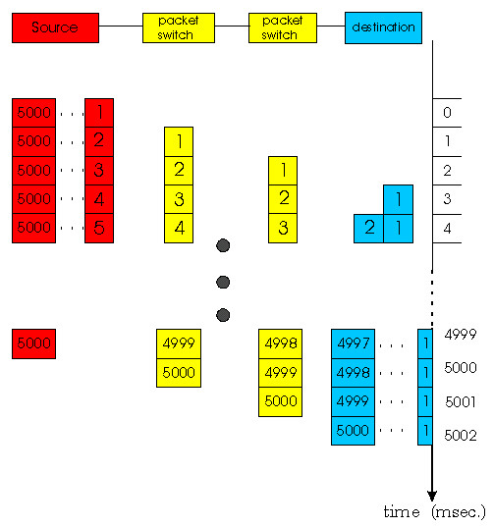
Network Core: Packet Switching
Packet-switching:
store and forward behavior

Slide 30
Packet switching versus circuit switching
Packet switching allows more users to use network!
1 Mbps link
each user:
  100Kbps when “active”
  active 10% of time
circuit-switching:
  10 users
packet switching:
  with 35 users, probability > 10 active less than .004
N users
1 Mbps link

Slide 31
Packet switching versus circuit switching
Is packet switching a “slam dunk winner?”
Great for bursty data
  resource sharing
  no call setup
Excessive congestion: packet delay and loss
  protocols needed for reliable data transfer, congestion control
Q: How to provide circuit-like behavior?
  bandwidth guarantees needed for audio/video apps
  still an unsolved problem!

Slide 32
Packet-switched networks: routing
Goal: move packets among routers from source to destination
  we’ll study several path selection algorithms
datagram network:
  destination address determines next hop
  routes may change during session
  analogy: driving, asking directions
virtual circuit network:
  each packet carries tag (virtual circuit ID), tag determines next hop
  fixed path determined at call setup time, remains fixed thru call
  routers maintain per-call state
  ATM

Slide 33
Delay in packet-switched networks
packets experience delay on end-to-end path
four sources of delay at each hop
nodal processing:
  check bit errors
  determine output link
queueing
  time waiting at output link for transmission
  depends on congestion level of router
transmission
A
propagation
B
nodal
processing
queueing

Slide 34
Delay in packet-switched networks
Transmission delay:
R=link bandwidth (bps)
L=packet length (bits)
time to send bits into link = L/R
Propagation delay:
d = length of physical link
s = propagation speed in medium (~2x10⁸ m/sec)
propagation delay = d/s
Note: s and R are very different quantitites!
transmission
A
propagation
B
nodal
processing
queueing

Slide 35
Performance
Bandwidth (throughput)
Amount of data that can be transmitted per time unit
Example: 10Mbps
link versus end-to-end
Notation
  KB = 2¹⁰ bytes
  Mbps = 10⁶ bits per second

Slide 36
Performance
Bandwidth related to “bit width”
a)
1 second
b)
1 second

Slide 37
Latency (delay)
Time it takes to send message from point A to point B
Example: 24 milliseconds (ms)
Sometimes interested in in round-trip time (RTT)
Components of latency
  Latency = Propagation + Transmit + Queue + Proc.
  Propagation = Distance / SpeedOfLight
  Transmit = Size / Bandwidth

Slide 38
Transmission and Propagation Delays
Propagation delay
  The propagation delay over a link is the time it takes a bit to travel from on end of the link to the other
  = d/s
Transmission delay
  It is the amount of time it takes to push the packet onto the link
  =L/B
Total latency over the link
  = transmission delay + propagation delay

Slide 39
Bandwidth v.s. Latency
Consider a standard 6250 bpi magnetic tape that holds 180 Megabytes. A station wagon can easily transport 200 tapes. Suppose the source and destination are an hour’s drive apart.
  Calculate the effective throughput:
    288000 megabits in 3600 seconds
    or 80 Mbps
  What is the moral of this story ?
Never underestimate the bandwidth of a station wagon full of tapes pacing down the highway.
But … What happens to the latency?

Slide 40
Delay x Bandwidth Product
  e.g., 100ms RTT and 45Mbps Bandwidth = 560KB of data
We have to view the network as a buffer. This may have interesting consequences:
  How much data did the sender transmit before a response can be received?
Delay
Bandwidth

Slide 41

“Best-Effort Packet Delivery Service”
THE
INTERNET
packets

Slide 42
What Goes Wrong in the Network?
Different types of Error:
  Bit-level errors (electrical interference)
    1 in 10⁶-10⁷ in copper
    1 in 10¹² - 10¹⁴ in fiber
  Packet-level errors (congestion)
  Link and node failures
How should we deal with these types of error?
What are the consequences of errors?

Slide 43
Problems in the Network
Messages are delayed
Messages are delivered out-of-order
Third parties eavesdrop
The key problem is to fill in the gap between what applications expect and what the underlying technology provides.

Slide 44
Abstraction through Protocol Layering
Modularity
  Each layer relies on services from layer below
  Each layer exports services to layer above
Interfaces
  Hides implementation details
  Layers can change without disturbing other layers
Application
Application-to-application channels
Host-to-host connectivity
Link hardware

Slide 45
Internet protocol stack
application: supporting network applications
  ftp, smtp, http
transport: host-host data transfer
  tcp, udp
network: routing of datagrams from source to destination
  ip, routing protocols
link: data transfer between neighboring network elements
  ppp, ethernet
physical: bits “on the wire”
application
transport
network
link
physical

Slide 46
The Internet Protocol Suite
FTP
HTTP
NV
TFTP
Applications
TCP
UDP
UDP
TCP
Waist
IP
Data Link
NET₁
NET₂
…
NET_{n}
Physical
The Hourglass Model
The “narrow waist” facilitates interoperability

Slide 47
Layering: logical communication
Each layer:
distributed
“entities” implement layer functions at each node
entities perform actions, exchange messages with peers
application
transport
network
link
physical
network
link
physical
application
transport
network
link
physical
application
transport
network
link
physical
application
transport
network
link
physical

Slide 48
Layering: logical communication
data
E.g.: transport
take data from app
add addressing, reliability check info to form “datagram”
send datagram to peer
wait for peer to ack receipt
analogy: post office
application
transport
network
link
physical
transport
ack
network
link
physical
application
transport
network
link
physical
data
data
application
transport
network
link
physical
application
transport
network
link
physical
transport

Slide 49
Layering: physical communication
data
application
transport
network
link
physical
network
link
physical
application
transport
network
link
physical
data
application
transport
network
link
physical
application
transport
network
link
physical

Slide 50
Protocol layering and data
Each layer takes data from above
adds header information to create new data unit
passes new data unit to layer below
source
destination
M
application
transport
network
link
physical
application
transport
network
link
physical
M
message
H
M
H
t
M
segment
t
H
H
H
H
M
datagram
n
t
M
n
t
H
H
H
H
H
H
M
frame
l
n
t
M
l
n
t

Slide 51
Internet structure: network of networks
roughly hierarchical
national/international backbone providers (NBPs)
  e.g. BBN/GTE, Sprint, AT&T, IBM, UUNet
  interconnect (peer) with each other privately, or at public Network Access Point (NAPs) (or switching centers)
regional ISPs
  connect into NBPs
local ISP, company
  connect into regional ISPs
local
ISP
regional ISP
NBP B
NAP
NAP
NBP A
regional ISP
local
ISP

Slide 52
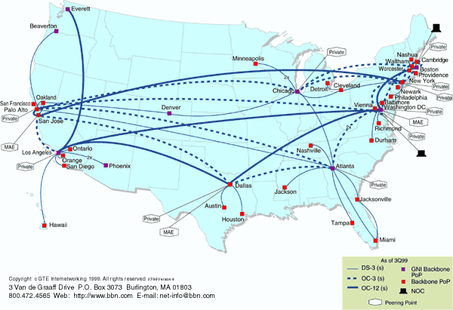
National Backbone Provider
e.g. BBN/GTE US backbone network

Slide 53
Key Concepts in Networking
Naming
  What to call computers, services, protocols, …
Layering
  Abstraction is the key to managing complexity
Protocols
  Speaking the same language
  Syntax and semantics
Resource allocation
  Dividing scarce resources among competing parties (routing)
  Memory, link bandwidth, wireless spectrum, paths

Slide 54
Power at the Network Edge
End-to-End Principle
Whenever possible, communications protocol operations should be defined to occur at the end-points of a communications system.
Programmability
With programmable end hosts, new network services can be added at any time, by anyone.
And end hosts became powerful and ubiquitous….

