Slide 1
Transport Layer: Principles of Reliable Data Transfer
Dr. Yingwu Zhu
Chapter 3.4

Slide 2
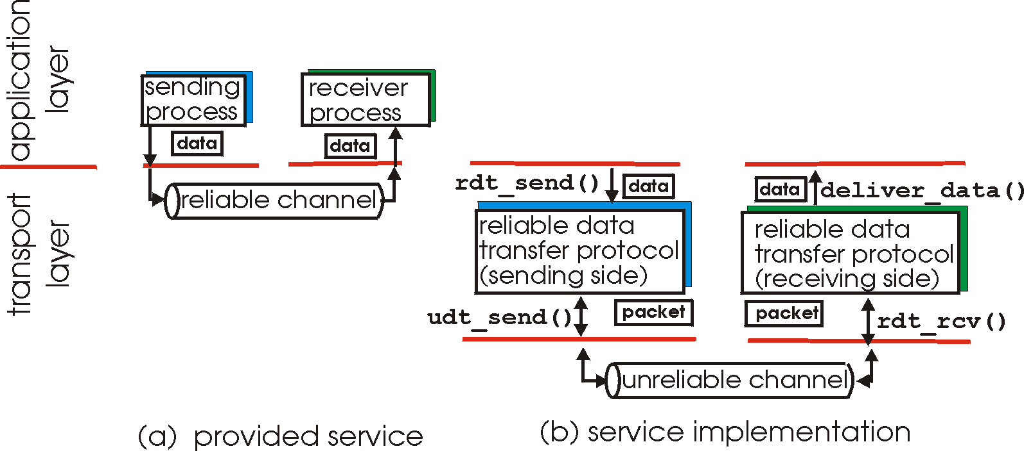
Principles of reliable data transfer
Provide reliable data transfer over unreliable network!
characteristics of unreliable channel will determine complexity of reliable data transfer protocol (rdt)

Slide 3
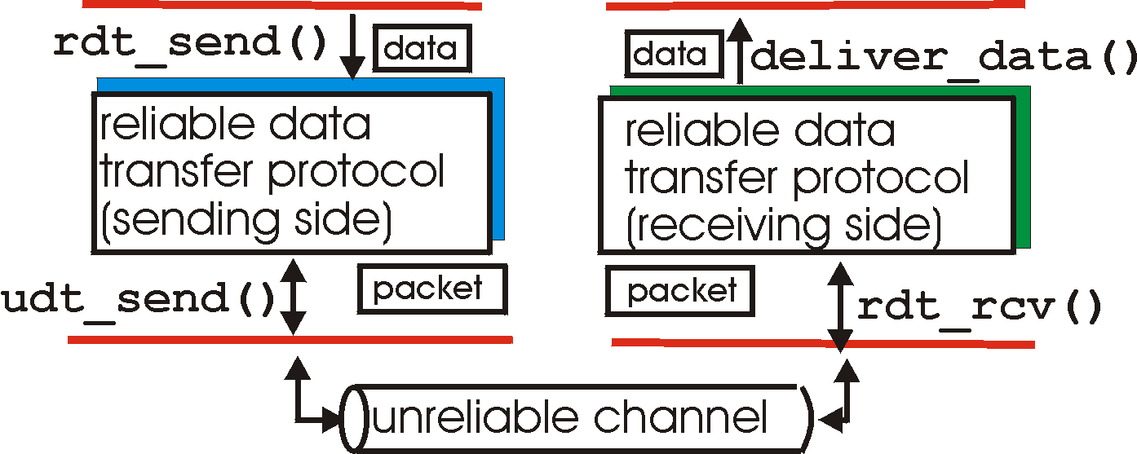
Reliable data transfer: getting started
rdt_send(): called from above, (e.g., by app.). Passed data to
deliver to receiver upper layer
deliver_data(): called by rdt to deliver data to upper
send
side
receive
side
udt_send(): called by rdt,
to transfer packet over
unreliable channel to receiver
rdt_rcv(): called when packet arrives on rcv-side of channel

Slide 4
Reliable data transfer: getting started
We’ll:
incrementally develop sender, receiver sides of reliable data transfer protocol (rdt)
consider only unidirectional data transfer
but control info will flow on both directions!
use finite state machines (FSM) to specify sender, receiver
event causing state transition
actions taken on state transition
state: when in this “state” next state uniquely determined by next event
state
1
state
2
event
actions

Slide 5
Reliable data transfer
Ideal world
Rdt 1.0: reliable channel, too good to be real
Rdt 2.0: unreliable channel with bit errors
Stop and Wait
Rdt 2.1: ACK-NAK
Rdt 2.2: NAK-free
Rdt 3.0: unreliable channel with bit errors and lost
Real world

Slide 6
Rdt1.0: reliable transfer over a reliable channel
underlying channel perfectly reliable
no bit errors
no loss of packets
separate FSMs for sender, receiver:
sender sends data into underlying channel
receiver read data from underlying channel
Wait for call from above
rdt_send(data)
Wait for call from below
rdt_rcv(packet)
extract (packet,data)
deliver_data(data)
packet = make_pkt(data)
udt_send(packet)
sender
receiver

Slide 7
Rdt2.0: channel with bit errors
underlying channel may flip bits in packet
How to detect it?
How to recover from errors?

Slide 8
Rdt2.0: channel with bit errors
underlying channel may flip bits in packet
How to detect it?
How to recover from errors?
new mechanisms in rdt2.0 (beyond rdt1.0):
error detection
Error recovery

Slide 9
Rdt2.0: channel with bit errors
underlying channel may flip bits in packet
checksum to detect bit errors
the question: how to recover from errors:
acknowledgements (ACKs): receiver explicitly tells sender that pkt received OK
negative acknowledgements (NAKs): receiver explicitly tells sender that pkt had errors
sender retransmits pkt on receipt of NAK
new mechanisms in rdt2.0 (beyond rdt1.0):
error detection
receiver feedback: control msgs (ACK,NAK) rcvr->sender

Slide 10
rdt2.0: FSM specification
rdt_send(data)
snkpkt = make_pkt(data, checksum)
udt_send(sndpkt)
receiver
rdt_rcv(rcvpkt) &&
isNAK(rcvpkt)
Wait for call from above
Wait for ACK or NAK
rdt_rcv(rcvpkt) &&
corrupt(rcvpkt)
udt_send(sndpkt)
udt_send(NAK)
rdt_rcv(rcvpkt) && isACK(rcvpkt)
Λ
Wait for call from below
sender
rdt_rcv(rcvpkt) &&
notcorrupt(rcvpkt)
extract(rcvpkt,data)
deliver_data(data)
udt_send(ACK)

Slide 11
rdt2.0: operation with no errors
rdt_send(data)
snkpkt = make_pkt(data, checksum)
udt_send(sndpkt)
rdt_rcv(rcvpkt) &&
isNAK(rcvpkt)
Wait for call from above
Wait for ACK or NAK
rdt_rcv(rcvpkt) &&
corrupt(rcvpkt)
udt_send(sndpkt)
udt_send(NAK)
rdt_rcv(rcvpkt) && isACK(rcvpkt)
Wait for call from below
Λ
rdt_rcv(rcvpkt) &&
notcorrupt(rcvpkt)
extract(rcvpkt,data)
deliver_data(data)
udt_send(ACK)

Slide 12
rdt2.0: error scenario
rdt_send(data)
snkpkt = make_pkt(data, checksum)
udt_send(sndpkt)
rdt_rcv(rcvpkt) &&
isNAK(rcvpkt)
Wait for call from above
Wait for ACK or NAK
rdt_rcv(rcvpkt) &&
corrupt(rcvpkt)
udt_send(sndpkt)
udt_send(NAK)
rdt_rcv(rcvpkt) && isACK(rcvpkt)
Wait for call from below
Λ
rdt_rcv(rcvpkt) &&
notcorrupt(rcvpkt)
extract(rcvpkt,data)
deliver_data(data)
udt_send(ACK)

Slide 13
rdt2.0 has a fatal flaw!
What is the fatal flaw?

Slide 14
rdt2.0 has a fatal flaw!
What happens if ACK/NAK corrupted?
sender doesn’t know what happened at receiver!
can’t just retransmit: possible duplicate !!!

Slide 15
rdt2.0 has a fatal flaw!
What happens if ACK/NAK corrupted?
sender doesn’t know what happened at receiver!
can’t just retransmit: possible duplicate !!!
Handling duplicates:
sender retransmits current pkt if ACK/NAK garbled
sender adds sequence number to each pkt: restransmission or new packet?
receiver discards (doesn’t deliver up) duplicate pkt
stop and wait
Sender sends one packet,
then waits for receiver
response

Slide 16
rdt2.1: sender, handles garbled ACK/NAKs
rdt_send(data)
sndpkt = make_pkt(0, data, checksum)
udt_send(sndpkt)
rdt_rcv(rcvpkt) &&
( corrupt(rcvpkt) ||
isNAK(rcvpkt) )
Wait for call 0 from above
Wait for ACK or NAK 0
udt_send(sndpkt)
rdt_rcv(rcvpkt)
&& notcorrupt(rcvpkt)
&& isACK(rcvpkt)
rdt_rcv(rcvpkt)
&& notcorrupt(rcvpkt)
&& isACK(rcvpkt)
Λ
Λ
Wait for ACK or NAK 1
Wait for
call 1 from above
rdt_rcv(rcvpkt) &&
( corrupt(rcvpkt) ||
isNAK(rcvpkt) )
rdt_send(data)
udt_send(sndpkt)
sndpkt = make_pkt(1, data, checksum)
udt_send(sndpkt)

Slide 17
rdt2.1: receiver, handles garbled ACK/NAKs
rdt_rcv(rcvpkt) && notcorrupt(rcvpkt)
&& has_seq0(rcvpkt)
extract(rcvpkt,data)
deliver_data(data)
sndpkt = make_pkt(ACK, chksum)
udt_send(sndpkt)
rdt_rcv(rcvpkt) && (corrupt(rcvpkt)
rdt_rcv(rcvpkt) && (corrupt(rcvpkt)
sndpkt = make_pkt(NAK, chksum)
udt_send(sndpkt)
sndpkt = make_pkt(NAK, chksum)
udt_send(sndpkt)
Wait for
0 from below
Wait for
1 from below
rdt_rcv(rcvpkt) &&
not corrupt(rcvpkt) &&
has_seq1(rcvpkt)
rdt_rcv(rcvpkt) &&
not corrupt(rcvpkt) &&
has_seq0(rcvpkt)
sndpkt = make_pkt(ACK, chksum)
udt_send(sndpkt)
sndpkt = make_pkt(ACK, chksum)
udt_send(sndpkt)
rdt_rcv(rcvpkt) && notcorrupt(rcvpkt)
&& has_seq1(rcvpkt)
extract(rcvpkt,data)
deliver_data(data)
sndpkt = make_pkt(ACK, chksum)
udt_send(sndpkt)

Slide 18
rdt2.1: discussion
Resending old packet or sending new packet?
Sender:
seq # added to pkt
two seq. #’s (0,1) will suffice. Why?
must check if received ACK/NAK corrupted
twice as many states
state must “remember” whether “current” pkt has 0 or 1 seq. #
Receiver:
must check if received packet is duplicate
state indicates whether 0 or 1 is expected pkt seq #
note: receiver can not know if its last ACK/NAK received OK at sender

Slide 19
rdt2.2: a NAK-free protocol
same functionality as rdt2.1, using ACKs only
instead of NAK, receiver sends ACK for last pkt received OK
receiver must explicitly include seq # of pkt being ACKed
duplicate ACK at sender results in same action as NAK: retransmit current pkt

Slide 20
rdt2.2: sender, receiver fragments
rdt_send(data)
sndpkt = make_pkt(0, data, checksum)
udt_send(sndpkt)
rdt_rcv(rcvpkt) &&
( corrupt(rcvpkt) ||
isACK(rcvpkt,1) )
Wait for call 0 from above
Wait for ACK
0
udt_send(sndpkt)
sender FSM
fragment
rdt_rcv(rcvpkt)
&& notcorrupt(rcvpkt)
&& isACK(rcvpkt,0)
rdt_rcv(rcvpkt) &&
(corrupt(rcvpkt) ||
has_seq1(rcvpkt))
Λ
Wait for
0 from below
receiver FSM
fragment
udt_send(sndpkt)
rdt_rcv(rcvpkt) && notcorrupt(rcvpkt)
&& has_seq1(rcvpkt)
extract(rcvpkt,data)
deliver_data(data)
sndpkt = make_pkt(ACK1, chksum)
udt_send(sndpkt)

Slide 21
rdt3.0: channels with errors and loss
New assumption: underlying channel can also lose packets (data or ACKs)
checksum, seq. #, ACKs, retransmissions will be of help, but not enough

Slide 22
rdt3.0: channels with errors and loss
New assumption: underlying channel can also lose packets (data or ACKs)
checksum, seq. #, ACKs, retransmissions will be of help, but not enough
Approach: sender waits “reasonable” amount of time for ACK
retransmits if no ACK received in this time
if pkt (or ACK) just delayed (not lost):
retransmission will be duplicate, but use of seq. #’s already handles this
receiver must specify seq # of pkt being ACKed
requires countdown timer

Slide 23
rdt3.0 sender
rdt_send(data)
rdt_rcv(rcvpkt) &&
( corrupt(rcvpkt) ||
isACK(rcvpkt,1) )
sndpkt = make_pkt(0, data, checksum)
udt_send(sndpkt)
start_timer
rdt_rcv(rcvpkt)
Λ
Λ
Wait for
call 0from above
Wait for ACK0
timeout
udt_send(sndpkt)
start_timer
rdt_rcv(rcvpkt)
&& notcorrupt(rcvpkt)
&& isACK(rcvpkt,1)
rdt_rcv(rcvpkt)
&& notcorrupt(rcvpkt)
&& isACK(rcvpkt,0)
stop_timer
stop_timer
Wait for ACK1
Wait for
call 1 from above
timeout
udt_send(sndpkt)
start_timer
rdt_rcv(rcvpkt)
rdt_send(data)
Λ
rdt_rcv(rcvpkt) &&
( corrupt(rcvpkt) ||
isACK(rcvpkt,0) )
sndpkt = make_pkt(1, data, checksum)
udt_send(sndpkt)
start_timer
Λ

Slide 24
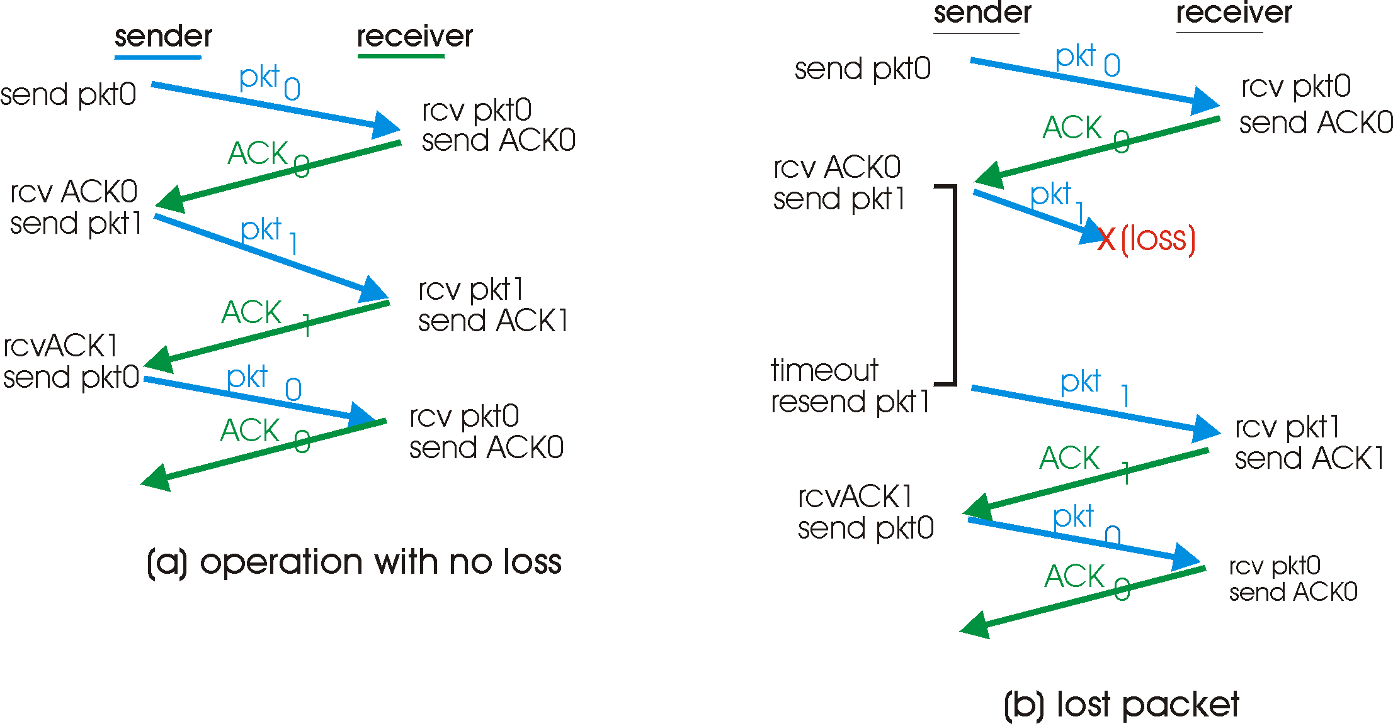
rdt3.0 in action

Slide 25
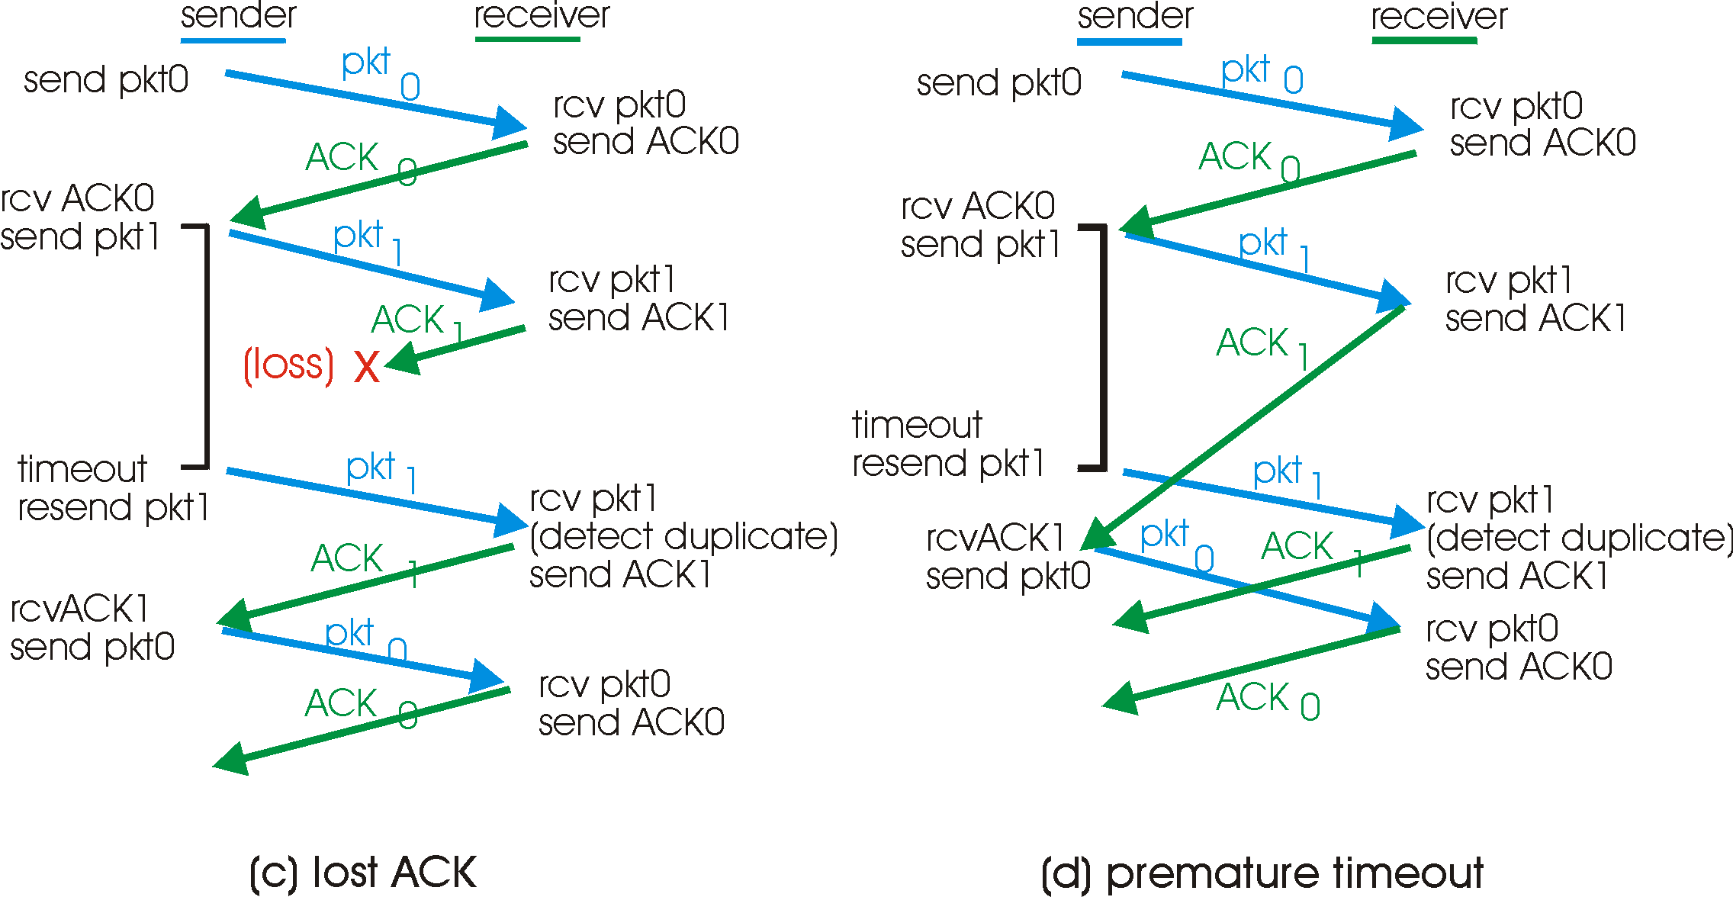
rdt3.0 in action

Slide 26
Performance of rdt3.0
example: 1 Gbps link, 15 ms end-end prop. delay, 1KB packet:
Performance, in term of
U _{sender}: utilization – fraction of time sender busy sending?

Slide 27
Performance of rdt3.0
rdt3.0 works, but performance stinks
example: 1 Gbps link, 15 ms e-e prop. delay, 1KB packet:
T
=
L (packet length in bits)
8kb/pkt
transmit
=
= 8 microsec
R (transmission rate, bps)
10**9 b/sec
U _{sender}: utilization – fraction of time sender busy sending
1KB pkt every 30 msec -> 33kB/sec thruput over 1 Gbps link
network protocol limits use of physical resources!

Slide 28
rdt3.0: stop-and-wait operation
sender
receiver
first packet bit transmitted, t = 0
last packet bit transmitted, t = L / R
first packet bit arrives
RTT
last packet bit arrives, send ACK
ACK arrives, send next
packet, t = RTT + L / R

Slide 29
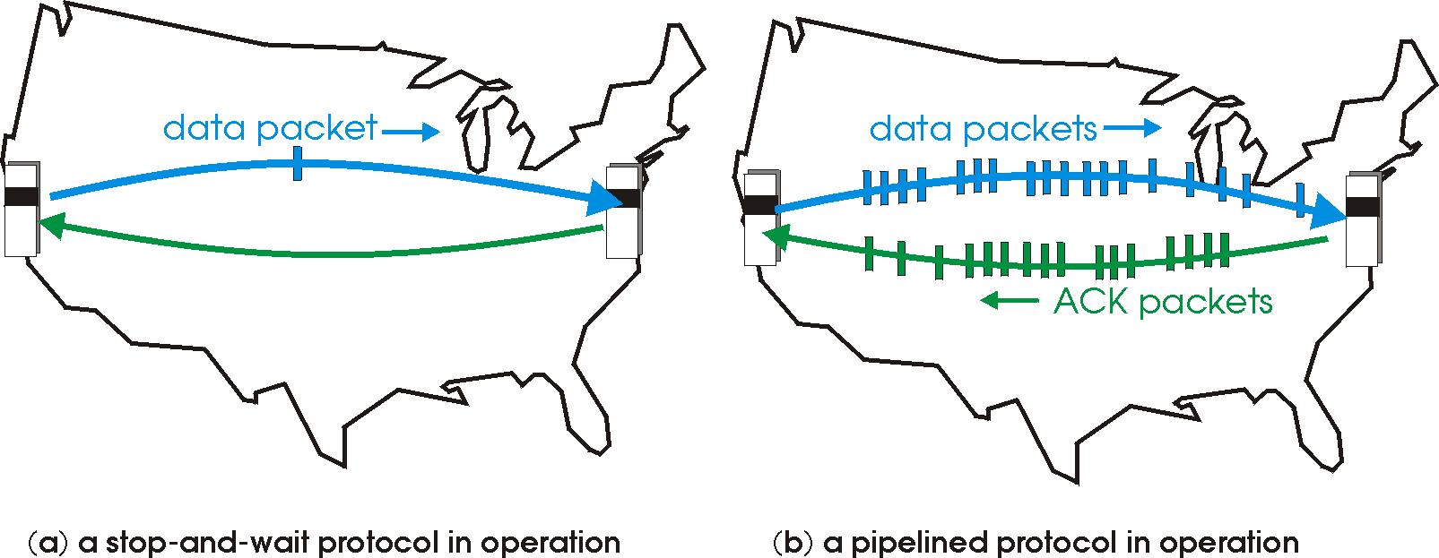
Pipelined protocols
Pipelining: sender allows multiple, “in-flight”, yet-to-be-acknowledged pkts
range of sequence numbers must be increased
buffering at sender and/or receiver
Two generic forms of pipelined protocols: go-Back-N, selective repeat

Slide 30
Pipelining: increased utilization
sender
receiver
first packet bit transmitted, t = 0
last bit transmitted, t = L / R
first packet bit arrives
RTT
last packet bit arrives, send ACK
last bit of 2nd packet arrives, send ACK
last bit of 3rd packet arrives, send ACK
ACK arrives, send next
packet, t = RTT + L / R
Increase utilization
by a factor of 3!

Slide 31
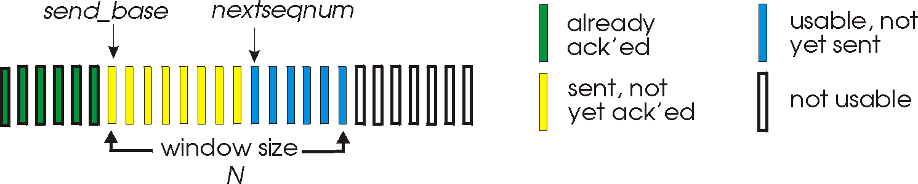
Go-Back-N
Sender:
k-bit seq # in pkt header
“window” of up to N, consecutive unack’ed pkts allowed
ACK(n): ACKs all pkts up to, including seq # n - “cumulative ACK”
may receive duplicate ACKs (see receiver)
timer for the oldest transmitted not yet acked packet!
timeout(n): retransmit pkt n and all higher seq # pkts in window

Slide 32
GBN: sender extended FSM
rdt_send(data)
if (nextseqnum < base+N) {
sndpkt[nextseqnum] = make_pkt(nextseqnum,data,chksum)
udt_send(sndpkt[nextseqnum])
if (base == nextseqnum)
start_timer
nextseqnum++
}
else
refuse_data(data)
Λ
base=1
nextseqnum=1
timeout
Wait
start_timer
udt_send(sndpkt[base])
udt_send(sndpkt[base+1])
…
udt_send(sndpkt[nextseqnum-1])
rdt_rcv(rcvpkt)
&& corrupt(rcvpkt)
Λ
rdt_rcv(rcvpkt) &&
notcorrupt(rcvpkt)
base = getacknum(rcvpkt)+1
If (base == nextseqnum) //no outstanding packet
stop_timer
else
start_timer

Slide 33
GBN: receiver extended FSM
default
udt_send(sndpkt)
rdt_rcv(rcvpkt)
&& notcurrupt(rcvpkt)
&& hasseqnum(rcvpkt,expectedseqnum)
Λ
Wait
extract(rcvpkt,data)
deliver_data(data)
sndpkt = make_pkt(expectedseqnum,ACK,chksum)
udt_send(sndpkt)
expectedseqnum++
expectedseqnum=1
sndpkt =
make_pkt(expectedseqnum,ACK,chksum)
ACK-only: always send ACK for correctly-received pkt with highest in-order seq #
may generate duplicate ACKs
need only remember expectedseqnum
out-of-order pkt:
discard (don’t buffer) -> no receiver buffering!
Re-ACK pkt with highest in-order seq #

Slide 34
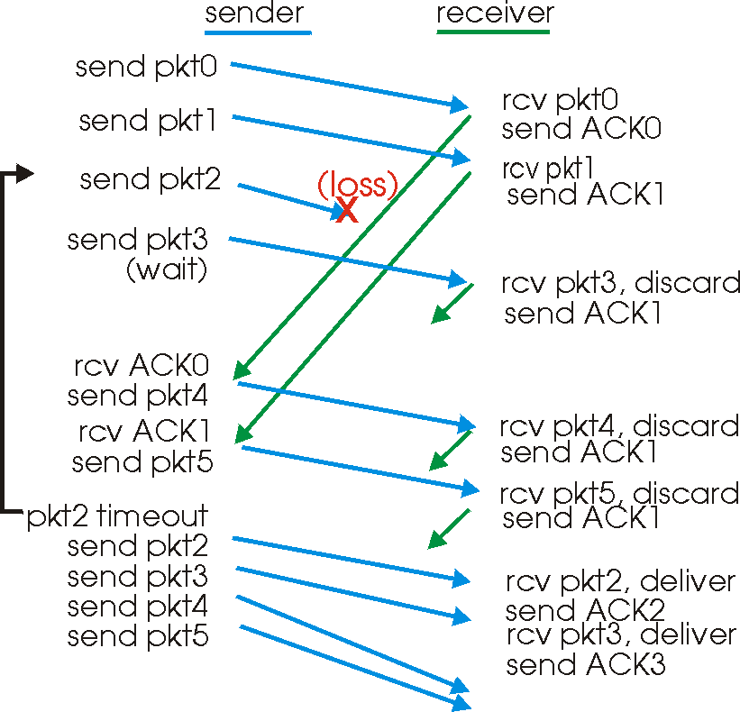
GBN in action

Slide 35
GBN: Discussions
Only one timer at the sender for unacked packets
Simple at receiver (NO receiver buffer), discard out-of-order packets
A single packet error cause GBN to transmit a large number of packets
In-order, but out-of-order in real world
Unnecessary packet re-transmission!! →performance stinks!

Slide 36
Selective Repeat
receiver individually acknowledges all correctly received pkts, could be out-of-order!!!
buffers pkts, as needed, for eventual in-order delivery to upper layer
sender only resends pkts for which ACK not received
sender timer for each unACKed pkt
Avoid unnecessary re-transmission in GBN!!!
sender window
N consecutive seq #’s
again limits seq #s of sent, unACKed pkts

Slide 37
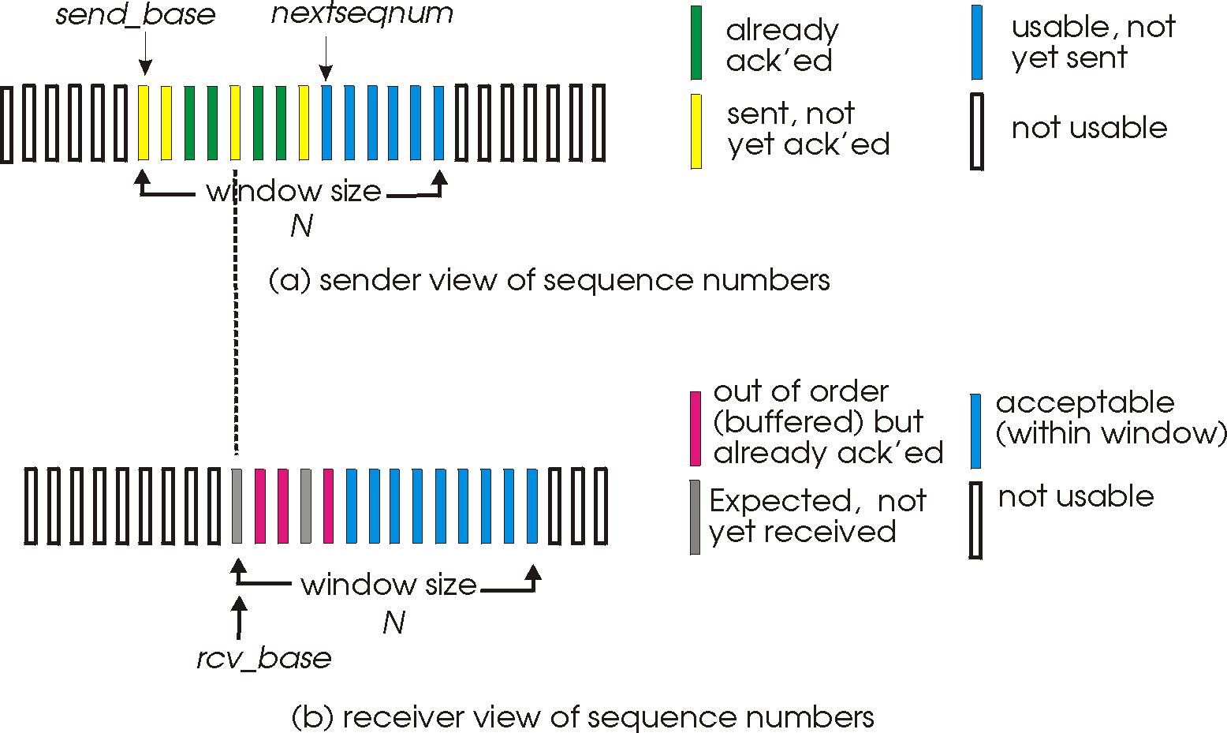
Selective repeat: sender, receiver windows

Slide 38
Selective repeat
sender
receiver
data from above :
if next available seq # in window, send pkt
timeout(n):
resend pkt n, restart timer
ACK(n) in [sendbase,sendbase+N]:
mark pkt n as received
if n is smallest unACKed pkt, advance window base to next unACKed seq #
pkt n in [rcvbase, rcvbase+N-1]
send ACK(n)
out-of-order: buffer
in-order: deliver (also deliver buffered, in-order pkts), advance window to next not-yet-received pkt
pkt n in [rcvbase-N,rcvbase-1]
ACK(n)
otherwise:
ignore

Slide 39
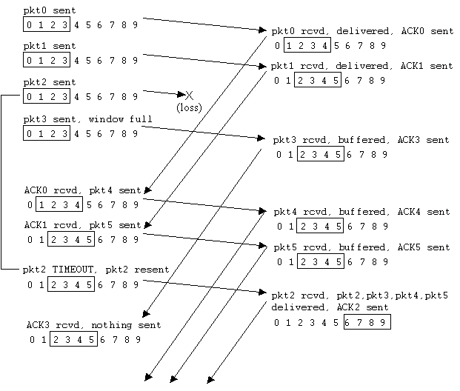
Selective repeat in action

Slide 40
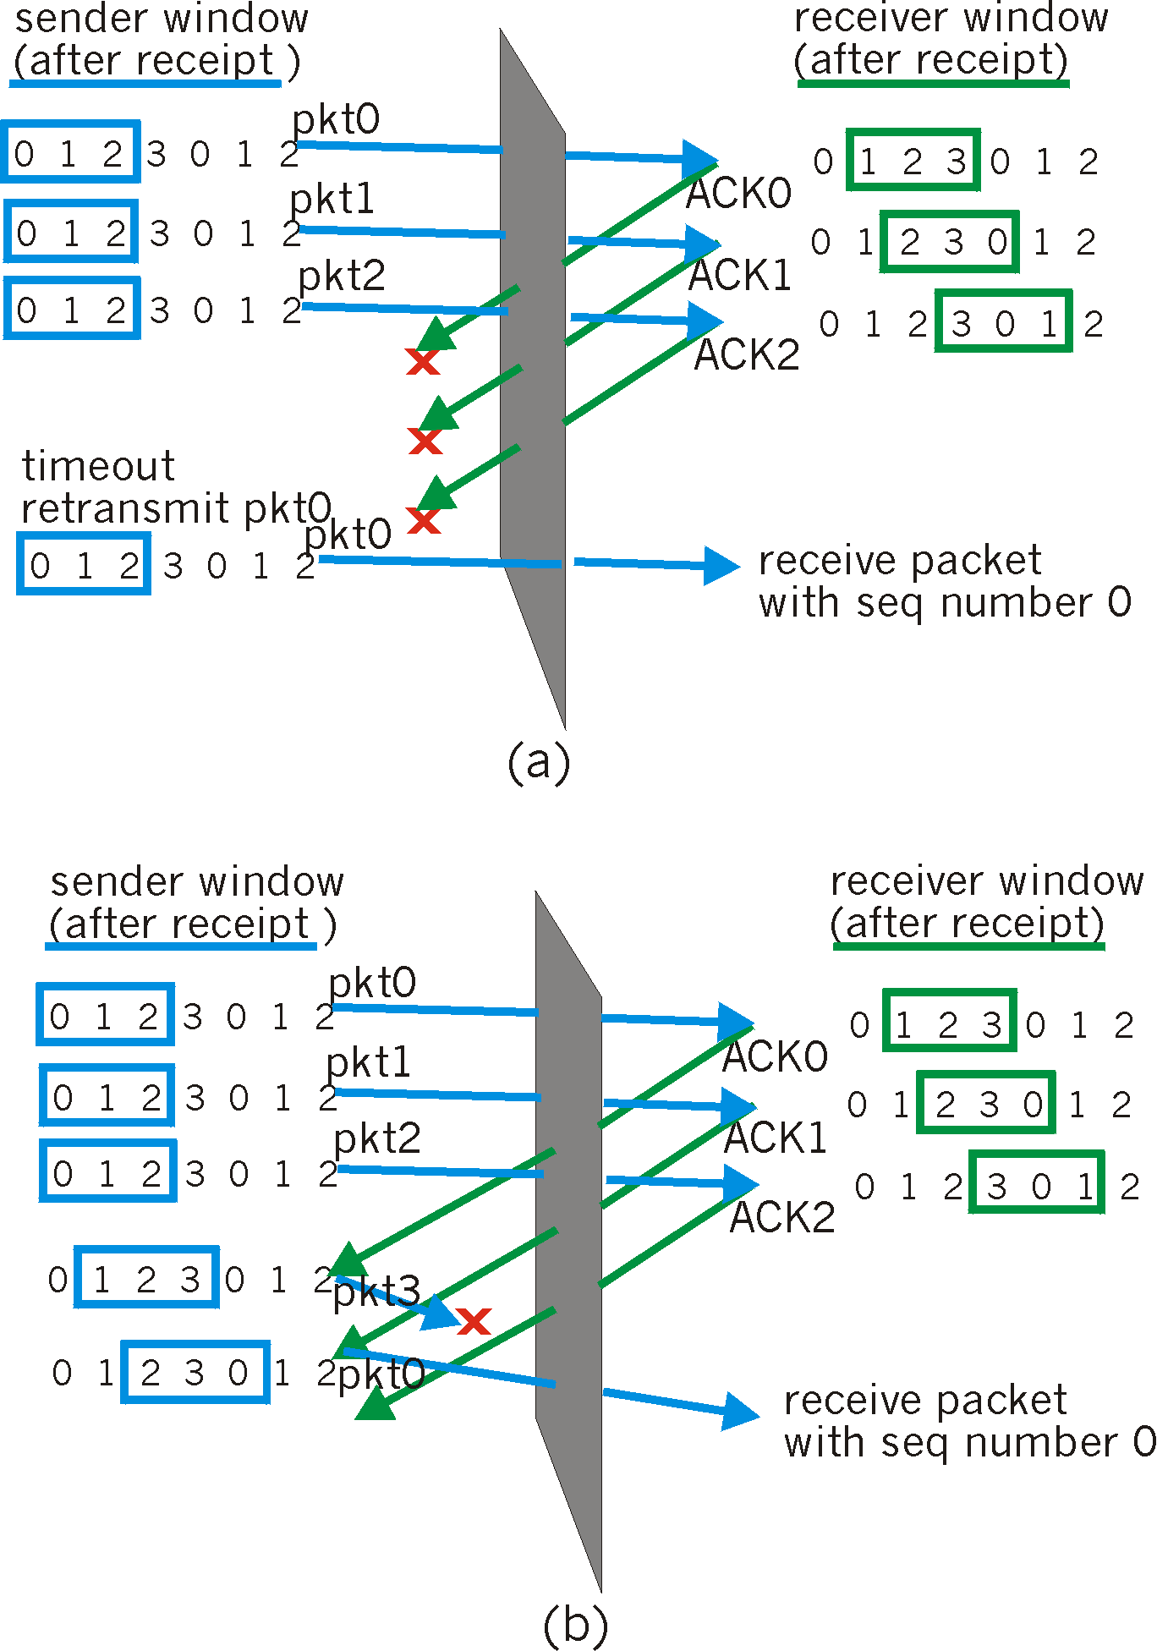
Selective repeat: dilemma
Example:
seq #’s: 0, 1, 2, 3
window size=3
receiver sees no difference in two scenarios!
incorrectly passes duplicate data as new in (a)
Q: what relationship between seq # size and window size?

Slide 41
Summary
Techniques to implement reliable data transfer over unreliable networks
ACKs/NAKs
Seq #
Checksum
Timeouts
Implementations
Stop-and-Wait: low utilization/performance
Pipelined protocols
Go-Back-N
Selective Repeat

