Slide 1
Transport Layer
Dr. Yingwu Zhu
Chapter 3.1, 3.2, 3,3 and 3.5

Slide 2
Transport Layer: Where Are We?

Slide 3
IP Protocol Stack: Key Abstractions
Application
Applications
Transport
Reliable streams
Messages
Network
Best-effort global packet delivery
Best-effort local packet delivery
Link
Transport layer is where we “pay the piper”
Provide applications with good abstractions
Without support or feedback from the network

Slide 4
Transport-Layer Protocols
reliable, in-order delivery (TCP)
congestion control
flow control
connection setup
unreliable, unordered delivery: UDP
services not available:
delay guarantees
bandwidth guarantees
application
transport
network
data link
physical
network
data link
physical
network
data link
physical
network
data link
physical
logical end-end transport
network
data link
physical
network
data link
physical
application
transport
network
data link
physical

Slide 5
Transport Protocols
Logical communication between processes
Sender divides a message into segments
Receiver reassembles segments into message
Transport services
(De)multiplexing packets
Detecting corrupted data
Optionally: reliable delivery, flow control, congestion control…

Slide 6
Two Basic Transport Features
Demultiplexing: port numbers
Error detection: checksums
Server host 128.2.194.242
Service request for
128.2.194.242:80
(i.e., the Web server)
Client host
Web server
(port 80)
Client
OS
Echo server
(port 7)
IP
payload
detect corruption
6

Slide 7
UDP

Slide 8
UDP: User Datagram Protocol [RFC 768]
“no frills,” “bare bones” Internet transport protocol
“best effort” service, UDP segments may be:
lost
delivered out of order to app
connectionless:
no handshaking between UDP sender, receiver
each UDP segment handled independently of others
Why is there a UDP?
no connection establishment (which can add delay)
simple: no connection state at sender, receiver
small segment header: 8 bytes
TCP header: 20 bytes
no congestion control: UDP can blast away as fast as desired

Slide 9
UDP: more
Often used for streaming multimedia apps
loss tolerant
rate sensitive
Other UDP uses
DNS
SNMP
Reliable transfer over UDP: add reliability at application layer
application-specific error recovery!
32 bits
Length, in
bytes of UDP
segment,
including
header
source port #
dest port #
length
checksum
Application
data
(message)
UDP segment format

Slide 10
UDP checksum
Goal: detect “errors” (e.g., flipped bits) in transmitted segment
Sender:
treat segment contents as sequence of 16-bit integers
checksum: addition (1’s complement sum) of segment contents
sender puts checksum value into UDP checksum field
Receiver:
compute checksum of received segment
check if computed checksum equals checksum field value:
NO - error detected
YES - no error detected. But maybe errors nonetheless? ….

Slide 11
Internet Checksum Example
Note
When adding numbers, a carryout from the most significant bit needs to be added to the result
Example: add two 16-bit integers
1 1 1 1 0 0 1 1 0 0 1 1 0 0 1 1 0
1 1 1 0 1 0 1 0 1 0 1 0 1 0 1 0 1
1 1 0 1 1 1 0 1 1 1 0 1 1 1 0 1 1
1 1 0 1 1 1 0 1 1 1 0 1 1 1 1 0 0
1 0 1 0 0 0 1 0 0 0 1 0 0 0 0 1 1
wraparound
sum
checksum
Notes:
Kurose and Ross forgot to say anything about wrapping the carry and adding it to low order bit

Slide 12
Advantages of UDP
Fine-grain control
UDP sends as soon as the application writes
No connection set-up delay
UDP sends without establishing a connection
No connection state
No buffers, parameters, sequence #s, etc.
Small header overhead
UDP header is only eight-bytes long

Slide 13
TCP

Slide 14
Transmission Control Protocol (TCP)
Stream-of-bytes service
Sends and receives a stream of bytes
Reliable, in-order delivery
Corruption: checksums
Detect loss/reordering: sequence numbers
Reliable delivery: acknowledgments and retransmissions
Connection oriented
Explicit set-up and tear-down of TCP connection
Flow control
Prevent overflow of the receiver’s buffer space
Congestion control
Adapt to network congestion for the greater good

Slide 15
TCP Offers Byte Stream Service: Breaking a Stream of Bytes into TCP Segments

Slide 16
TCP “Stream of Bytes” Service
Host A
Byte 0
Byte 1
Byte 2
Byte 3
Byte 80
Host B
Byte 0
Byte 1
Byte 2
Byte 3
Byte 80
16

Slide 17
…Emulated Using TCP “Segments”
Host A
Byte 0
Byte 1
Byte 2
Byte 3
Byte 80
Segment sent when:
Segment full (Max Segment Size),
Not full, but times out, or
“Pushed” by application
TCP Data
TCP Data
Host B
Byte 0
Byte 1
Byte 2
Byte 3
Byte 80
17

Slide 18
TCP Segment
IP Data
IP packet
No bigger than Maximum Transmission Unit (MTU)
E.g., up to 1500 bytes on an Ethernet link
TCP packet
IP packet with a TCP header and data inside
TCP header is typically 20 bytes long
TCP segment
No more than Maximum Segment Size (MSS) bytes
E.g., up to 1460 consecutive bytes from the stream
TCP Data (segment)
TCP Hdr
IP Hdr
18

Slide 19
TCP segment structure
32 bits
URG: urgent data
(generally not used)
counting
by bytes
of data
(not segments!)
source port #
dest port #
sequence number
ACK: ACK #
valid
acknowledgement number
head
len
not
used
U
Receive window
A
P
R
S
PSH: push data now
(generally not used)
F
# bytes
rcvr willing
to accept
checksum
Urg data pnter
RST, SYN, FIN:
connection estab
(setup, teardown
commands)
Options (variable length)
application
data
(variable length)
Internet
checksum
(as in UDP)
The head length is in terms of 32-bit words

Slide 20
TCP: Sequence Numbers

Slide 21
Sequence Number
Host A
ISN (initial sequence number)
Byte 81
Sequence number = 1st byte
TCP Data
TCP Data
Host B
21

Slide 22
Initial Sequence Number (ISN)
Sequence number for the very first byte
E.g., Why not a de facto ISN of 0?
Practical issue: reuse of port numbers
Port numbers must (eventually) get used again
… and an old packet may still be in flight
… and associated with the new connection
So, TCP must change the ISN over time
Set from a 32-bit clock that ticks every 4 microsec
… which wraps around once every 4.55 hours!
22

Slide 23
Reliable Delivery on a Lossy Channel With Bit Errors

Slide 24
Challenges of Reliable Data Transfer
Over a perfectly reliable channel: Done
Over a channel with bit errors
Receiver detects errors and requests retransmission
Over a lossy channel with bit errors
Some data missing, others corrupted
Receiver cannot easily detect loss
Over a channel that may reorder packets
Receiver cannot easily distinguish loss vs. out-of-order
24

Slide 25
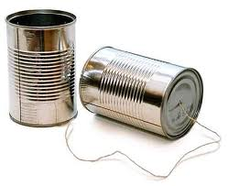
An Analogy
Alice and Bob are talking
What if Alice couldn’t understand Bob?
Bob asks Alice to repeat what she said
What if Bob hasn’t heard Alice for a while?
Is Alice just being quiet? Has she lost reception?
How long should Bob just keep on talking?
Maybe Alice should periodically say “uh huh”
… or Bob should ask “Can you hear me now?”
25

Slide 26
Take-Aways from the Example
Acknowledgments from receiver
Positive: “okay” or “uh huh” or “ACK”
Negative: “please repeat that” or “NACK”
Retransmission by the sender
After not receiving an “ACK”
After receiving a “NACK”
Timeout by the sender (“stop and wait”)
Don’t wait forever without some acknowledgment
26

Slide 27
TCP Support for Reliable Delivery
Detect bit errors: checksum
Used to detect corrupted data at the receiver
…leading the receiver to drop the packet
Detect missing data: sequence number
Used to detect a gap in the stream of bytes
... and for putting the data back in order
Recover from lost data: retransmission
Sender retransmits lost or corrupted data
Two main ways to detect lost packets
27

Slide 28
TCP Acknowledgments
Host A
ISN (initial sequence number)
Sequence number = 1st byte
TCP Data
ACK sequence number = next expected byte
TCP Data
Host B
28

Slide 29
Automatic Repeat reQuest (ARQ)
ACK and timeouts
Receiver sends ACK when it receives packet
Sender waits for ACK and times out
Simplest ARQ protocol
Stop and wait
Send a packet, stop and wait until ACK arrives
Sender
Receiver
Packet
Timeout
ACK
Time

Slide 30
Quick TCP Math
Initial Seq No = 501. Sender sends 4500 bytes successfully acknowledged. Next sequence number to send is:
(A) 5000 (B) 5001 (C) 5002
Next 1000 byte TCP segment received. Receiver acknowledges with ACK number:
(A) 5001 (B) 6000 (C) 6001

Slide 31
Quick TCP Math
Initial Seq No = 501. Sender sends 4500 bytes successfully acknowledged. Next sequence number to send is:
(A) 5000 (B) 5001 (C) 5002
Next 1000 byte TCP segment received. Receiver acknowledges with ACK number:
(A) 5001 (B) 6000 (C) 6001

Slide 32
Flow Control: TCP Sliding Window

Slide 33
Motivation for Sliding Window
Stop-and-wait is inefficient (from RDT protocol discussions)
Only one TCP segment is “in flight” at a time
Consider: 1.5 Mbps link with 50 ms round-trip-time (RTT)
Assume TCP segment size of 1 KB (8 Kbits)
8 Kbits/segment at 50 msec/segment → 160 Kbps
That’s 11% of the capacity of 1.5 Mbps link
33

Slide 34
Sliding Window
Allow a larger amount of data “in flight”
Allow sender to get ahead of the receiver
… though not too far ahead
Sending process
Receiving process
TCP
TCP
Last byte written
Last byte read
Next byte expected
Last byte ACKed
Last byte sent
Last byte received
34

Slide 35
Sliding Window
Receive window size
Amount that can be sent without acknowledgment
Receiver must be able to store this amount of data
Receiver tells the sender the window
Tells the sender the amount of free space left
TCP
Window Size
TCP
}
OK to send
Next byte expected
Last byte ACKed
Last byte sent
Last byte received
35

Slide 36
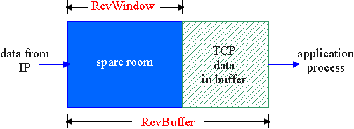
TCP Flow Control
flow control
sender won’t overflow
receiver’s buffer by
transmitting too much,
too fast
receive side of TCP connection has a receive buffer:
speed-matching service: matching the send rate to the receiving app’s drain rate
app process may be slow at reading from buffer

Slide 37
TCP Flow control: how it works
Rcvr advertises spare room by including value of RcvWindow in segments
Sender limits unACKed data to RcvWindow
guarantees receive buffer doesn’t overflow
(Suppose TCP receiver discards out-of-order segments)
spare room in buffer
= RcvWindow
= RcvBuffer-[LastByteRcvd - LastByteRead]

Slide 38
TCP Flow control: how it works
If the sender gets notified of RcvWindow = 0 from the receiver?
Problem: the sender never able to send data to the receiver
Why: the receiver will not send segments to the sender unless having data/ack to send
Solution: the sender continues to send a segment with 1 data byte when RcvWindow = 0; then the receiver will update it.

Slide 39
Optimizing Retransmissions

Slide 40
Reasons for Retransmission
Packet
Packet
Packet
Timeout
Timeout
ACK
Timeout
ACK
Packet
Packet
Packet
ACK
Timeout
Timeout
Timeout
ACK
ACK
Packet lost
ACK lost
DUPLICATE PACKET
Early timeout
DUPLICATE PACKETS
Notes:
Application may get duplicates in the case of early timeouts

Slide 41
How Long Should Sender Wait?
Sender sets a timeout to wait for an ACK
Too short: wasted retransmissions
Too long: excessive delays when packet lost
TCP sets timeout as a function of the RTT
Expect ACK to arrive after an “round-trip time”
… plus a fudge factor to account for queuing
But, how does the sender know the RTT?
Running average of delay to receive an ACK
41

Slide 42
Example RTT Estimation
42

Slide 43
Still, timeouts are slow (≈RTT)
When packet n is lost…
… packets n+1, n+2, and so on may get through
Exploit the ACKs of these packets
ACK says receiver is still awaiting nth packet
Duplicate ACKs suggest later packets arrived
Sender uses “duplicate ACKs” as a hint
Fast retransmission
Retransmit after “triple duplicate ACK”
43

Slide 44
Effectiveness of Fast Retransmit
When does Fast Retransmit work best?
High likelihood of many packets in flight
Long data transfers, large window size, …
Implications for Web traffic
Most Web transfers are short (e.g., 10 packets)
So, often there aren’t many packets in flight
Making fast retransmit is less likely to “kick in”
Forcing users to click “reload” more often…
44

Slide 45
Effectiveness of Fast Retransmit
When does Fast Retransmit work best?
(A) Short data transfers
(B) Large window size
(C) Small RTT networks
45

Slide 46
Starting and Ending a Connection: TCP Handshakes

Slide 47
Establishing a TCP Connection
A
B
SYN
SYN ACK
Each host tells its ISN to the other host.
ACK
Data
Data
Three-way handshake to establish connection
Host A sends a SYN (open) to the host B
Host B returns a SYN acknowledgment (SYN ACK)
Host A sends an ACK to acknowledge the SYN ACK

Slide 48
TCP Header
Source port
Destination port
Sequence number
Flags:
SYN
FIN
RST
PSH
URG
ACK
Acknowledgment
HdrLen
0
Flags
Advertised window
Checksum
Urgent pointer
Options (variable)
Data

Slide 49
Step 1: A’s Initial SYN Packet
A’s port
B’s port
A’s Initial Sequence Number
Flags:
SYN
FIN
RST
PSH
URG
ACK
Acknowledgment
20
Flags
Advertised window
0
Checksum
Urgent pointer
Options (variable)
A tells B it wants to open a connection…

Slide 50
Step 2: B’s SYN-ACK Packet
B’s port
A’s port
B’s Initial Sequence Number
Flags:
SYN
FIN
RST
PSH
URG
ACK
A’s ISN plus 1
20
Flags
Advertised window
0
Checksum
Urgent pointer
Options (variable)
B tells A it accepts, and is ready to hear the next byte…
… upon receiving this packet, A can start sending data
50

Slide 51
Step 3: A’s ACK of the SYN-ACK
A’s port
B’s port
Sequence number
Flags:
SYN
FIN
RST
PSH
URG
ACK
B’s ISN plus 1
20
Flags
Advertised window
0
Checksum
Urgent pointer
Options (variable)
A tells B it is okay to start sending
… upon receiving this packet, B can start sending data
51

Slide 52
SYN Loss and Web Downloads
Upon sending SYN, sender sets a timer
If SYN lost, timer expires before SYN-ACK received
Sender retransmits SYN
How should the TCP sender set the timer?
No idea how far away the receiver is
Some TCPs use default of 3 or 6 seconds
Implications for web download
User gets impatient and hits reload
… Users aborts connection, initiates new socket
Essentially, forces a fast send of a new SYN!
52

Slide 53
SYN flood attack
“A SYN flood is a form of denial-of-service attack in which an attacker sends a succession of SYN requests to a target's system in an attempt to consume enough server resources to make the system unresponsive to legitimate traffic”, from Wikipedia
Half-open TCP connections consume resources at the server

Slide 54
Tearing Down the Connection
B
ACK
SYN
SYN ACK
Data
ACK
FIN
ACK
FIN
ACK
A
time
Closing (each end of) the connection
Finish (FIN) to close and receive remaining bytes
And other host sends a FIN ACK to acknowledge
Reset (RST) to close and not receive remaining bytes
54

Slide 55
Sending/Receiving the FIN Packet
Sending a FIN: close()
Process is done sending data via socket
Process invokes “close()”
Once TCP has sent all the outstanding bytes…
… then TCP sends a FIN
Receiving a FIN: EOF
Process is reading data from socket
Eventually, read call returns an EOF
55

Slide 56
TCP Connection Management: Connection Tear-down
Closing a connection:
Two double handshakes
client closes socket: clientSocket.close();
Step 1: client end system sends TCP FIN control segment to server
Step 2: server receives FIN, replies with ACK, sends FIN.
client
server
close
FIN
ACK
close
FIN
ACK
timed wait
closed

Slide 57
TCP Connection Management (cont.)
Step 3: client receives FIN, replies with ACK.
Enters “timed wait” - will respond with ACK to received FINs
Step 4: server, receives ACK. Connection closed.
Note: with small modification, can handle simultaneous FINs.
client
server
closing
FIN
ACK
closing
FIN
ACK
timed wait
closed
closed

Slide 58
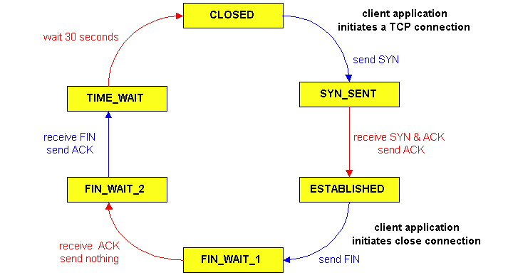
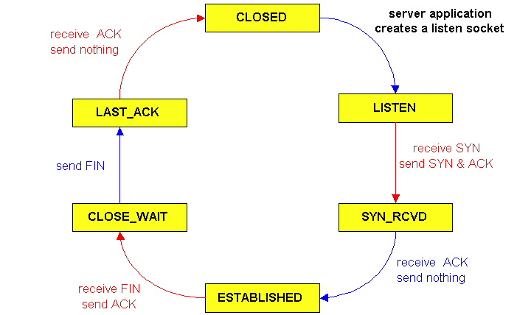
TCP Connection Management (cont)
TCP server
lifecycle
TCP client
lifecycle

Slide 59
Conclusions
Transport protocols
Multiplexing and demultiplexing
Checksum-based error detection
Sequence numbers
TCP Retransmission
TCP Window-based flow control
59

