Slide 1
Team 9
{Rupali,Sowmya}

Slide 2
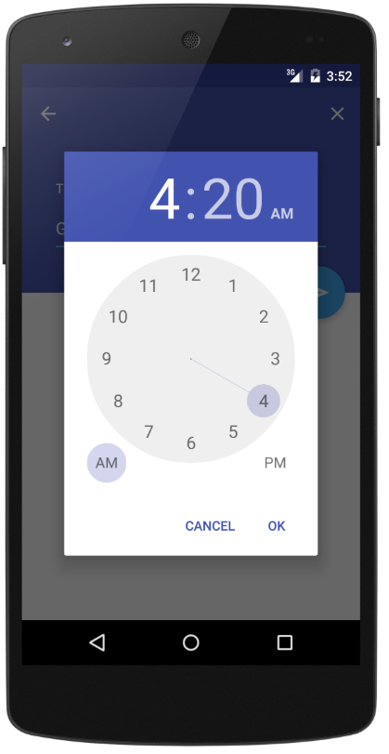

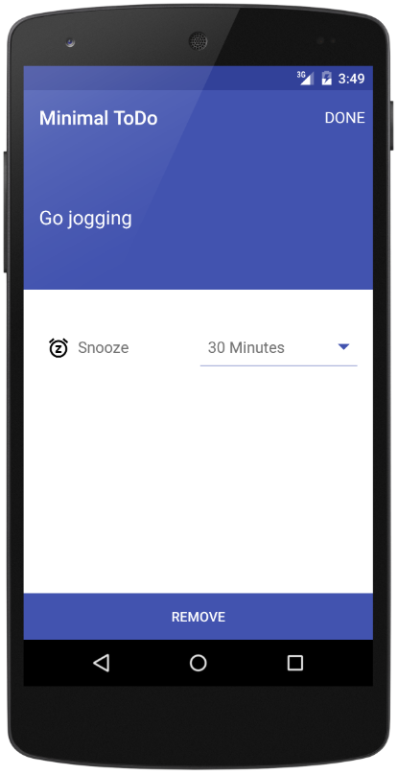
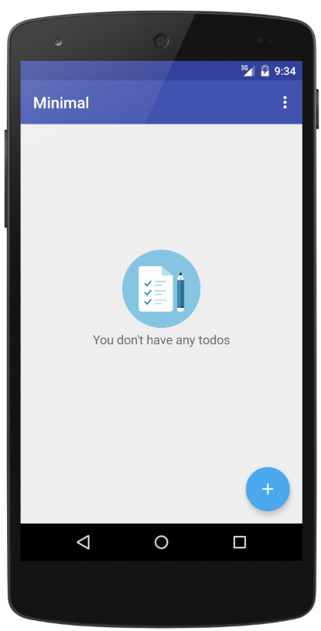
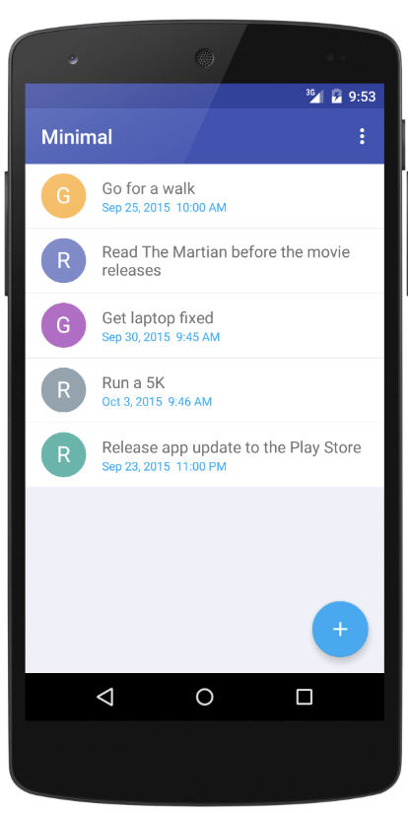
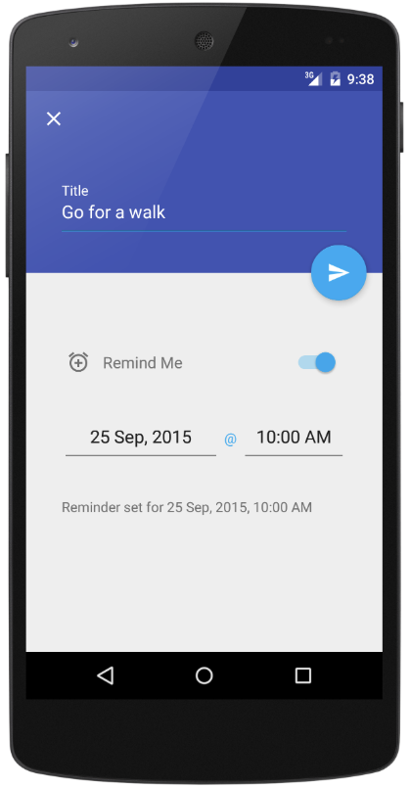

Android Minimal - TODO
https://github.com/avjinder/Minimal-Todo

Slide 3
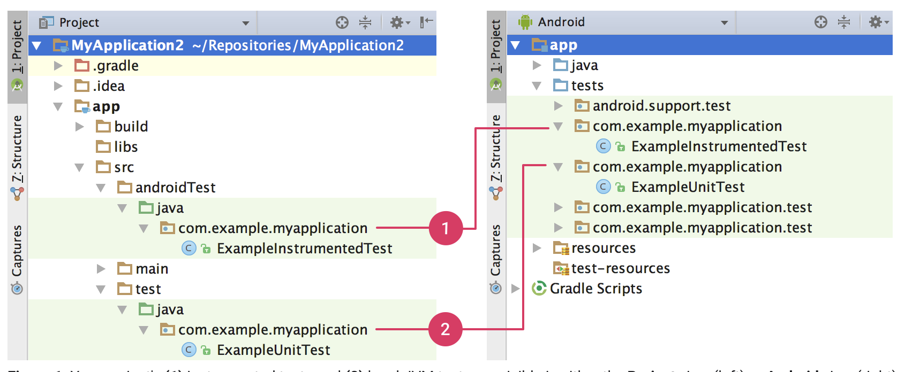
Instrumented tests Vs Local unit test
Local Unit tests - Located at module-name/src/test/java/.
These are tests that run on your machine's local Java Virtual Machine (JVM).
These tests to minimize execution time - no Android framework dependencies, can mock Android Framework This lets you use popular mocking libraries, like Mockito.
Integrated tests - Located at module-name/src/androidTest/java/.
These are tests that run on a hardware device or emulator.
These tests have access to Instrumentation APIs, gives us access to the context of the application and we can control app under test.
Used when writing integration and functional UI tests to automate user interaction, or when tests have Android dependencies that mock objects cannot satisfy

Slide 4


JUnit Code Snippets
Dependencies Test cases

