Slide 1
Captone
Health Care

Slide 2
Problem Statement
Build a model to accurately predict whether the patients in the dataset have diabetes or not?
The datasets consists of several medical predictor variables and one target variable, Outcome. Predictor variables includes the number of pregnancies the patient has had, their BMI, insulin level, age, and so on.
The description to each of the variable could be find here

Slide 3
EDA-Exploratory Data Analysis
I carried out data exploration on the data set to understand what kind of data I had in hand using many methods that are available such as “describe”, “info”, ”values” and have provide the output in Screenshots.
By did a histogram plotting and carried out Skewness and Kurtossis test to see if the variables are left or right Skwed or have a normal distribution and how spread the data is using Kurtosis. From there I concluded the variables “Pregnancies”, “Insulin”, “BMI”, “Diabetes Pedigree Function” and “Age” are right skewed and “Blood Pressure” is left Skewed.
I checked for null using Isnull() function but I got zero percent meaning, there are no missing values. But there are zeroes in the data set which I got to know when I did dataframe.column.values. Because in these dataset zero mean no sense I need to remove them, but before that I am tried to explore the co-relation between the variables using cor method and pair plot.

Slide 4
EDA-Exploratory Data Analysis(contd)
Creating a count (frequency) plot describing the data types and the count of variables.
Also checking for outliers if any using boxplot.
There are outliers but based on the which algorithm is going to fit will decide if outliers need to be removed or not.
I plotted a co-relation matrix using dataframe.corr method to see co-relation between variables and observed that no variable had a co-relation number nearly equal to 1 and hence retained all the variables as is.

Slide 5
EDA , Treating zeroes in the dataset
I carried out a count plot against the variables to see the count of the values they own. The Outcome variable showed there are more of non diabetic patient in the dataset provided, which clearly showed the class imbalance.
I Split the data into train and test with 80:20 ratio using train_test_split method creating X and y variables with y consisting of the Dependednt variable in our case “OutCome”
I scaled the dataset using StandardScaler from sklearn to treat the zeroes present.

Slide 6
Fitting the Model to training Data
I created a pipeline of all the classification algorithms that I was going to use as this business case fit the classification set where we were dealing with two categories of people “Diabetic” and “Non-Diabetic”
Then I used KFold and cross_val_score from model selection to select the model that had best score and it happened to Random Forest Classifier with 83.5 % score.
Then I evaluated the model with test data getting an accuracy score of 74.03% and precision score of 63.16 % which is good.

Slide 7
HyperParam Tuning
I carried out HyperParam Tuning using GridSearchCV and estimated what should the value of each parameter be to achieve the best score.
With these params as best was able to achieve a score of about 77.8%.
Finally created a classification report with y_test and y_pred which provide in screenshots and printed the ROC_AUC_Score which is 71%.

Slide 8
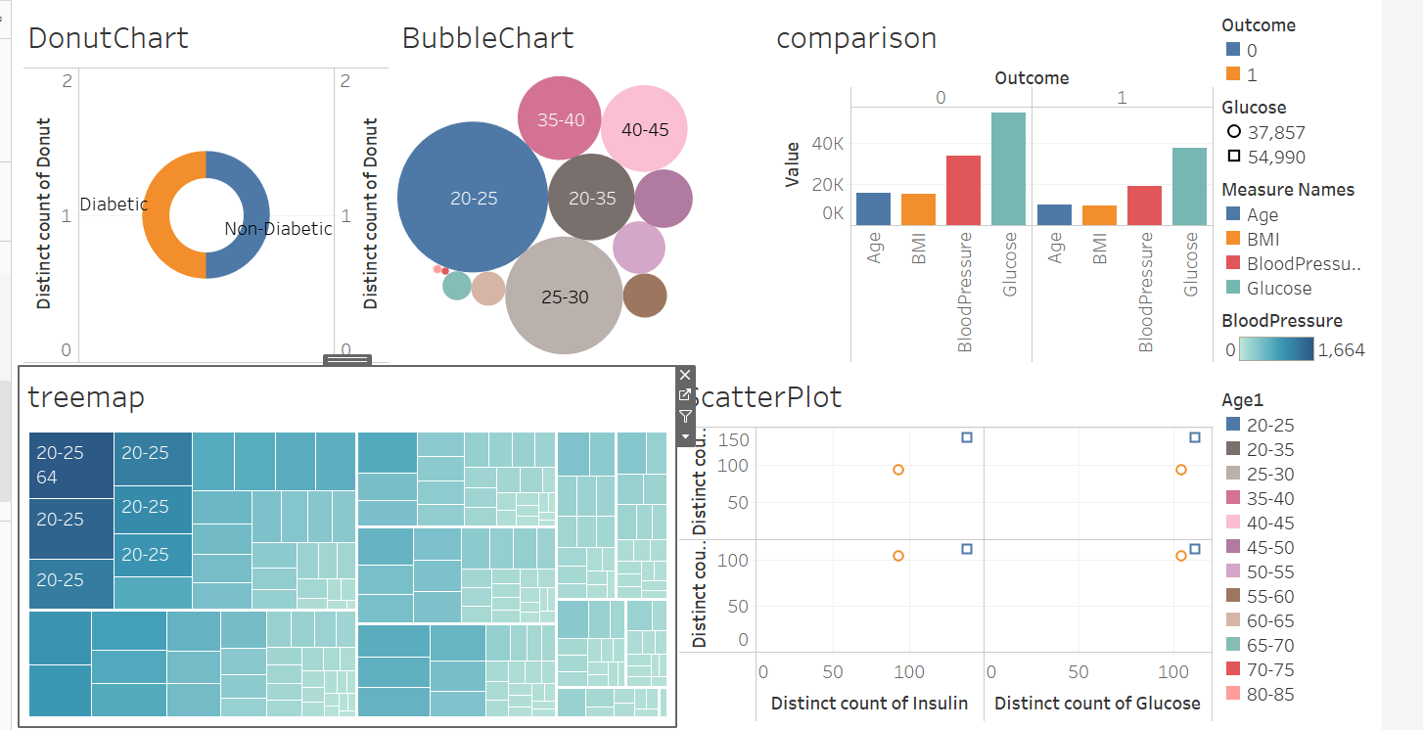
DashBoard
https://public.tableau.com/profile/sowmya.s6273#!/vizhome/FinalDash1/Dashboard2?publish=yes

Slide 9
THANK YOU

