Slide 1
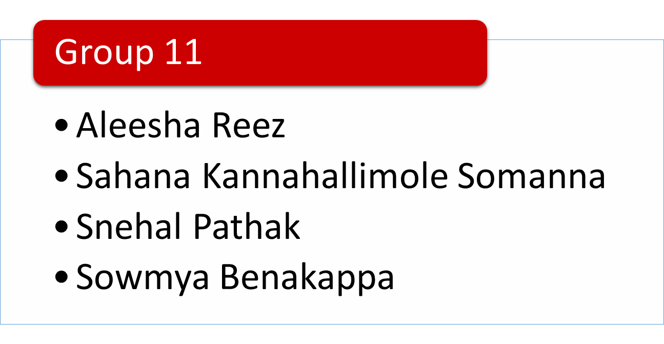
Online Shopping Website

Slide 2
Agenda
Purpose and Business Problem Addressed
Entity Relationship Diagram
Design Document
Database Implementation
Views
Data Analysis Report
Q & A

Slide 3
Purpose
Online shopping website enables customers to shop at their comfort reducing overhead of going to physical stores
Business Problem Addressed
Allows Admin to anticipate merchandise inventory needed for on demand clothes
Admin will take care of adding products, suppliers and distributors
Allows customer to view products based on their preferences (e.g. sizes, types, categories) , search, sort and add products to cart
Customer can place order and view order summary for the same
Support team helps to handle all customer queries

Slide 4
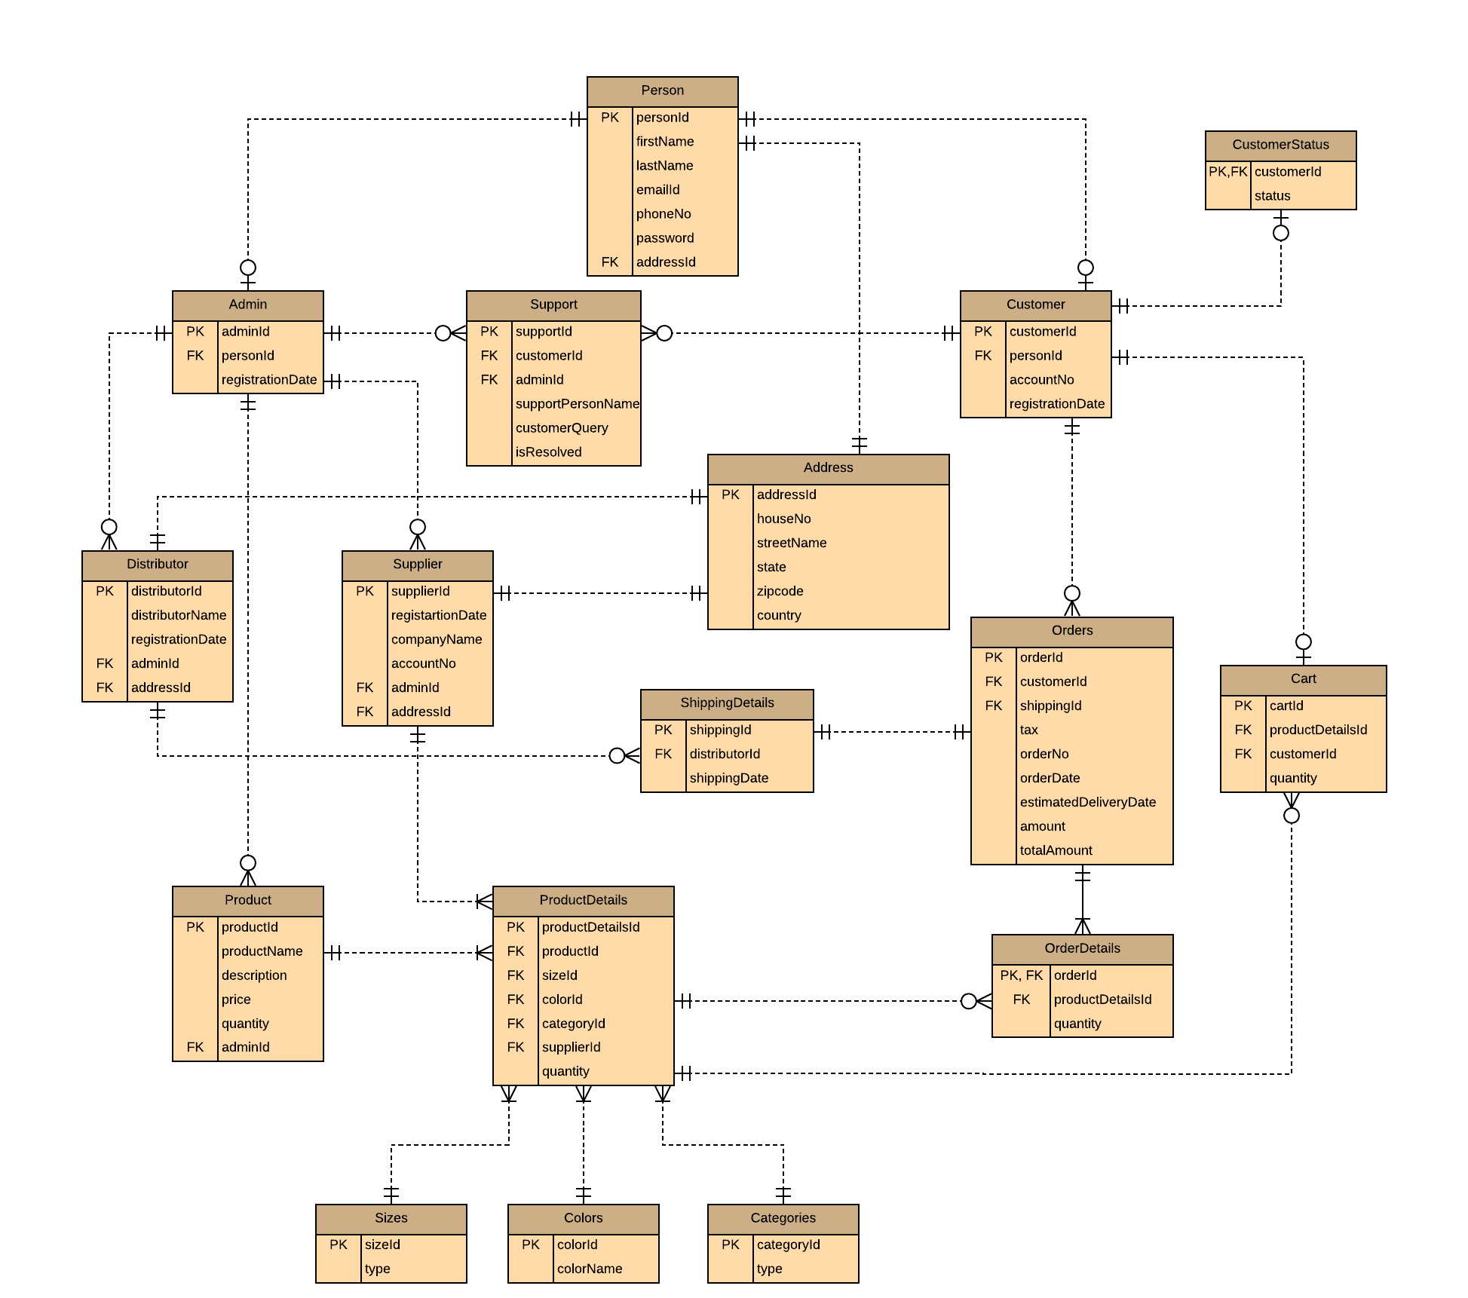
Entity Relationship Diagram

Slide 5
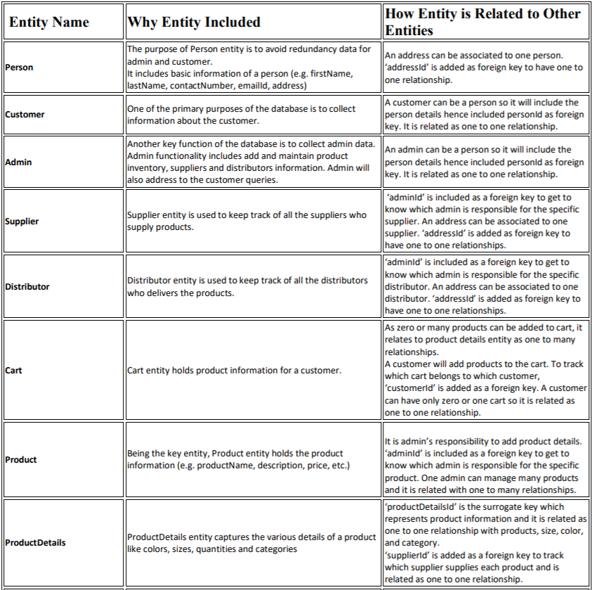
Design Document

Slide 6
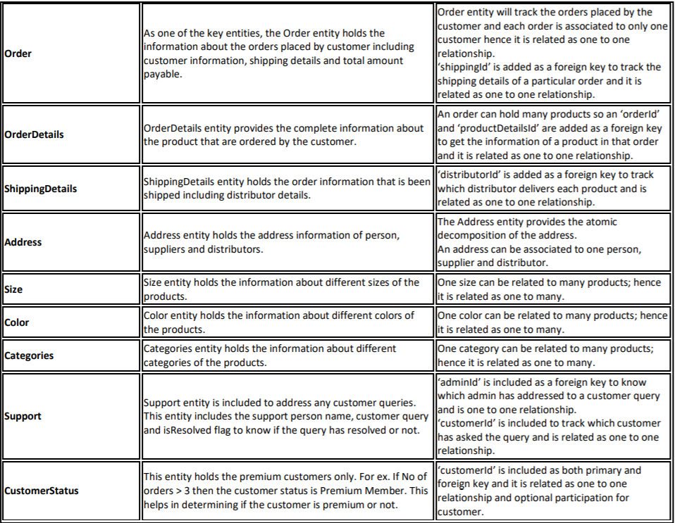
Continued...

Slide 7
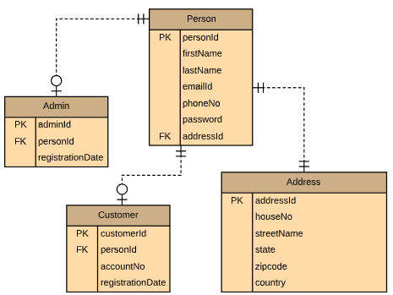
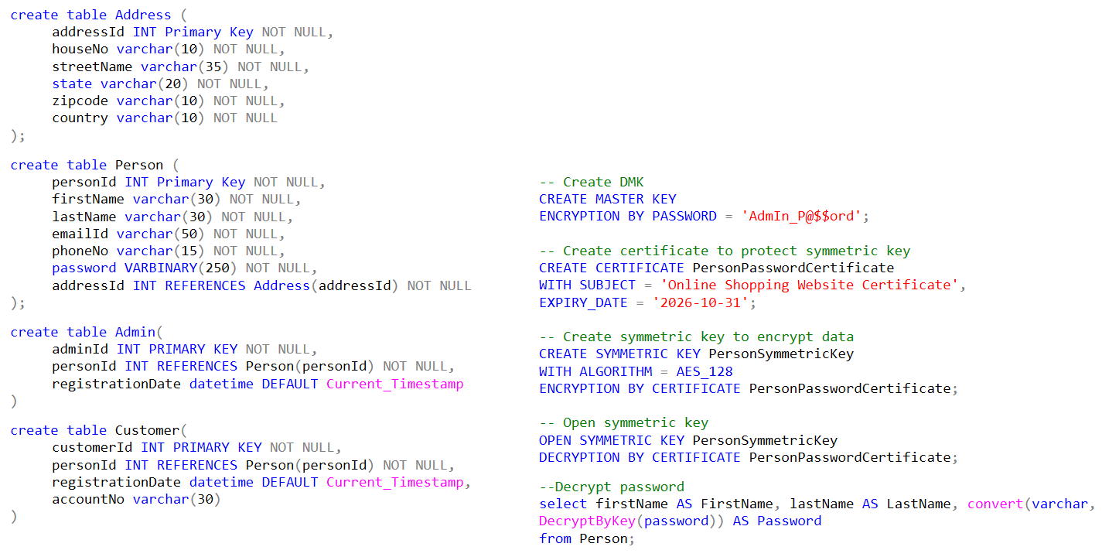
Database Implementation

Slide 8
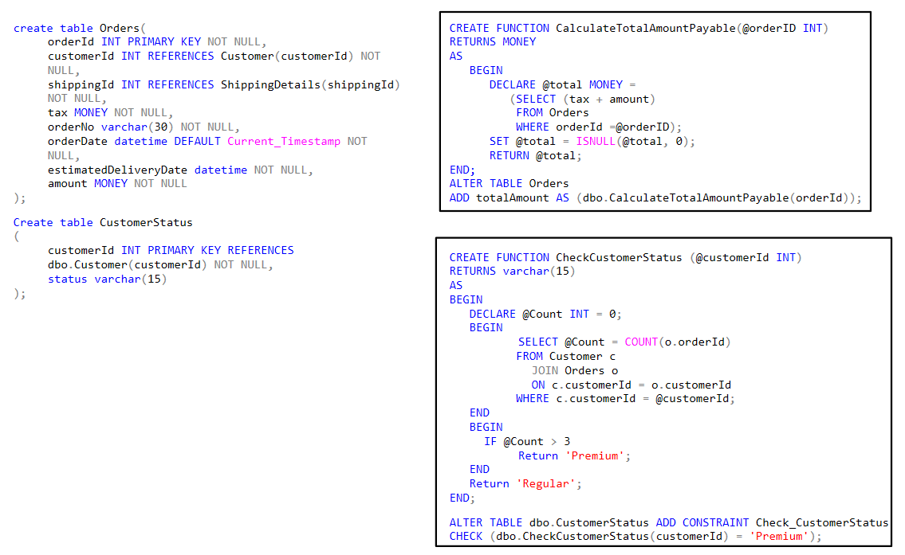
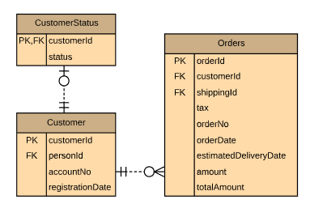

Slide 9
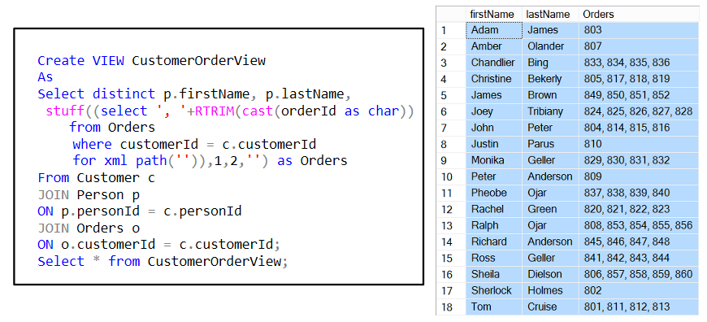
Views
View to generate horizontal reports for Customer and their Orders

Slide 10
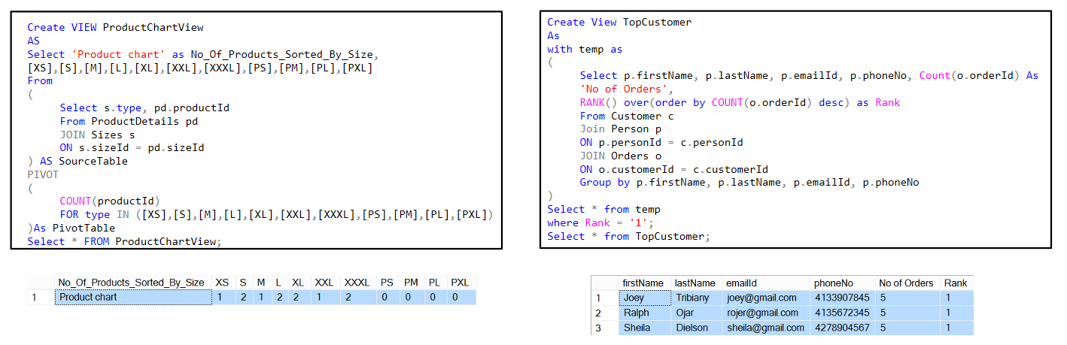
Horizontal reporting to get count of
product for all available sizes
View to get customer details with highest number of orders

Slide 11
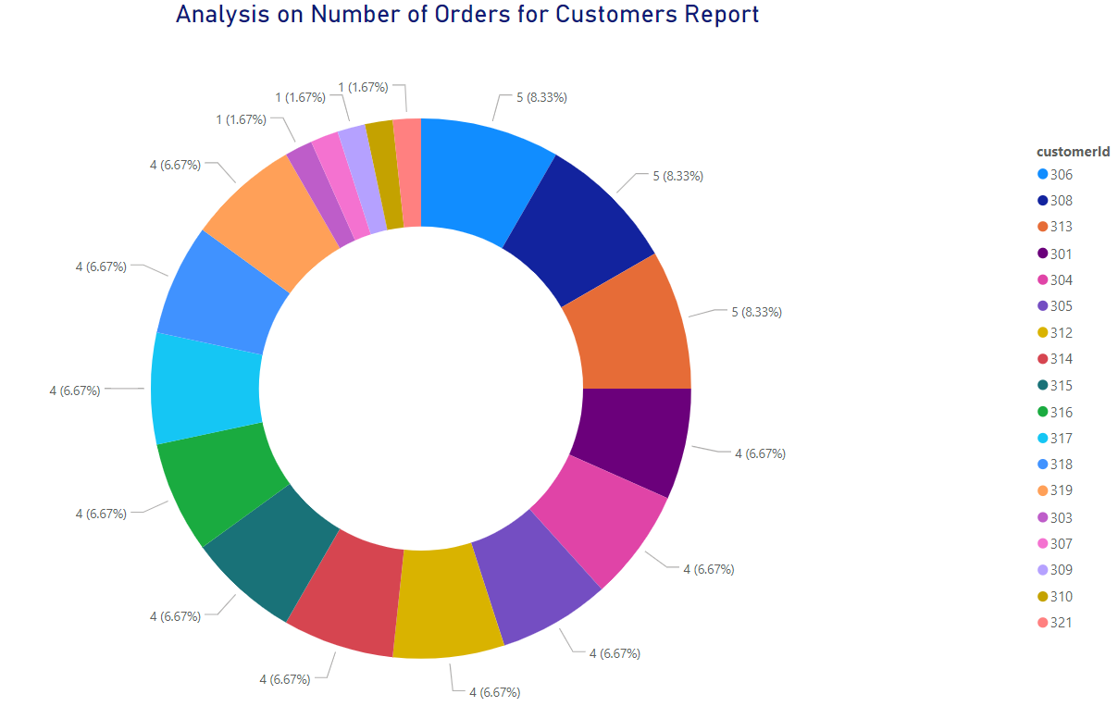
Data Analysis Report

Slide 12
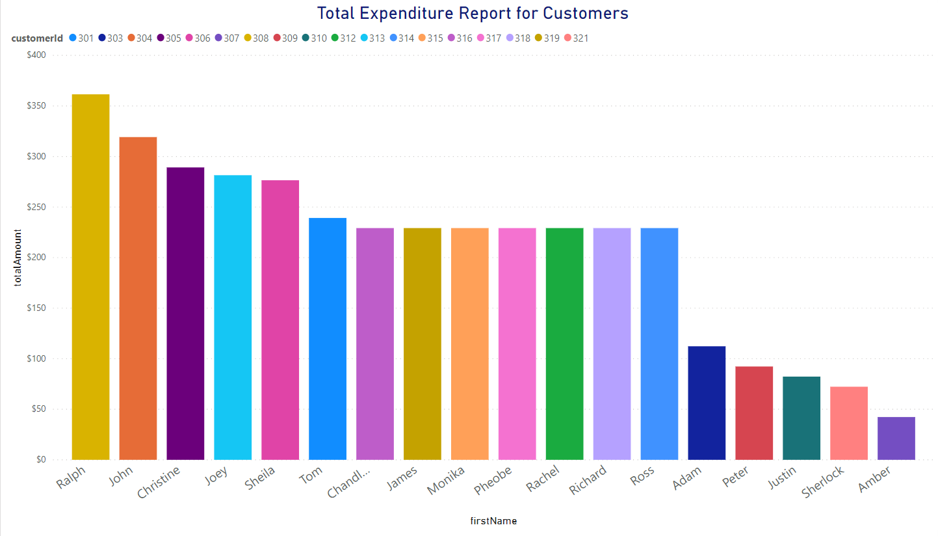

Slide 13
Q & A
Thank You!!!

