Slide 1
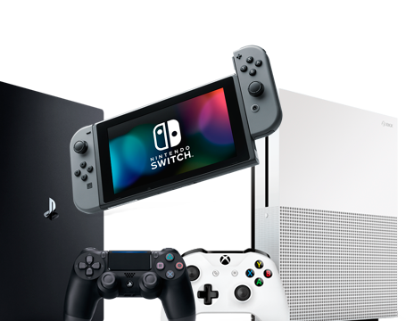
Video games sales EDA
By Sowmya Chavali
Bellevue university

Slide 2

overview
Video games are no longer a hobby exclusively enjoyed by the young.
As generations have grown up with video games a normal part of life, the video gaming market size has increased across the globe.
In this analysis I would like to take a deep dive into platforms, publishers, and genres along with the regional sales. I'll focus on these questions to better direct the focus, and shape of the analysis.

Slide 3
Research Questions
What are the sales of video games per genre?
What are sales of video games per platform?
Visualizations of platforms total sales and understanding each platform’s composition.
What are the top 5 publishers with highest global sales?
What is the growth of the top publisher of games over years?
Generate correlation table and observe the interaction between variables.
Observation on Year Wise Video Game Releases
Understanding the global sales pattern
How are the changes in sales over time?

Slide 4
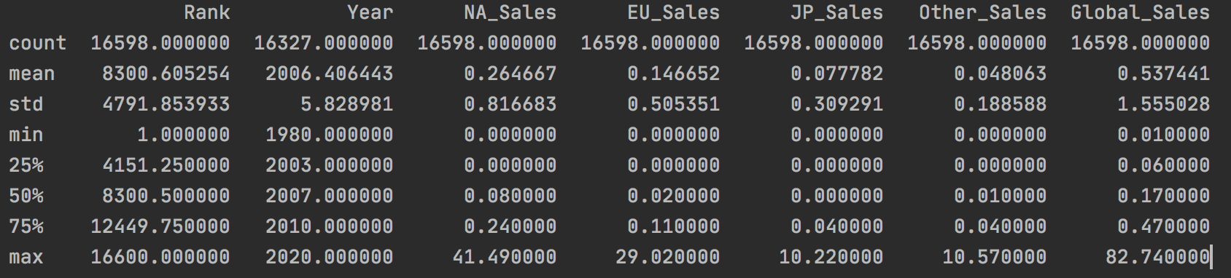
Describing dataset variables

Slide 5
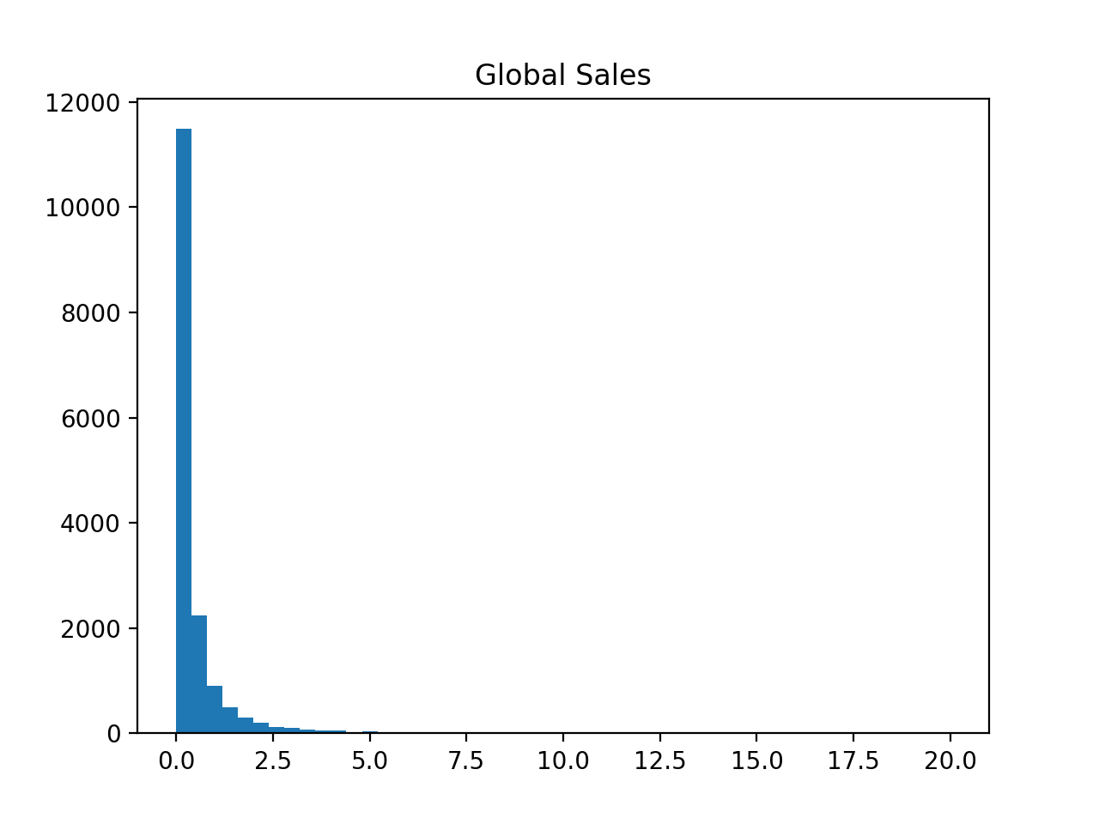
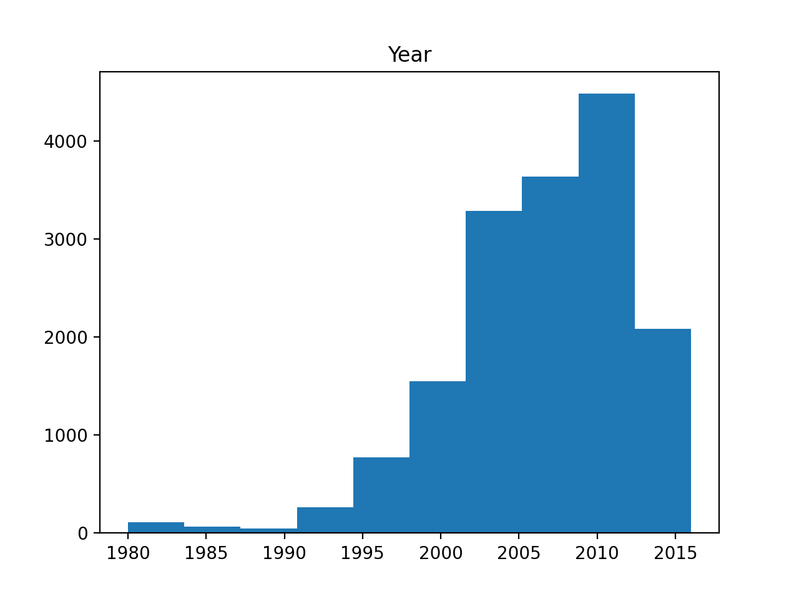
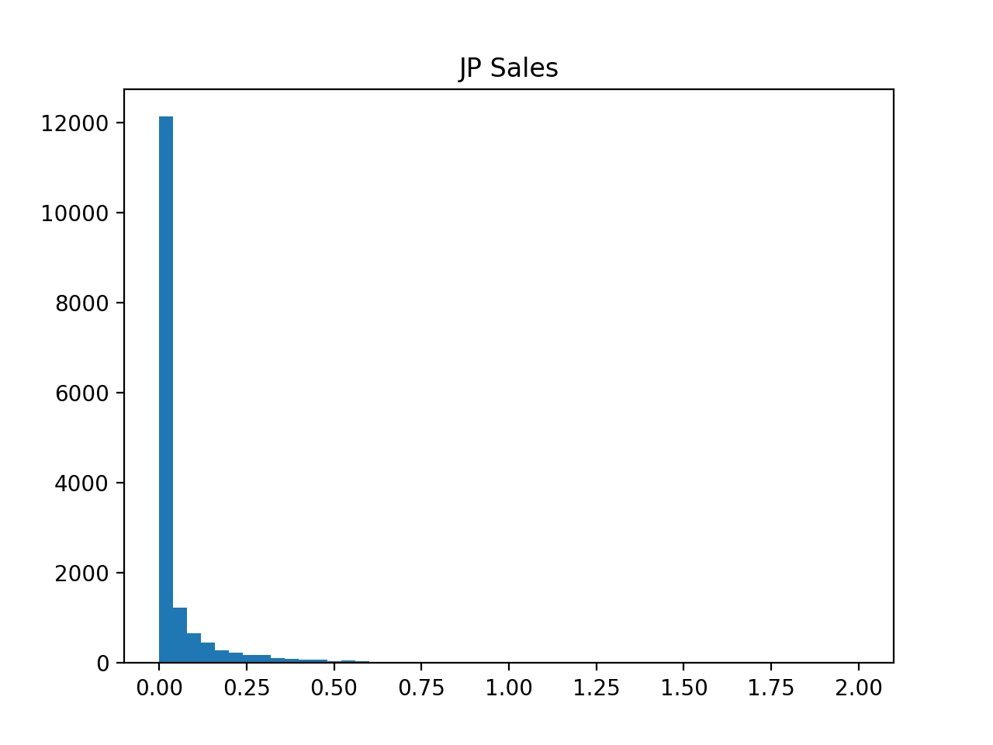
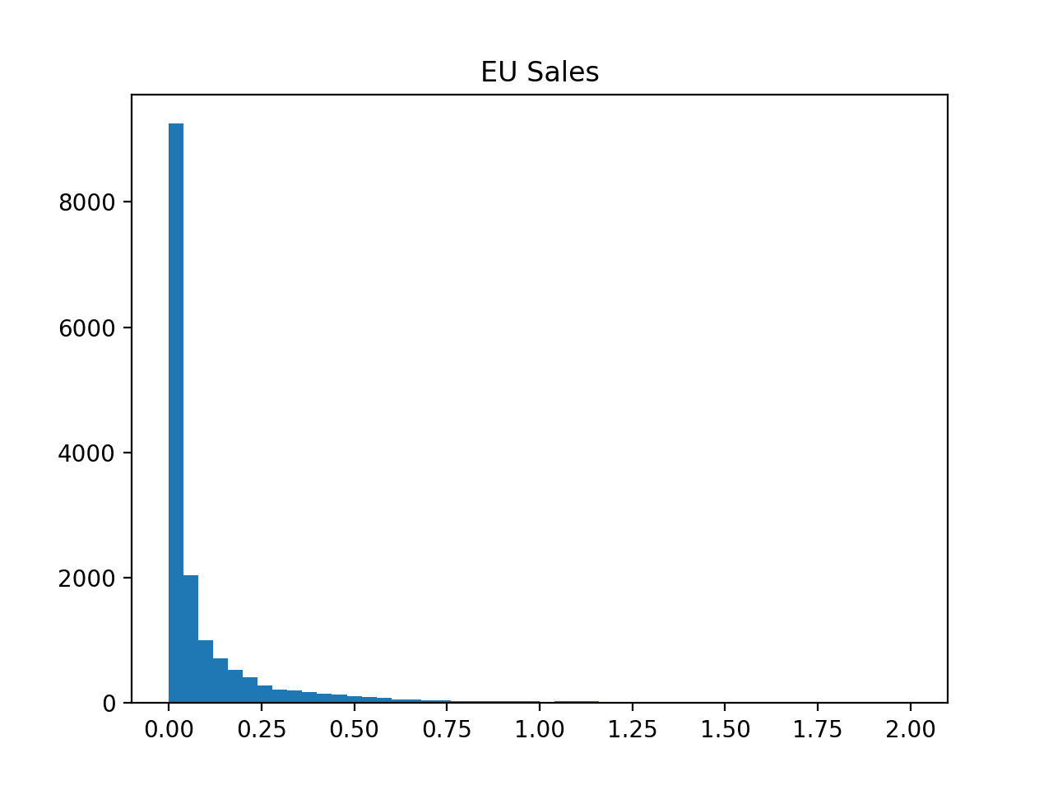
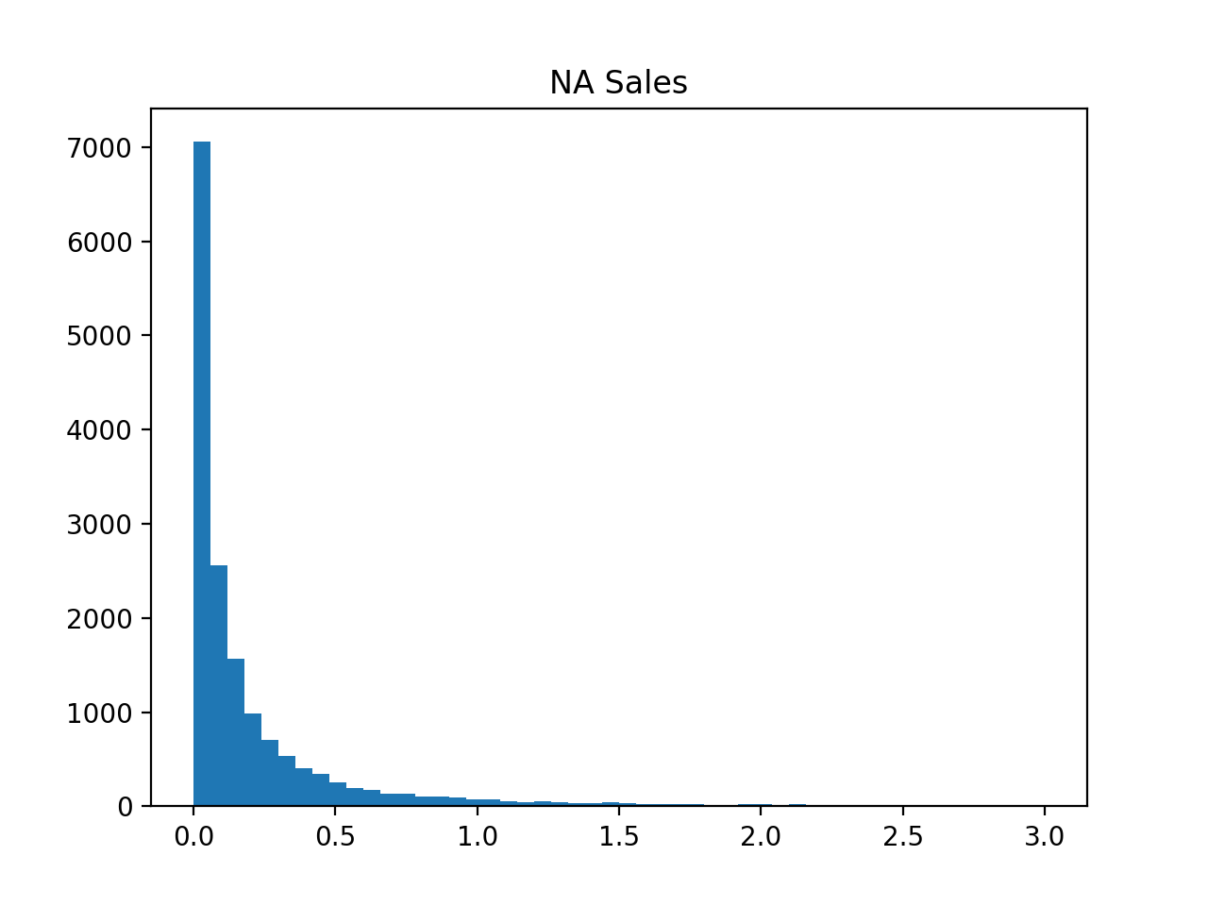
Histogram

Slide 6
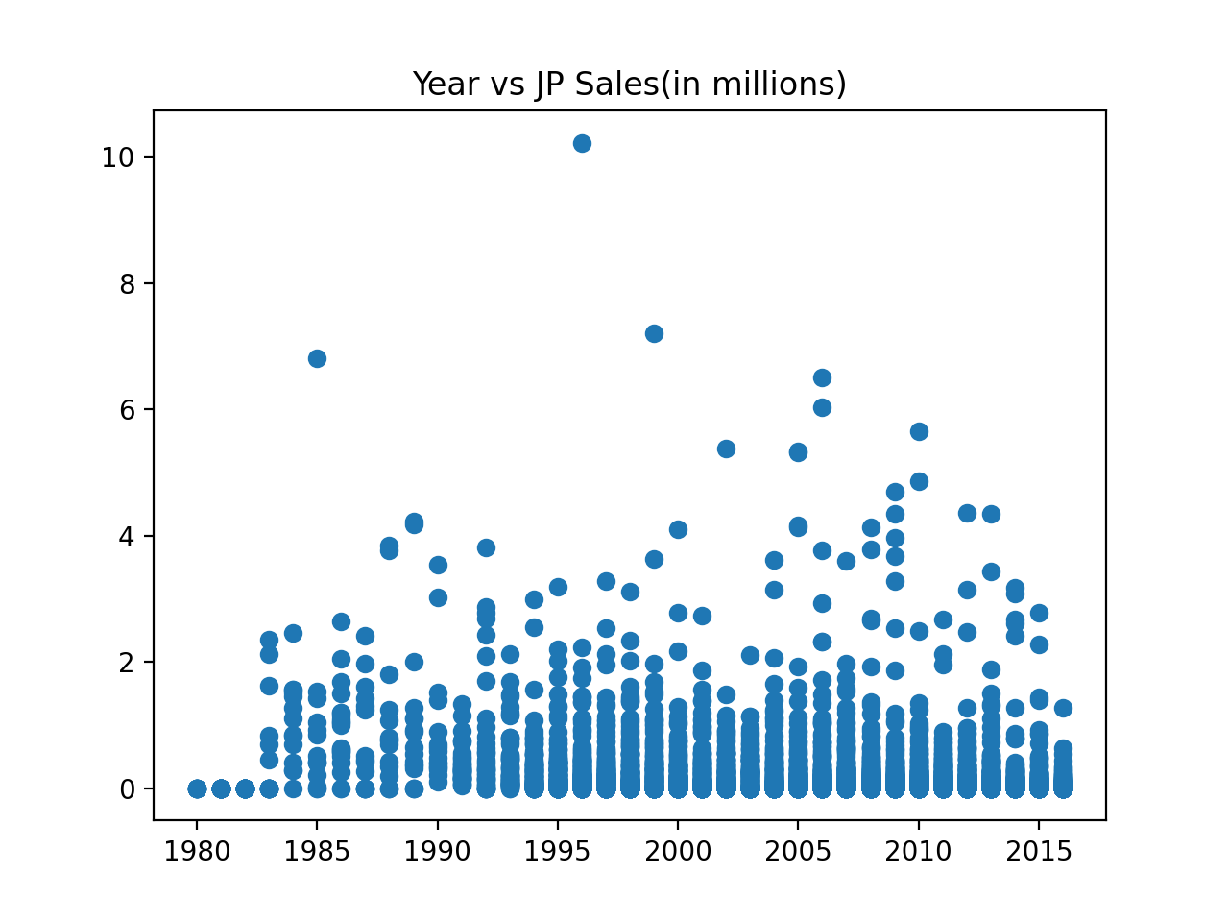
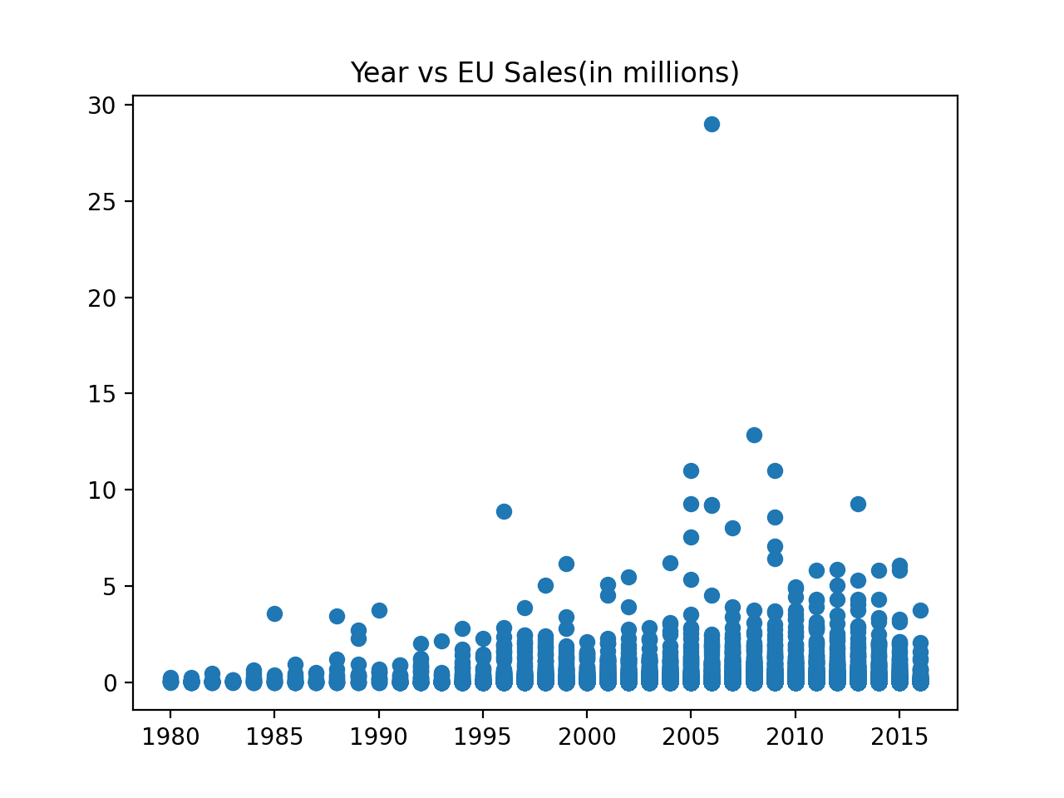
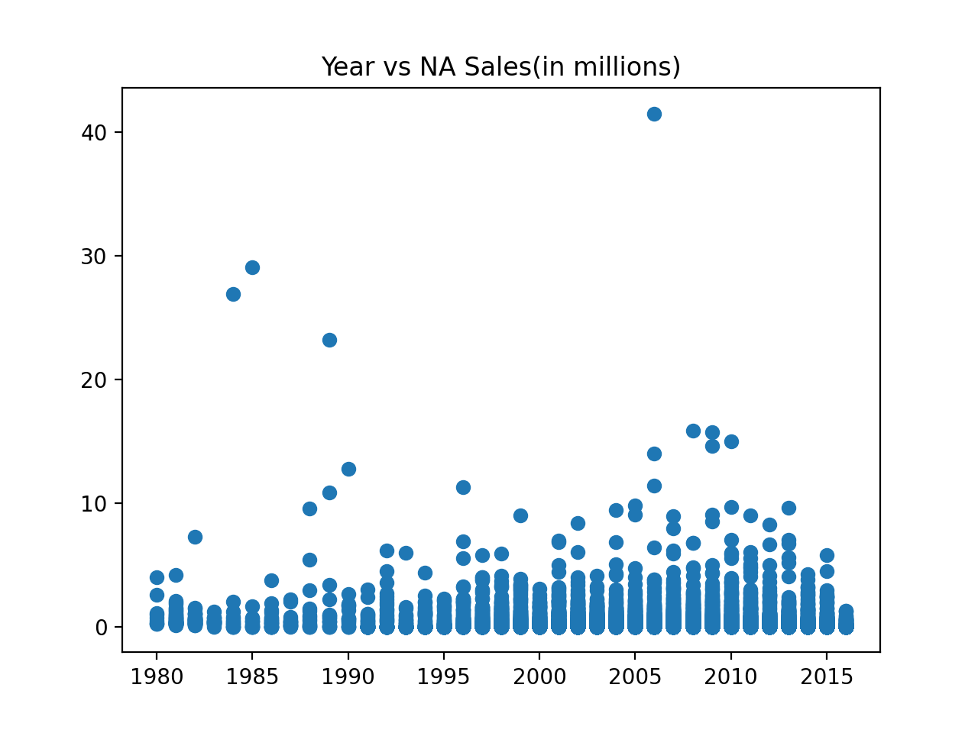

Scatter plots

Slide 7
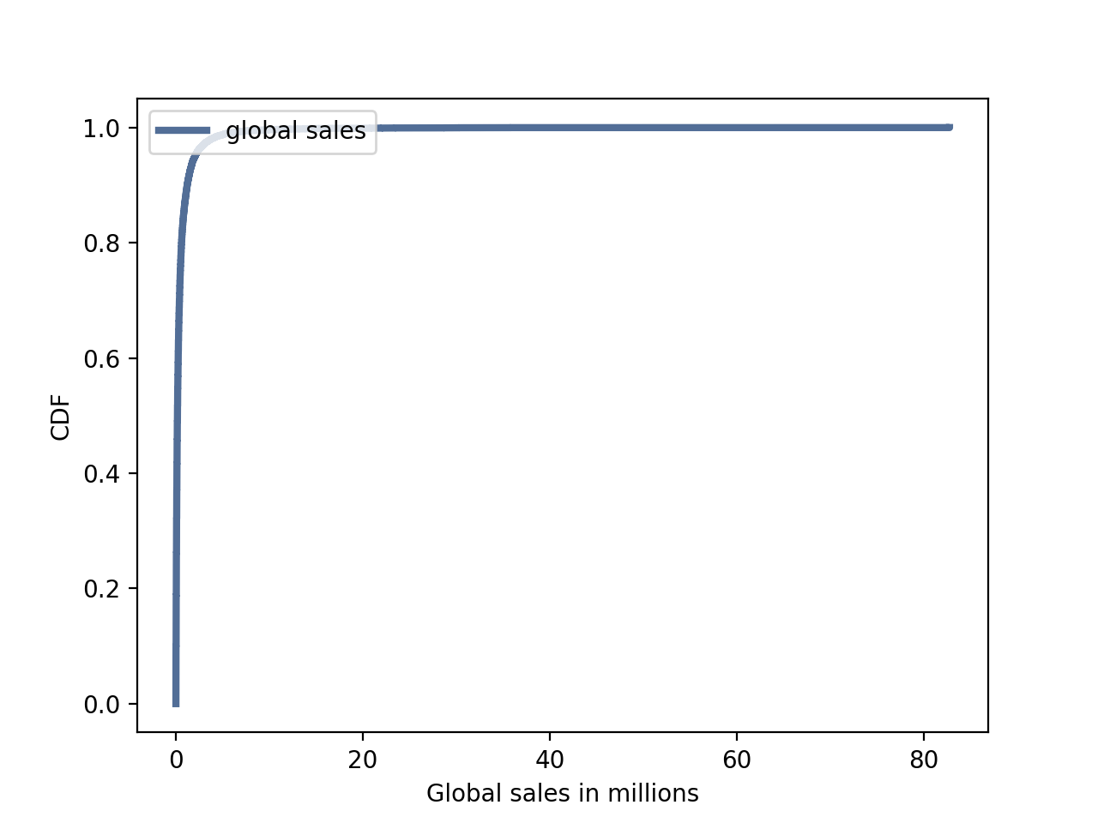
CDF
The global sales follows an exponential distribution.

Slide 8
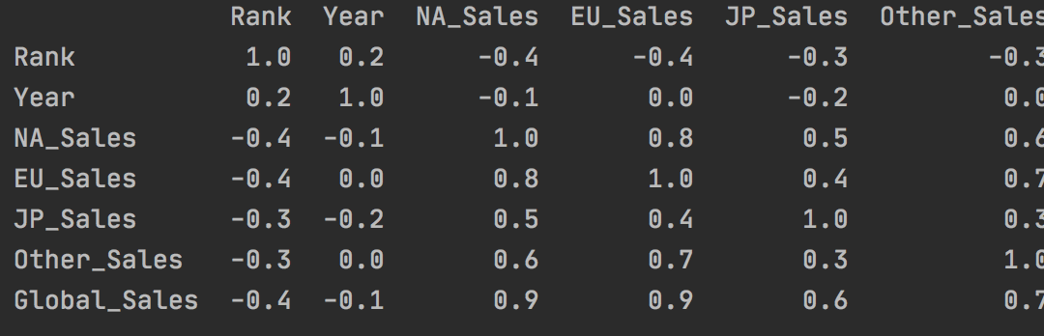
Correlation between variables

Slide 9
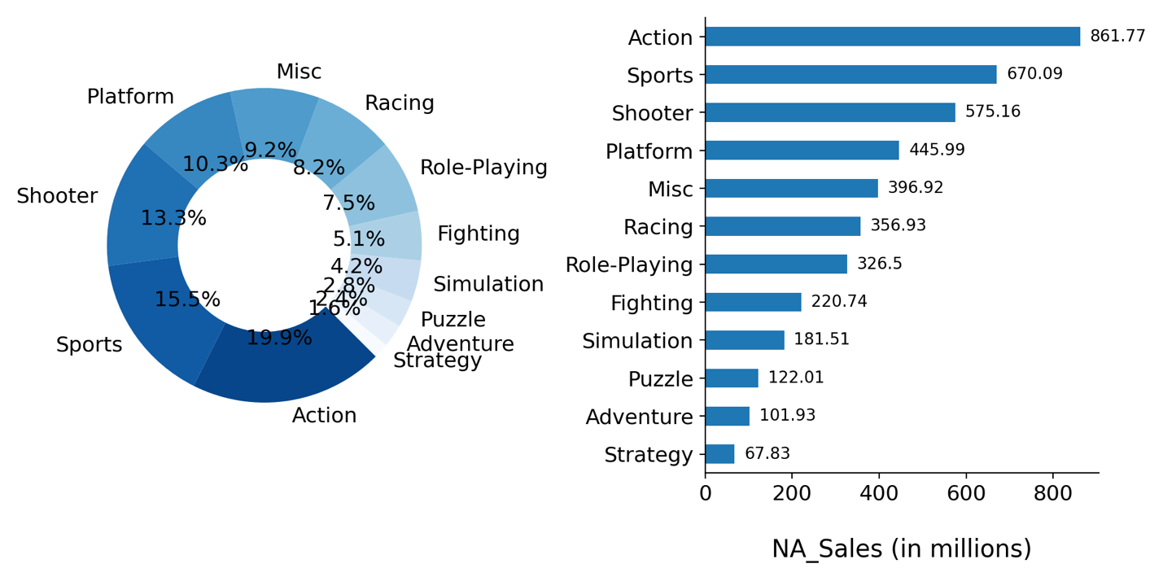
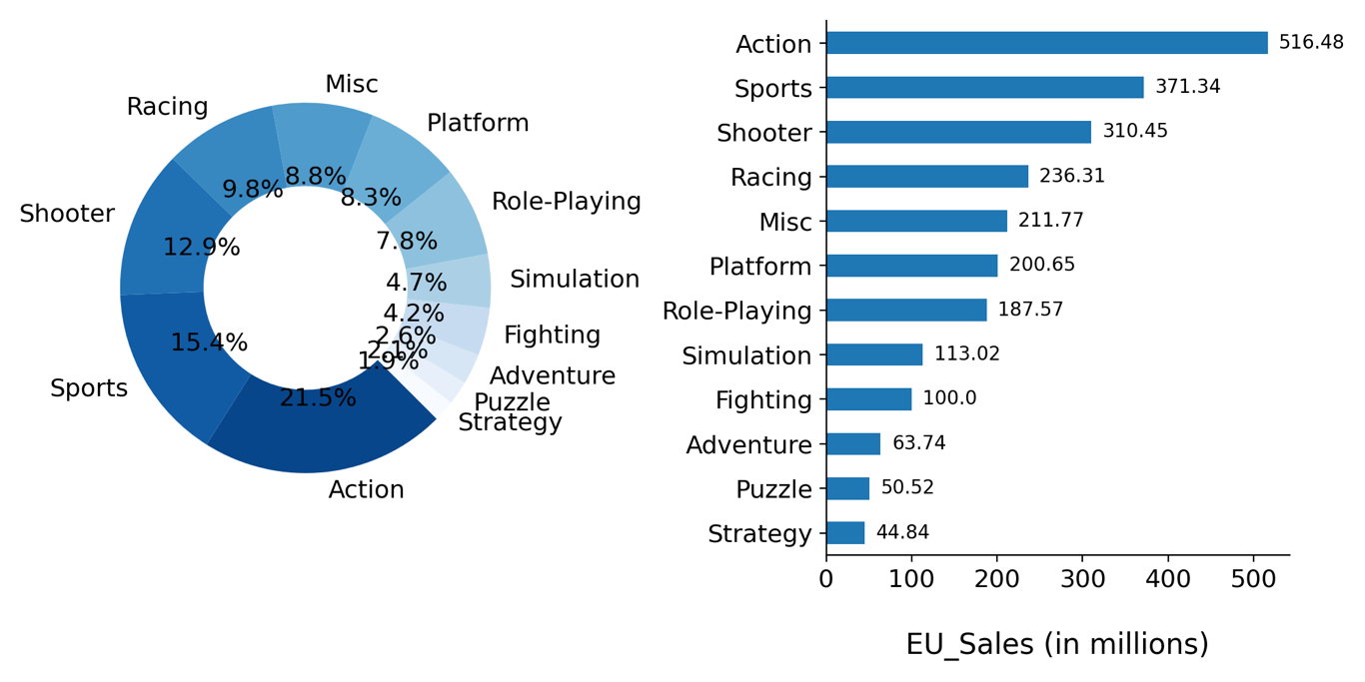
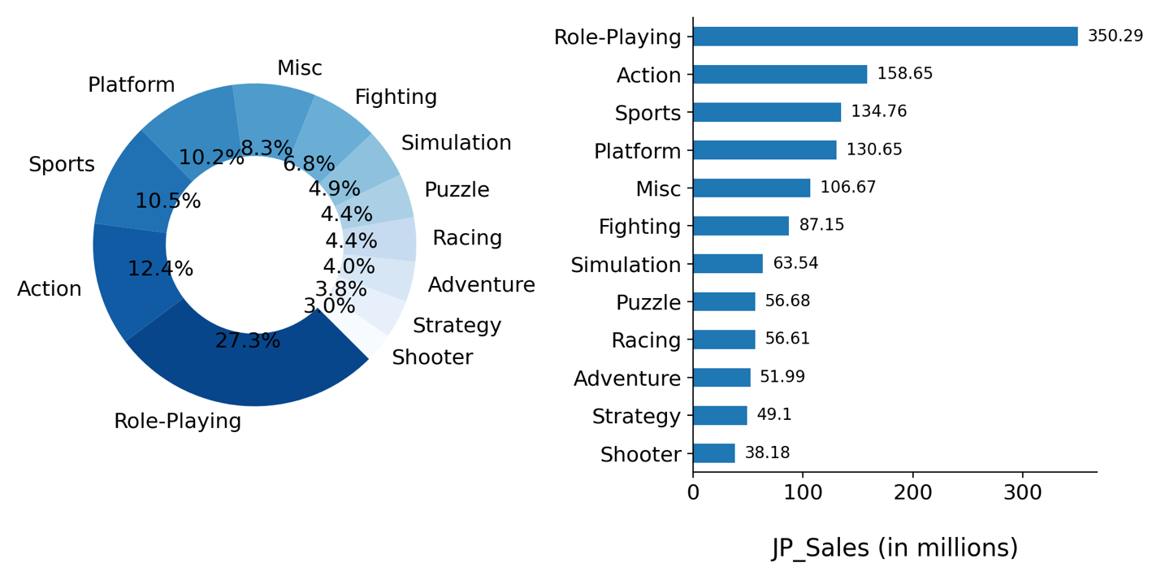
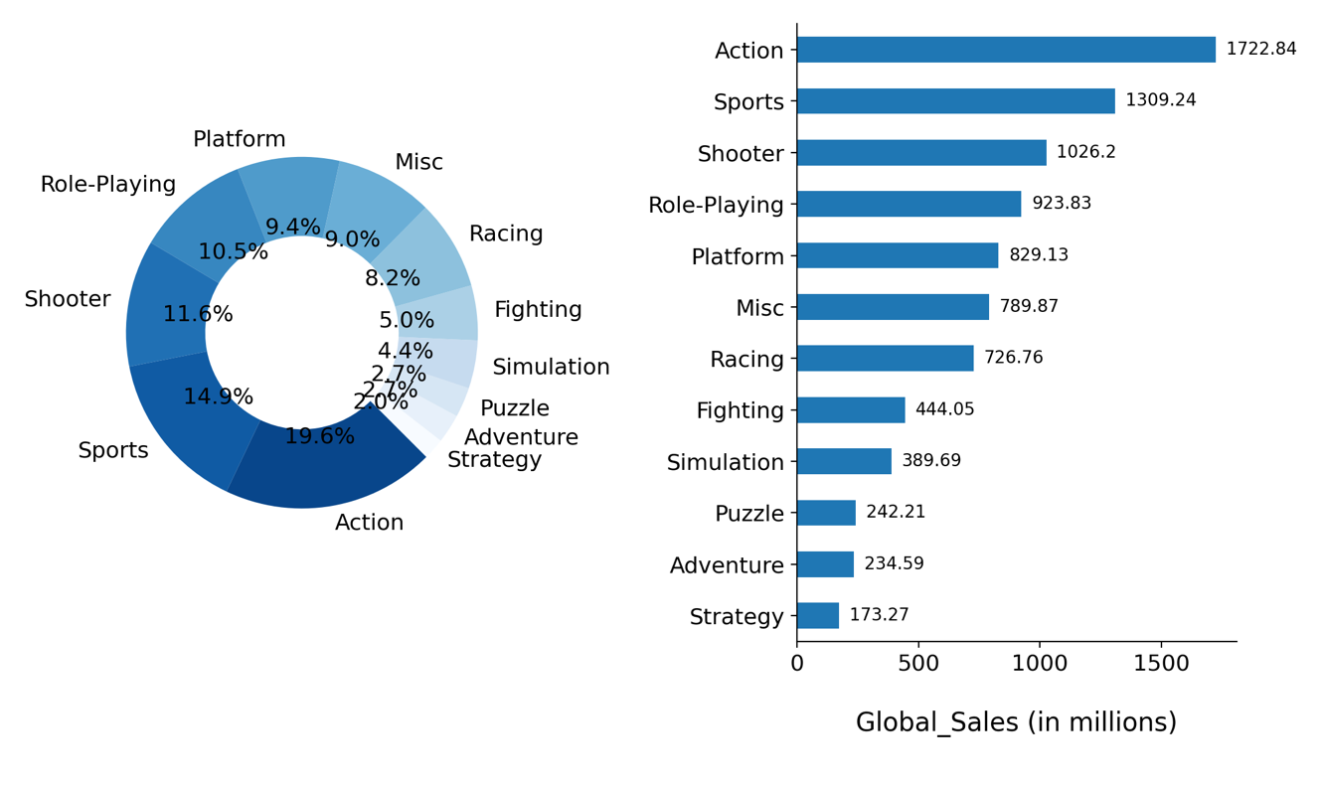
Sales of the video games per genre
Observations-
World-wide the most popular genre is Action followed by Sports and Shooter.
Action is the most popular genre across Europe and North America.
The most popular genre in Japan is Role-Playing.

Slide 10
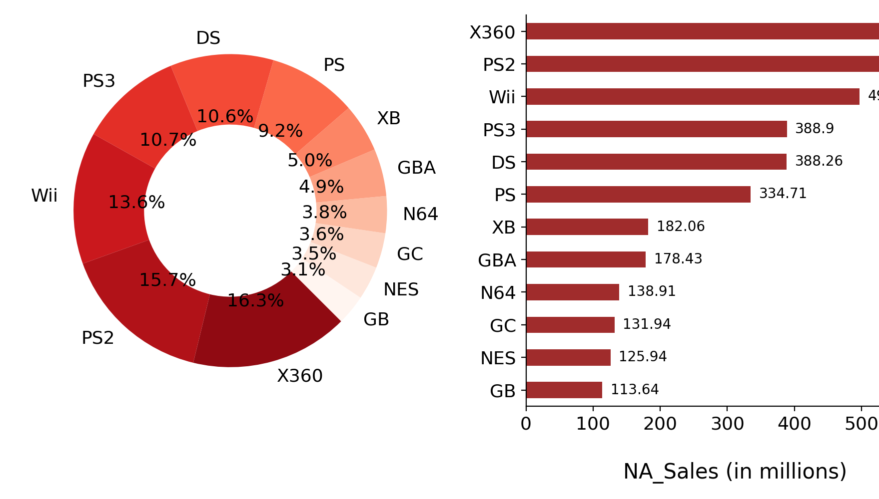
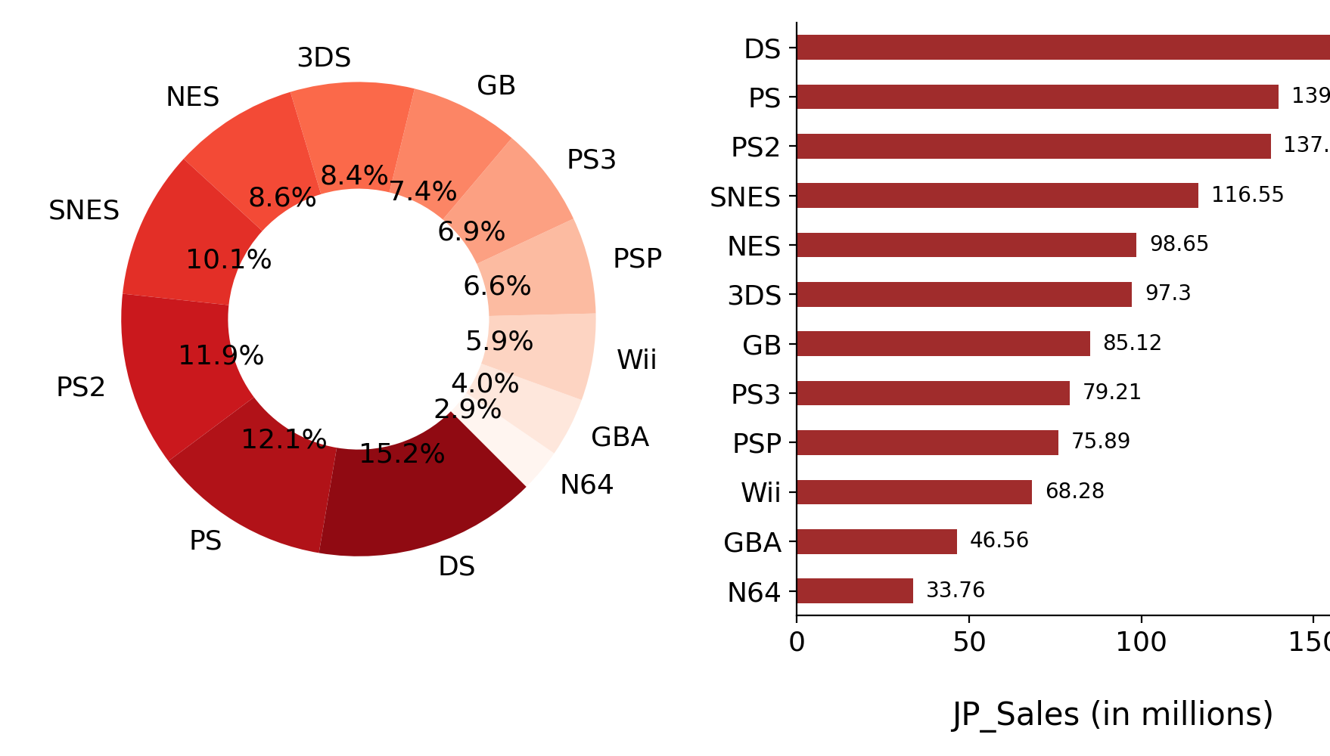
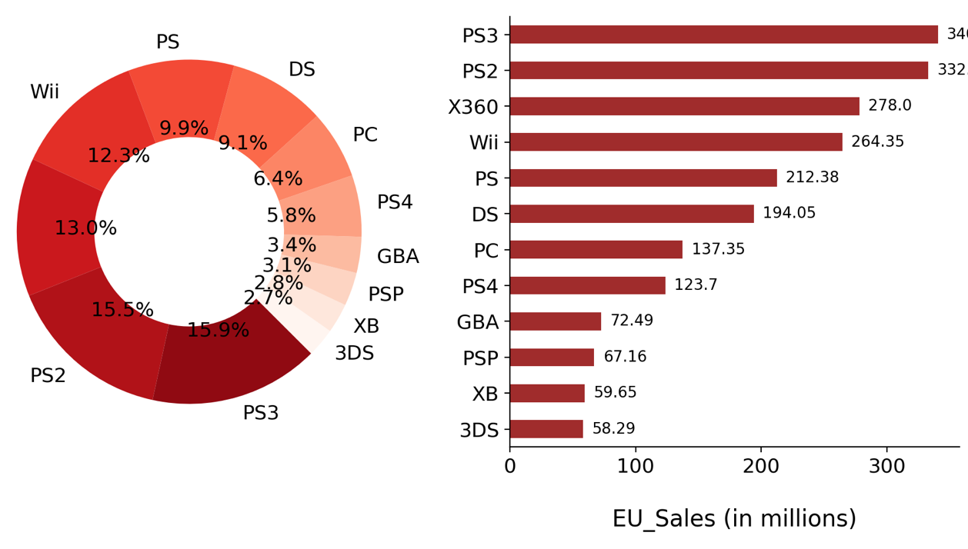
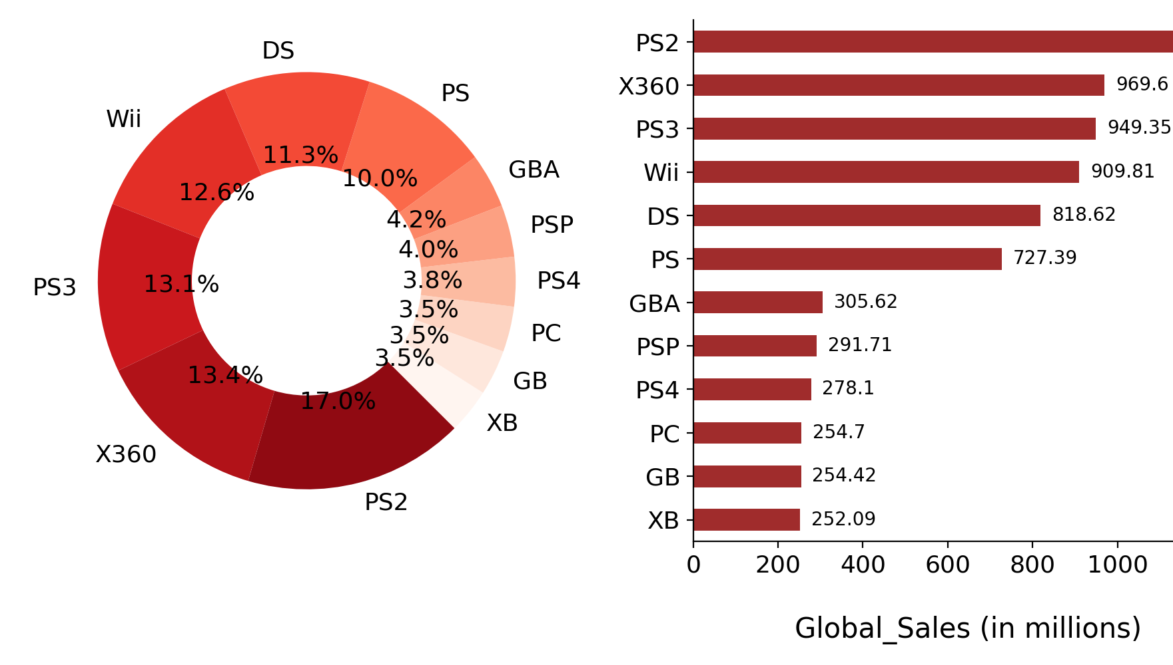
Sales of video games for each platform
Observations –
Globally the most popular platform till date is PS2(17%) followed by Xbox360 and PS3.
The most popular platform in till date North America is Xbox 360(16.3%) followed by PS2 and Wii
The most popular platform in Europe is PS3(15.9%) followed by PS2 and Xbox360
The most popular platform in Japan is DS(15.2%) followed by PS and PS2

Slide 11
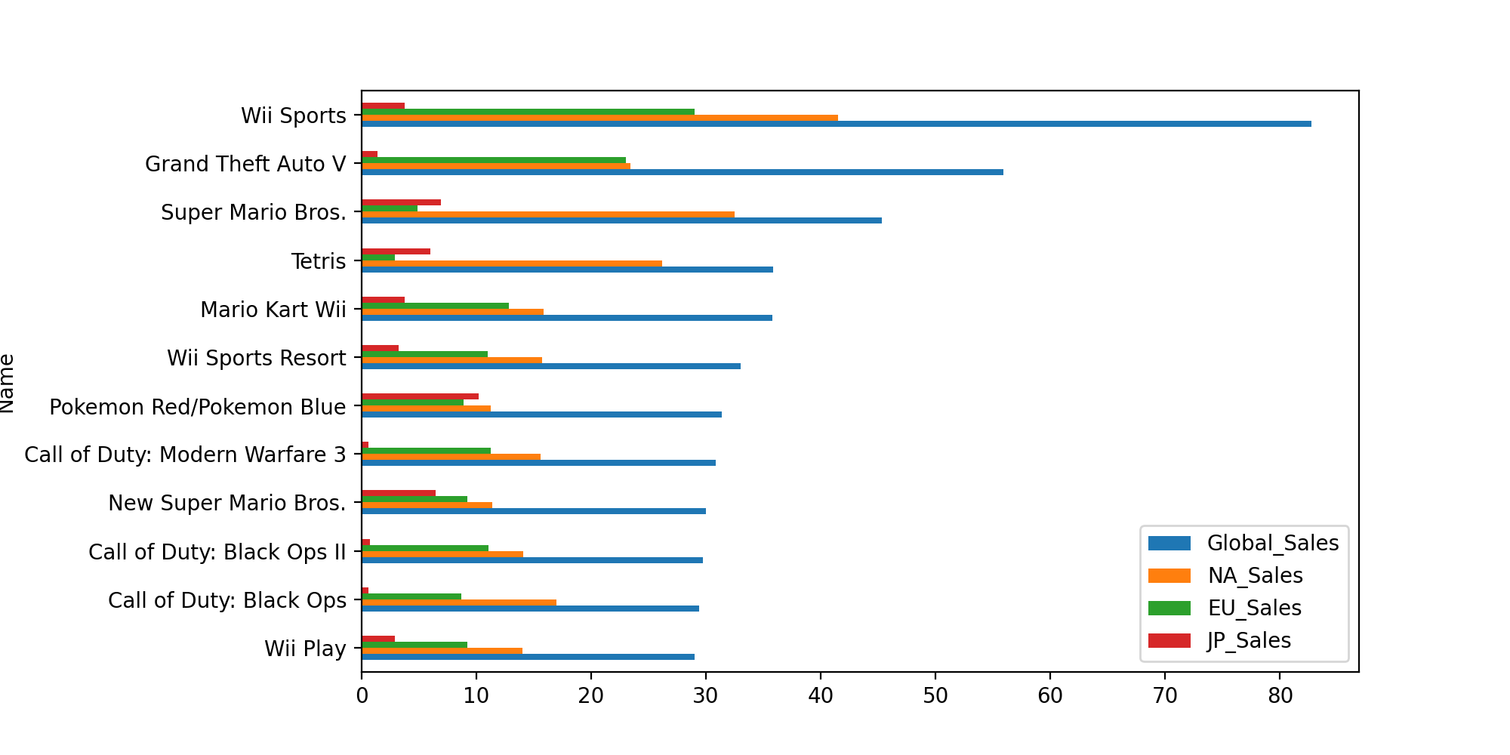
Sales of game titles across all regions
Wii Sports is the most popular in Europe, North America and globally, where as Pokemon Red/Pokemon Blue (Role-Playing genre) is the most popular game in japan.

Slide 12
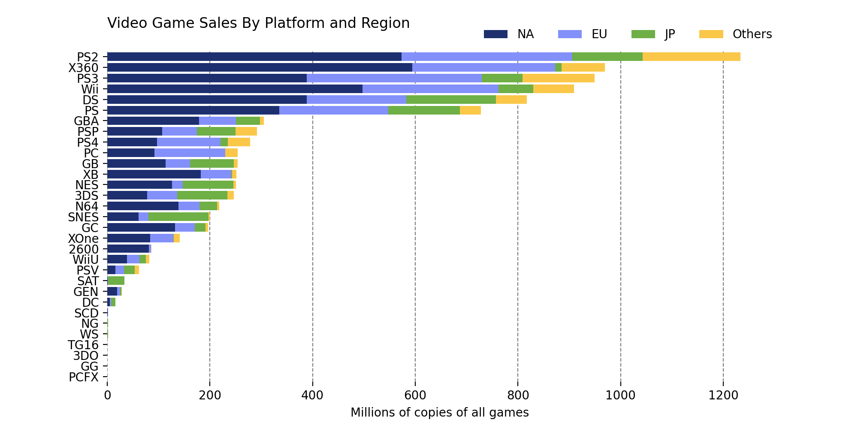
Platform and region
Platform’s total sales and understanding each platform's composition

Slide 13

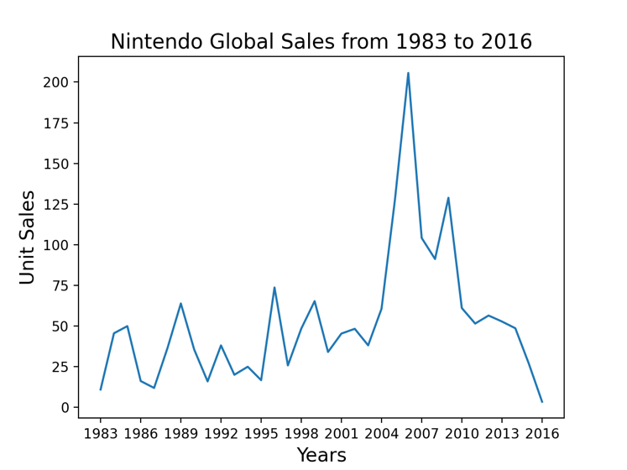
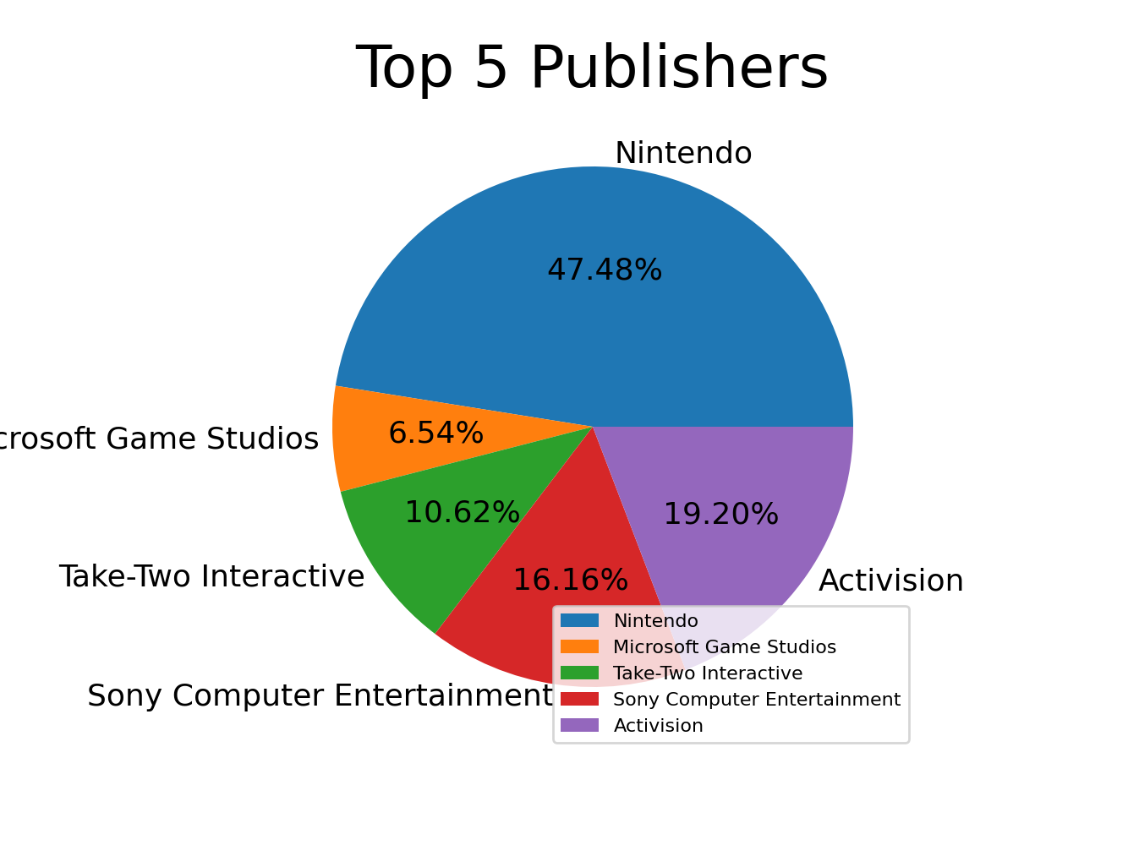
Top 5 publishers with highest global sales and growth over years of top publisher
Nintendo takes the top spot with approx. half the share i.e., 47.48% of global sales among the top5 publishers.
Nintendo sales were at peak in the year 2006 and dropped to its lowest in 2016

Slide 14
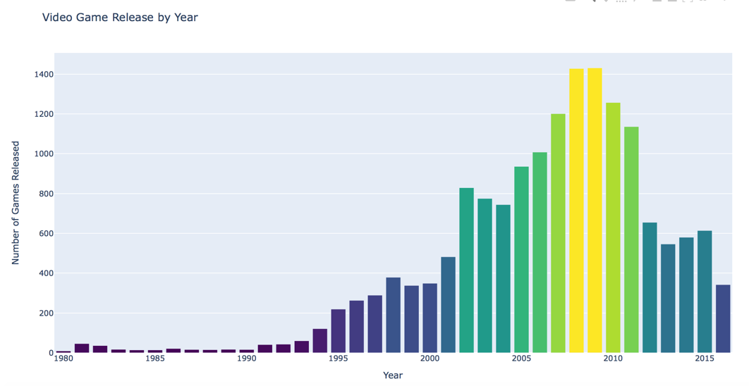
Year Wise Video Game Release Count
The plot says that the year 2009 has the highest number of games released. 2009/2010 years were the golden era for video games.

Slide 15
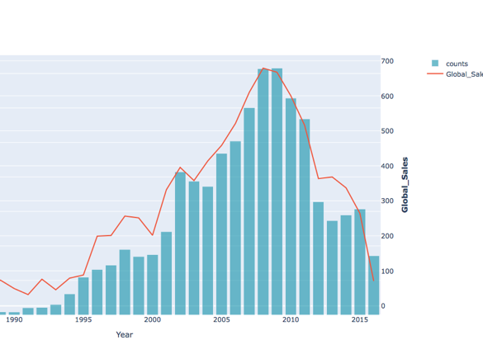
Changes in sales over time
After a small dip in sales 2003/2004, sales exploded and peaked in 2008-2010. Also known as the golden age of gaming where many games were released and sales were at its peak in the same time.
The sales volume in a year is often proportional of the games released in the given year. However, one outlier being 2004, where in my opinion, the resale/collectivity of games began to gain traction.

Slide 16
Summary
When it comes to the platform market, Nintendo is a powerhouse. What surprises me the most, it's not only the quantity of games they are releasing year to year that are driving the results. The only competitor being Microsoft, due to how big of a hit the xbox 360 was.
Nintendo has proven year after year, the quality of their games are top notch. However, you have to give credit where credit is due. Activision shows the ability to make quality games. With Call of Duty releasing every year, and a younger generation that doesn’t care as much about story lines, and single player game modes, the online realm seems to be dominated by activision and EA.
The global sales started to rise in the early 90's and for the most part, didn’t slow down(except for 2001/2002) until 2011. 2009/2010 were by far the golden era for video game. Not just for the companies behind the platform, or the studio's responsible for the product, but also for the consumer. During 2009, blockbuster games like Call of Duty Modern Warfare 2, littlebigplanet(psp),and assassins creed 2 were all very good games, and were marketed extremely well leading up to the 2009 release season.

Slide 17
References
1.https://en.wikipedia.org/wiki/2009_in_video_games#:~:text=The%20year%202009%20saw%20many,Dance%2C%20Minecraft%2C%20and%20Prototype.
2.https://gamerant.com/video-games-best-years/

