Slide 1
Project Title: Home Credit Default Risk
Team Name : FP_GroupN_21

Slide 2
Contents
Project Description
Data Lineage
Modelling Pipelines
Neural Network
Loss Function
Results and discussion
Four-P
Conclusion

Slide 3
Abstract
The course project focuses on predicting whether a client is capable of repaying a loan or not, using the Home Credit Default Risk Kaggle Competition dataset. The aim is to improve the loan experience for clients who have insufficient credit histories by using additional information, such as telco and transactional data. For the final phase of the project, three neural networks were implemented using PyTorch Lightning for classification. The dataset was transformed into a tensor using the 'Data_pre_nn' function, and ReLU was used as the activation function, along with the Adam optimizer and a learning rate of 0.01. The binary cross-entropy loss function was used, and backward propagation was implemented to minimize the loss. Neural Network 1, with 4 hidden layers, 400 epochs, and a batch size of 100, gave the best results. Neural Network 2 had the same architecture as Neural Network 1, but with 100 epochs and a batch size of 128. Neural Network 3 had a different architecture, with 3 hidden layers and 2 sigmoid output layers. The first neural network performed better compared to other 2 with accuracy of 0.938 and AUC score of 0.580

Slide 4
Project Description
The course project is based on Home Credit Default Risk Kaggle Competition (HCDR). The main goal of this project is to predict whether the client is capable to repay the loan or not. Due to insufficient credit histories many people not could get the loan, in order to provide them with better loan experience Home credit works by taking extra information including telco and transactional information to predict client repaying capabilities.
For the final phase of the project, we implemented three Neural Networks using PyTorch Lightning for classification. For the classification of neural network, we transformed the dataset into a tensor using the ‘Data_pre_nn’ function. This Neural Network has 160 input features and one output feature.
The DataLoader function then converts the train, test and validation data with 160 features. We have used the ReLU (Rectified Linear Unit) function as the activation function and Adam algorithm as an optimizer with a learning rate of 0.01.
For the loss function, we have used the Binary cross entropy loss function, and are using Backward Propagation to minimize the loss. BCE(t, p) = - (t * log(p) + (1 - t) * log(1 - p))
Neural Network 1 is implemented with 4 hidden layers, 400 epochs, 100 batch size and with below architecture : 160 - 128 - Relu - 64 - Relu - 32 - Relu - 16 - Relu - 1 sigmoid
Neural Network 2 is implemented with same 4 hidden layers but100 epochs, 128 batch size and architecture: 160 - 128 - Relu - 64 - Relu - 32 - Relu - 16 - Relu - 1 sigmoid
Neural Network 3 is implemented with 3 hidden layers, 100 epochs, 128 batch size and with below architecture : 160 - 128 - Relu - 64 - Relu - 32 - Relu - 2 sigmoid
Overall, the performance of the model depends on the architecture like learning rate, epochs, the choice of optimizer and loss function. In this case, Neural Network 1 with higher learning rate, more epochs, and with 4 hidden layers gave the best results.

Slide 5
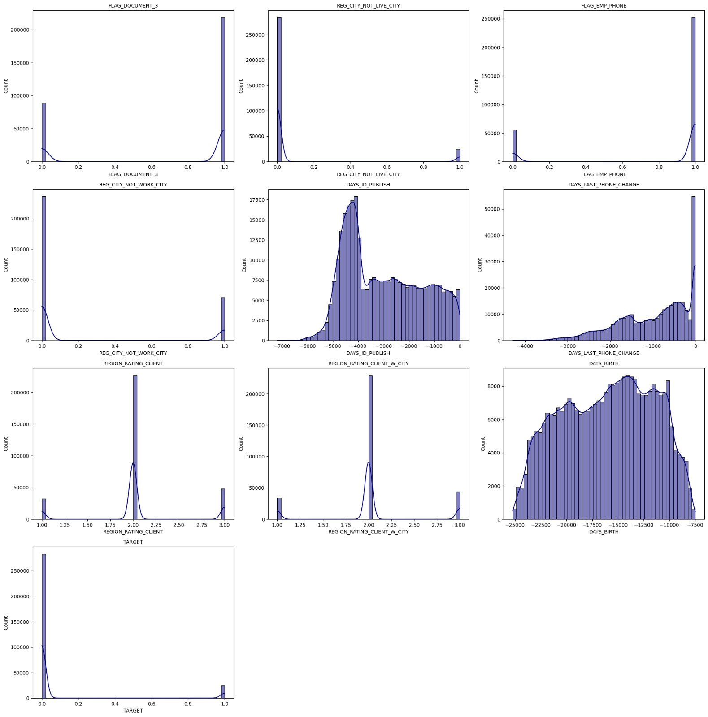
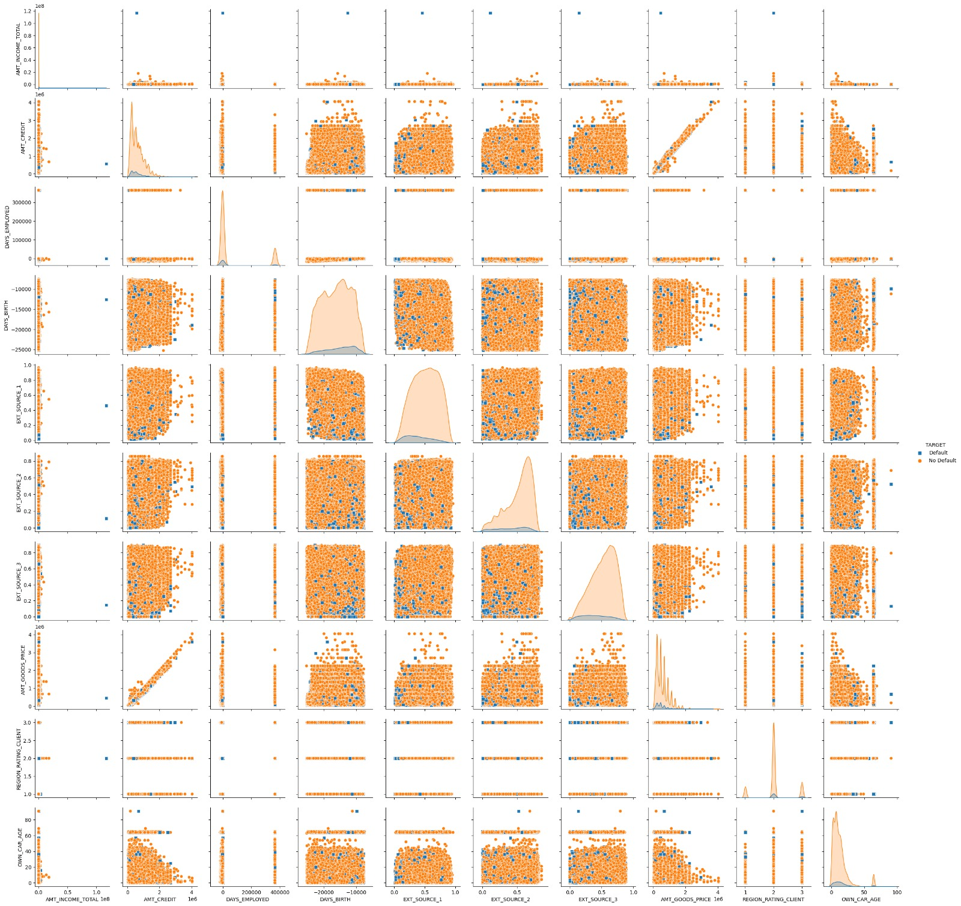
EDA Summary
During the EDA of the HCDR dataset, we performed visualizations of the distributions and central tendencies of the input features. We also inspected the number of missing values in each table, along with the numerical and categorical features present in each table. To understand the relationship between the input features and the target variable, we calculated the correlation coefficients between them and identified the features that are most highly correlated with the target. Additionally, we created a pair plot to visualize the relationship between different input features. Overall, the EDA allowed us to gain insights into the data, understand the distributions and correlations, and identify potential relationships between the input features and the target.
Distribution of top 10 positive correlation variables​
Pair plot

Slide 6
Data Lineage
The data was initially downloaded from Kaggle website which was made open by the home credit group in an attempt to make better predictions while classifying a user as a potential defaulter/non-defaulter based on non-conventional user data.
Source Data
Loading Data into Dictionary
Perform EDA on data
Feature Engineering
Preprocessing Pipelines
Transformation and Merging
Numerical and Categorical Pipelines
Feature Union Pipeline
Modelling Pipelines

Slide 7
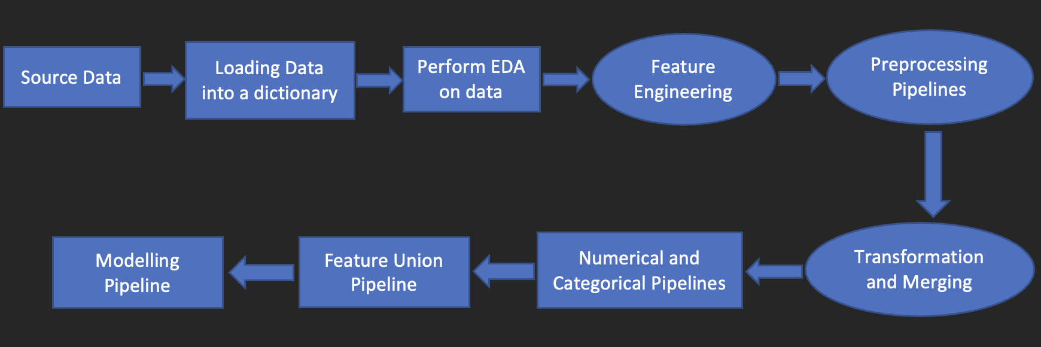
Data Lineage
The top 10 features based on our observation as FLAG_DOCUMENT_3, REG_CITY_NOT_LIVE_CITY, FLAG_EMP_PHONE, REG_CITY_NOT_WORK_CITY, DAYS_ID_PUBLISH, DAYS_LAST_PHONE_CHANGE, REGION_RATING_CLIENT, REGION_RATING_CLIENT_W_CITY, DAYS_BIRTH, EXT_SOURCE_1

Slide 8
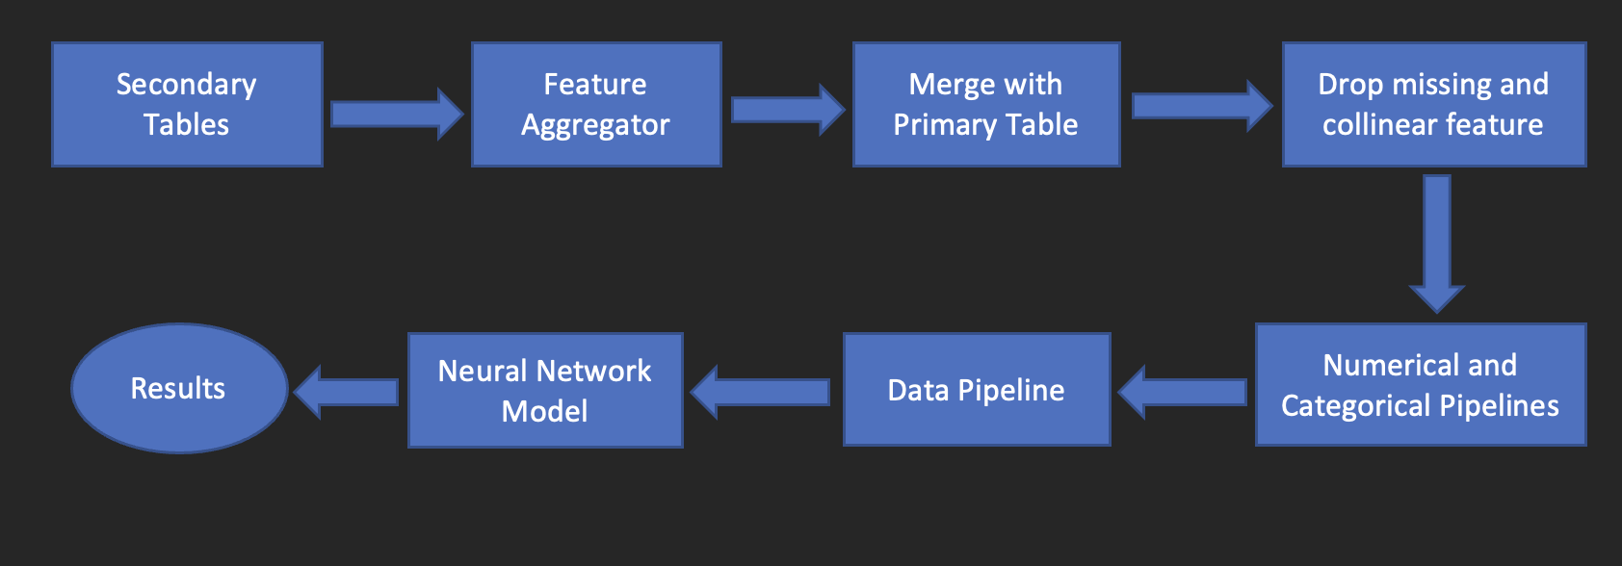
Modelling Pipelines

Slide 9
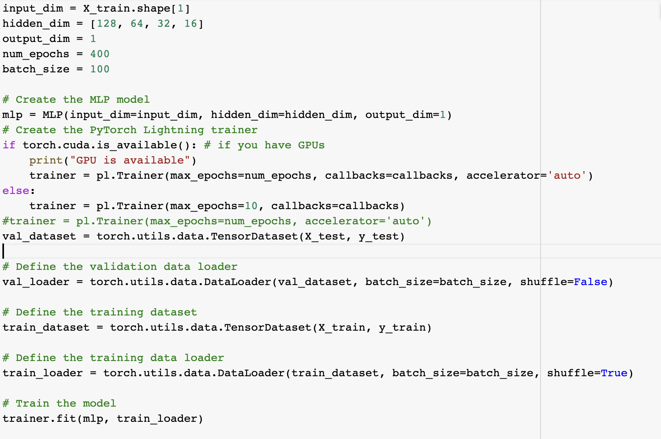
Neural Network - 1

Slide 10
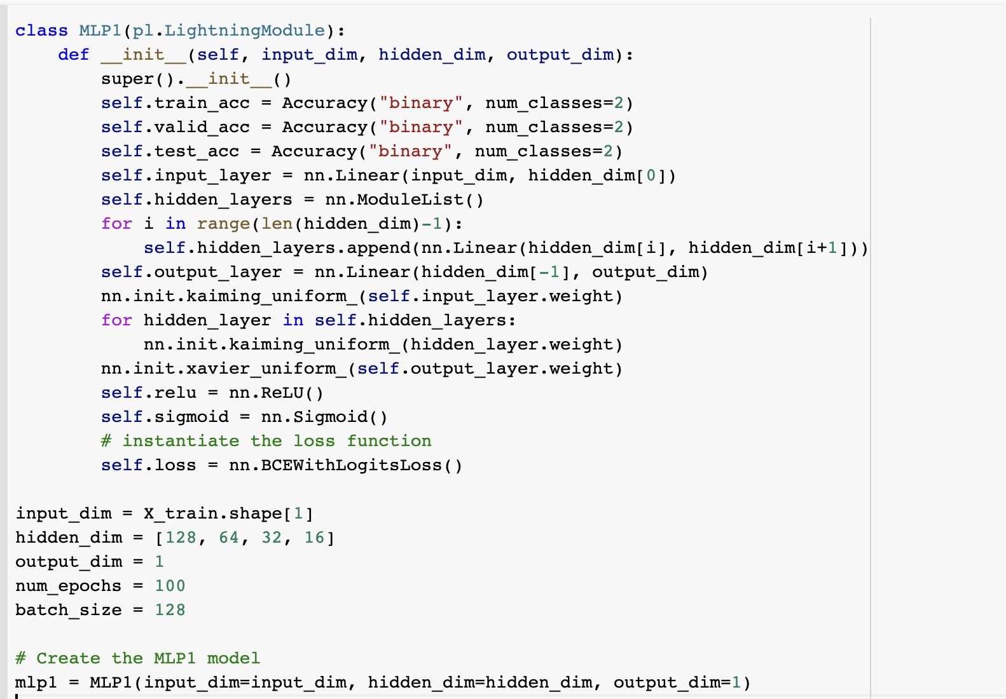
Neural Network -2

Slide 11
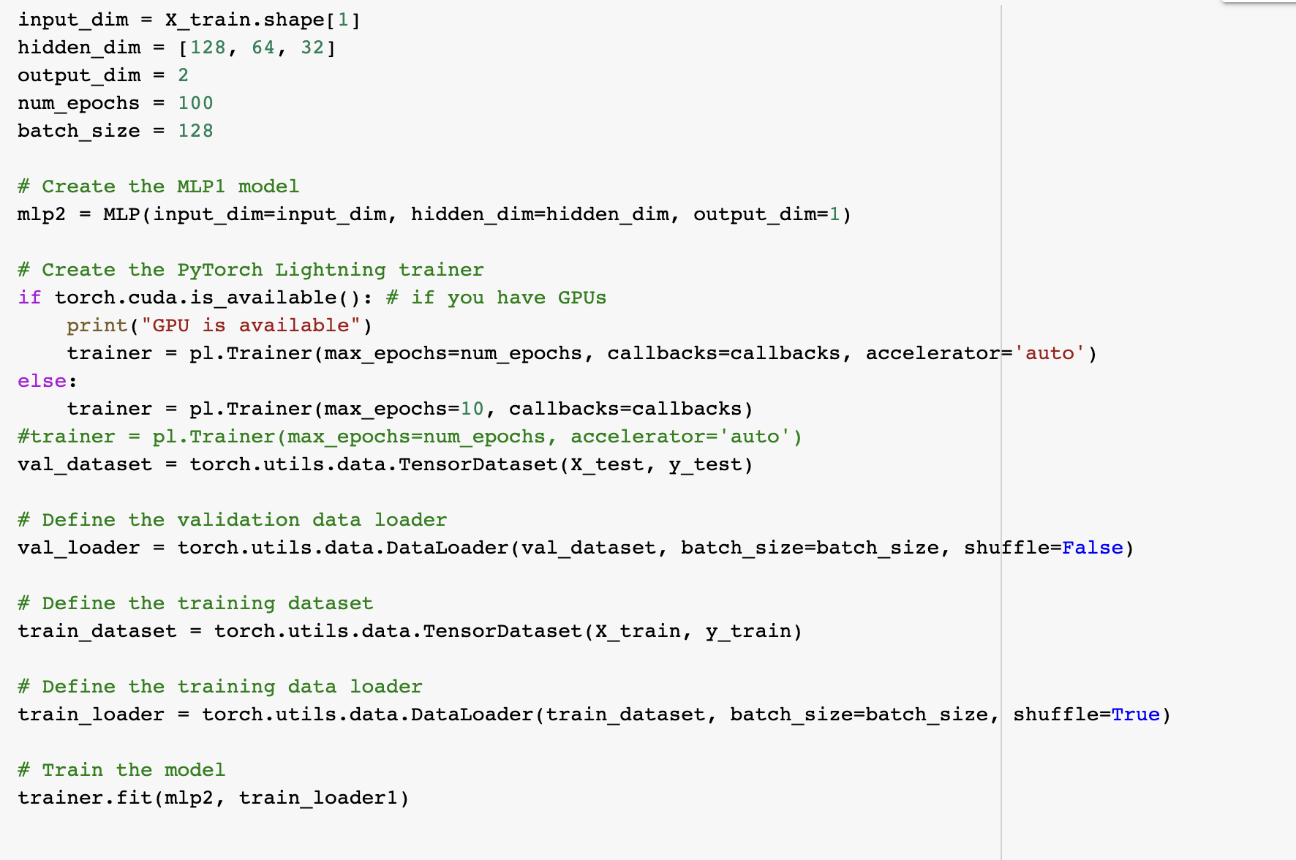
Neural Network -3

Slide 12
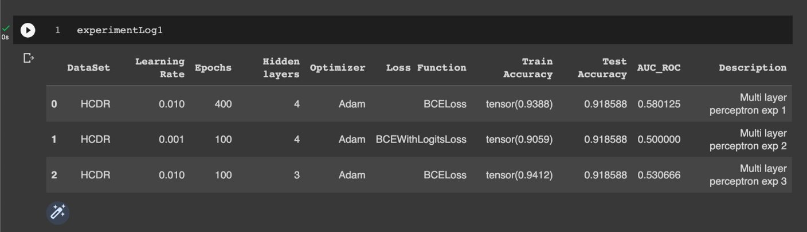
Results and Discussion

Slide 13
Results and Discussion
In Experiment1 we used a higher learning rate of 0.01, trained for 400 epochs with 4 hidden layers, optimized with the Adam optimizer and trained with binary cross-entropy (BCE) loss function. This model achieved the highest AUC-ROC score of 0.580125, indicating that it performed the best in predicting the binary output for the given dataset. The model also achieved a high train accuracy of 0.9388 and a test accuracy of 0.918588.
In experiment 2 used a lower learning rate of 0.001, trained for 100 epochs with 4 hidden layers, optimized with the Adam optimizer and trained with binary cross-entropy with logits (BCEWithLogits) loss function. This model achieved a lower AUC-ROC score of 0.5, indicating that it did not perform well in predicting the binary output for the given dataset. However, the model achieved a high train accuracy of 0.9059 and the same test accuracy of 0.918588 as the other two models.
In Experiment 3 used a higher learning rate of 0.01, trained for 100 epochs with 3 hidden layers, optimized with the Adam optimizer and trained with binary cross-entropy (BCE) loss function. This model achieved a slightly lower AUC-ROC score of 0.530666 compared to Model 0, indicating that it did not perform as well as the first model in predicting the binary output for the given dataset. However, the model achieved the highest train accuracy of 0.9412 and the same test accuracy of 0.918588 as the other two models.
Overall, We can infer that experiment 1 with a higher learning rate and more number of epochs achieved better test accuracy of 0.918 and AUC_ROC score of 0.58.

Slide 14
Four-P
Past: The Home Credit Default Risk project aims to provide loans and financial services to unbanked and low-credit-scored customers. In the past, we denormalized and merged the primary and secondary tables and performed exploratory and visual data analysis. We also trained machine learning models such as Logistic Regression and Random forest and obtained accuracy and AUC scores. Later, we focused on feature engineering and hyperparameter tuning. We used functions to drop columns with missing values and collinear features and created three new features based on domain knowledge. We then trained a Logistic Regression model using grid search and cross-validation to find the best hyperparameters. Finally, we tested the model on the Kaggle test set and made a submission.
Present: In the present, we focused on implementing Neural Networks using PyTorch Lightning for classification. For the classification of neural network, we transformed the dataset into a tensor using the ‘Data_pre_nn’ function. We have used the ReLU (Rectified Linear Unit) function as the activation function. We are using the Adam algorithm as an optimizer with a learning rate of 0.01. For the loss function, we have used the Binary cross entropy loss function, and are using Backward Propagation to minimize the loss.
Problems - Some of the problems we faced were the large sizes of the datasets, which led to long running times and kernel crashes. Additionally, we had to deal with computational complexity and selecting appropriate parameters for the model for which have conducted experiments by changing the parameters.

Slide 15
Conclusion
The Home Credit Default Risk Initiative project aims to predict whether a borrower will repay their debt accurately. Our hypothesis follows: ML pipelines used with custom features or by taking only appropriate features instead of all features, might give good predictions for the client's repaying capability. In the phase1 we have performed EDA where we got lot of insights into data and their relations, In the next phase we focused on feature engineering where we used functions to drop columns with missing values and collinear features and created three new features based on domain knowledge. We then conducted hyperparameter tuning using grid search and cross-validation to find the best hyperparameters. After this we implemented an MLP model using PyTorch lightining where we have conducted 3 experiments by changing the parameters. In this we got the best results for Exp1 with highest AUC score of 0.58 and test accuracy of 0.918 when we used the following parameters: 400 epochs, learning rate as 0.01, adam optimizer, BCE loss for the loss function. Overall, we didn’t get expected result using the MLP model as the obtained AUC score is not ideal and less when compared to AUC score obtained from logistic regression model in previous phase.

