Slide 1
Image Steganography Using LSB(Least Significant Bit) Technique Seminar
Batch-no : C-16
Internal Guide : Dr.S. Dheeraj
Project Co-ordinator : Mrs. Preethi Jeevan
By:
C. Sowmya (17311A05D4)
B. Hima Bindu (17311A0A05D2)
M. Nagalaxmi (17311A05F1)

Slide 2
Abstract
Steganography is a technique for information hiding. It is the art of hiding information within other information in such a way that it is hard or even impossible to identify the existence of any hidden information. There are many different carriers for steganography such as audio, image, video, etc of which, most popular ones are digital images. On the other side, steganalysis aims to expose the presence of hidden secret messages in those stego media. Steganalysis and steganography are the two different sides of the same coin. In practice two properties, undetectability and embedding capacity should be carefully considered when designing a steganographic algorithm. Usually, the larger payload embedded in a cover, the more detectable artifacts would be introduced into the stego. In many applications, the most important requirement for steganography is undetectability, which means that the stegos should be visually and statistically similar to the covers while keeping the embedding rate as high as possible.

Slide 3
Architecture
Secret
message
Stegosystem
encoder
Stego image
Cover image
Communication
channel
Secret
message
Stegosystem
decoder
Stego
image

Slide 4
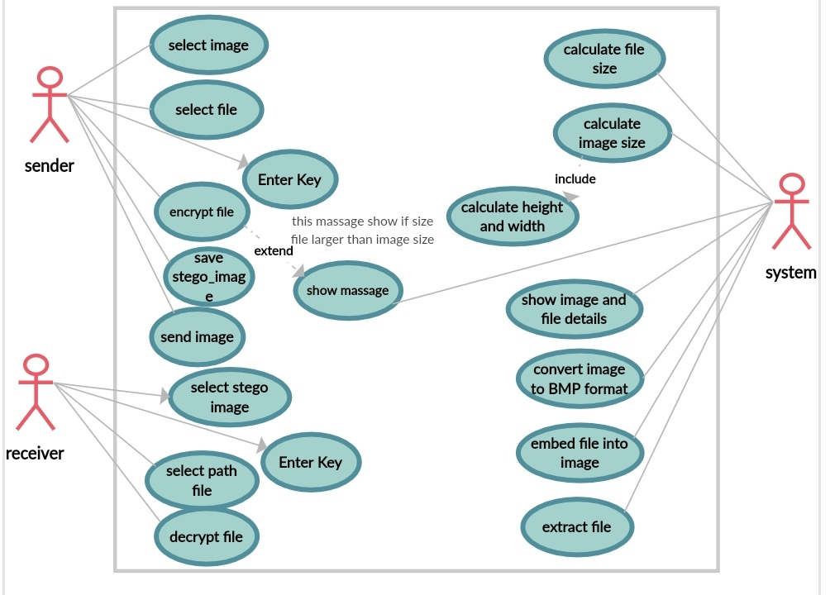
USE CASE DIAGRAM

Slide 5
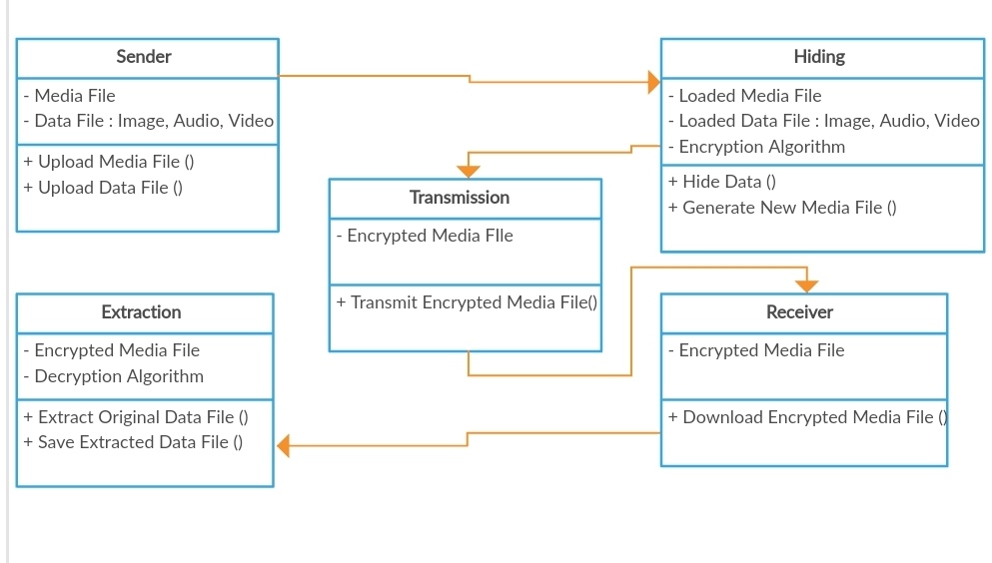
CLASS DIAGRAM

Slide 6
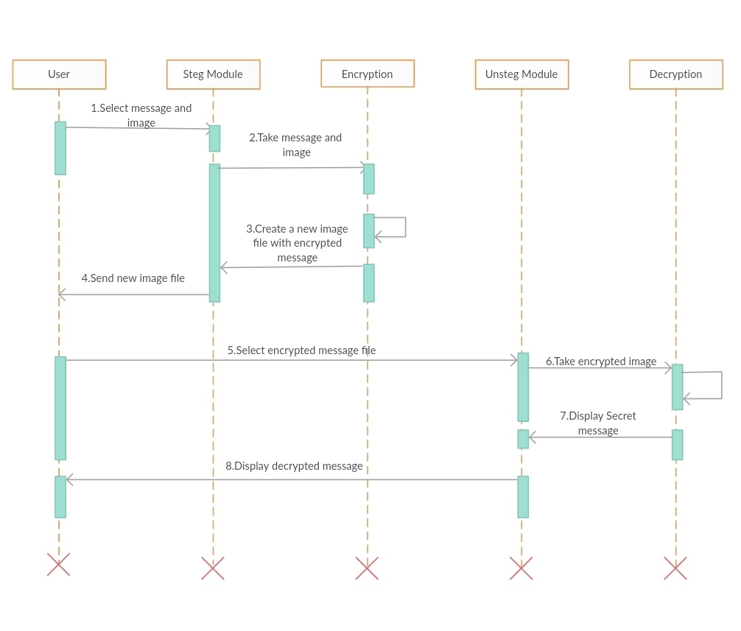
SEQUENCE DIAGRAM

Slide 7
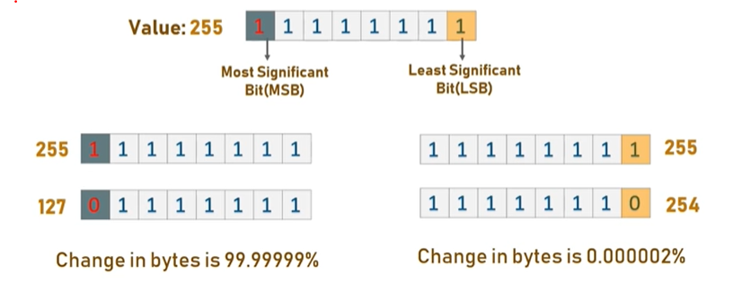
Least Significant Bit

Slide 8
LSB Mechanism
Each pixel contains three values which are Red, Green, Blue, these values range from 0 to 255, in other words, they are 8-bit values. Let’s take an example of how this technique works, suppose you want to hide the message “hi” into a 4x4 image which has the following pixel values:
[(225, 12, 99), (155, 2, 50), (99, 51, 15), (15, 55, 22),(155, 61, 87), (63, 30, 17), (1, 55, 19), (99, 81, 66),(219, 77, 91), (69, 39, 50), (18, 200, 33), (25, 54, 190)]
Using the ASCII Table, we can convert the secret message into decimal values and then into binary: 0110100 0110101.Now, we iterate over the pixel values one by one, after converting them to binary, we replace each least significant bit with that message bits sequentially (e.g 225 is 11100001, we replace the last bit, the bit in the right (1) with the first data bit (0) and so on).This will only modify the pixel values by +1 or -1 which is not noticeable at all. The resulting pixel values after performing LSBS is as shown below:
[(224, 13, 99),(154, 3, 50),(98, 50, 15),(15, 54, 23),(154, 61, 87),(63, 30, 17),(1, 55, 19),(99, 81, 66),(219, 77, 91),(69, 39, 50),(18, 200, 33),(25, 54, 190)]

Slide 9
Requirements
Hardware :
Processor: Intel core i3 or above
RAM: 4 GB
System Type: 32-bit Operating System
Software :
Programming language : Python(version above (3.0))
Libraries : PIL, Tkinter, io
Technologies : Image Processing(Spatial domain)
Operating System : Windows 7 or later / Linux

Slide 10
Existing System
Cryptography is technique of securing information and communications through use of codes so that only those person for whom the information is intended can understand it and process it.
In cryptography only secret message is hidden, but the fact that secret communication is taking place is not hidden.
So the third party can easily suspect the existence of the secret message.
In this process even the structure of the data(secret message) is altered.
It involves number theory, mathematics etc, which can be complex sometimes.

Slide 11
Proposed System
To avoid above situations we propose this model.
We propose a model that can hide the data behind the image, using which the third party can’t even suspect the existence of secret information.
For this we use the LSB(Least Significant Bit) method.
This technique works by replacing some of the information in a given pixel with information from the data in the image. While it is possible to embed data into an image on any bit-plane, LSB embedding is performed on the least significant bit(s). This minimizes the variation in colours that the embedding creates.
Thus the output image has very slight difference to the input image which is mostly not recognizable.

Slide 12
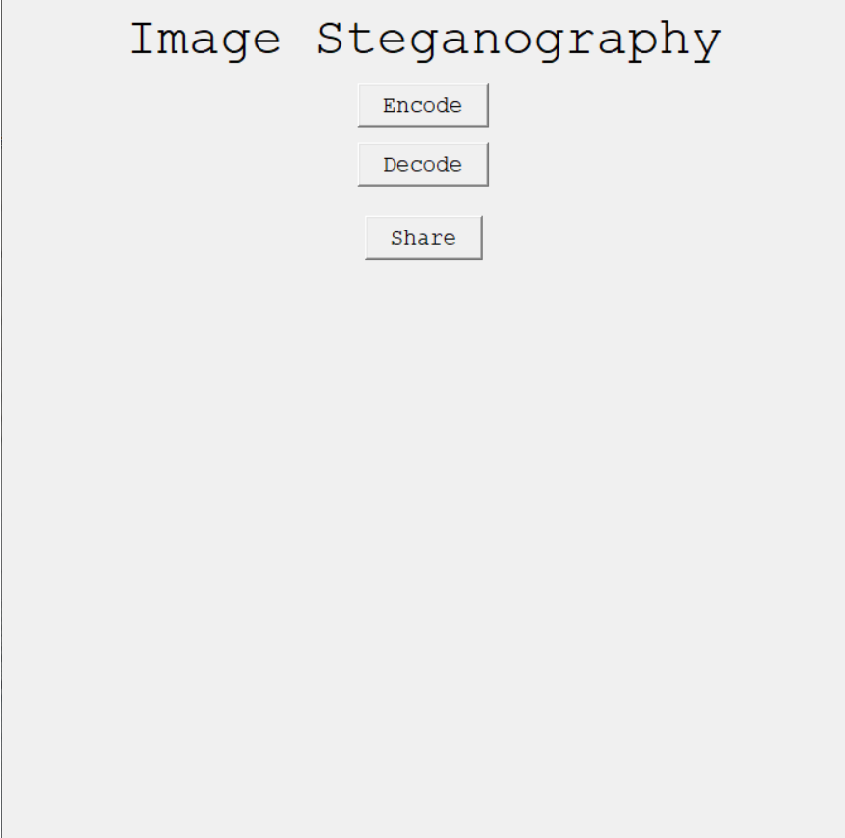
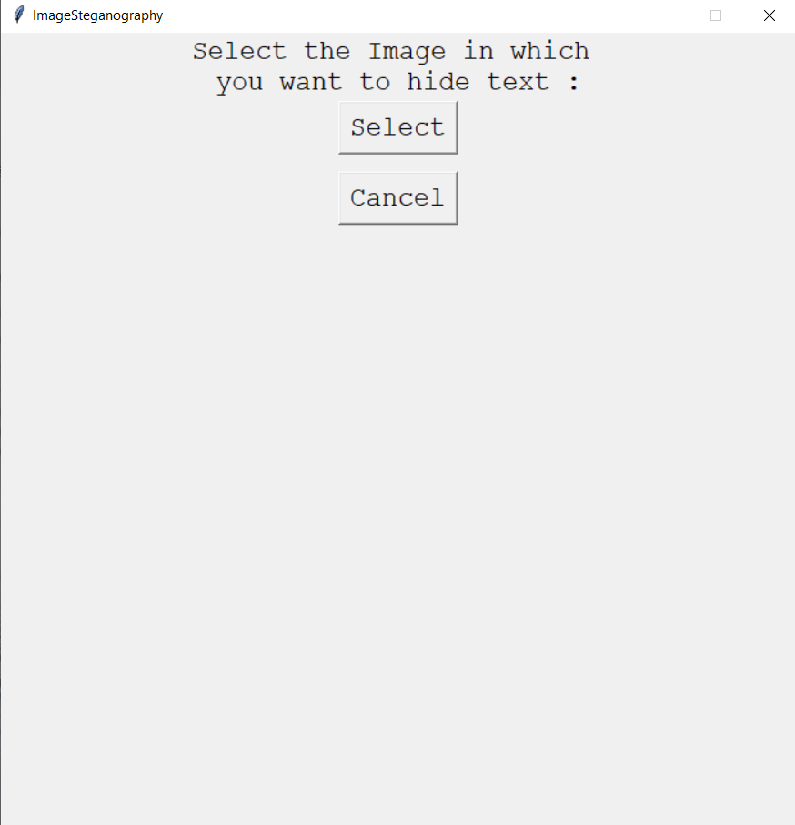
Result :

Slide 13
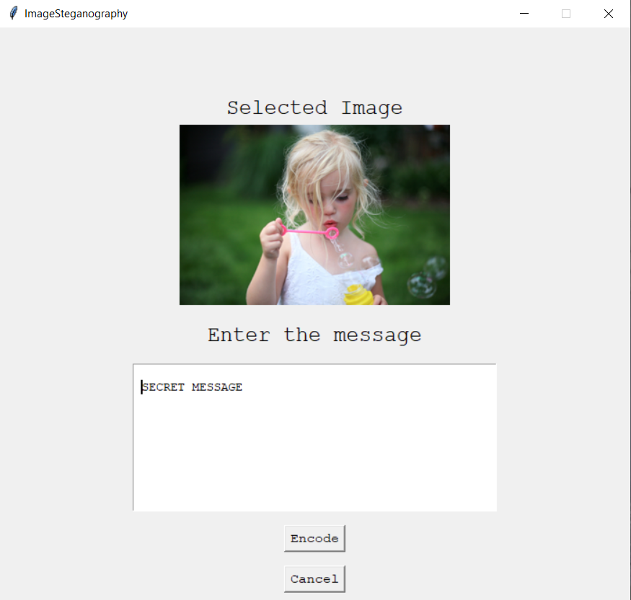
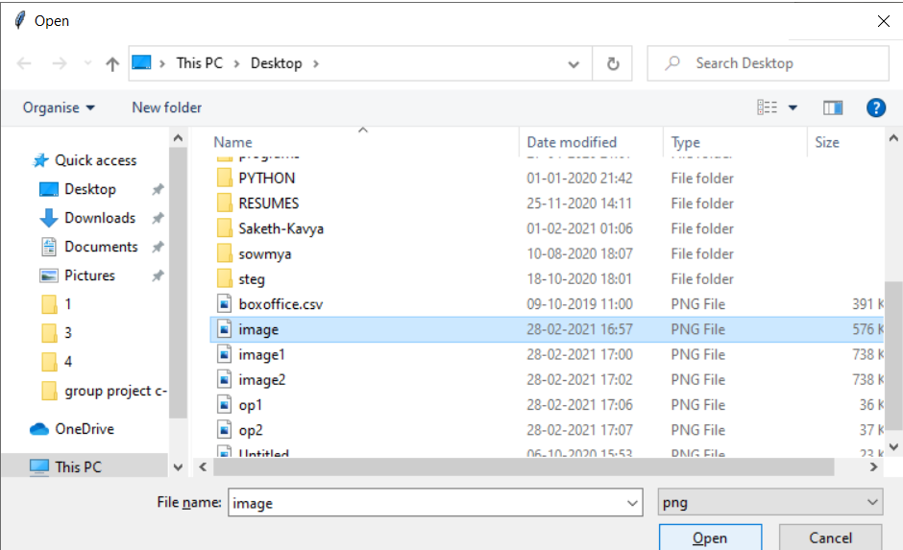

Slide 14
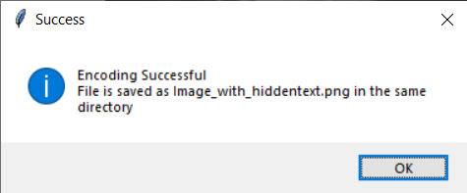
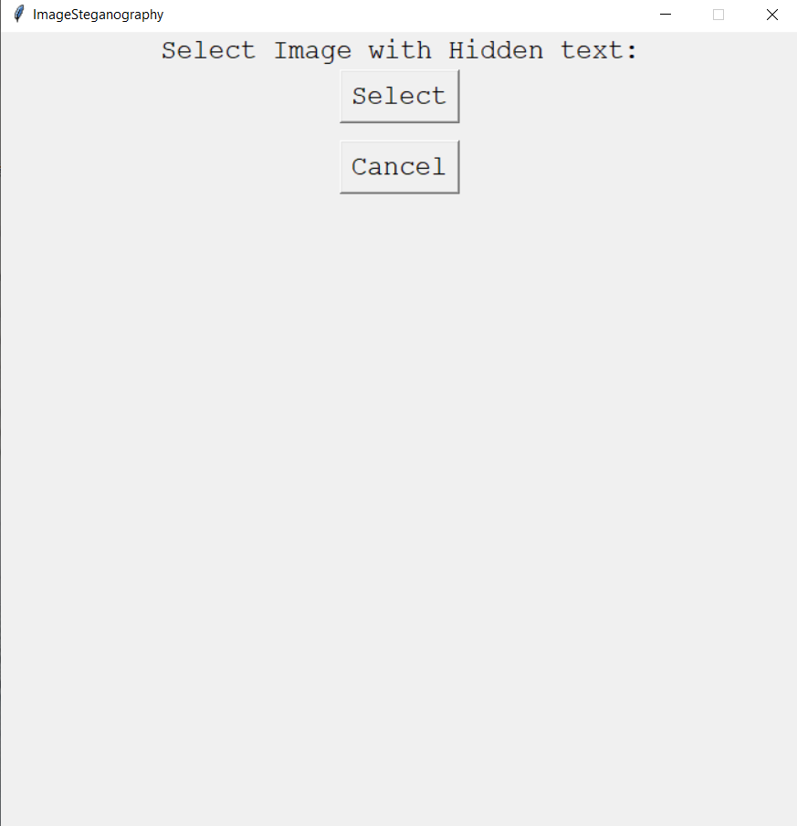

Slide 15
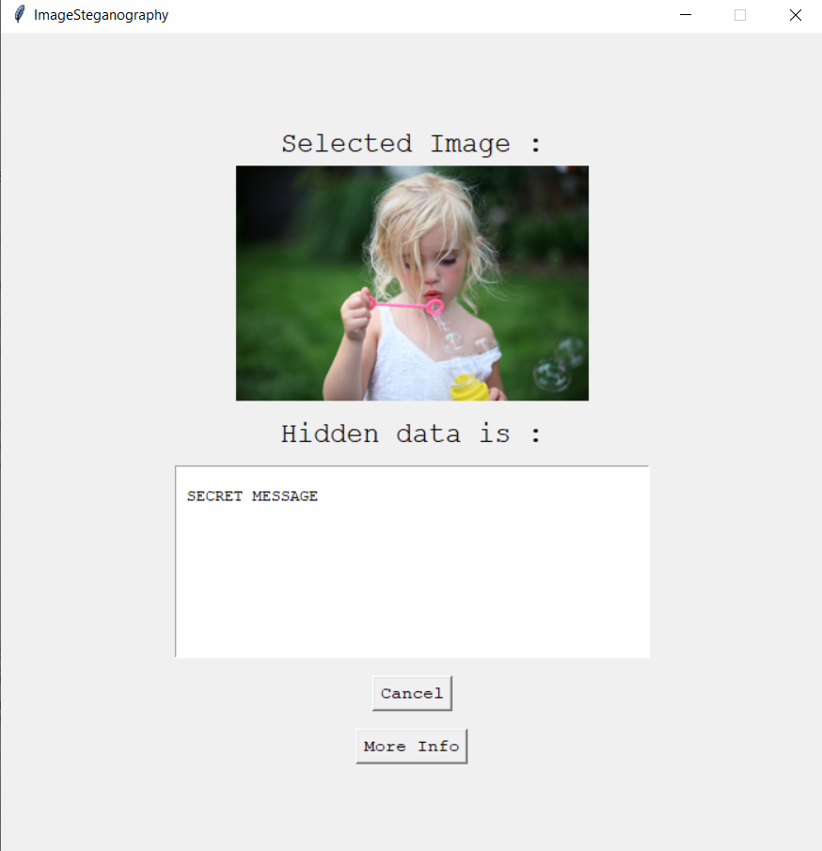
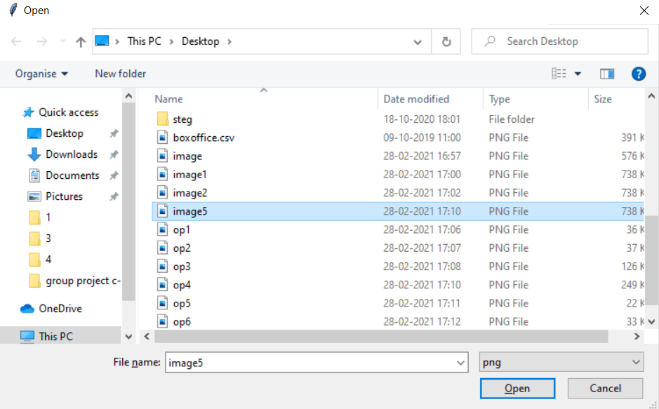

Slide 16
THANK YOU

