Slide 1

SREENIDHI INSTITUTE OF SCIENCE AND TECHNOLOGY
(AN AUTONOMOUS INSTITUTION Approved by UGC)
Yamnampet, Ghatkesar, R.R. District -501 301
DEPARTMENT OF
COMPUTER SCIENCE AND ENGINEERING
Project-2 Implementation Presentation
On
A TIME-SERIES PREDICTION MODEL USING LONG-SHORT TERM MEMORY NETWORKS FOR PREDICTION OF COVID – 19 DATA
Batch No: C16
Baddam HimaBindu (17311A05D2)
Cheedu Sowmya (17311A05D4)
Mannem Nagalaxmi (17311A05F1)
Internal Guide Project Coordinator Head of the Department
Ms. J.Neha Mrs. Preethi Jeevan Dr. Aruna Varanasi

Slide 2
ABSTRACT
The recent outbreak of Coronavirus disease 2019 (COVID-19), which gets caused by severe acute respiratory syndrome (SARS) coronavirus 2 (SARS-CoV-2), has been responsible for the deaths of over 3,00,000 people and at the same time has infected over 4.7 million people in the whole world as of mid-May, 2020. There has been more that 1.8 million recoveries during this period too. It becomes imperative for Governments to be aware of the situation and to be able to predict the future number of patients so that readiness in terms of health care and planning of other necessary actions can be maintained. Using this as a driving force, a model for prediction of the number of COVID–19 patients has been developed using the Long-Sort Term Memory (LSTM) network and then employed it for forecasting future cases. The cases India are taken into account. The study finds that the LSTM network developed in this paper performs better than other networks and thus can be a useful candidate for prediction of future number of patients of COVID–19.

Slide 3
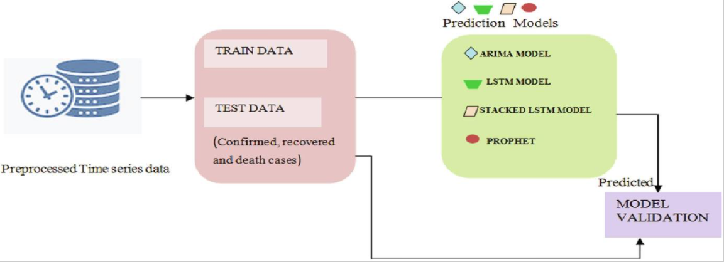
ARCHITECTURE

Slide 4
METHODOLOGIES
Data Preparation :
Before a LSTM series can be modelled, it must be prepared.
The LSTM model will learn a function that maps a sequence of past observations as input to an output observation. As such, the sequence of observations must be transformed into multiple examples from which the LSTM can learn.
Consider a given univariate sequence: [10, 20, 30, 40, 50, 60, 70, 80, 90]
We can divide the sequence into multiple input/output patterns called samples, where three time steps are used as input and one time step is used as output for the one-step prediction that is being learned.
1 2 3 4 5 | X y [10, 20, 30] 40 [20, 30, 40] 50 [30, 40, 50] 60 ...

Slide 5
LSTM Model
Long Short-Term Memory (LSTM) networks are a type of recurrent neural network capable of learning order dependence in sequence prediction problems.
The two technical problems overcome by LSTMs are vanishing gradients and exploding gradients, both related to how the network is trained.
We use networks with one input layer, one hidden layer, and one output layer… The (fully) self-connected hidden layer contains memory cells and corresponding gate units.
An LSTM layer consists of a set of recurrently connected blocks, known as memory blocks. Each one contains one or more recurrently connected memory cells and three multiplicative units – the input, output and forget gates

Slide 6
We have implemented a simple Long Short-Term Memory (LSTM) model with an input layer, a single hidden layer, and an output layer that is used to make a prediction. The input layer has some neurons equal to 5 sequence steps . The hidden layer is an LSTM layer with 10 hidden units (neurons) and a rectified linear unit (ReLU) as an activation function. The output layer had a dense layer with 1 unit for predicting the output. The testing rate is set to 0.2, and it decays every five epochs. Moreover, we have used 300 as the number of epochs, Adam as the optimizer, and the mean square error as the loss function. After that, we fit the model with prepared data to make a prediction. The obtained results may vary given the stochastic nature of the LSTM model; therefore, we have run it several times. Finally, we enter the last sequence with output to forecast the next value in the series.

Slide 7
Modules:
NumPy
NumPy is a Python library used for working with arrays. It also has functions for working in domain of linear algebra, fourier transform, and matrices.
Matplotlib
Matplotlib is an amazing visualization library in Python for 2D plots of arrays. Matplotlib is a multi-platform data visualization library built on NumPy arrays
sklearn
Scikit-learn is a free machine learning library for Python. It features various algorithms like support vector machine, random forests, and k-neighbours, and it also supports Python numerical and scientific libraries like NumPy and SciPy .
TensorFlow
TensorFlow is an open-source library developed by Google primarily for deep learning applications. It also supports traditional machine learning. TensorFlow accepts data in the form of multi-dimensional arrays of higher dimensions called tensors.

Slide 8
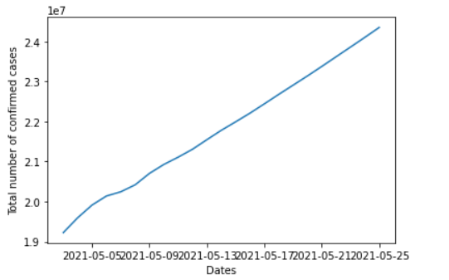
RESULTS AND DISCUSSIONS
Results:
The created series of prediction and forecasting model based on time-series data to predict the future covid cases is straightforward and easy. We calculated the future cases , accuracy rate of the model and plotted the graph for dates vs future confirmed cases as shown below.

Slide 9
Discussion
From the LSTM model, we confirm that the India would take the most extended period to recover from the virus (during 2021).As the graph is increasing exponentially indicating the second wave which involves more number of cases in 2021 this may be due to lack of social distance etc. By the first week of may the total number of covid effected people in India has crossed 2crores which indicates the high alarming situation so, the government should take particular measures like implementing lockdown in the states which have high positivity rate, bringing awareness among people, completing the vaccination and improving the healthcare system.

Slide 10
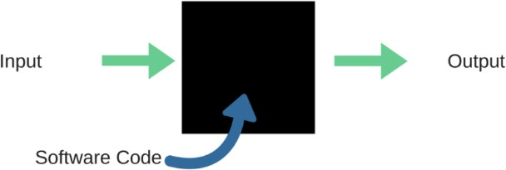
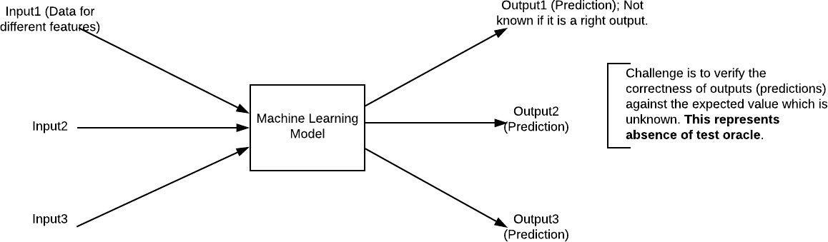
TESTING
Black Box Testing
Blackbox testing is testing the functionality of an application without knowing the details of its implementation including internal program structure, data structures etc. Test cases for black box testing are created based on the requirement specifications. Therefore, it is also called as specification-based testing. Fig represents the black box testing:

Slide 11
Testcase ID | Testcase Name | Testcase scenario | Expected | Actual | Testcase status | Remarks
01 | 01/01/2021 | Confirmed cases till the end of 2020 | 10286709 | 9829005 | pass | Gave output with only error rate of less than 5%
02 | 05/01/2021 | Confirmed cases by the 1st week of jan | 10374932 | 9905832 | pass | High accuracy
03 | 28/12/2020 | Confirmed covid cases by the last week of 2020 | 10224303 | 5895423 | fail | Less accurate

Slide 12
Testcase Id | Testcase Name | Testcase scenario | Expected | Actual | Testcase status | Remarks
04 | Graph plotting | Graph with dates vs confirmed cases | Graph showing the increase in cases | Irregular graph with no indication of increment or decrement | fail | Error in the graph plotting

Slide 13
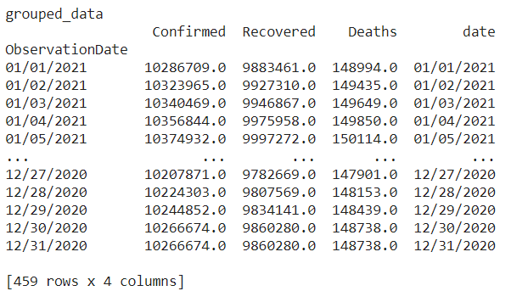
OUTPUT SCREENS

Slide 14
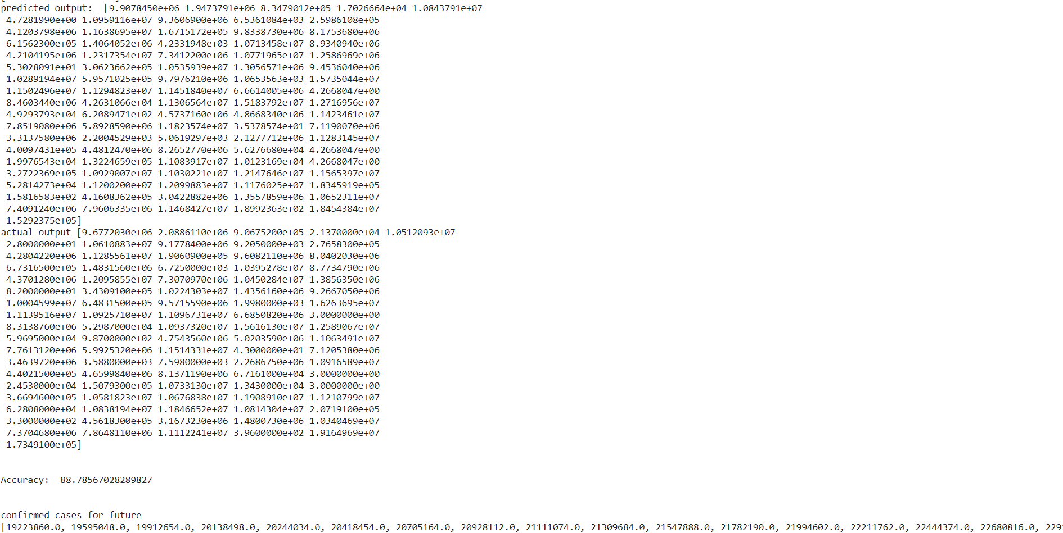

Slide 16
CONCLUSION
In this study, an LSTM network was used to study the forecasting capability using the COVID-19 dataset. The LSTM network outperformed the other competing networks by giving the high accuracy rate.
Thus, the LSTM network can be thought of being used as a good model for prediction of COVID–19 patients.

Slide 17
FUTUTRE SCOPE
Coronavirus being a contagious and infectious disease like the flu with certain growth patterns, such patterns are noted to be non-linear and dynamic in nature. Data is Dynamic in nature as the cases might differ based on the seasons, populations etc. Thus a deep learning model based on long short term memory networks can be used to predict the data accurately.
This could help in reducing the stress on health care systems and administrations by helping them plan better.
Thus LSTM model can be a useful candidate for prediction of future number of patients of COVID–19.

Slide 18
REFERENCES
World Health Organization, Coronavirus disease (COVID-19) outbreak. https://www.who.int/emergencies/diseases/novel-coronavirus-2019 (accessed on May 14, 2020).
Zhu, N.; Zhang, D.; Wang, W.; Li, X.; Yang, B.; Song, J.; Zhao, X.; Huang, B.; Shi, W.; Lu, R.; Niu, P.; Zhan, F.; Ma, X.; Wang, D.; Xu, W.; Wu, G.; Gao, G. F.; Tan, W. A novel coronavirus from patients with pneumonia in China, 2019. N. Engl. J. Med. 2020, 382, 727.
Paules, C. I.; Marston, H. D.; Fauci, A. S. Coronavirus infections—more than just the common cold, JAMA 2020, 323, 707.
Johns Hopkins University Center for Systems Science and Engineering, Coronavirus (COVID-19) Cases. https://github.com/CSSEGISandData/COVIDQ3 (accessed on April 14, 2020).
Wikipedia, 2019-20 coronavirus outbreak. https://en.wikipedia.org/wiki/2019- 20_coronavirus_outbreak (accessed on May 14, 2020).
N. C. P. E. R. E. Team. The epidemiological characteristics of an outbreak of 2019 novel coronavirus diseases (COVID-19) in China, China CDC Weekly 2020, 41, 145.
W. Jiang and H. D. Schotten, "Deep Learning for Fading Channel Prediction," in IEEE Open Journal of the Communications Society, vol. 1, pp. 320-332, 2020
Connor, J.T., Martin, R.D., Atlas, L.E., “Recurrent Neural Networks and Robust Time Series Prediction”, IEEE Transactions on Neural Networks Volume 5, Issue 2, Pages 240-254 March, 1994

Slide 19
Sepp Hochreiter and Jürgen Schmidhuber, Long Short-Term Memory, Neural Computation Volume 9 Issue 8, November 15, p.1735-1780, 1997
Sun, Q., Jankovic, M. V., Bally, L. Mougiakakou, S. G. Predicting Blood Glucose With anLSTM and Bi-LSTM Based Deep Neural Network (n.d.).
Anuradha Tomar, Neeraj Gupta, “Prediction for the spread of COVID-19 in India and effectiveness of preventive measures”, Science of the Total Environment, Vol. 728, 2020
Global research on coronavirus disease (COVID-19)
https://www.who.int/emergencies/diseases/novel-coronavirus-2019/global-research-on-novel- coronavirus-2019-ncov. (accessed on May 14, 2020)

Slide 20
THANK YOU

