Slide 1
BREAST CANCER CLASSIFICATION USING NEURAL NETWORKS

Slide 2
Group Member Information:
Aishwarya Pasumarthy - 700759282
Sowmya Doneti - 700754085
Pavan Kumar Kandukuri - 700740975
LithinChowdary Vemulapalli - 700741290

Slide 3
Role/Responsibilities and Contribution in project:
Aishwarya Pasumarthy | Collecting data from various source and formatted it to suite machine learning models, worked in developing MLP model and also worked for final IEEE paper.
Sowmya Doneti | Designed and developed the Multilayer Perceptron (MLP) model using TensorFlow and Keras and configured the layers, activation functions, and regularization techniques.
Pavan Kumar Kandukuri | Trained the MLP model on the dataset, optimized the model parameters to improve performance metrics and worked on final PPT presentation.
Lithin Chowdary Vemulapalli | Evaluated the trained MLP model using validation techniques, analyzed the model's performance and interpreted the results for insights and worked on final PPT presentation .

Slide 4
Motivation:
The research is motivated by the potential of machine learning, particularly neural networks, to achieve accurate and efficient classification of breast cancer tumors.
Early detection is crucial for improving survival rates among individuals with breast cancer.
Leveraging advanced technologies, such as machine learning, holds promise in enhancing the accuracy and efficiency of breast cancer detection.
The overarching goal is to contribute to early detection efforts, recognizing that timely intervention is a critical factor in improving outcomes for individuals diagnosed with breast cancer.

Slide 5
Objectives:
Utilization of neural networks for breast cancer classification:
Implementing a Multi-Layer Perceptron (MLP) neural network for classifying breast tumors based on various features.
Implementation of a predictive system for real-time tumor classification:
Develop a predictive system capable of classifying breast tumors as malignant or benign in real-time, providing timely and accurate diagnoses.
Assessment of model performance using accuracy and loss metrics:
Evaluate the performance of the neural network model using standard metrics such as accuracy and loss, providing insights into its effectiveness in classifying tumors.

Slide 6
Exploration of the impact of data standardization on model training:
Investigate the effect of data standardization techniques, such as normalization or scaling, on the training process and performance of the neural network model.
Evaluation of the proposed framework in comparison to existing methodologies:
Compare the performance and efficacy of the proposed neural network-based framework with existing methodologies for breast cancer classification, assessing its superiority in terms of accuracy, reliability, and efficiency.

Slide 7
Related work :
Previous research in breast cancer classification has explored various traditional and machine learning-based methods.
Statistical approaches, such as logistic regression and decision trees, have been utilized for tumor classification with moderate success.
These methods rely on manual feature selection and often struggle with high-dimensional data.More recent studies have focused on machine learning techniques, including support vector machines (SVMs), random forests, and k-nearest neighbors (k-NN).
These methods offer improvements over traditional approaches but may still face challenges in accurately distinguishing between benign and malignant tumors.
Neural networks, particularly deep learning models(MLP), have demonstrated promise in breast cancer classification.

Slide 8
Problem Statement :
Breast cancer, a global health challenge, demands early detection for effective treatment. Current classification methods lack precision, especially in recognizing subtle tumor variations.
To overcome this, the challenge is to create a robust neural network-based system.
Neural networks offer nuanced pattern recognition, vital for distinguishing between benign and malignant tumors based on various features.
Minimize misdiagnosis and improve accuracy in tumor classification.

Slide 9
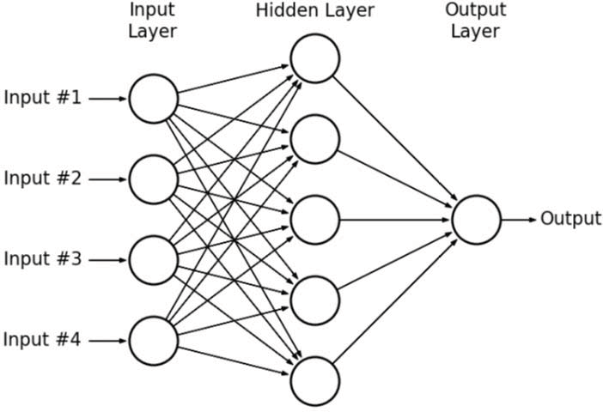
Proposed Solution:
Algorithm Used: Multi-Layer Perceptron (MLP)
Multi-Layer Perceptron (MLP) neural network architecture consists of multiple layers of interconnected neurons, including an input layer, one or more hidden layers, and an output layer.
MLPs excel at pattern recognition tasks, making them well-suited for complex classification problems like breast cancer diagnosis.
Through forward propagation and backpropagation algorithms, MLPs learn to identify intricate patterns in the input data, enabling accurate classification of tumors as benign or malignant.

Slide 10
Proposed Solution:
Data Collection and Processing:
Load the Breast Cancer dataset into a Pandas DataFrame.
Handle missing values by dropping columns with all missing values.
Data Preprocessing:
Encode the target variable 'diagnosis' to numerical labels using LabelEncoder.
Scale the features using MinMaxScaler to bring them into a similar range.
Neural Network Model Setup:
Design a Multi-Layer Perceptron (MLP) model architecture using TensorFlow and Keras.
Configure the model with input, hidden, and output layers, including L2 regularization and dropout layers.
Model Training:
Split the dataset into training and testing sets using train_test_split.
Train the model on the training data, specifying epochs, batch size, and validation data.
Model Evaluation:
Predict test set results and evaluate model performance using confusion matrix visualization.
Implement a function to make predictions for new patient details and determine the predicted diagnosis.

Slide 11
Results/Simulations:
The research demonstrates the successful application of neural networks for breast cancer classification, showcasing the potential of advanced machine learning techniques.
The proposed framework, encompassing data preprocessing, model training, and the implementation of a predictive system, yields promising results in breast cancer classification.
This study contributes to ongoing efforts to improve breast cancer diagnosis by leveraging advanced machine learning, addressing the need for more sophisticated and accurate classification methods.

Slide 12
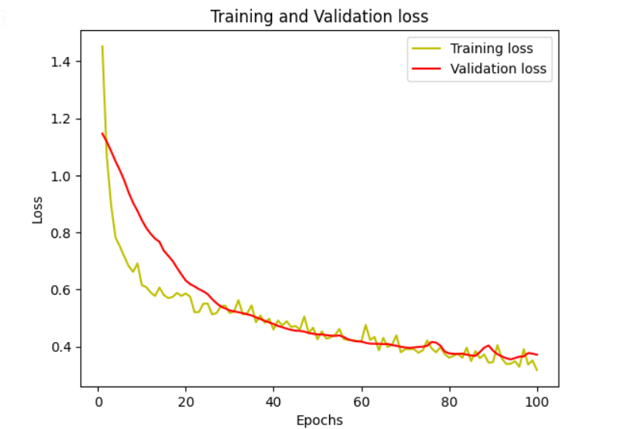
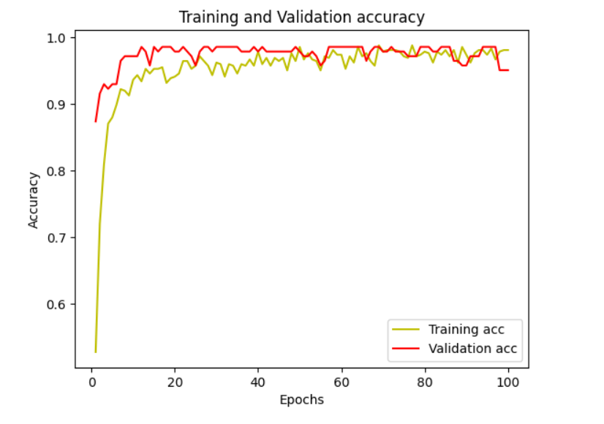
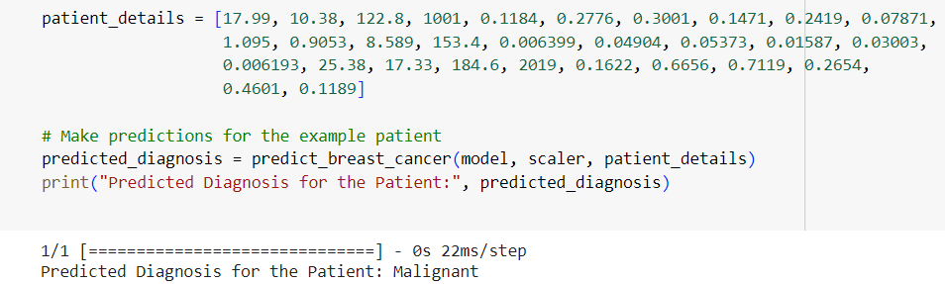

Slide 13
References:
[1] Ponraj.N,Jenifer.E,Poongodi,P,Manoharan.S. (2012). "Morphological operations for the mammogram image to increase the contrast for the efficient detection of breast cancer",European Journal of Scientific Reasrch, (ISSN) 1450-216X (68) NO.4(2012).PP.494-505.
[2] Mohd Anisur Rahman Forazy, “Incidence of breast cancer in Bangladesh”,Health Care: Current Reviews, 2015.
[3] Tüba KIYAN and Tülay Yildirim, “Breast Cancer Diagnosis Using Statistical Neural Networks,” Journal Of Electrical & Electronics Engineering., vol. 4, 2004, pp. 1149-1153.
[4] R. El hamdi, M. Njah and M. Chtourou, “Breast Cancer Diagnosis Using a Hybrid Evolutionary Neural Network Classifier,” (IEEE)., Vol. 3, No. 7, 2014.
[5] Moi Hoon Yap, Member, Gerard Pons, Joan Mart´ı, Sergi Ganau, Melcior Sent´ıs, Reyer Zwiggelaar, Adrian K. Davison., “Automated Breast Ultrasound Lesions Detection using Convolutional Neural Networks.,”, JOURNAL OF L ATEX CLASS FILES, VOL. XX, NO. X, XXXX 2016.

Slide 14
References
[6] Seral Sahana, Kemal Polata, Halife Kodazb, Salih Güne, “A new hybrid method based on fuzzy-artificial immune system and KNN algorithm for breast cancer diagnosis,” Computers in Biology and Medicine., Vol. 37, 2007.
[7] R. R. Janghel, Anupam Shukla, Ritu Tiwari and Rahul Kala, “Breast Cancer Diagnosis using Artificial Neural Network Models,” 3rd International Conference on Information Sciences and Interaction Sciences (ICIS), Chengdu, China, pp. 89-94, 23-25 Jun. 2010.
[8] Punam S. Pawar and Dharmaraj R. Patil., “Breast Cancer Detection Using Neural Network Models.”,2013 International Conference on Communication Systems and Network Technologiesvol, 978-0-7695-4958-3/13, 2013.
[9] Haowen You and George Rumbe, “Comparative Study of Classification Techniques on Breast Cancer FNA Biopsy Data,” International Journal of Artificial Intelligence and Interactive Multimedia., vol. 1, No. 3, 2004.
[10] A. A. Kalteh, Payam Zarbakhsh1, Meysam Jirabadi2, Jalil Addeh3, “A research about breast cancer detection using different neural networks and K-MICA algorithm,” Journal of Cancer Research and Therapeutics., vol. 9, issue. 3, 2013.

Slide 15
THANK YOU

