Slide 1

Operational Efficiency and Cost Reduction in Supply Chain Management
By
Sowmya Sree Kapula
05/24/2026

Slide 2
Problem
High operational costs impact profitability
Inefficiencies in supply chain processes
Need to identify key cost drivers
Goal: Improve efficiency and reduce costs

Slide 3
Data Overview
Supply Chain Analysis Dataset (Kaggle)
Includes product, cost, and logistics data
Key features:
Shipping costs
Manufacturing costs
Transportation modes
Product types

Slide 4
Methodology
Data preprocessing:
One hot encoding
Feature scaling
Train test split
Built regression models:
Linear Regression
Decision Tree
Random Forest

Slide 5
Models Evaluated
Linear Regression (baseline)
Decision Tree (nonlinear model)
Random Forest (ensemble model)
Hyperparameter tuning applied

Slide 6
Model Results
Random Forest performed best
MAE: 274.84
RMSE: 311.58
R²: -0.49
Model captures some patterns but needs improvement

Slide 7
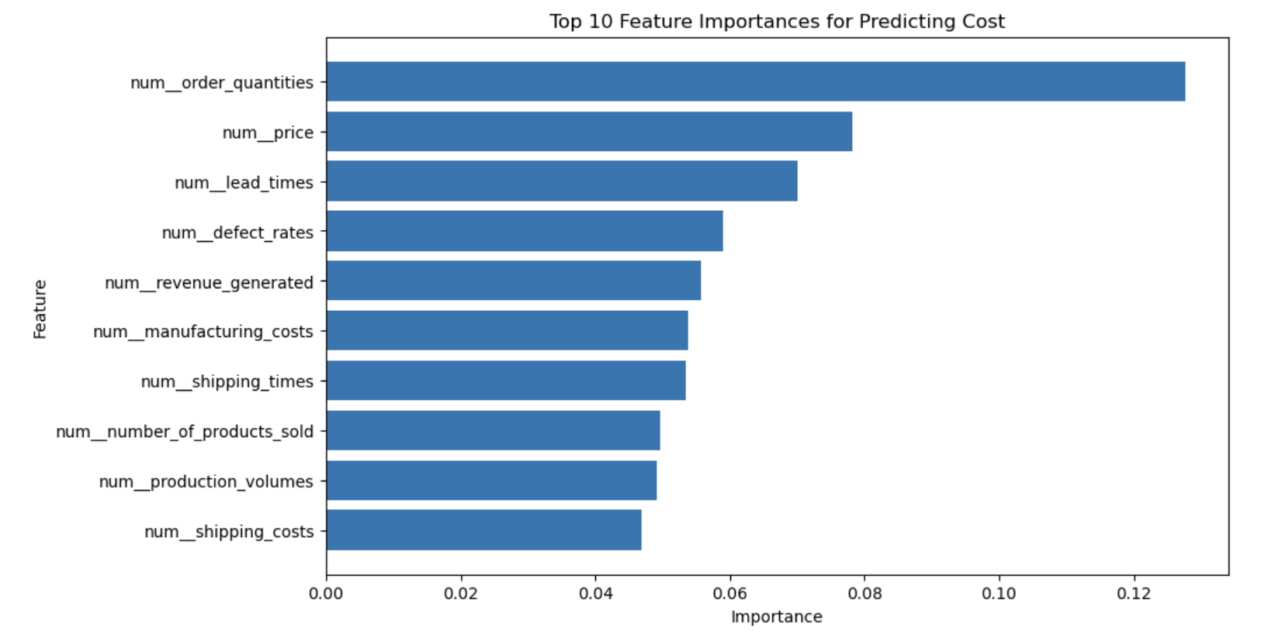
Key Visual Insights
Feature Importance
Order quantities and price are major cost drivers
Lead time also impacts cost
Indicates importance of operational volume and timing

Slide 8
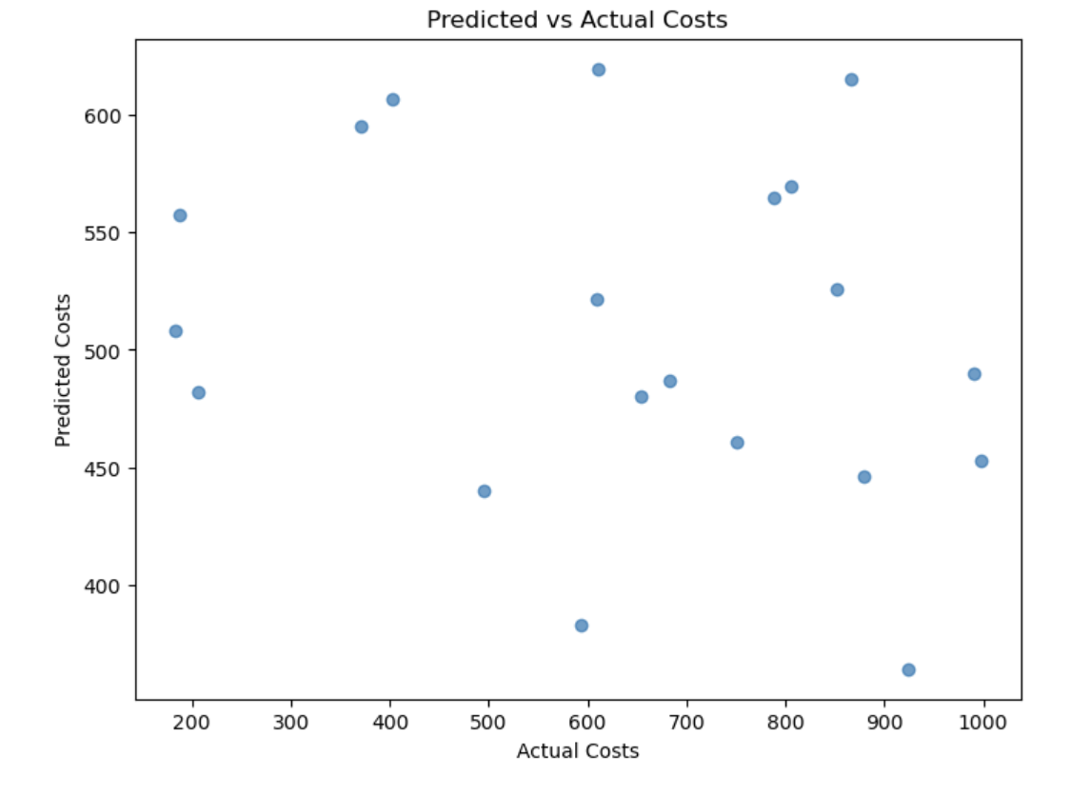
Model Performance
Predicted vs Actual
Shows the relationship between predicted and actual costs
Model captures trends but has prediction errors
Indicates room for improvement

Slide 9
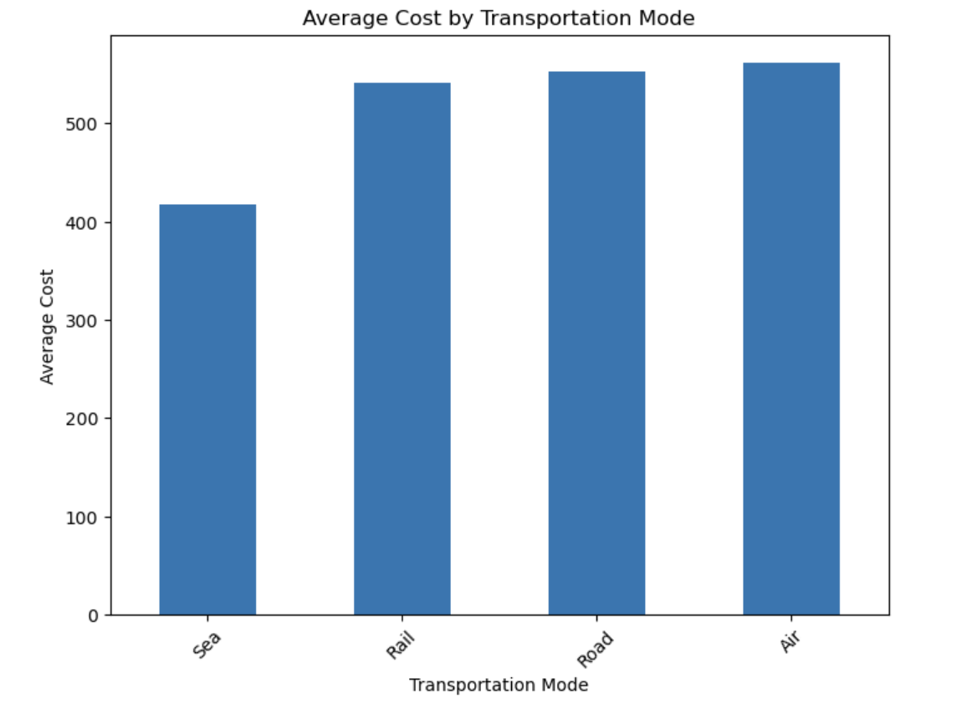
Cost by Category
Cost by Category
Cost varies across transportation modes
Some modes are more expensive
Opportunity to optimize logistics decisions

Slide 10
Recommendations
Optimize transportation strategies
Reduce variability in shipping costs
Improve supplier and production efficiency

Slide 11
Business Impact
Reduces operational costs
Improves decision making
Enables data-driven planning

Slide 12
Conclusion
Random Forest identified key cost drivers
Insights support cost reduction strategies
Data-driven decisions can improve efficiency

Slide 13
Questions ?

