Slide 1

Research Question – Tutorial Presentation for Feedback Date: 17th November 2024
Names of Student Attendees:
Sowmya Kondam
Student Name 2
Student Name 3
Student Name 4
Student Name 5
Group Name: Name of Student Presenting: Sowmya Kondam

Slide 2
Team Research Project - Amazon Sales Dataset
Analyzing Consumer Reviews and Pricing Trends on Amazon

Slide 3
Dataset Overview
Dataset Source: Provided from Kaggle.com.
Dataset Name: Amazon Sales Dataset
Dataset Code: DS128
Introduction of dataset:
The Amazon Sales Dataset provides detailed information about products on Amazon, including product details such as name, category, and description. It also contains pricing information, including original price, discounted price, and discount percentage, making it useful for analyzing pricing strategies. Customer feedback is captured through ratings, number of reviews, and detailed review content. Additionally, the dataset includes links to product images and pages, offering further context. This dataset is ideal for exploring customer behavior, product performance, and e-commerce trends.

Slide 4
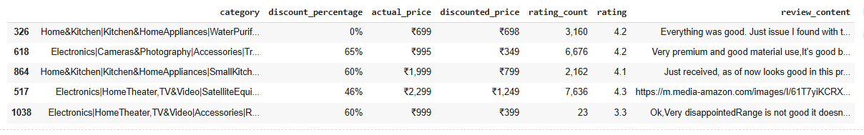
Dataset Information
Variables:
Independent Variables: category, discount _percentage, actual _price, discounted _price, rating _count
Dependent Variable: rating, review content.
Dataset Size: Total Rows: 1465
Data Snapshot:

Slide 5
Research Objective & Question
Objectives:
Analyze the impact of product pricing and discount percentages on customer ratings.
Examine the relationship between product categories and customer satisfaction.
Explore the role of review content and rating count in influencing product performance on Amazon.
Research Question:
How do pricing strategies, discount percentages, and product categories influence customer ratings and reviews on Amazon?

Slide 6
Hypothesis for Amazon Sales Dataset
Null Hypothesis (H₀):
There is no significant relationship between product attributes (Discount Percentage, Product Category, Actual Price, Rating Count) and customer satisfaction (Customer Rating and Customer Review Sentiment).
Alternative Hypothesis (H₁):
There is a significant relationship between product attributes and customer satisfaction.

Slide 7
Statistical Testing Approach for Amazon Sales Dataset
Correlation Analysis:
To assess the strength and direction of the relationship between product attributes and customer satisfaction.
P-value:
Used to determine whether to reject or fail to reject the null hypothesis (α = 0.05).

Slide 8
Expected Outcome
Based on p-values, we will either accept or reject the null hypothesis, providing insights into how product attributes impact customer satisfaction.

Slide 9
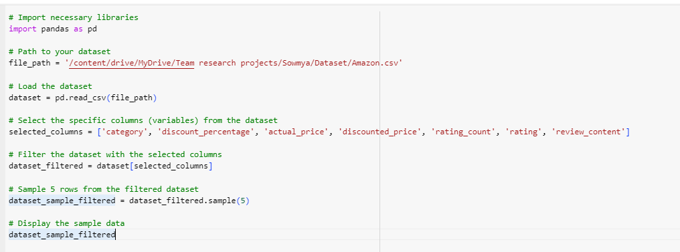
Python Code

Slide 10
Thanking You

