Slide 1


Body Signals of Smoking
Sowmya Maddali
Sunisha Harish

Slide 2
Overview
Introduction
Data Overview
Data Preprocessing
Model Building
Model Evaluation
Conclusion
References

Slide 3
Introduction
Smoking is a major public health concern worldwide, with more than 1 billion people estimated to be regular smokers. It is a major contributor to avoidable deaths and is linked to several health issues, such as lung cancer, heart disease, stroke, and respiratory illnesses. Therefore, understanding the physical and psychological effects of smoking on the body is important for developing effective interventions to help people quit smoking.
Researchers have conducted studies on the consequences of smoking on the human body to better understand the physical signals connected with smoking. The signals that have been examined in these investigations include, among others, respiratory function, cardiovascular health, and cognitive performance.
The Body Signal of smoking dataset is a collection of basic health biological signal data that can help find smokers by the vital signs. It can be used to train machine learning models that can predict the presence or absence of smoking. These models can help develop more effective interventions to help people quit smoking and improve their health.

Slide 4
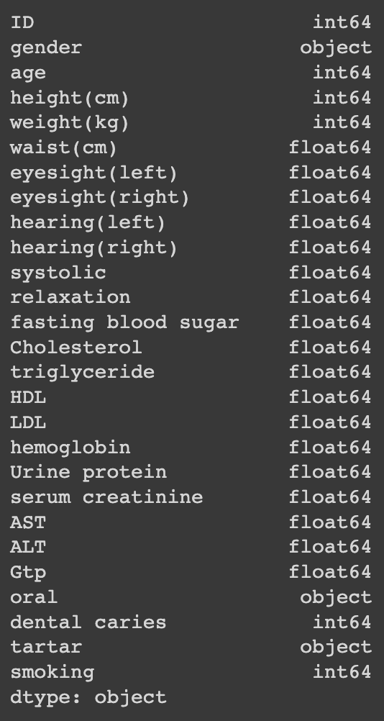
Data Overview
The Body Signal of Smoking dataset was obtained from Kaggle and contains more than 50000+ rows.
The dataset was sourced from the official e-Government website of Republic of Korea. [Link]
The data was later processed and filtered.
The dataset contains a total of 26 features out of which 23 variables are numerical and the rest are categorical.
The target variable is binary and indicates whether the person is a smoker or not.

Slide 5
Data Preprocessing
Splitting the data
The train dataset is further split into training data (80%) and validation data (20%).
Handling uncommon features
In this step, we identify what are the common features between train, validation and test data. The features that are not common between these 3 datasets are removed to reduce the model complexity.
Handling identifiers
The next step is finding out the identifiers in our dataset. Columns such as 'id' which are unique do not provide any meaningful information for predicting our target variable. Hence, we removed the identifiers from our dataset.

Slide 6
Data Preprocessing
Handling missing data
We first identified the missing values proportion for each variable. Then, we imputed those values with statistical measures such as mean, median and mode to avoid bias and improve the model performance.
Encoding categorical features
In this step, we first identified the number of unique categories for each variable. Since the number was less, we did not remove any categorical features. Next, we one hot encoded these variables as machine learning models require numeric input and increasing the dimensionality improves model performance.
Splitting the feature and target
Here, we split the feature variables and the target variable in our data.
Scaling the data
In the last step, we scaled the data so that it can handle different scales and reduce outliers impact.

Slide 7
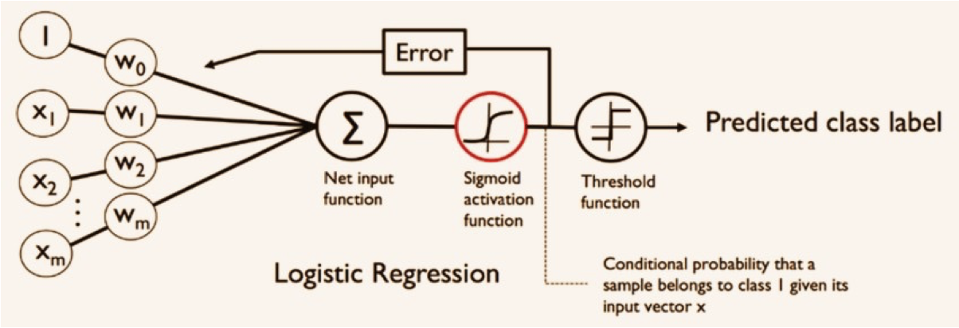
Model Building
Logistic Regression
Logistic regression is a statistical method for analyzing a dataset in which there are one or more independent variables that determine an outcome. The outcome is measured with a dichotomous variable.
The algorithm for logistic regression involves estimating the coefficients of a linear equation, which relates the independent variables to the probability of the outcome. The coefficients are estimated using a maximum likelihood estimation method, which seeks to maximize the likelihood of the observed data given the estimated coefficients.
Once the coefficients are estimated, they can be used to make predictions on new data by applying the logistic function to the linear equation. The logistic function transforms the linear equation into a probability value between 0 and 1, which represents the probability of the outcome for a given set of input variables.

Slide 8
Model Building
Histogram-Based Gradient Boosting
In Histogram Gradient Boosting, the key innovation is the use of histogram-based decision trees instead of traditional binary decision trees. A histogram-based decision tree partitions the feature space into bins based on the distribution of the feature values. This is in contrast to traditional binary decision trees which use a single threshold to split the data.
The advantage of using histogram-based decision trees is that they can be constructed much faster than binary decision trees, since they require only a single pass over the data to build the histograms. This makes Histogram Gradient Boosting a much faster algorithm than other gradient boosting algorithms.
In Histogram Gradient Boosting, each iteration of the algorithm involves fitting a new histogram-based decision tree to the negative gradient of the loss function with respect to the current predictions. The negative gradient is essentially the error that the current model is making, and the new tree is designed to correct for that error.
The final prediction is obtained by summing the predictions of all the trees in the ensemble. The weights of each tree in the ensemble are determined by the gradient of the loss function with respect to the predicted values.

Slide 9
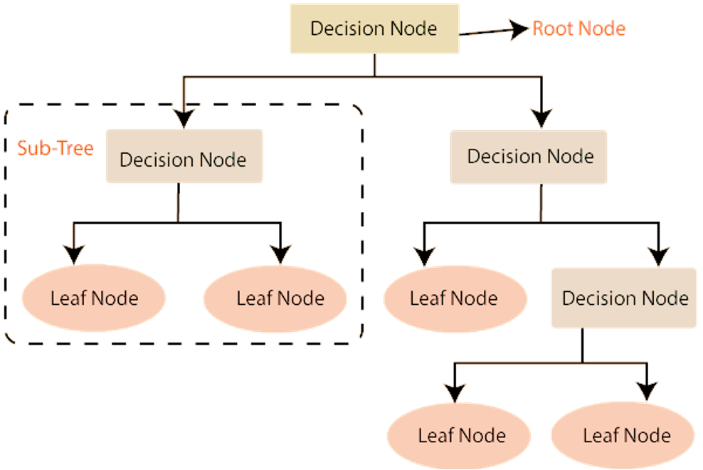
Model Building
Decision Tree Classifier
Decision trees are a type of supervised learning algorithm that can be used for both classification and regression tasks.
The algorithm builds a tree-like model of decisions and their possible consequences. Each node in the tree represents a decision or test on a feature, while the branches represent the possible outcomes of the decision.
The algorithm recursively splits the data into subsets based on the values of the features, until the subsets are homogeneous, or the maximum depth of the tree is reached.

Slide 10
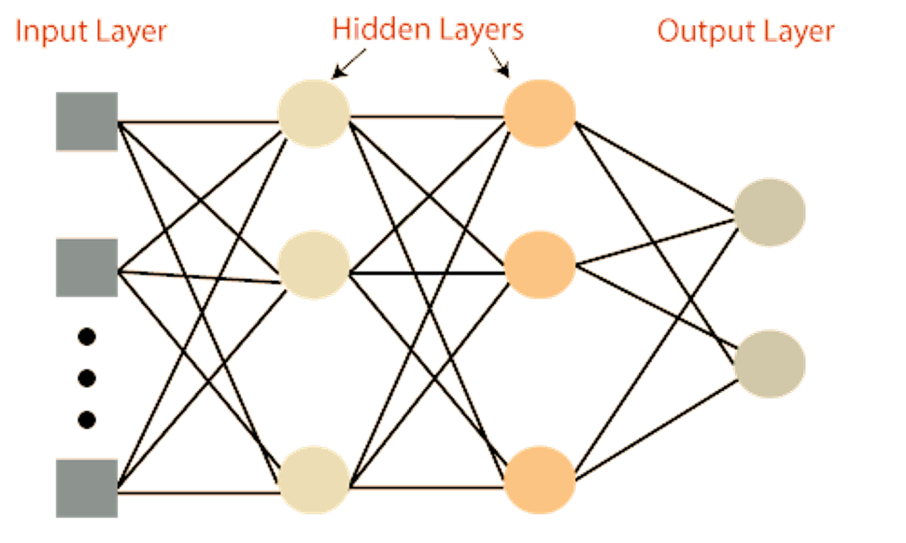
Model Building
Multi-Layer Perceptron Classifier
The MLP Classifier is a type of artificial neural network that is widely used for classification tasks. It consists of multiple layers of interconnected nodes or neurons, where each neuron receives input from the previous layer and computes an output that is passed on to the next layer.
The first layer of the MLP Classifier is the input layer, which takes the input data and passes it on to the next layer. The next layers are called hidden layers, and they perform intermediate computations on the input data. The final layer is the output layer, which produces the classification output.
During training, the MLP Classifier adjusts the weights and biases of the neurons to minimize the difference between the predicted output and the actual output. This process is known as backpropagation, and it is used to update the weights and biases of the neurons in the network.
The MLP Classifier can be used for both binary and multi-class classification problems. For binary classification, the output layer typically consists of a single neuron with a sigmoid activation function, which produces a probability value between 0 and 1.

Slide 11
F1 Macro score
Model | Best Score
Decision Tree Classifier | 0.805344
Histogram-Based Gradient Boosting | 0.760279
MLP Classifier | 0.751127
Logistic Regression | 0.716431

Slide 12
Conclusion
Based on the results obtained above, we can conclude that the Decision Tree Classifier is the best model in identifying the presence or absence of smoking.​
It has performed better compared to other models such as Logistic Regression, MLP Classifier and Histogram-based Gradient Boosting.

Slide 13
References
Arnaud Chiolero, David Faeh, Fred Paccaud, Jacques Cornuz (April 2008). Consequences of smoking for body weight, body fat distribution, and insulin resistance. Retrived from https://academic.oup.com/ajcn/article/87/4/801/4633357
IfeanyiChukwu O. Onor, Daniel L. Stirling, Shandrika R. Williams, Daniel Bediako, Amne Borghol, Martha B. Harris, Tiernisha B. Darensburg, Sharde D. Clay, Samuel C. Okpechi,and Daniel F. Sarpong, (Sept 2017). Clinical Effects of Cigarette Smoking: Epidemiologic Impact and Review of Pharmacotherapy Options. Retrived from https://www.ncbi.nlm.nih.gov/pmc/articles/PMC5664648/
GeÌ ron, A. (2019). Hands-on machine learning with Scikit-Learn, Keras and TensorFlow: concepts, tools, and techniques to build intelligent systems (2nd ed.). O’Reilly.

Slide 14
Video Recording Link
Body Signals of Smoking - Video Recording

Slide 15
Thank You

