Slide 1
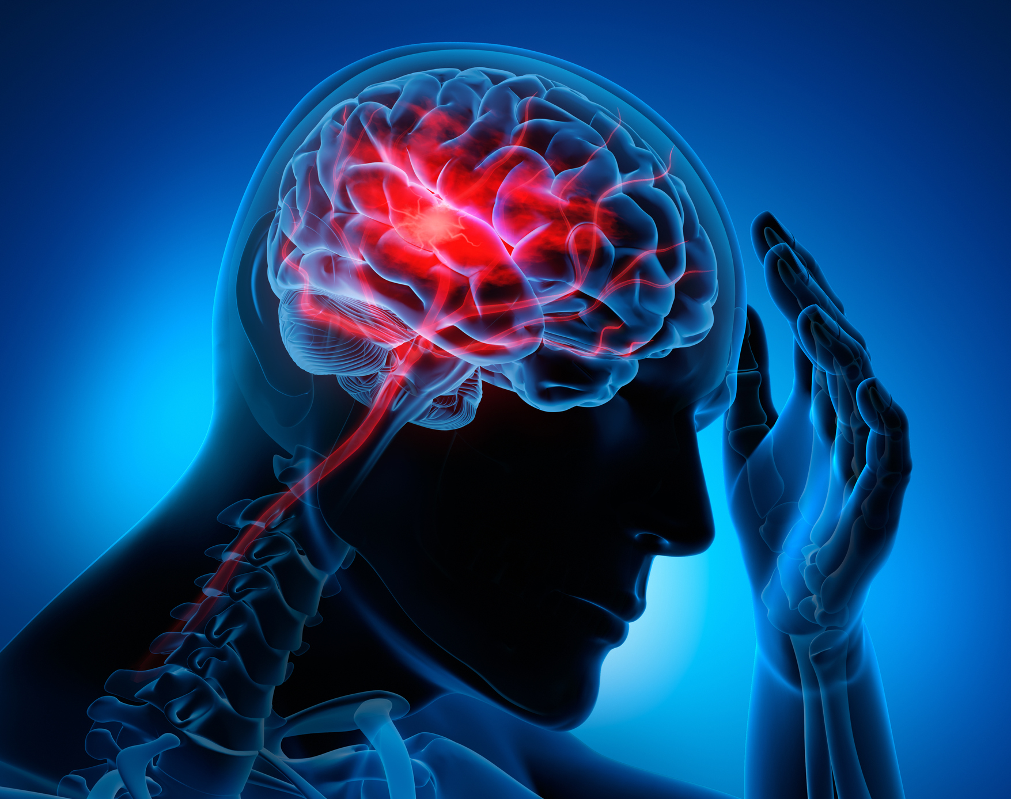
Team Sage Brain Stroke Prediction
Jerrick Gerald
Renganathan Laxmanan
Sai Dontukurti
Sowmya Maddali

Slide 2
Why brain stroke?
In the US, stroke is one of the main causes of mortality and disability. A stroke may happen to anybody, regardless of age or background.
Approximately 795,000 individuals in the US suffer strokes each year, and 137,000 of them face death, according to the National Institutes of Health (NIH), US Department of Health and Human Services.
According to the World Health Organization (WHO) stroke is the 2nd leading cause of death globally, responsible for approximately 11% of total deaths.
Ref: Eunice Kennedy Shriver National Institute of Child Health and Human Development

Slide 3
About the dataset
The dataset has been taken from Kaggle under the name Stroke Prediction dataset
It is used to predict whether a patient is likely to get a stroke based on the input parameters like gender, age, BMI, hypertension, average glucose level, marital status, work type, residence type, various diseases, and smoking status.
Each row in the dataset provides relevant information about the patient.
Gender | Age | Heart_disease | BMI | Hypertension
Avg Glucose Level | Ever_married | Work_Type | Residence_Type | Stroke - Target

Slide 4
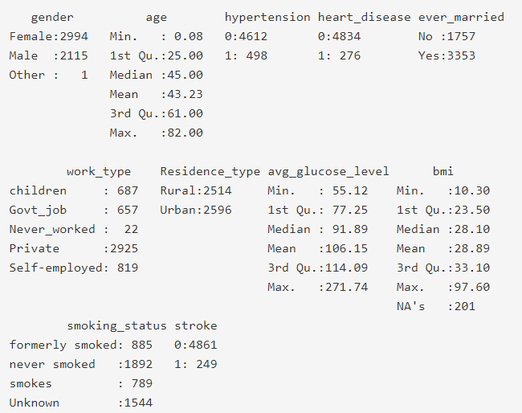
Summary of the dataset

Slide 5
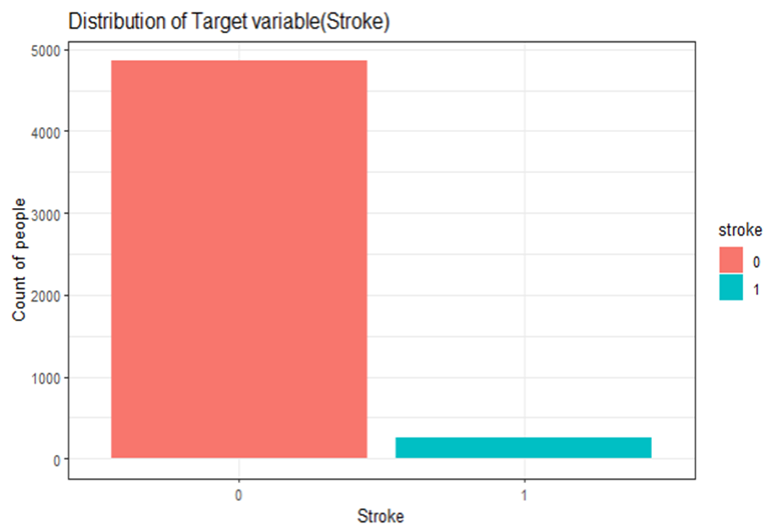
Distribution of the target variable

Slide 6
Data Pre-Processing
Converting the columns into their respective data types.
NA removal from BMI.
Subsetting of dataset purely for Data Analysis.

Slide 7
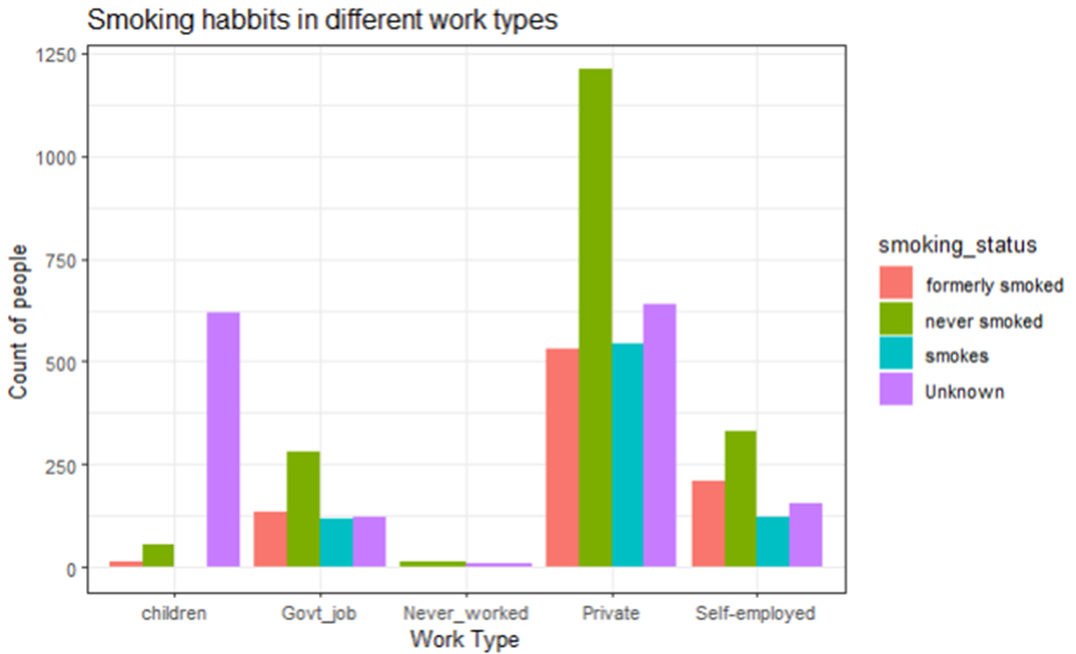
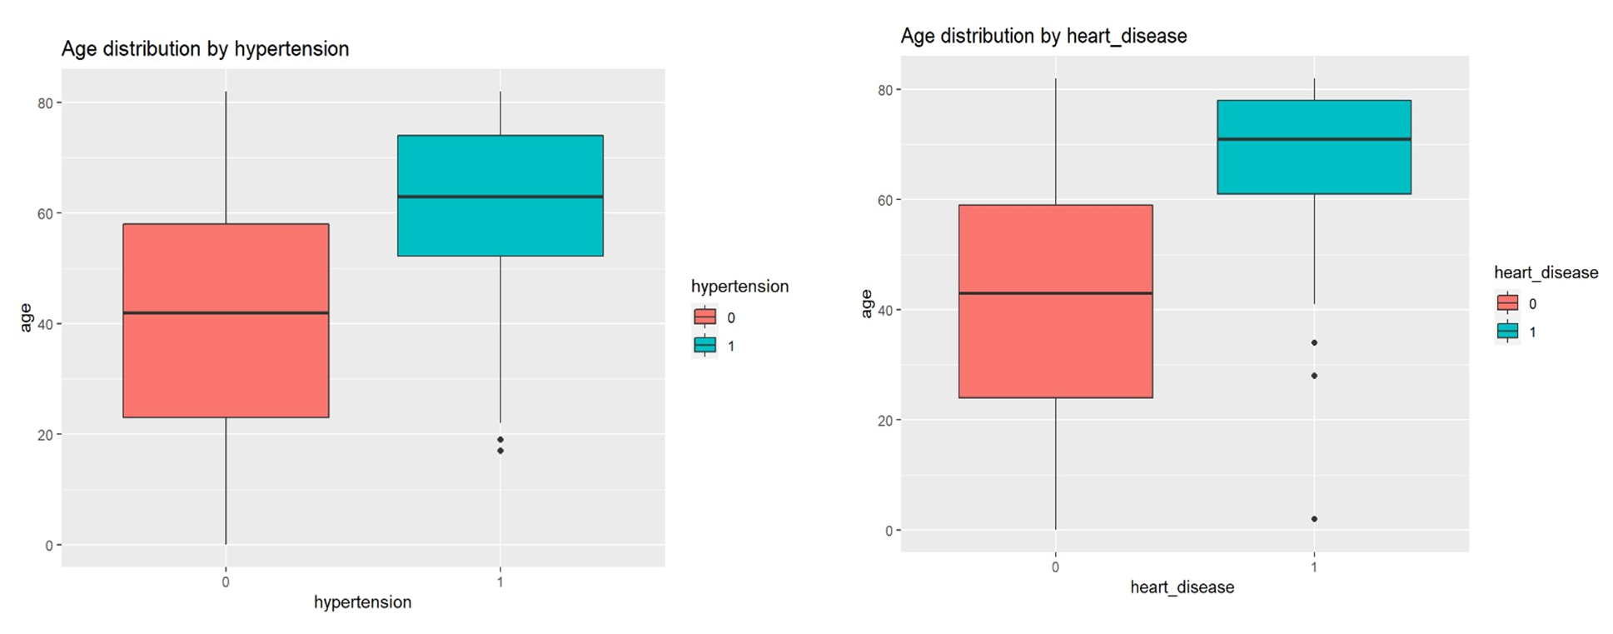
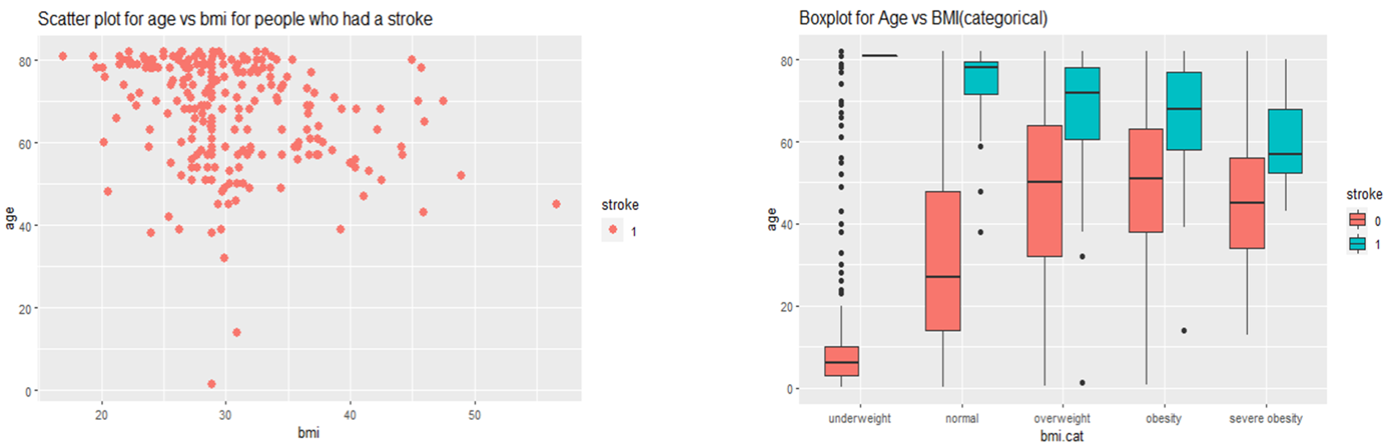
Basic EDA

Slide 8
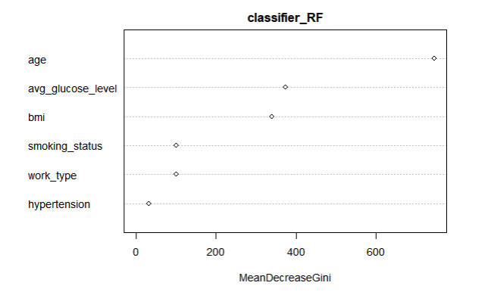
Feature Selection
Random Forest Feature Importance Plot

Slide 9
SMART: How to address the data imbalance issue in the dataset?
Data distribution is 96% of no stroke and 4% of stroke.
Balancing Techniques:
ROSE – Random Over Sampling Examples
BOTH – Under and Over Sampling

Slide 10
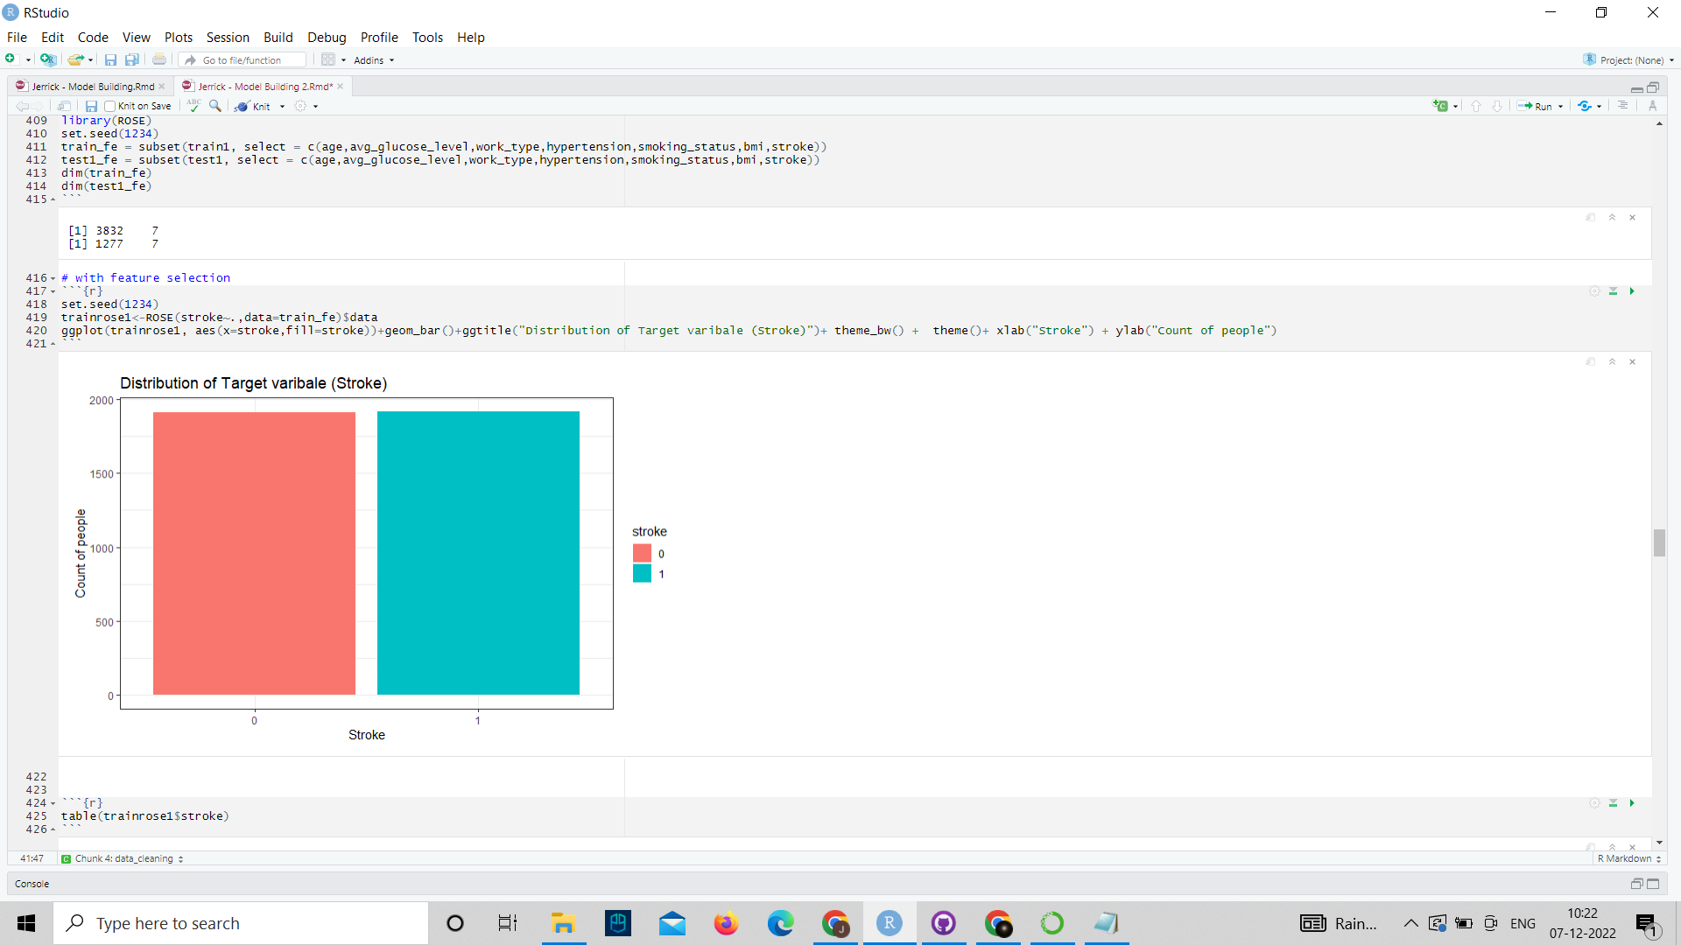
Data Balancing
BEFORE BALANCING
AFTER BALANCING

Slide 11
Model Building
Model Techniques:
Logistic Regression
Decision Tree Classifier
Random Forest Classifier

Slide 12
SMART: What evaluation metrics can be used to find the best model and why?
Evaluation Metrics:
Metrics to be considered:
TN – True Negative : Patient has no stroke and model classified as having no stroke.
TP – True Positive : Patient has a stroke and the model classifies it as a stroke.
FP – False Positive : A Patient who does not have stroke is classified as a patient having a stroke.
FN – False Negative : A Patient who has a stroke but is classified as no stroke.
Recall (IMPORTANT), and Accuracy is considered for metrics.

Slide 13
Why Recall ?
Recall is given more preference than precision because of two drawbacks,
Case 1: The model predicts the patient has no stroke, but the patient has stroke (FN).
Case 2: The model predicts the patient has stroke, but the patient has no stroke(FP).

Slide 14
Modeling on Balanced Dataset ROSE Technique
MODELS | RECALL | ACCURACY
LOGISTIC REGRESSION | 0.80 | 0.74
DECISION TREE | 0.796 | 0.734
DECISION TREE- TUNED | 0.796 | 0.736
RANDOM FOREST | 0.52 | 0.78

Slide 15
Modeling on Balanced Data with Feature Selection
MODELS | RECALL | ACCURACY
LOGISTIC REGRESSION | 0.87 | 0.74
DECISION TREE | 0.79 | 0.73
DECISION TREE -TUNED | 0.79 | 0.73
RANDOM FOREST | 0.64 | 0.75
ROSE Technique

Slide 16
Modeling on Balanced Data
BOTH (Under And Over) sampling technique
MODELS | RECALL | ACCURACY
LOGISTIC REGRESSION | 0.84 | 0.74
DECISION TREE | 0.796 | 0.734
DECISION TREE- TUNED | 0.796 | 0.736
RANDOM FOREST | 0.52 | 0.78

Slide 17
Modeling on Balanced Data with Feature Selection
BOTH (Under And Over) sampling technique
MODELS | RECALL | ACCURACY
LOGISTIC REGRESSION | 0.87 | 0.73
DECISION TREE | 0.84 | 0.70
DECISION TREE- TUNED | 0.68 | 0.75
RANDOM FOREST | 0.31 | 0.90

Slide 18
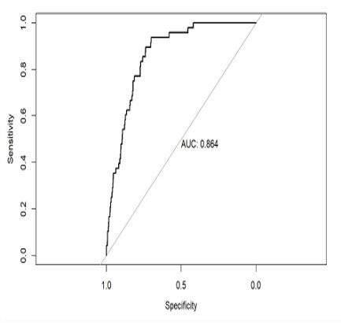
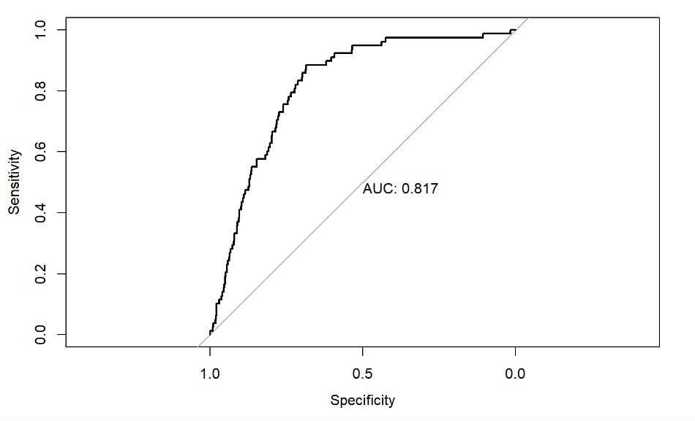
AUC-ROC CURVE OF THE BEST MODEL WITHOUT FEATURE SELECTION
Logistic Regression - ROSE
Logistic Regression – Under & Over (BOTH) sampling

Slide 19
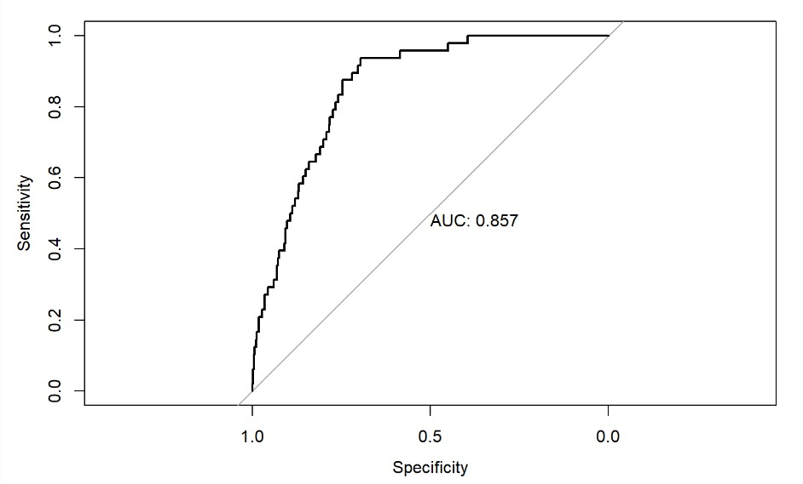
AUC-ROC CURVE OF THE BEST MODEL WITH FEATURE SELECTION
Logistic with feature selection- ROSE
Logistic Regression- BOTH (Under & Over sampling)

Slide 20
SMART: What is the best machine learning model that predict the
likelihood of a stroke?
MODELS | RECALL​ | AUC Score​ | ACCURACY​
Logistic Regression with feature selection using BOTH technique (Under and Over Sampling) | 0.87​ | 0.85 | 0.73​

Slide 21
CONCLUSION
The main factors that we used to predict the likelihood of a stroke are age, average glucose level, BMI, smoking status, work type, and hypertension.
The data imbalance is addressed by using BOTH ( Under and Oversampling Technique) & ROSE – Random Over sampling Examples.
Recall is mainly used as an evaluation metric to find the best model.
Logistic Regression with feature selection using BOTH (Under and Over sampling) technique performs the best.

Slide 22
THANK YOU

