Slide 1
Data Mining
Cluster Analysis: Basic Concepts and Algorithms
Lecture Notes for Chapter 8
Introduction to Data Mining
by
Tan, Steinbach, Kumar
© Tan,Steinbach, Kumar Introduction to Data Mining 4/18/2004 <number>

Slide 2
What is Cluster Analysis?
Finding groups of objects such that the objects in a group will be similar (or related) to one another and different from (or unrelated to) the objects in other groups
Inter-cluster distances are maximized
Intra-cluster distances are minimized

Slide 3
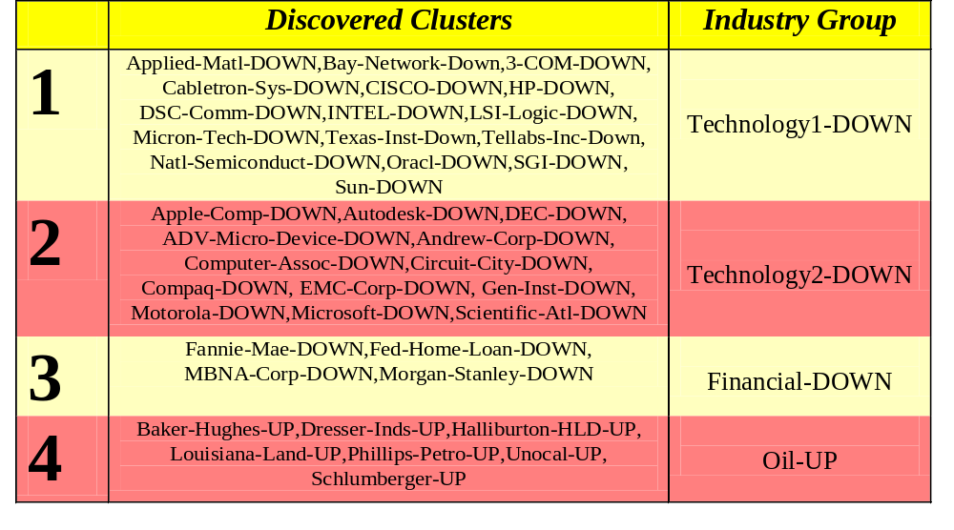
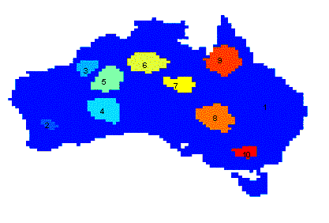
Applications of Cluster Analysis
Understanding
  Group related documents for browsing, group genes and proteins that have similar functionality, or group stocks with similar price fluctuations
Summarization
  Reduce the size of large data sets
Clustering precipitation in Australia

Slide 4
What is not Cluster Analysis?
Supervised classification
  Have class label information
Simple segmentation
  Dividing students into different registration groups alphabetically, by last name
Results of a query
  Groupings are a result of an external specification

Slide 5
Notion of a Cluster can be Ambiguous
How many clusters?
Six Clusters
Two Clusters
Four Clusters

Slide 6
Types of Clusterings
A clustering is a set of clusters
Important distinction between hierarchical and partitional sets of clusters
Partitional Clustering
  A division data objects into non-overlapping subsets (clusters) such that each data object is in exactly one subset
Hierarchical clustering
  A set of nested clusters organized as a hierarchical tree

Slide 7

Partitional Clustering
Original Points
A Partitional Clustering

Slide 8
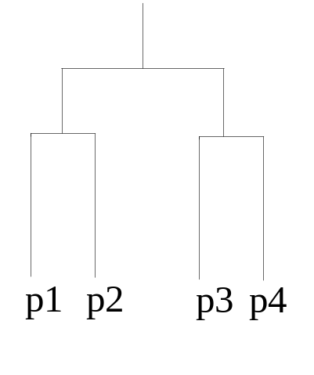
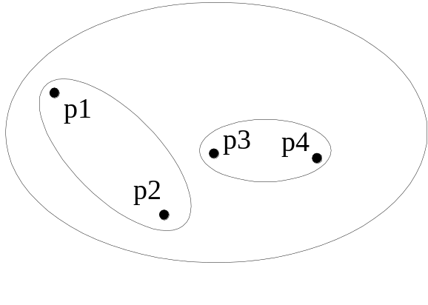
Hierarchical Clustering
Hierarchical Clustering
Dendrogram

Slide 9
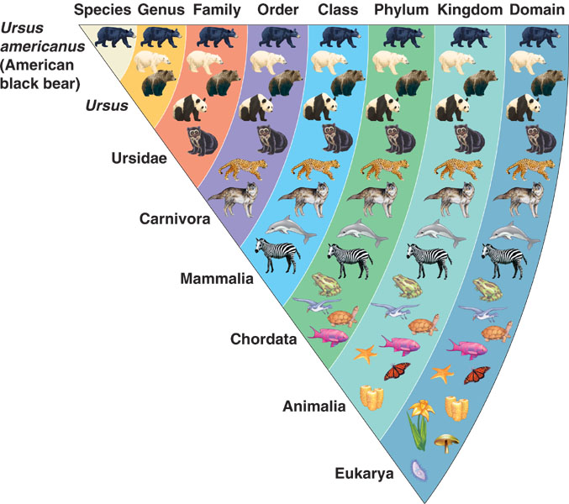
Hierarchical clustering - example

Slide 10
Other Distinctions Between Sets of Clusters
Exclusive versus non-exclusive
  In non-exclusive clusterings, points may belong to multiple clusters.
  Can represent multiple classes or ‘border’ points
Fuzzy versus non-fuzzy
  In fuzzy clustering, a point belongs to every cluster with some weight between 0 and 1
  Weights must sum to 1
  Probabilistic clustering has similar characteristics
Partial versus complete
  In some cases, we only want to cluster some of the data
  Ex: sportspersons in a class; badminton, tennis…. Non-players.
Heterogeneous versus homogeneous
  Cluster of widely different sizes, shapes, and densities

Slide 11
Types of Clusters
Well-separated clusters
Center-based clusters
Contiguous clusters
Density-based clusters
Property or Conceptual
Described by an Objective Function

Slide 12
Types of Clusters: Well-Separated
Well-Separated Clusters:
  A cluster is a set of points such that any point in a cluster is closer (or more similar) to every other point in the cluster than to any point not in the cluster.
3 well-separated clusters

Slide 13
Types of Clusters: Center-Based
Center-based
  A cluster is a set of objects such that an object in a cluster is closer (more similar) to the “center” of a cluster, than to the center of any other cluster
  The center of a cluster is often a centroid, the average of all the points in the cluster, or a medoid, the most “representative” point of a cluster
4 center-based clusters

Slide 14
Types of Clusters: Contiguity-Based
Contiguous Cluster (Nearest neighbor or Transitive)
  A cluster is a set of points such that a point in a cluster is closer (or more similar) to one or more other points in the cluster than to any point not in the cluster.
8 contiguous clusters

Slide 15
Types of Clusters: Density-Based
Density-based
  A cluster is a dense region of points, which is separated by low-density regions, from other regions of high density.
  Used when the clusters are irregular or intertwined, and when noise and outliers are present.
6 density-based clusters

Slide 16
Types of Clusters: Conceptual Clusters
Shared Property or Conceptual Clusters
  Finds clusters that share some common property or represent a particular concept.
  .
2 Overlapping Circles

Slide 17
Types of Clusters: Objective Function
Clusters Defined by an Objective Function
  Finds clusters that minimize or maximize an objective function.
  Enumerate all possible ways of dividing the points into clusters and evaluate the `goodness' of each potential set of clusters by using the given objective function. (NP Hard)
  Can have global or local objectives.
    Hierarchical clustering algorithms typically have local objectives
    Partitional algorithms typically have global objectives
  A variation of the global objective function approach is to fit the data to a parameterized model.
    Parameters for the model are determined from the data.
    Mixture models assume that the data is a ‘mixture' of a number of statistical distributions.

Slide 18
Types of Clusters: Objective Function …
Map the clustering problem to a different domain and solve a related problem in that domain
  Proximity matrix defines a weighted graph, where the nodes are the points being clustered, and the weighted edges represent the proximities between points
  Clustering is equivalent to breaking the graph into connected components, one for each cluster.
  Want to minimize the edge weight between clusters and maximize the edge weight within clusters

Slide 19
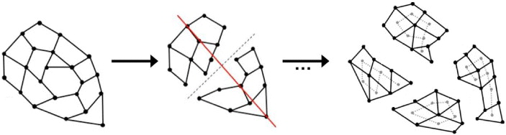
Graph-based clustering - illustrations
Cluster #1
Cluster #2
Illustration #1:
Illustration #2:

Slide 20
Characteristics of the Input Data Are Important
Type of proximity or density measure
  This is a derived measure, but central to clustering
Sparseness
  Dictates type of similarity
  Adds to efficiency
Attribute type
  Dictates type of similarity
Type of Data
  Dictates type of similarity
  Other characteristics, e.g., autocorrelation
Dimensionality
Noise and Outliers
Type of Distribution

Slide 21
Clustering Algorithms
Prototype-based clustering
Graph-based clustering
Density-based clustering

Slide 22
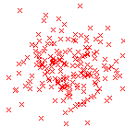
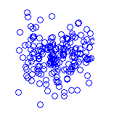
Prototype-based clustering
Cluster #1
Cluster #2

Slide 23
Types of Prototype-based clustering methods
k-means clustering
k-medoids clustering
Hierarchical clustering
Fuzzy k-means clustering
Scale-based clustering
Incremental clustering
Self-organizing maps

Slide 24

K-means Clustering
Partitional clustering approach
Each cluster is associated with a centroid (center point)
Each point is assigned to the cluster with the closest centroid
Number of clusters, K, must be specified
The basic algorithm is very simple

Slide 25
K-means Clustering – Details
Initial centroids are often chosen randomly.
  Clusters produced vary from one run to another.
The centroid is (typically) the mean of the points in the cluster.
‘Closeness’ is measured by Euclidean distance, cosine similarity, correlation, etc.
K-means will converge for common similarity measures mentioned above.
Most of the convergence happens in the first few iterations.
  Often the stopping condition is changed to ‘Until relatively few points change clusters’
Complexity is O( n * K * I * d )
  n = number of points, K = number of clusters,
  I = number of iterations, d = number of attributes

Slide 26



Two different K-means Clusterings
Original Points
Optimal Clustering
Sub-optimal Clustering

Slide 27
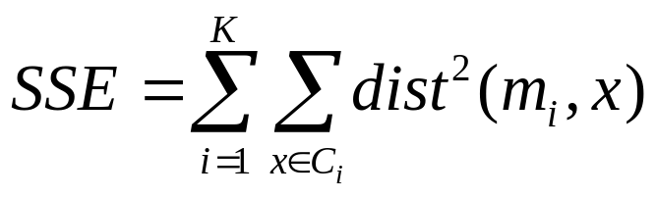
Evaluating K-means Clusters
Most common measure is Sum of Squared Error (SSE)
  For each point, the error is the distance to the nearest cluster
  To get SSE, we square these errors and sum them.
  x is a data point in cluster C_{i} and m_{i} is the representative point for cluster C_{i}
    can show that m_{i} corresponds to the center (mean) of the cluster
  Given two clusters, we can choose the one with the smallest error
  One easy way to reduce SSE is to increase K, the number of clusters
    A good clustering with smaller K can have a lower SSE than a poor clustering with higher K

Slide 28
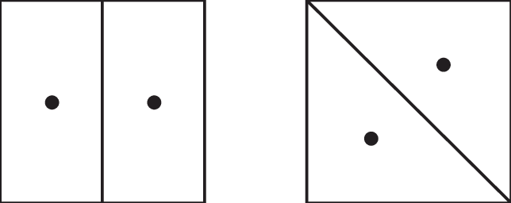
K-Means generates Voronoi tessellations
K-means partitions the input space using Nearest Neighbor criterion
Examples with K = 2
The boundary is the perpendicular bisector of the two centroids

Slide 29
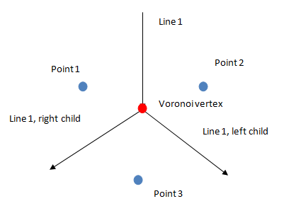
Partition with K = 3

Slide 30
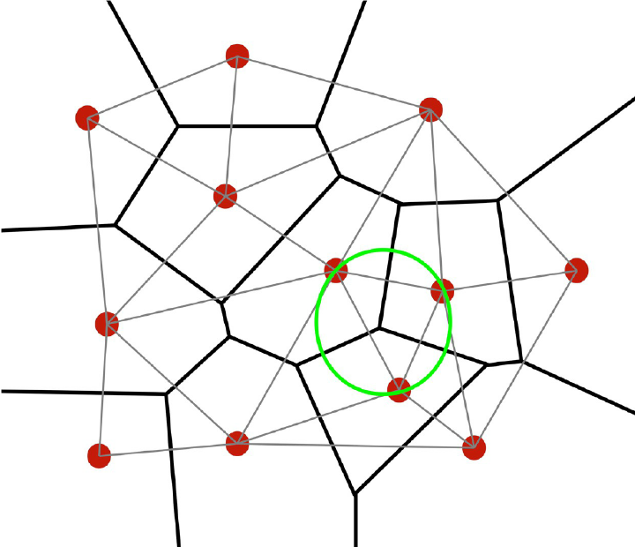
General K
Such partitions are
Called
Voronoi Tessellations

Slide 31
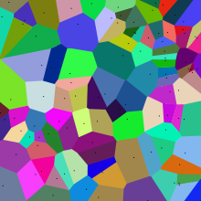

Slide 32
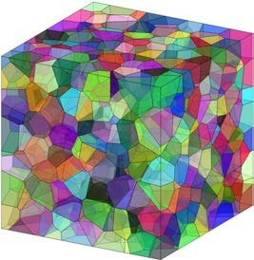
Voronoi Tessellation in 3D

Slide 33






Importance of Choosing Initial Centroids

Slide 34
Importance of Choosing Initial Centroids

Slide 35
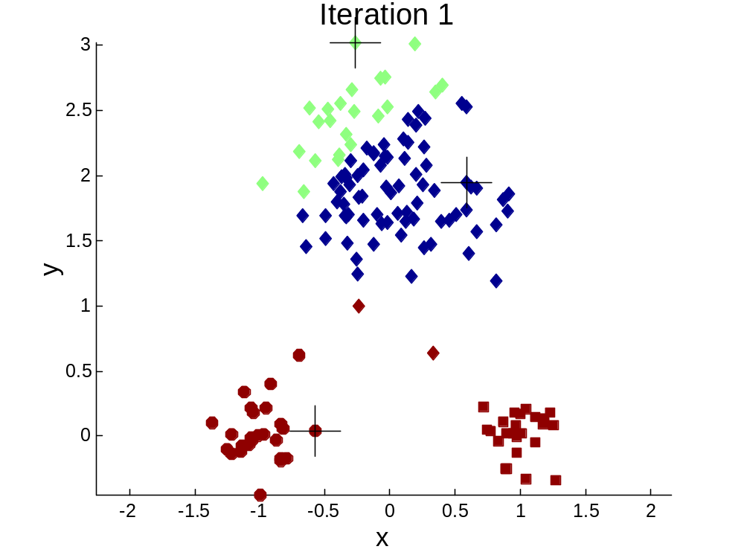


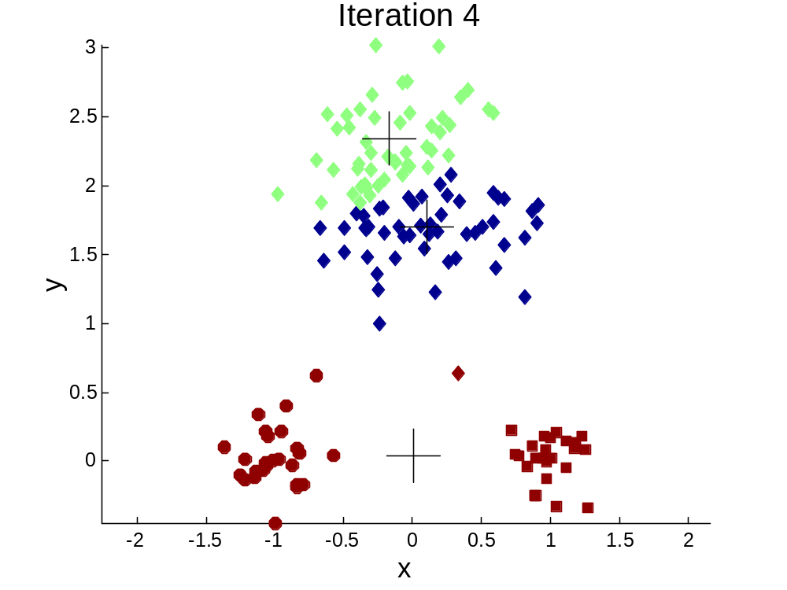
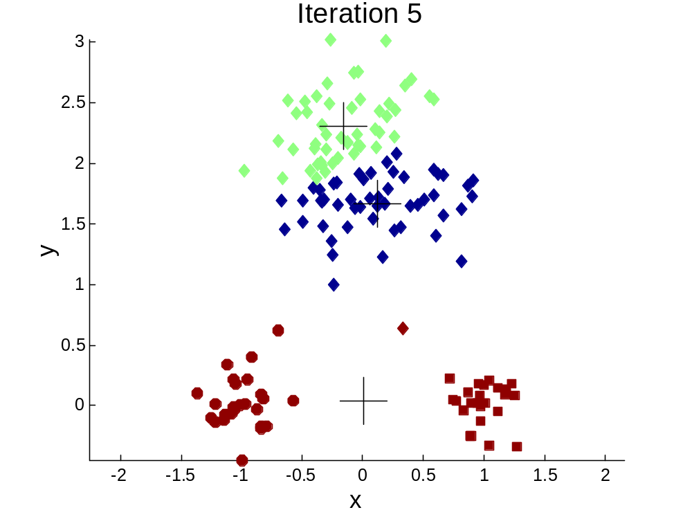
Importance of Choosing Initial Centroids …

Slide 36
Importance of Choosing Initial Centroids …

Slide 37
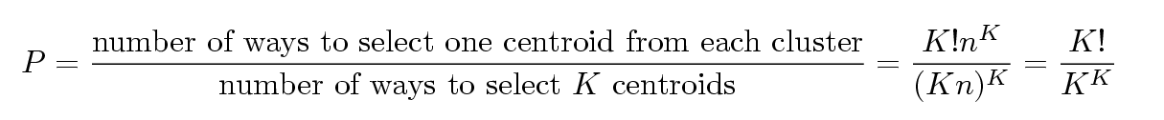
Problems with Selecting Initial Points
If there are K ‘real’ clusters then the chance of selecting one centroid from each cluster is small.
  Chance is relatively small when K is large
  If clusters are the same size, n, then
  For example, if K = 10, then probability = 10!/10¹⁰ = 0.00036
  Sometimes the initial centroids will readjust themselves in ‘right’ way, and sometimes they don’t
  Consider an example of five pairs of clusters

Slide 38
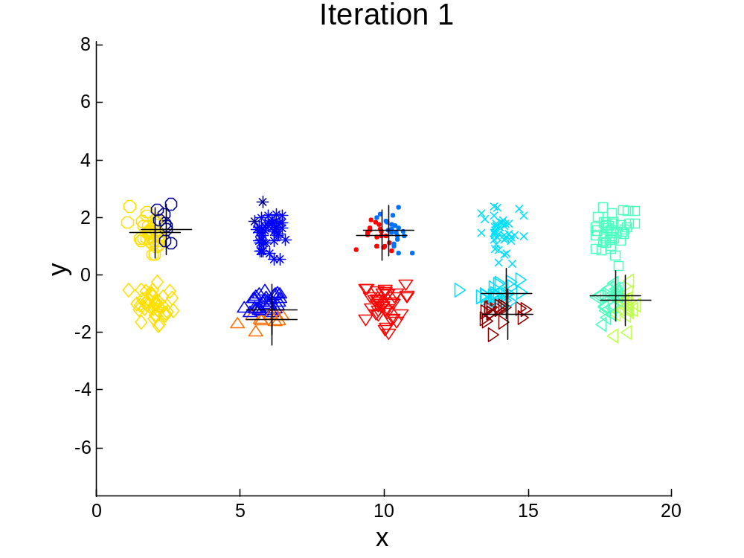
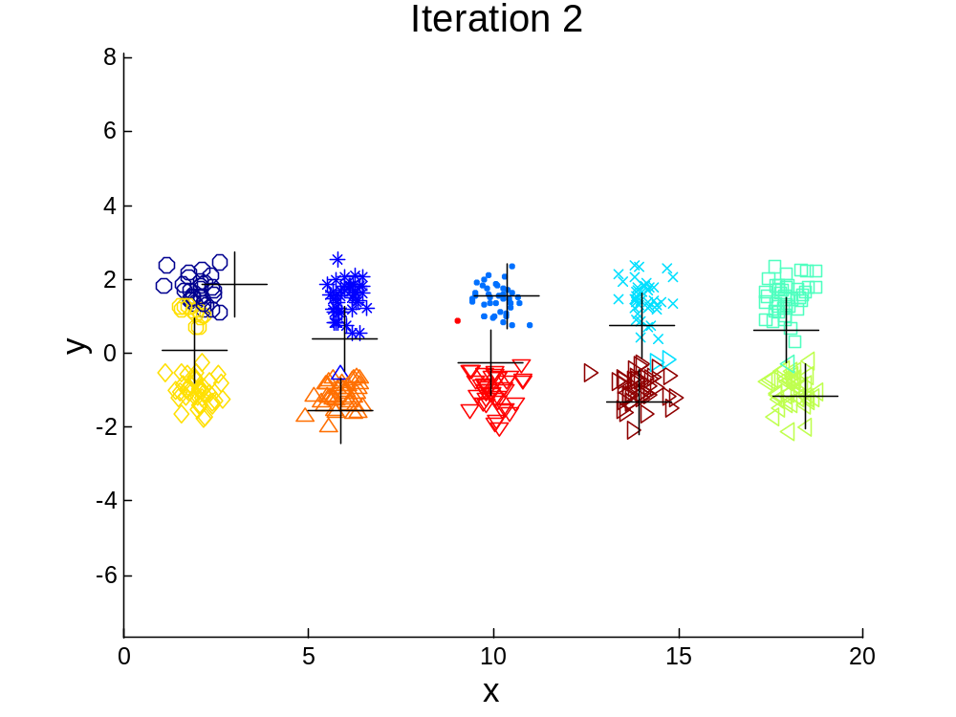
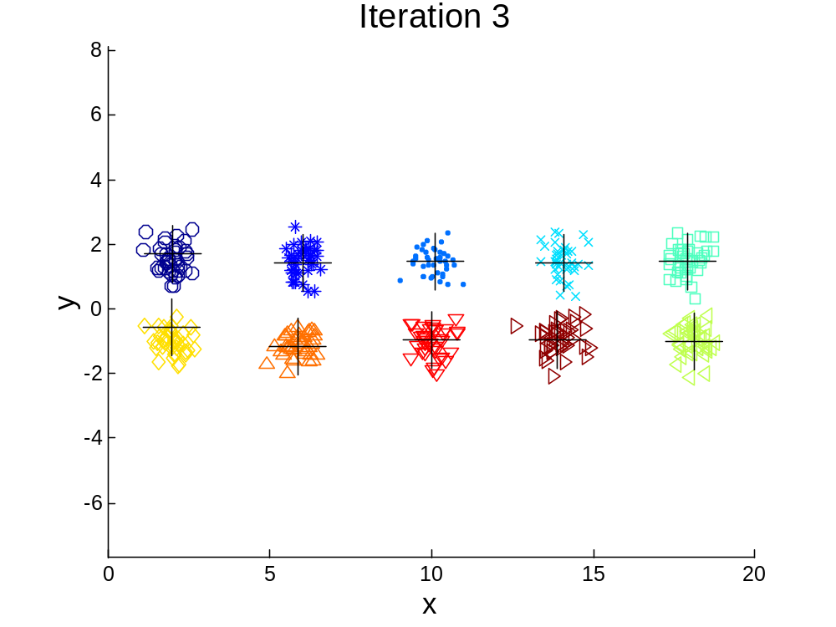

10 Clusters Example
Starting with two initial centroids in one cluster of each pair of clusters

Slide 39
10 Clusters Example
Starting with two initial centroids in one cluster of each pair of clusters

Slide 40
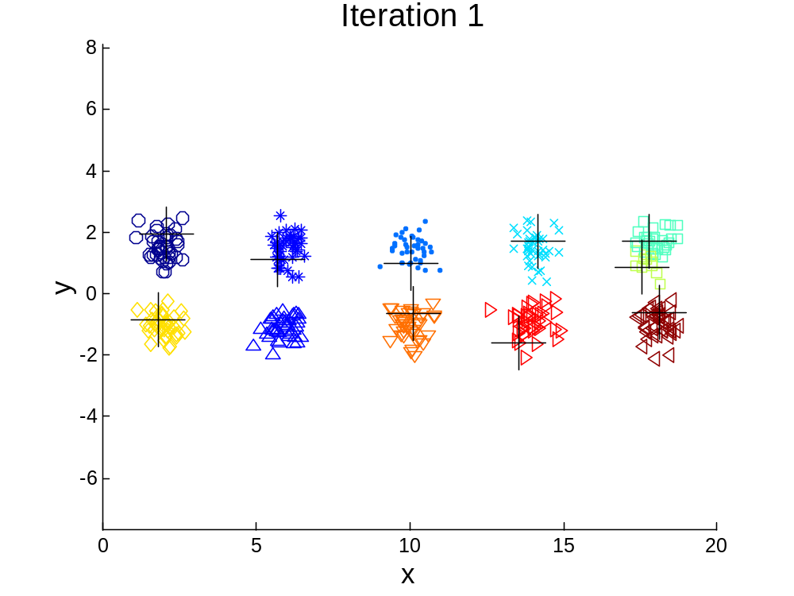



10 Clusters Example
Starting with some pairs of clusters having three initial centroids, while other have only one.

Slide 41
10 Clusters Example
Starting with some pairs of clusters having three initial centroids, while other have only one.

Slide 42
Solutions to Initial Centroids Problem
Multiple runs
  Helps, but probability is not on your side
Sample and use hierarchical clustering to determine initial centroids
Select more than k initial centroids and then select among these initial centroids
  Select most widely separated
Postprocessing
Bisecting K-means
  Not as susceptible to initialization issues

Slide 43
Handling Empty Clusters
Basic K-means algorithm can yield empty clusters
Several strategies
  Choose a point from the cluster with the highest SSE
  If there are several empty clusters, the above can be repeated several times.

Slide 44
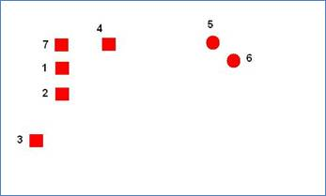
Empty clusters - example
2 natural clusters
K=3. chosen points 3, 5, and 6 as our initial cluster centers.
http://www.ceng.metu.edu.tr/~tcan/ceng465_s1011/Schedule/KMeansEmpty.html

Slide 45
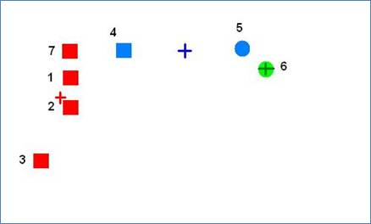
Empty clusters - example
At the end of first iteration points 3, 1, 2, and 7 will be in one cluster. 4 and 5 will be in another cluster. And 6 will be in the last cluster.
Note here that the distance between 3 and 4 is larger than the distance between 4 and 5 and so 4 is assigned to the cluster represented by 5
Now, the cluster center for the red cluster moved closer to point 4 due to 1, 2, and 7. And the cluster center for the blue cluster moved away from 5 due to point 4.
http://www.ceng.metu.edu.tr/~tcan/ceng465_s1011/Schedule/KMeansEmpty.html

Slide 46
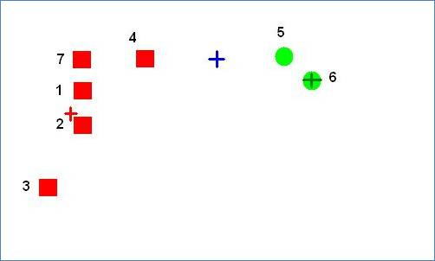
Empty clusters - example
In the next iteration point 4 will decide
that it is closer to the red cluster
and point 5 will decide that it is closer
to the green cluster. This will cause
the blue cluster to be empty.
http://www.ceng.metu.edu.tr/~tcan/ceng465_s1011/Schedule/KMeansEmpty.html

Slide 47
Updating Centers Incrementally
In the basic K-means algorithm, centroids are updated after all points are assigned to a centroid
An alternative is to update the centroids after each assignment (incremental approach)
  Each assignment updates zero or two centroids
  More expensive
  Introduces an order dependency
  Never get an empty cluster
  Can use “weights” to change the impact

Slide 48
Pre-processing and Post-processing
Pre-processing
  Normalize the data
  Eliminate outliers
Post-processing
  Eliminate small clusters that may represent outliers
  Split ‘loose’ clusters, i.e., clusters with relatively high SSE
  Merge clusters that are ‘close’ and that have relatively low SSE

Slide 49

Bisecting K-means
Bisecting K-means algorithm
  Variant of K-means that can produce a partitional or a hierarchical clustering

Slide 50
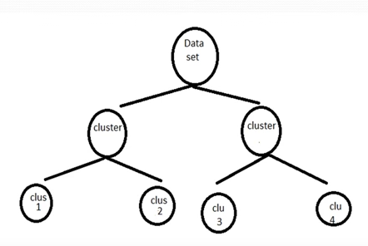
Bisecting k-means

Slide 51
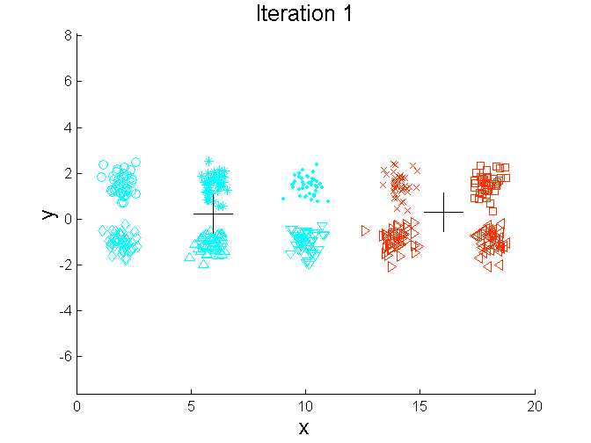
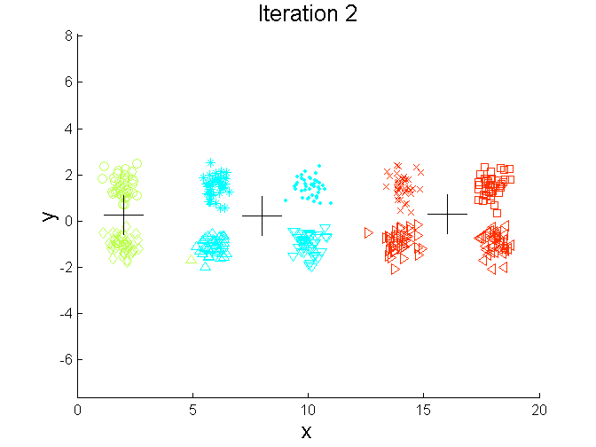
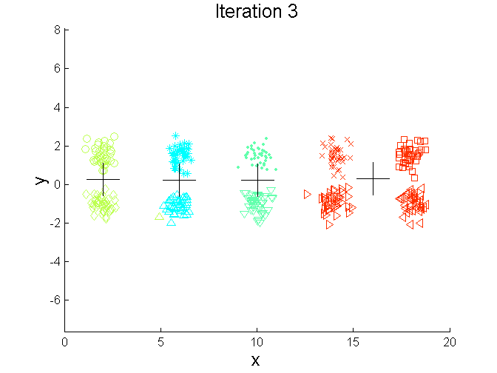
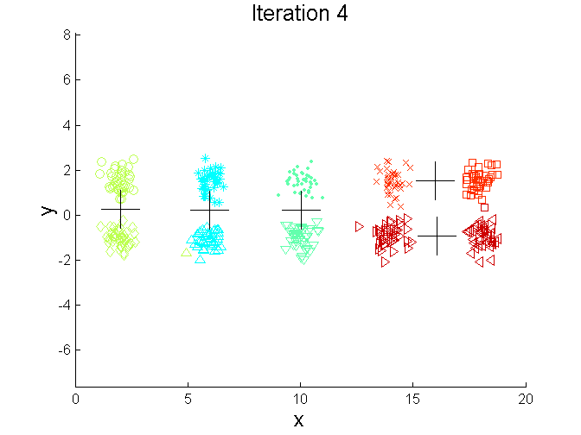
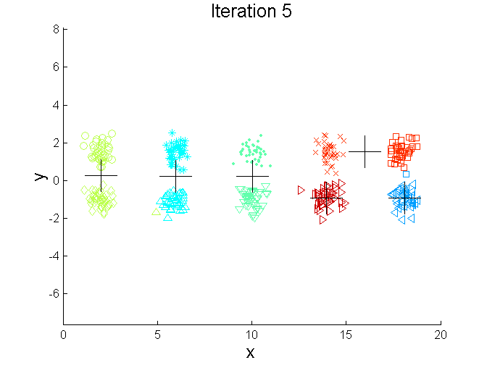
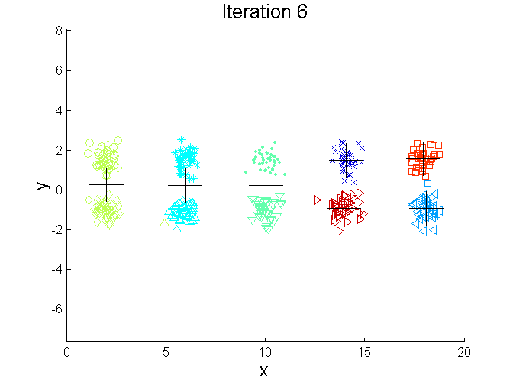
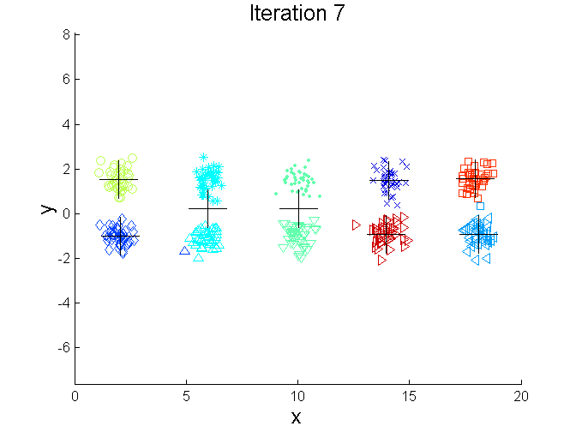
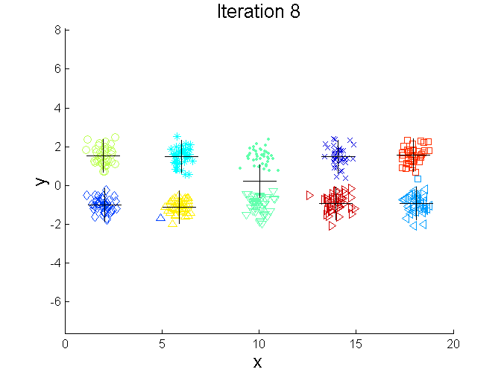
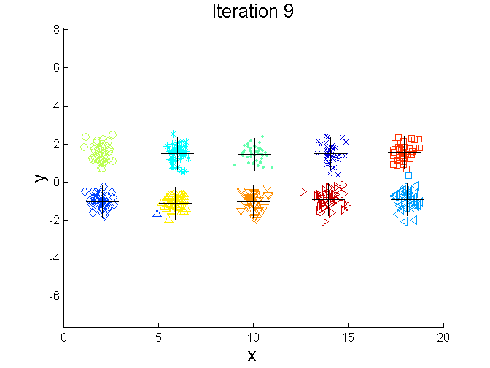
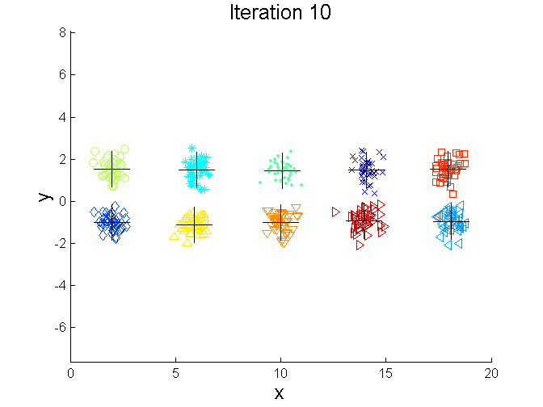
Bisecting K-means Example

Slide 52
Limitations of K-means
K-means has problems when clusters are of differing
  Sizes
  Densities
  Non-globular shapes
K-means has problems when the data contains outliers.

Slide 53


Limitations of K-means: Differing Sizes
Original Points
K-means (3 Clusters)

Slide 54


Limitations of K-means: Differing Density
Original Points
K-means (3 Clusters)

Slide 55


Limitations of K-means: Non-globular Shapes
Original Points
K-means (2 Clusters)

Slide 56

Overcoming K-means Limitations
Original Points K-means Clusters
One solution is to use many clusters.
  Find parts of clusters, but need to put together.

Slide 57
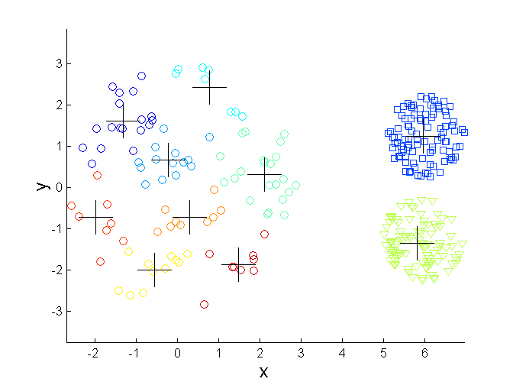
Overcoming K-means Limitations
Original Points K-means Clusters

Slide 58
K - Medoids
K-means requires calculation of a mean vector which assumes that it is possible to “ADD” data objects
In some cases such “addition” of data objects is not defined
Only a distance or similarity measure is available
K-medoids is the solution in such cases

Slide 59
Partitioning Around Medoids (PAM) or
K – Medoids algorithm
Initialize: randomly select k of the n data points as the medoids
Associate each data point to the “closest” medoid.
- For each medoid m
  For each non-medoid data point o
    Swap m and o and compute the total cost (SSE) of the configuration
Select the configuration with the lowest cost.
Repeat steps 2 to 4 until there is no change in the medoid.

Slide 60
K-medoids example
N = 10 data points
K = 2

Slide 61
c₁ = (3,4) and c₂ = (7,4)
Cluster₁ = {(3,4)(2,6)(3,8)(4,7)}
Cluster₂ = {(7,4)(6,2)(6,4)(7,3)(8,5)(7,6)}
So the total cost involved is 20.

Slide 62
Select one of the nonmedoids O′
Let us assume O′ = (7,3)
So now the medoids are c₁(3,4) and O′(7,3)
Reassign data to Medoids.
Recalculate SSE
= 22
So the new C2 = O’ = (7,3) is not good.
Try another nonmedoid data point and continue

