Slide 1
DBSCAN – Density-Based Spatial Clustering of Applications with Noise
Reference:
M.Ester, H.P.Kriegel, J.Sander and Xu.
A density-based algorithm for discovering clusters in large spatial databases, Aug 1996

Slide 2
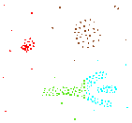
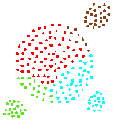
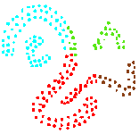
Density-Based Clustering
Basic Idea:
  Clusters are dense regions in the data space, separated by regions of lower object density
Why Density-Based Clustering?
Results of a k-medoid
algorithm for k=4
Different density-based approaches exist
Here we discuss the ideas underlying the DBSCAN algorithm

Slide 3
DBSCAN
Density-based Clustering locates regions of high density that are separated from one another by regions of low density.
  Density = number of points within a specified radius (Eps)
DBSCAN is a density-based algorithm.
  A point is a core point if it has more than a specified number of points (MinPts) within Eps
    These are points that are at the interior of a cluster
  A border point has fewer than MinPts within Eps, but is in the neighborhood of a core point
  A noise point is any point that is not a core point or a border point.

Slide 4
DBSCAN: Clustering method
  Any two core points are close enough– within a distance Eps of one another – are put in the same cluster
  Any border point that is close enough to a core point is put in the same cluster as the core point
  Noise points are discarded

Slide 5
Border & Core
Outlier
Border
Core
ε = 1unit
MinPts = 5

Slide 6
Concepts: ε-Neighborhood
ε-Neighborhood - Objects within a radius of ε from an object. (epsilon-neighborhood)
Core objects - ε-Neighborhood of an object contains at least MinPts of objects
ε-Neighborhood of p
ε
ε
ε-Neighborhood of q
q
p
p is a core object (MinPts = 4)
q is not a core object

Slide 7
Concepts: Reachability
Directly density-reachable
  An object q is directly density-reachable from object p if q is within the ε-Neighborhood of p and p is a core object.
q is directly density-reachable from p
p is not directly density- reachable from q
ε
ε
q
p

Slide 8
Concepts: Reachability
Density-reachable:
  An object p is density-reachable from q w.r.t ε and MinPts if there is a chain of objects p₁,…,p_{n}, with p₁=q, p_{n}=p such that p_{i+1}is directly density-reachable from p_{i} w.r.t ε and MinPts for all 1 <= i <= n
q is density-reachable from p
asymmetric
q
p

Slide 9
An Example
MinPts = 4
ε
C₁
C₁
ε
ε
C₁

Slide 10
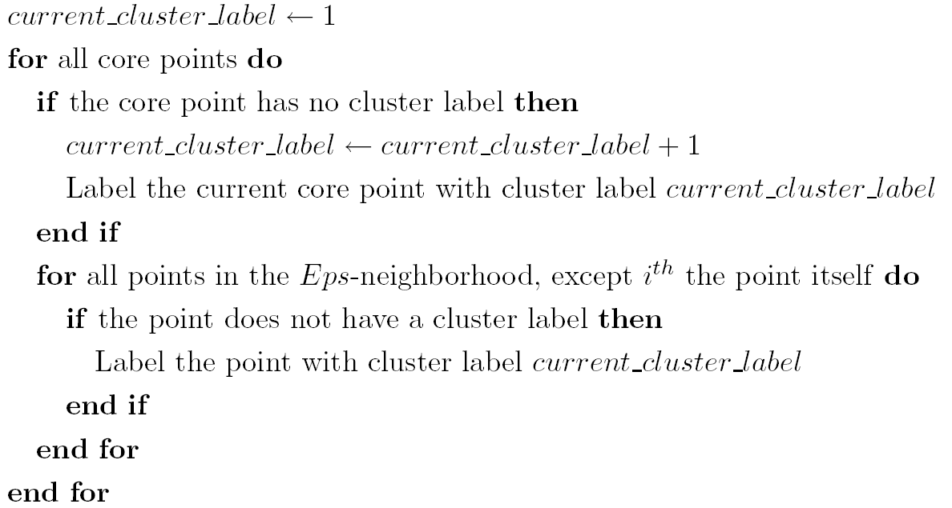
DBSCAN Algorithm
Eliminate noise points
Perform clustering on the remaining points

Slide 11
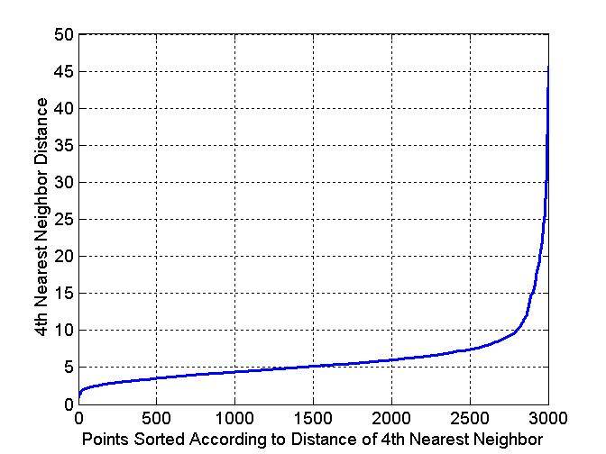
DBSCAN: Determining EPS and MinPts
The idea is that for points in a cluster, their k^{th} nearest neighbors are at roughly the same distance
Noise points have the k^{th} nearest neighbor at farther distance
So, plot sorted distance of every point to its k^{th} nearest neighbor

Slide 12
DBSCAN: Determining EPS and MinPts
Distance from a point to its k^{th} nearest neighbor=>k-dist
For points that belong to some clusters, the value of k-dist will be small if k is not larger than cluster size
For points that are not in a cluster such as noise points, the k-dist will be relatively large
Compute k-dist for all points for some k
Sort them in increasing order and plot sorted values
A sharp change at the value of k-dist that corresponds to suitable value of eps and the value of k as MinPts

Slide 13
DBSCAN: Determining EPS and MinPts
A sharp change at the value of k-dist that corresponds to suitable value of eps and the value of k as MinPts
  Points for which k-dist is less than eps will be labeled as core points while other points will be labeled as noise or border points.
If k is too large=> small clusters (of size less than k) are likely to be labeled as noise
If k is too small=> Even a small number of closely spaced that are noise or outliers will be incorrectly labeled as clusters

Slide 14
DBSCAN
DBSCAN is a density-based algorithm.
  Density = number of points within a specified radius (Eps)
  A point is a core point if it has more than a specified number of points (MinPts) within Eps
    These are points that are at the interior of a cluster
  A border point has fewer than MinPts within Eps, but is in the neighborhood of a core point
  A noise point is any point that is not a core point or a border point.

Slide 15
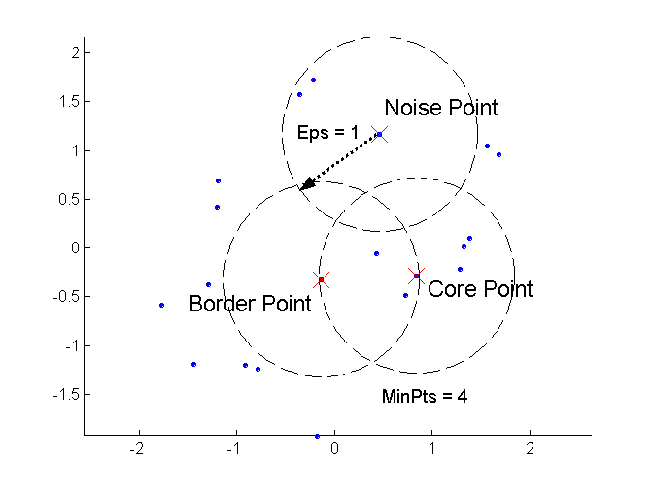
DBSCAN: Core, Border, and Noise Points

Slide 16
DBSCAN algorithm
Label all points as core, border and noise points
Eliminate noise points
Put an edge between all core points that are within Eps of each other
Make each group of connected core points into a separate cluster
Assign each border point to one of the clusters of the associated core points

Slide 17
DBSCAN Algorithm: Example
Parameter
    ε = 2 cm
    MinPts = 3
for each o ∈ D do
if o is not yet classified then
if o is a core-object then
collect all objects density-reachable from o
and assign them to a new cluster.
else
assign o to NOISE

Slide 18
DBSCAN Algorithm: Example
Parameter
    ε = 2 cm
    MinPts = 3
for each o ∈ D do
if o is not yet classified then
if o is a core-object then
collect all objects density-reachable from o
and assign them to a new cluster.
else
assign o to NOISE

Slide 19
DBSCAN Algorithm: Example
Parameter
    ε = 2 cm
    MinPts = 3
for each o ∈ D do
if o is not yet classified then
if o is a core-object then
collect all objects density-reachable from o
and assign them to a new cluster.
else
assign o to NOISE

Slide 20
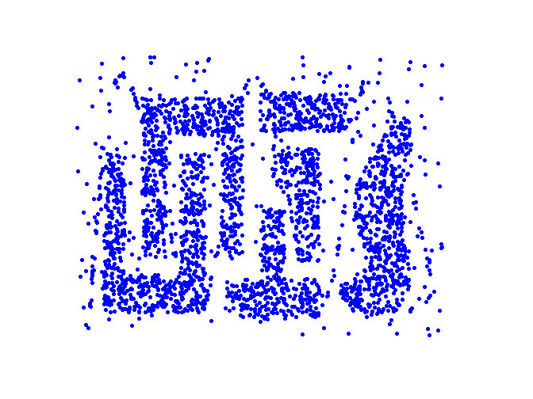
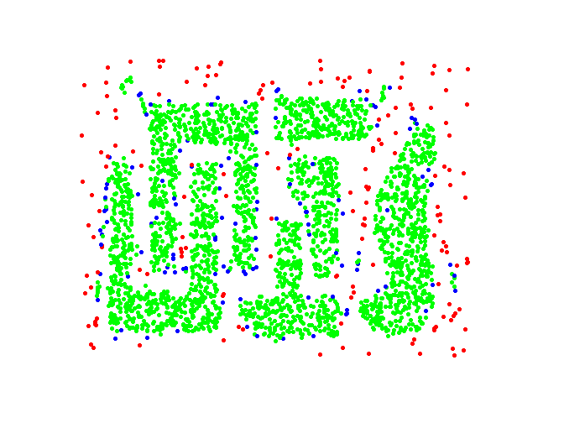
DBSCAN: Core, Border and Noise Points
Original Points
Point types: core, border and noise
Eps = 10, MinPts = 4

Slide 21
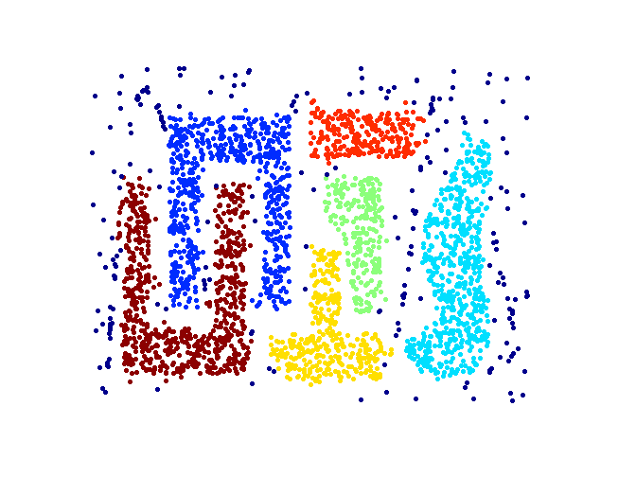
When DBSCAN Works Well
Original Points
Clusters
Resistant to Noise
Can handle clusters of different shapes and sizes

Slide 22
Data with variable densities
Noise N1 has same density as clusters C and D
A
B
C
D
N1
N2
If Eps threshold is low enough to find clusters C and D, then A, B and N1 will be treated
as a single cluster
If Eps threshold is high enough to find A and B as separate clusters, then points in
N1, C, D and N2 will all be marked as noise

Slide 23
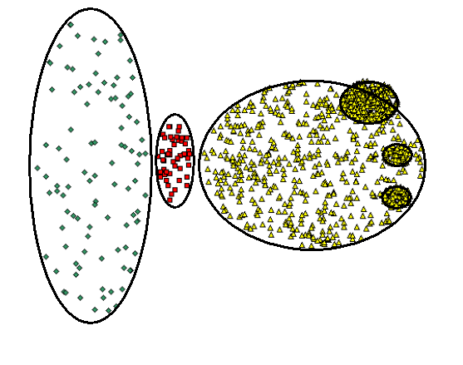
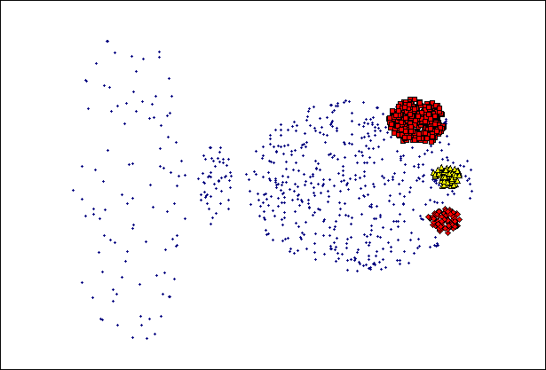
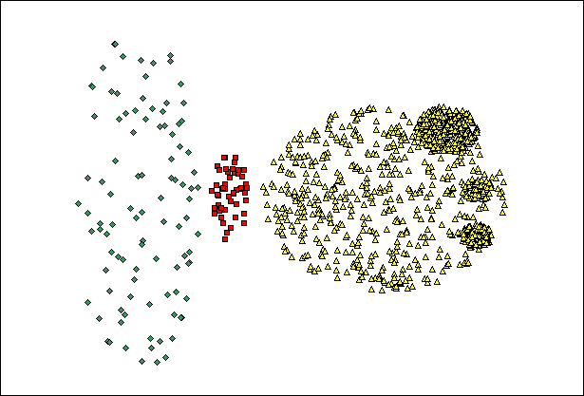
When DBSCAN Does NOT Work Well
(MinPts=4, Eps=9.92)
Original Points
Varying densities
High-dimensional data
(MinPts=4, Eps=9.75).

