Slide 1
Expectation maximization by Gaussian Mixture Models

Slide 2
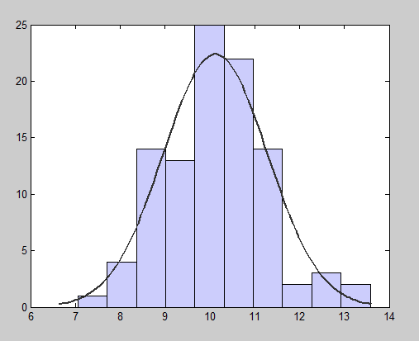
Fitting a Single Gaussian to data

Slide 3
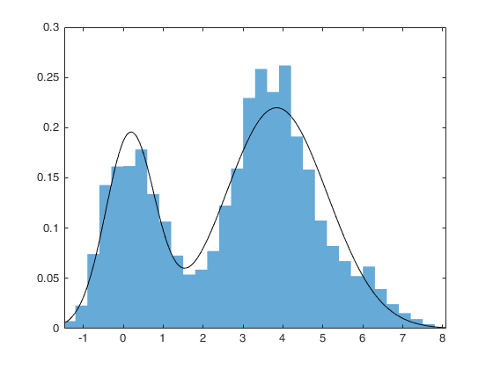
Fitting a Gaussian Mixture to data
CLUSTERS ARE PEAKS OF THE GAUSSIANS IN THE MIXTURE

Slide 4
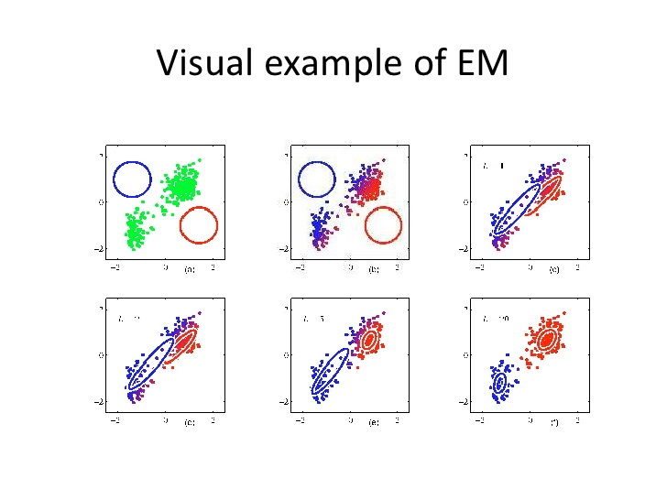

Slide 5
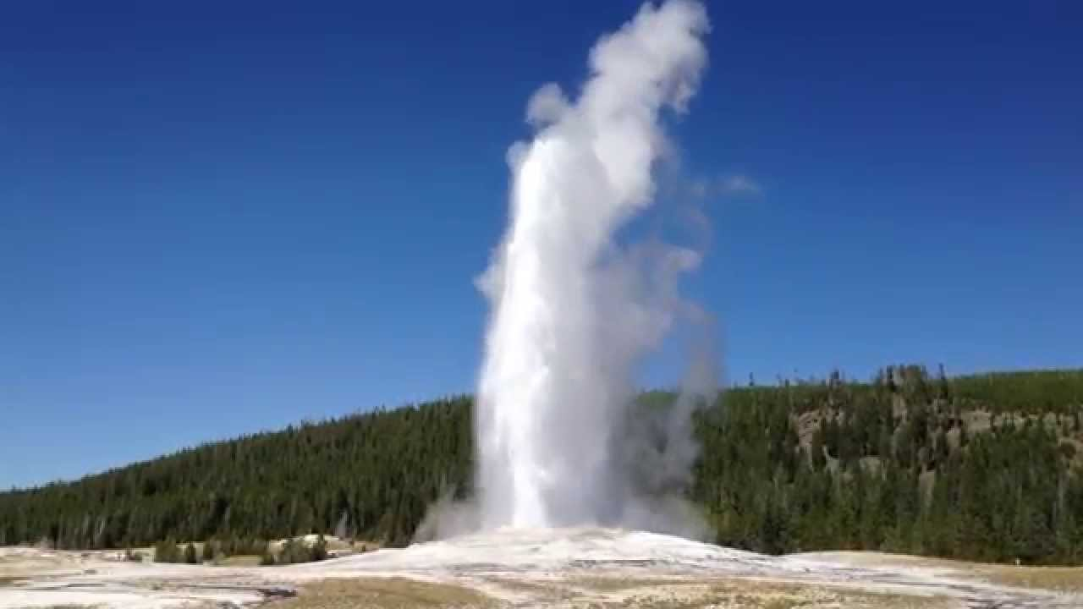
Old faithful geyser (Yellowstone National Park)

Slide 6
Fitting a Gaussian to data - iteratively

Slide 7
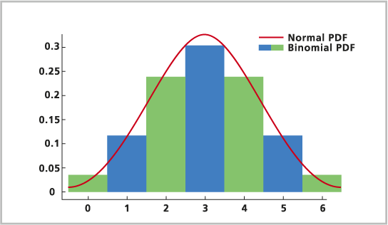
Binomial distribution – Normal distribution

