Slide 1
Graph based Clustering
BT 3041 Analysis and interpretation of Biological Data

Slide 2
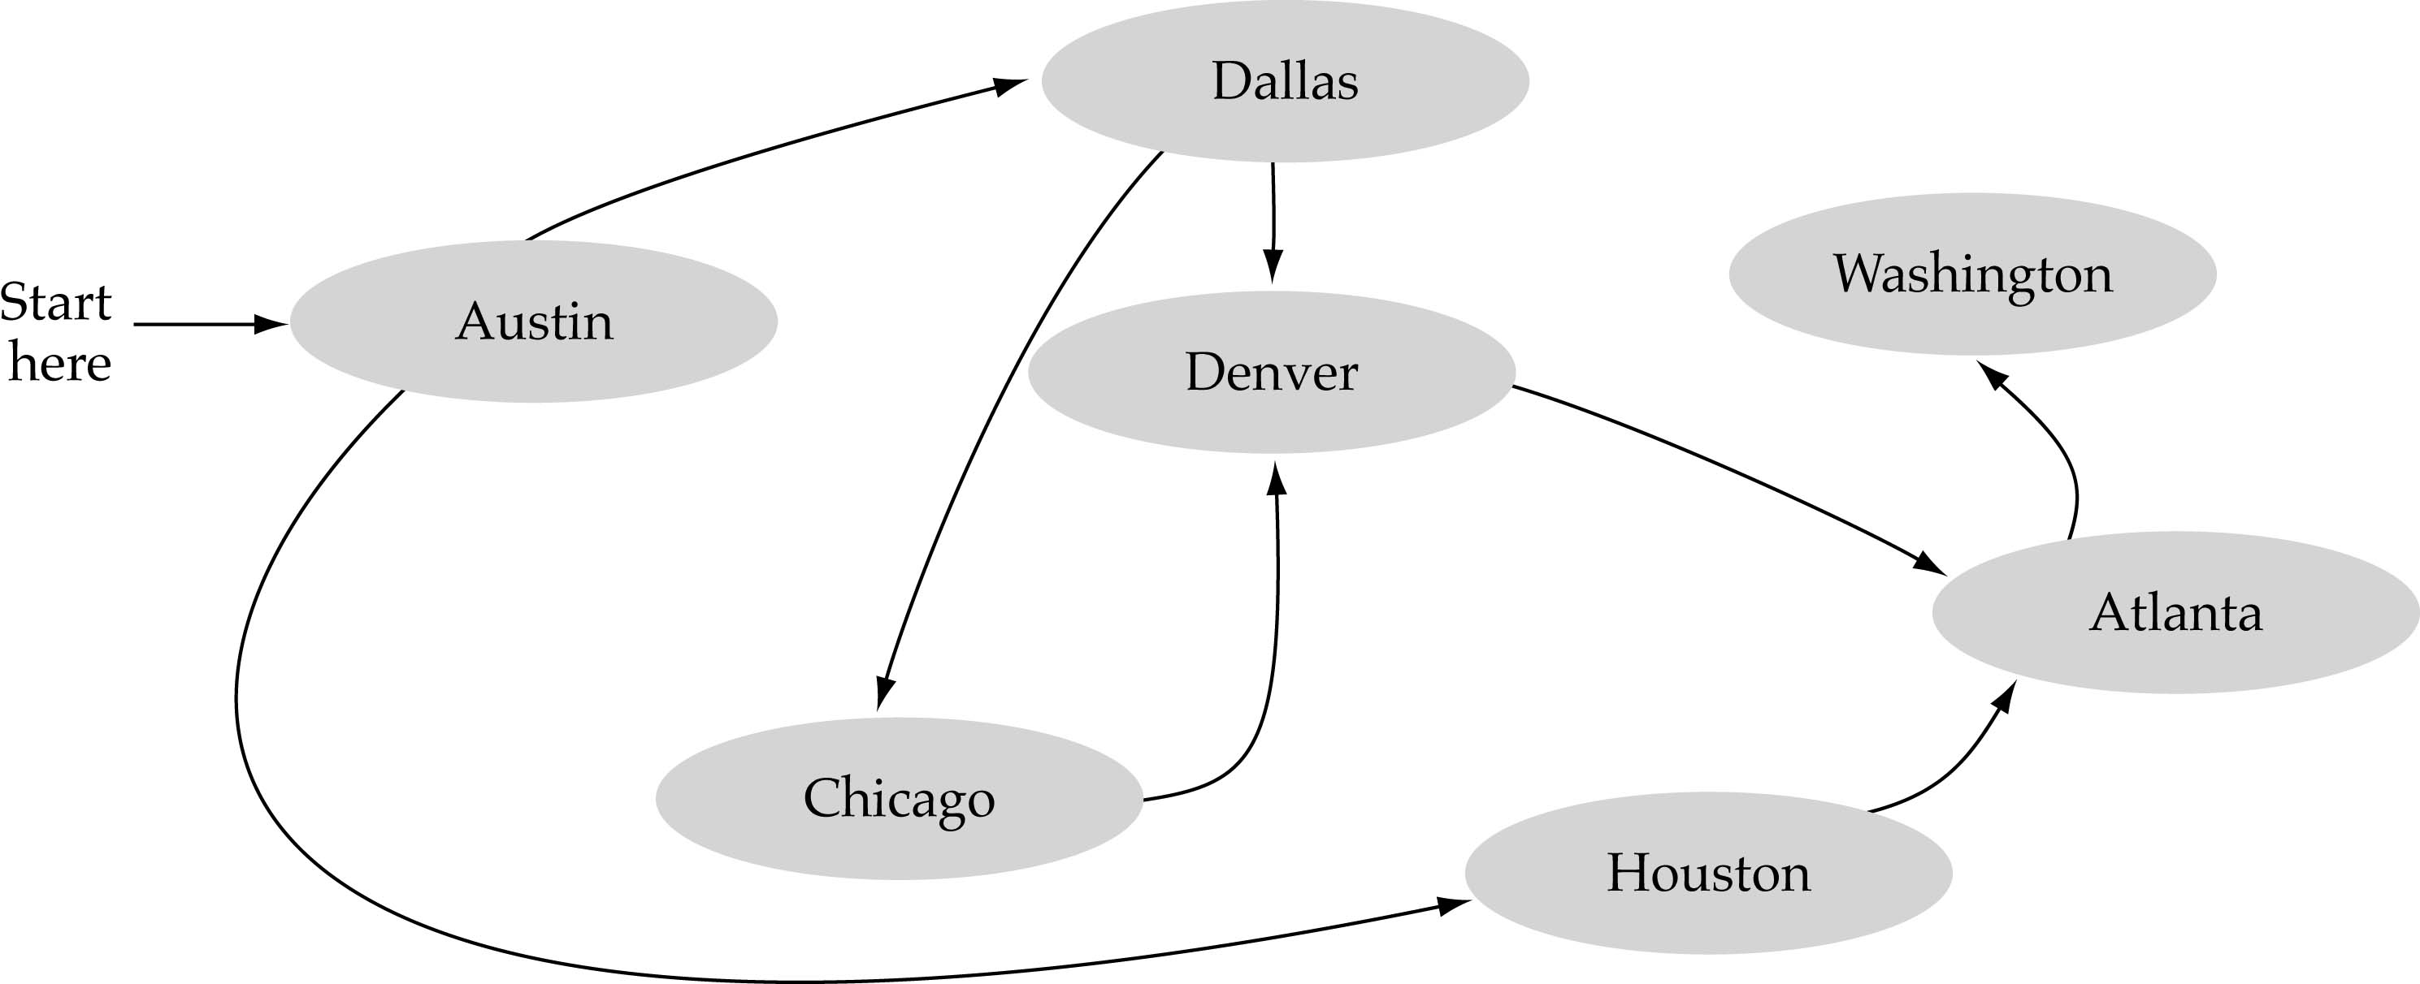
What is a graph?
A data structure that consists of a set of nodes (vertices) and a set of edges that relate the nodes to each other
The set of edges describes relationships among the vertices

Slide 3
Formal definition of graphs
A graph G is defined as follows:
G=(V,E)
V(G): a finite, nonempty set of vertices
E(G): a set of edges (pairs of vertices)

Slide 4
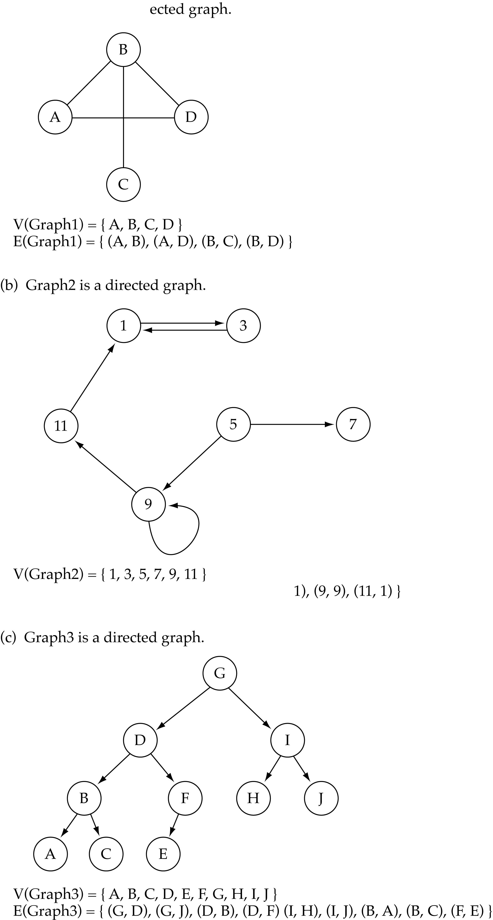
Directed vs. undirected graphs
When the edges in a graph have no direction, the graph is called undirected

Slide 5
Directed vs. undirected graphs (cont.)
When the edges in a graph have a direction, the graph is called directed (or digraph)
Warning: if the graph is directed, the order of the vertices in each edge is important !!
E(Graph2) = {(1,3) (3,1) (5,9) (9,11) (5,7)

Slide 6
Trees vs graphs
Trees are special cases of graphs!!

Slide 7
Graph terminology
Adjacent nodes: two nodes are adjacent if they are connected by an edge
Path: a sequence of vertices that connect two nodes in a graph
Complete graph: a graph in which every vertex is directly connected to every other vertex
5 is adjacent to 7
7 is adjacent from 5

Slide 8
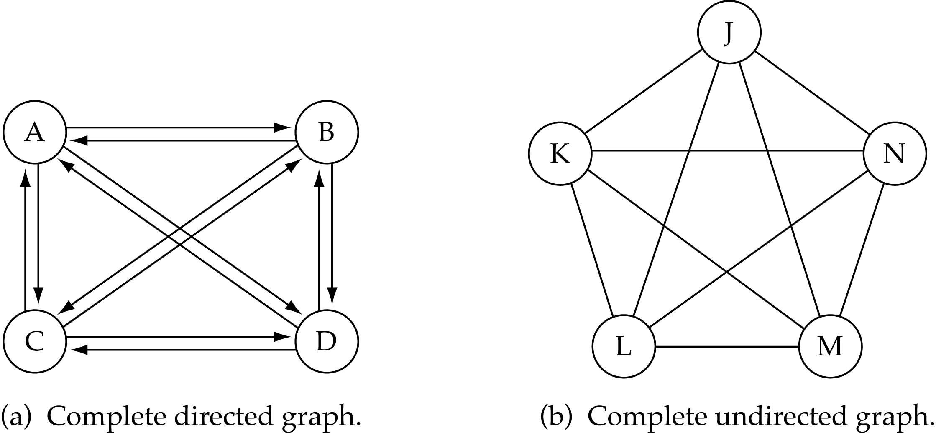
Graph terminology (cont.)
What is the number of edges in a complete directed graph with N vertices?
N * (N-1)

Slide 9
Graph terminology (cont.)
What is the number of edges in a complete undirected graph with N vertices?
N * (N-1) / 2

Slide 10
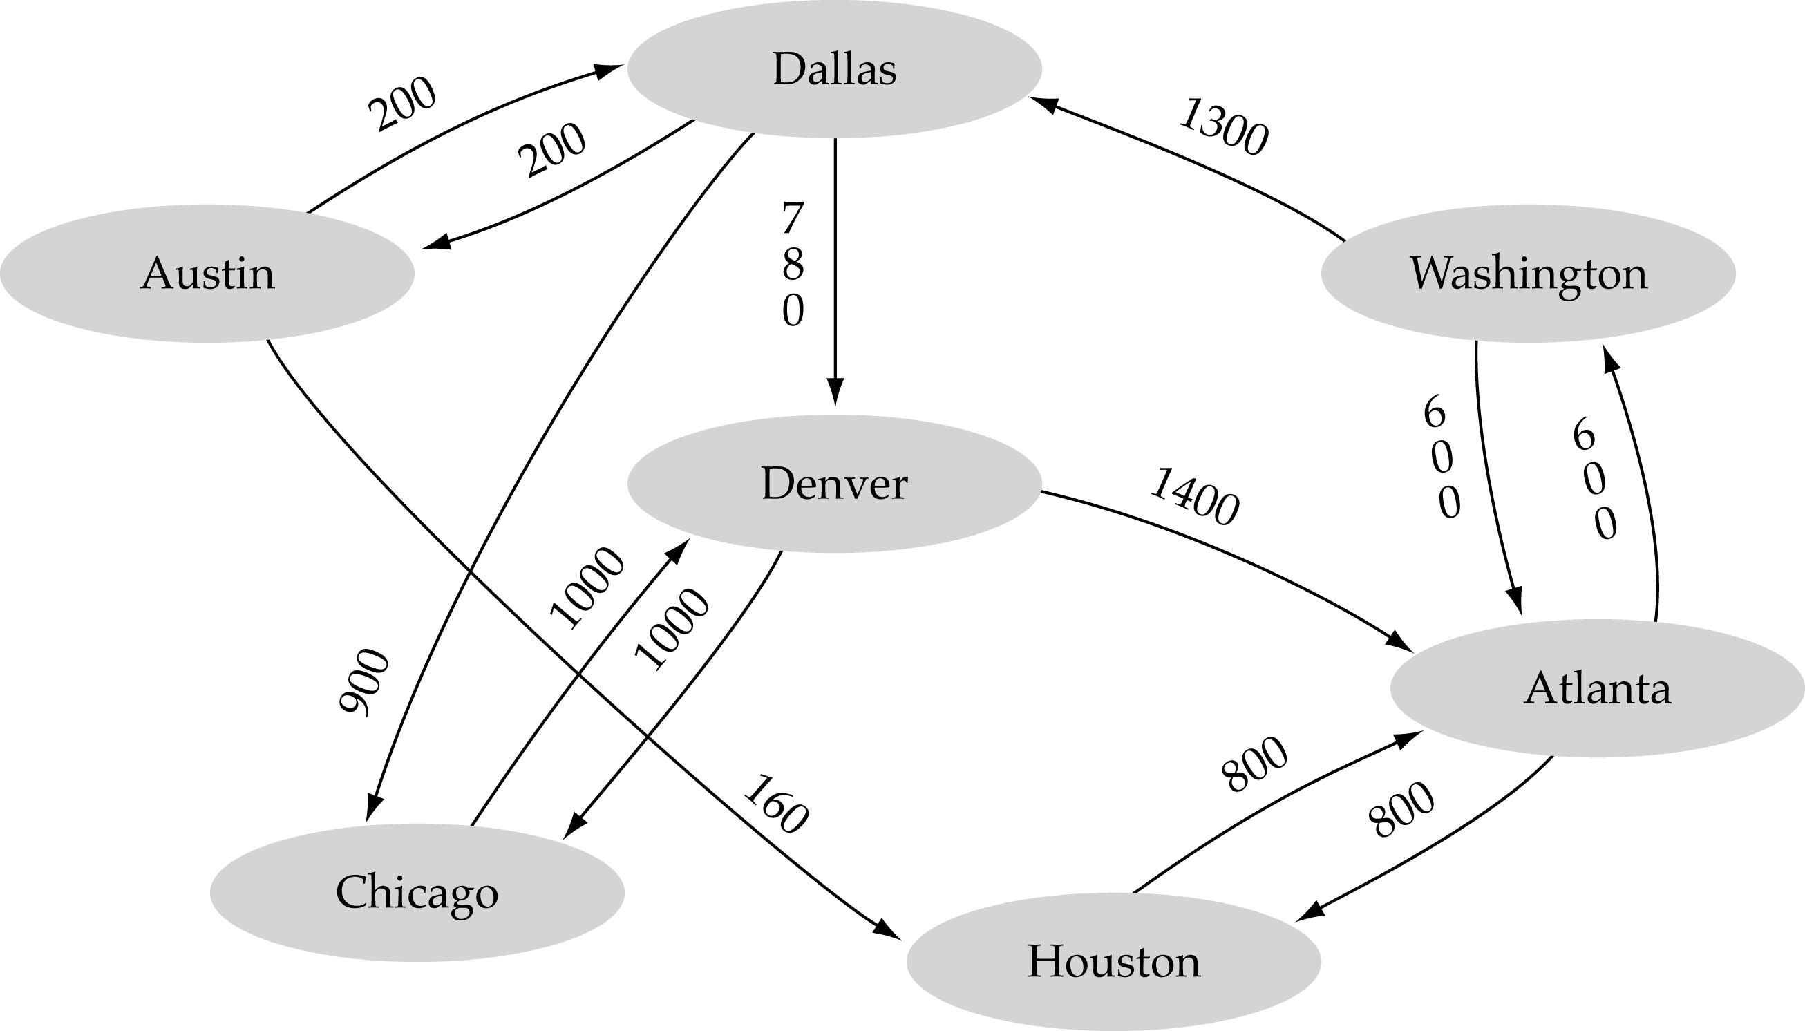
Graph terminology (cont.)
Weighted graph: a graph in which each edge carries a value

Slide 11
Graph implementation
Array-based implementation
A 1D array is used to represent the vertices
A 2D array (adjacency matrix) is used to represent the edges

Slide 12
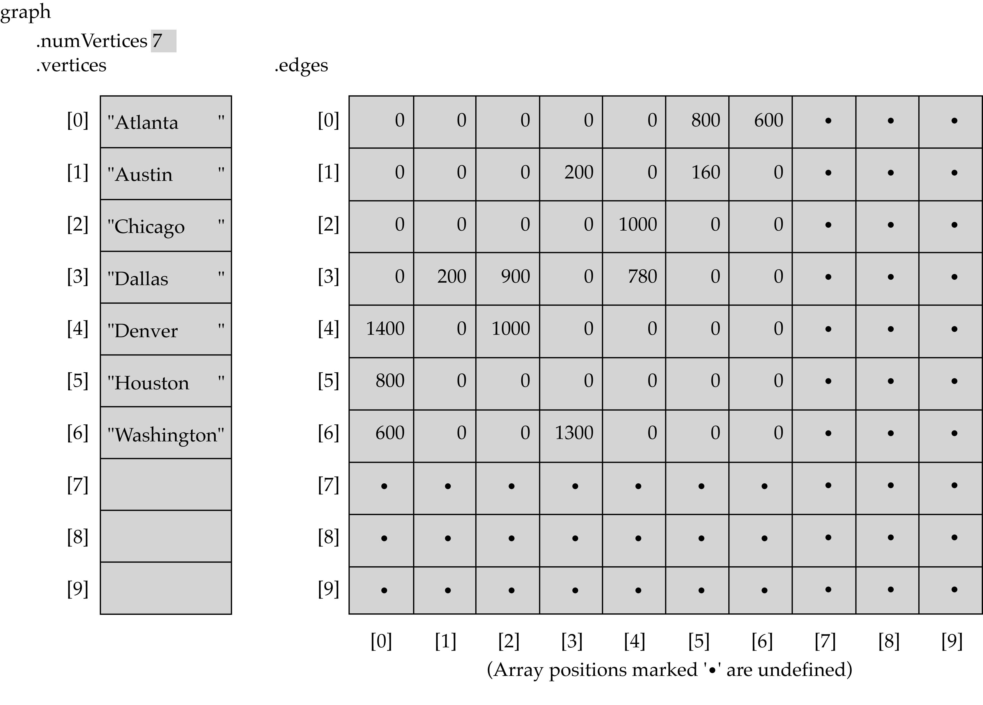
Array-based implementation

Slide 13
Problems with traditional similarity – Clustering high-dim data
Similarity is typically low in high-dimensional data
Example from document classes
Doc class | Average cosine similarity
Entertainment | 0.032
Financial | 0.03
Foreign | 0.03
Metro | 0.021
National | 0.027
Sports | 0.036
All sections | 0.014

Slide 14
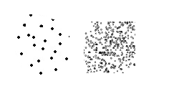
Problems with traditional similarity – Clustering high-dim data
Problems with differences in densities

Slide 15
Data with variable densities
Noise N1 has same density as clusters C and D
A
B
C
D
N1
N2
If Eps threshold is low enough to find clusters C and D, then A, B and N1 will be treated
as a single cluster
If Eps threshold is high enough to find A and B as separate clusters, then points in
N1, C, D and N2 will all be marked as noise
Need a measure based on “relative” density, not “absolute” density.

Slide 16
Shared Near Neighbor Approach
SNN graph: the weight of an edge is the number of shared neighbors between vertices given that the vertices are connected
i
j
i
j
4

Slide 17
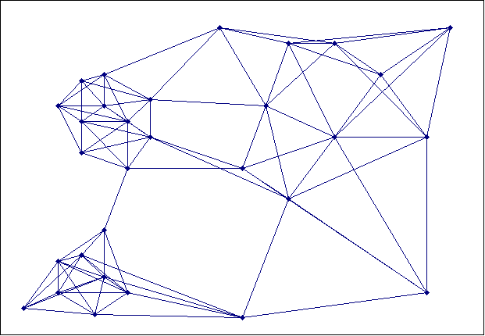
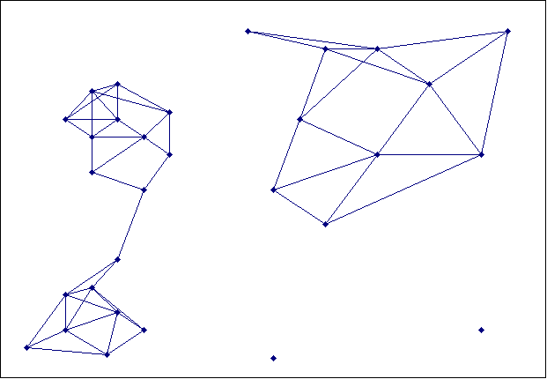
Creating the SNN Graph
Sparse Graph
Link weights are similarities between neighboring points
Shared Near Neighbor Graph
Link weights are number of Shared Nearest Neighbors

Slide 18
Jarvis-Patrick Clustering
k-nearest neighbors of all points are found
In graph terms this can be regarded as breaking all but the k strongest links from a point to other points in the proximity graph
A pair of points is put in the same cluster if
the two points are in each others k nearest neighbor list
any two points share more than T neighbors
Ex. k=20 and T=10
Jarvis-Patrick clustering is too brittle

Slide 19
JP algorithm
Merits:
Can handle clusters of different sizes, shapes and densities
Works well for high-dimensional data
Demerits:
Since it depends on Connected Components in SNN similarity graph, splitting/merging of a cluster can depend on a single link
Not all objects are clustered

Slide 20
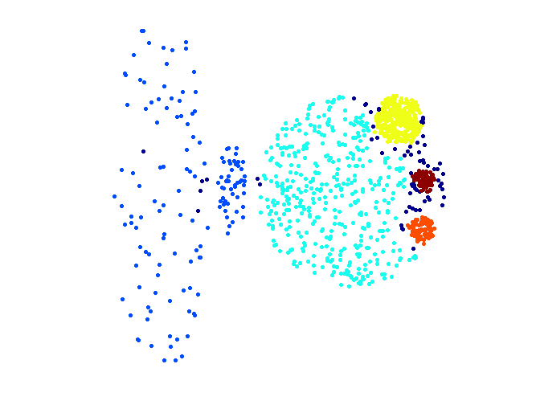
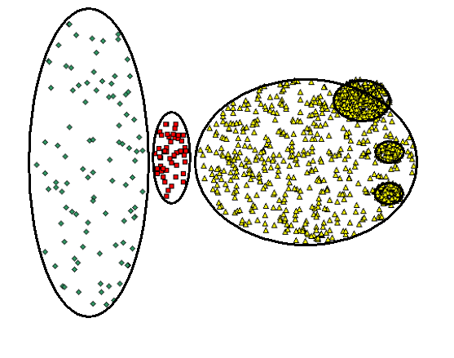
When Jarvis-Patrick Works Reasonably Well
Original Points
Jarvis Patrick Clustering
6 shared neighbors out of 20

Slide 21
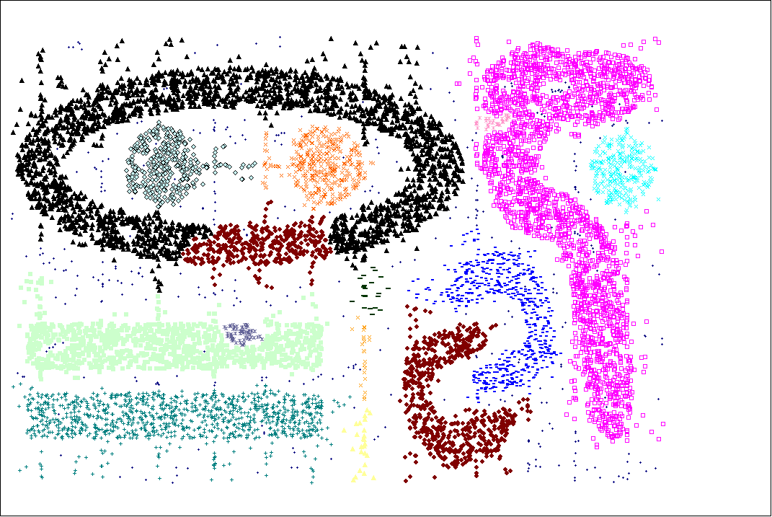
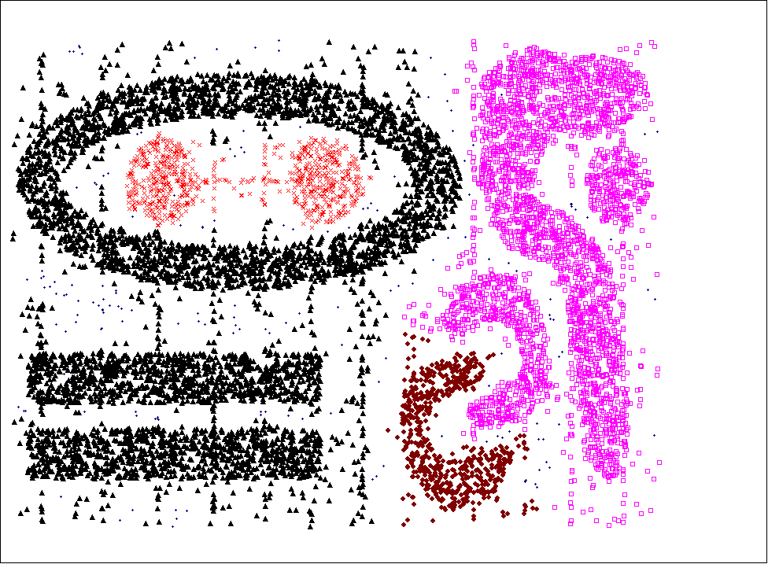
When Jarvis-Patrick Does NOT Work Well
Smallest threshold, T, that does not merge clusters.
Threshold of T - 1

Slide 22
SNN Density Clustering Algorithm A combination of SNN approach and DBSCAN
Compute the similarity matrix This corresponds to a similarity graph with data points for nodes and edges whose weights are the similarities between data points
Sparsify the similarity matrix by keeping only the k most similar neighbors This corresponds to only keeping the k strongest links of the similarity graph
Construct the shared nearest neighbor graph from the sparsified similarity matrix. At this point, we could apply a similarity threshold and find the connected components to obtain the clusters (Jarvis-Patrick algorithm)
Find the SNN density of each Point. Using a user specified parameter, Eps, find the number of points that have an SNN similarity of Eps or greater to each point. This is the SNN density of the point

Slide 23
SNN Clustering Algorithm …
Find the core points Using a user specified parameter, MinPts, find the core points, i.e., all points that have an SNN density greater than MinPts
Form clusters from the core points If two core points are within a radius, Eps, of each other they are place in the same cluster
Discard all noise points All non-core points that are not within a radius of Eps of a core point are discarded
Assign all non-noise, non-core points to clusters This can be done by assigning such points to the nearest core point
(Note that steps 4-8 are DBSCAN)

Slide 24
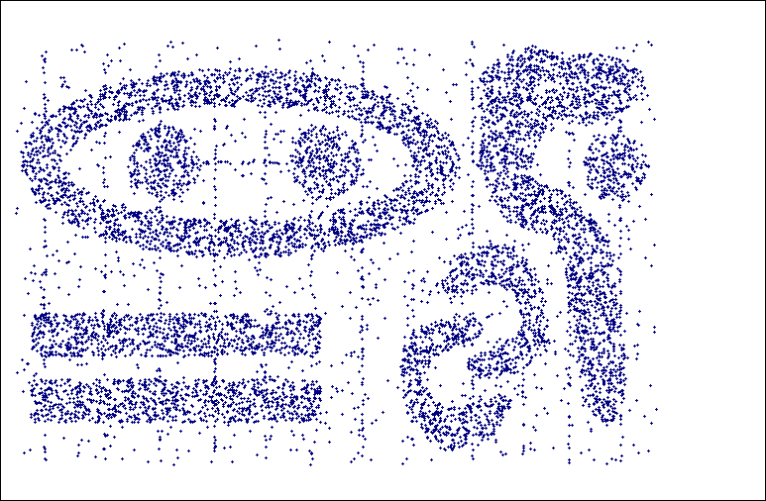
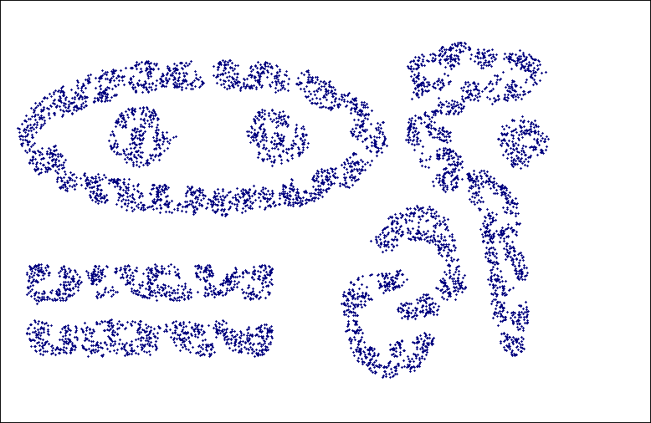
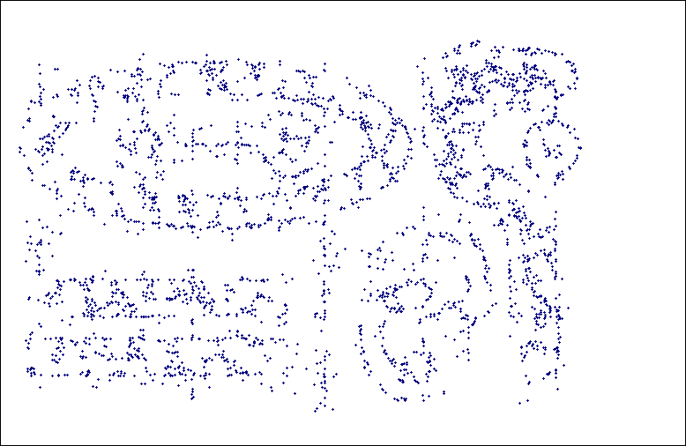
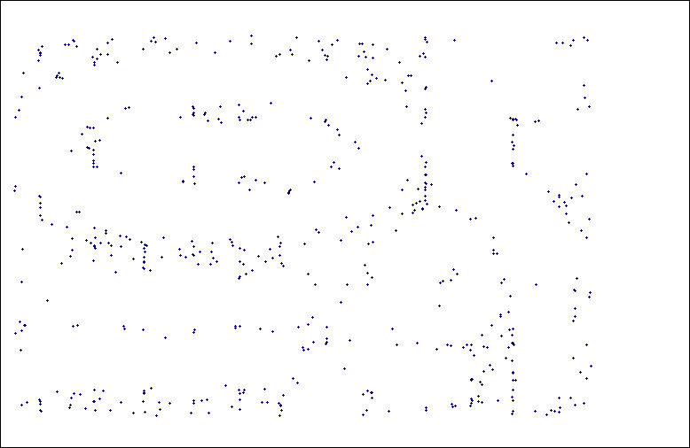
SNN Density
a) All Points b) High SNN Density
c) Medium SNN Density d) Low SNN Density

Slide 25
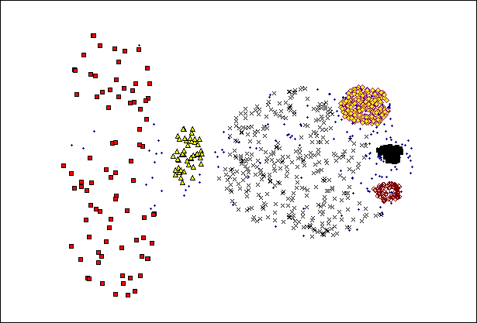
SNN Clustering Can Handle Differing Densities
Original Points
SNN Clustering

Slide 26
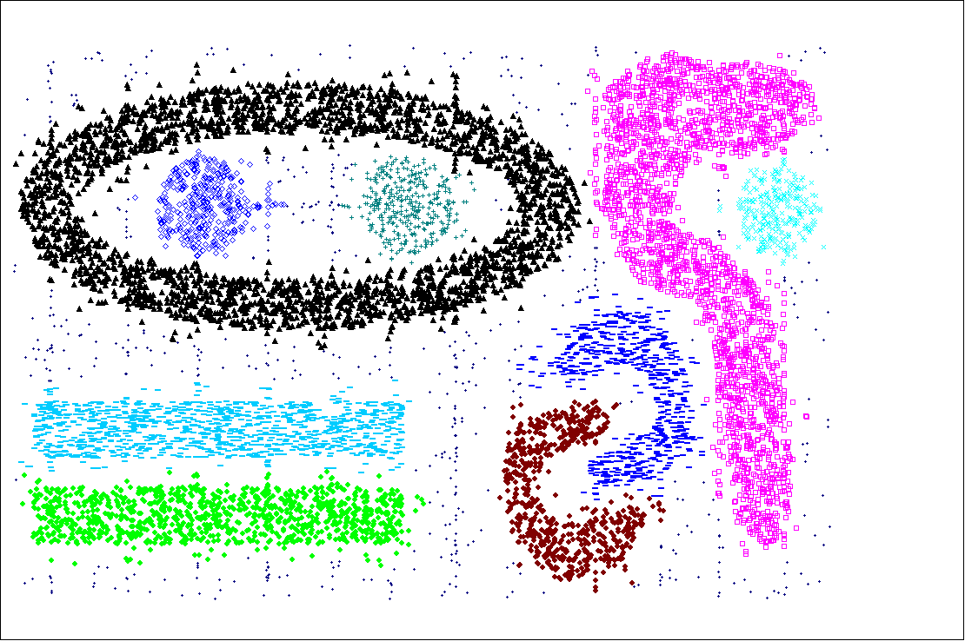
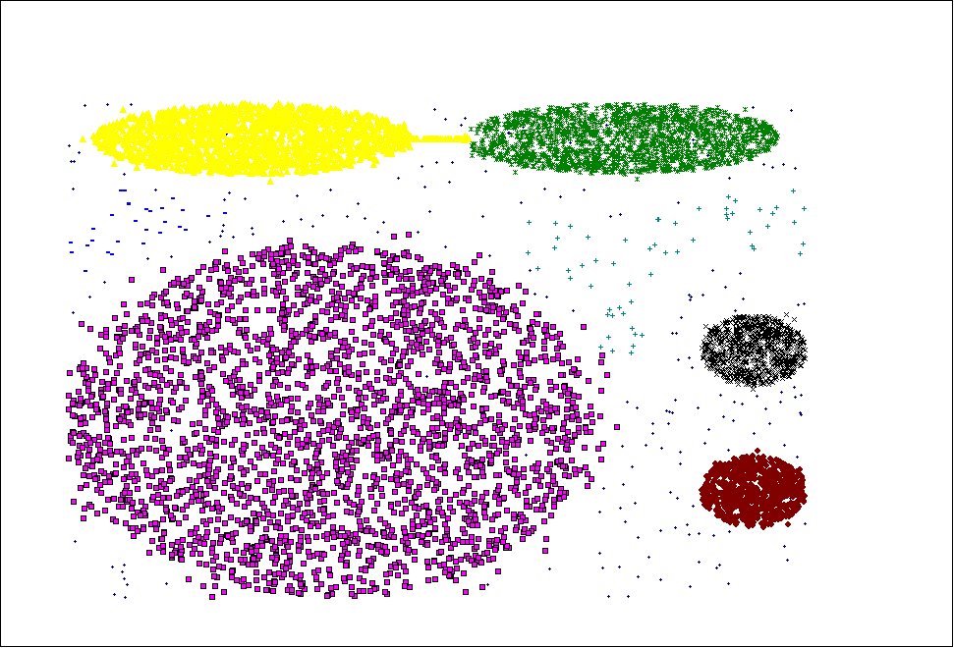
SNN Clustering Can Handle Other Difficult Situations

Slide 27
Features and Limitations of SNN Clustering
Does not cluster all the points
Complexity of SNN Clustering is high

